Slide 1


Nana Yaw Yankah
Principal Economic Officer
Sustainable Development Finance Specialists
Lead – Ghana INFF

Slide 2
INFF in Ghana
SDGs Budgeting
Agenda
Methodology
Achievements
Conclusion

Slide 3





INFF in Ghana
Ministry of Finance
Sub-National Ownership
National Oversight Committee
Sub-National Rapid Assessment
Gaps in Financing
Development Finance Assessment
INFF Building Blocks
Innovations in financing
Integrated National Financing Framework
Sustainable Financing
Nationally Determined Contributions
Climate Financing

Slide 4
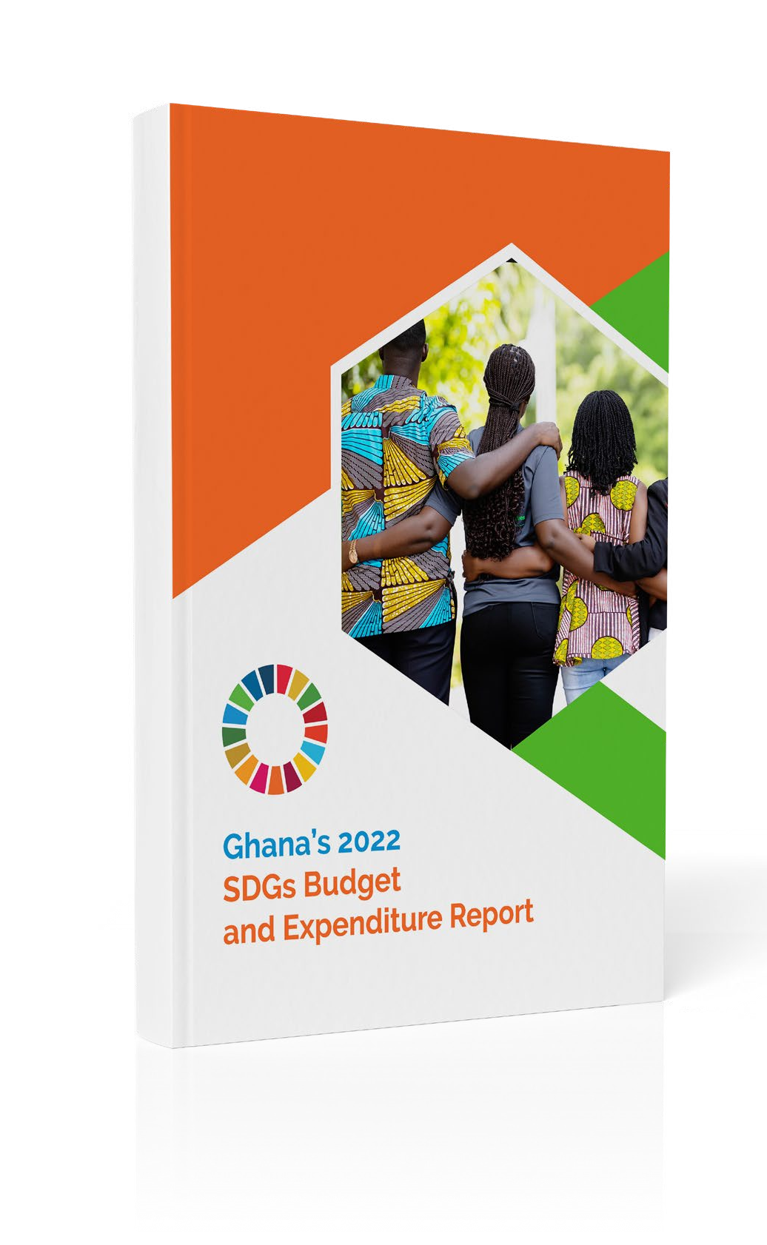
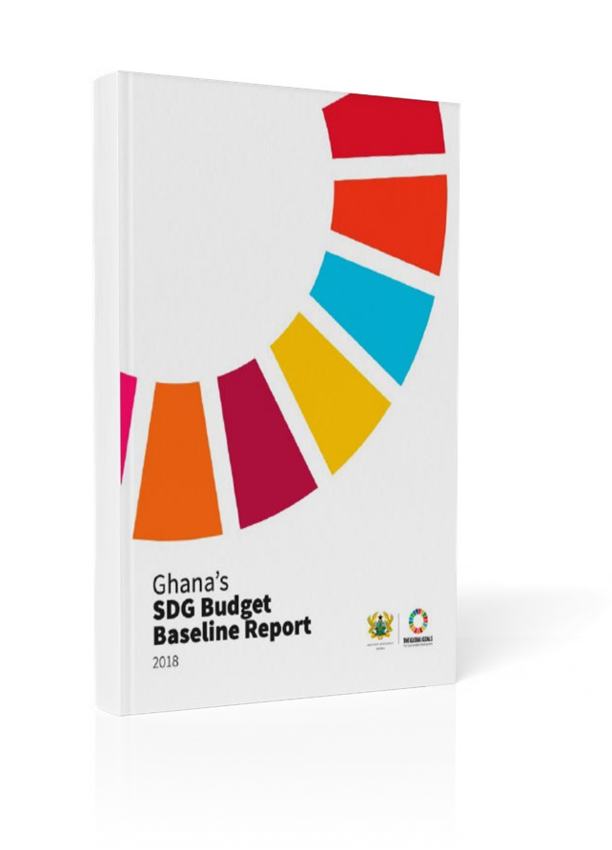
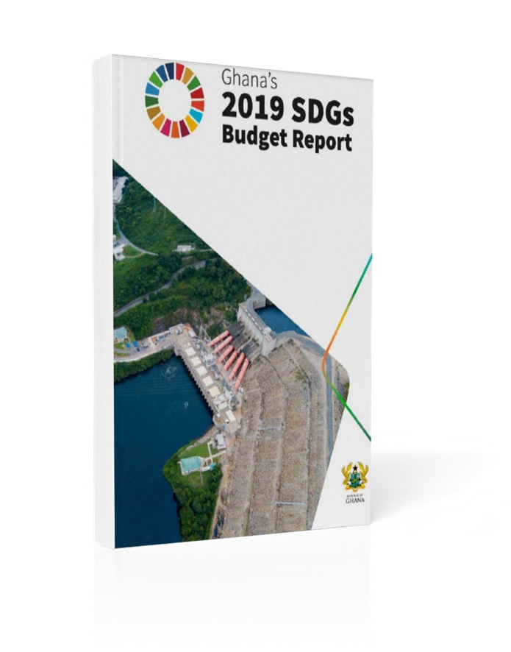
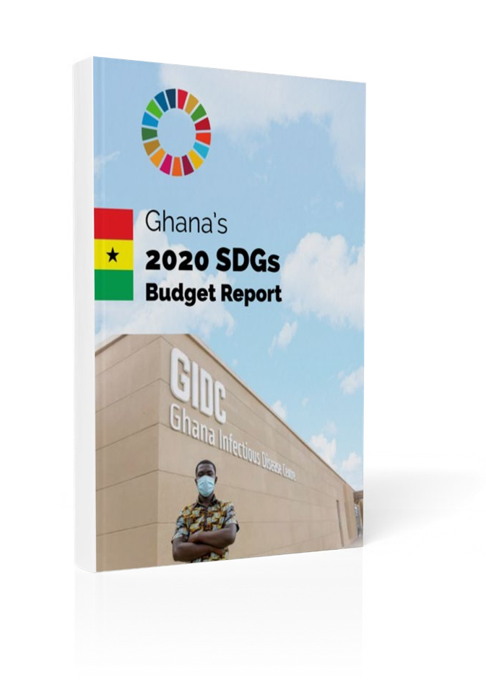
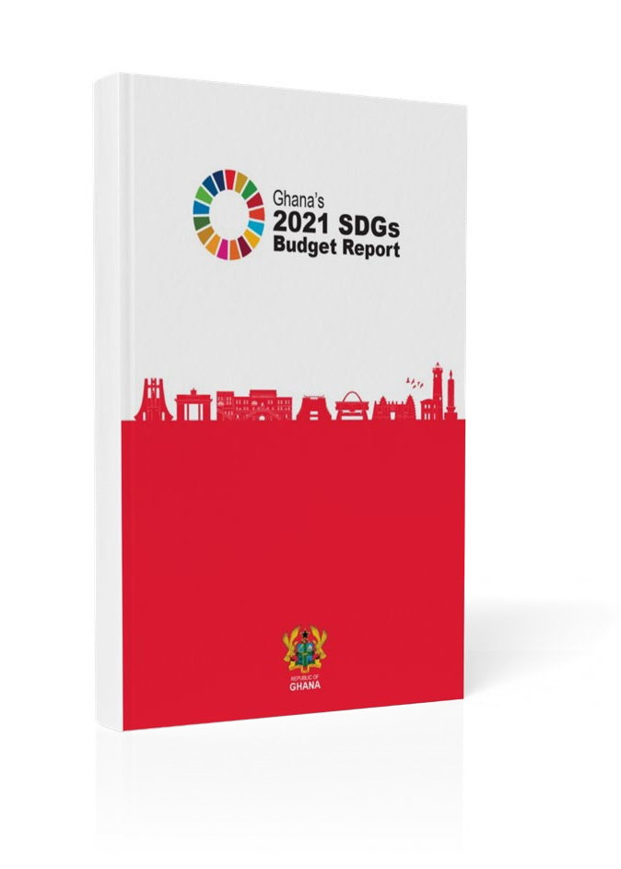

Milestones: SDG Budget and Expenditure Reports

Slide 5
Methodology
Allocation of resources to various Policies and SDG Targets
Analysis and Ranking of Goals by allocation and Funding
Alignment of SDG Targets to The Policy segment of the Chart of Accounts
Extraction of Budget Data across all levels of Government by Chart of Accounts
Allocation and Expenditure report by Goals and Fund sources
Prioritization of SDGs
Mobilization of resources
Improved tracking and reporting

Slide 6



Allocations and Expenditures 2022
Goal 1; 1.1; 1.2; 1.3; 1.4; 1.5; 1.a; 1.b
Consolidated Fund: 599,694,250.93
177,626,797.18
Consolidated other fund: 150,008,346.75
77,393,938.73
Goal 3: 3.2; 3.3; 3.6; 3.7; 3.8; 3.d
Consolidated Fund: 575,058,964.51
59,473,838.85
Consolidated other fund: 114,748,152.01
63,381,114.06
Goal 4: 4.1; 4.2; 4.3; 4.4; 4.5; 4.6; 4.7; 4.a; 4.c
Consolidated Fund: 1,914,017,050.38
520,667,509.87
Consolidated other fund: 1,132,121,541.68
1,399,687,716.99

Slide 7



Achievements
Reporting on Budget vrs Actuals
Strong focus on government spending in priority areas especially on Education, Climate Change and Gender
Update of CoA to include Gender & Child and Climate related codes
Update of SDGs Manual to track allocations and expenditures on Gender and Climate

Slide 8
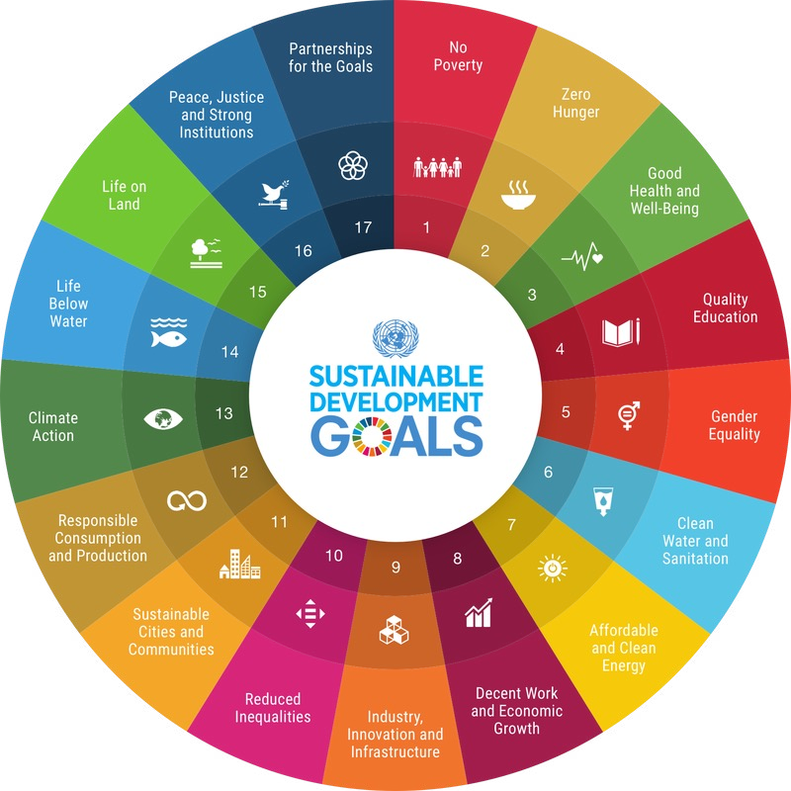
Access Full Report Here:
https://sdg.mof-bism.com
Contact us: BTAS@mofep.gov.gh

Slide 9


