Slide 1

INFF and Improving Budget Credibility in Malawi
Regional Workshop on Integrated National Financing Frameworks 2024
Public Finance for Sustainable Development in Africa by
Patrick Liphava
(MSc. PLSCM, MSc. ITLTP,BBA)
Addis Ababa, Ethiopia 12-13 June 2024

Slide 2
Outline
Status of
INFF in Malawi
2. Budget Credibility for Malawi
3. Expected impact of INFF on Budget Credibility
4. Conclusion

Slide 3
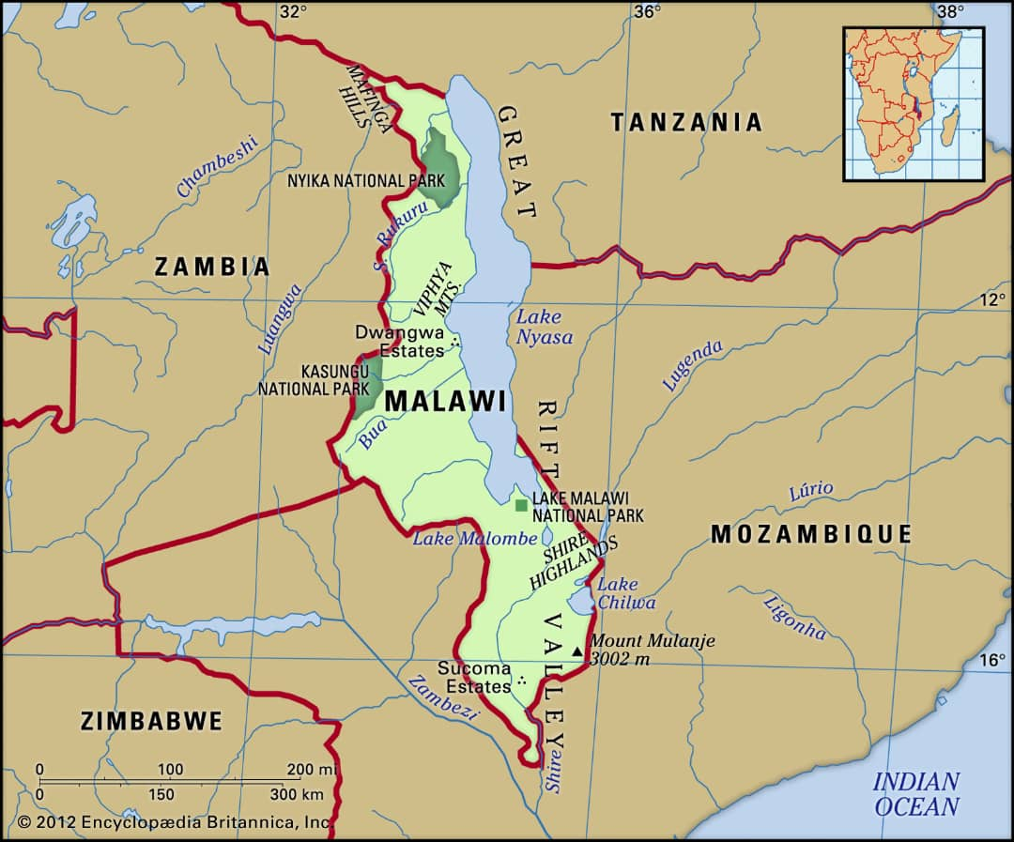
Malawi
Malawi is in South East Africa, bordered by Zambia, Tanzania, and Mozambique
118,484 sqkm
Population 21million

Slide 4
Progress made on INFF development in Malawi
Development of INFF Started,
Development of the SDG Investor Map started
Development of DFEAS Started
DFEAS finalized and Validated
Phase 1 Report of SDG Investor Map Finalised and Validated
INFF finalized.
INFF to be validated
INFF, SDG Investor Map & DFEAS to be launched
,
MW2063 finalized & launched with MIP-1.
SDGs Integrated into MIP-1
DFA & LLFA review to incorporate changes and include MW2063 aspiration
Implementation
Assessment and Diagnostic resulting in DFA & LLFA. EU and UNDP support
2025
2024
2023
2022
2021
V
2018

Slide 5
INFF
Malawi Started developing the INFF in line with the Addis Ababa Agenda for Action (AAAA).
Malawi looks at the INFF as a tool that consolidates other financing sources, which are grouped into Domestic and International sources of both Public and Private
INFF, as a financing planning tool that enhances both the revenue and expenditure sides, can improve resource mapping and result in planning for the timely completion of national development Projects.

Slide 6
INFF Cont…
The Malawi INFF/S has made short-term, medium-term, and long-term reform recommendations to create an enabling environment for the robust implementation of financing strategies.
The reforms in financial instruments, business processes, regulatory framework, and policies have been clearly outlined, with a full division of labor among MDAs for accountability.
Implementing such reforms will enhance the budget's reliability with political will and administrative support.

Slide 7
Budget Credibility
Definitions:
International Budget Partnership (IBM) defines Budget Credibility as “the Government's Ability to meet its revenue and expenditure targets during the financial year”; the World Bank, through its 2014 working paper no. 400 defines budget credibility as “the legitimacy of the process by which a budget has been created.” (INFF Facility working paper Jan.2024) defines budget credibility or reliability as “the ability of the government to meet the expenditure and revenue targets set out in the budget accurately and consistently.”
Therefore, understanding the above definitions, I will share on how Malawi is fairing on the budget credibility radar.
It is worth noting that in developing countries like Malawi, The risk of budget credibility gets high as the budget disaggregates further to the sectoral level, whereby resources can be diverted from the very intended activities to different ones.

Slide 8
Malawi Situation on Budget Credibility
Malawi is implementing a transparent and consultative budget process
On average, Malawi’s budget performance is within the international threshold of around 10% gap between approved and actual outturn.
Overall Budget Credibility performance is good, though challenging in specific budget lines, mainly statutory expenditures and politically induced expenditures.
For the past three years, up to 2023/24 FY, the outturn vs. approved budget gap has been around 10%.
For the 2023/24FY, the gap was 9%, outturn was 91% of the approved budget.

Slide 9
Internal Challenges
Balancing revenue performance and the political desire to increase expenditures
  E.g Decisions on subsidies & creation of new projects without associated revenue streams.
Lack of legal framework to control the levels of expenditure and contain the budget deficit. For the past three years, 2021/22 to 2023/24FY, the budget deficit as a percentage of GDP has exceeded the recommended threshold of around 3%.
The high budget deficit leads to either additional borrowing or delayed completion of Government funded projects. Hence delayed national development in some sectors.

Slide 10
External Challenges
Malawi’s vulnerability to shocks –
economic and health-related shocks that distort budget execution.
  For instance, in December 2023, Malawi implemented a 44% devaluation as a currency realignment measure. This economic shock led to expenditure overruns on the debt servicing budget line, budget overruns on projects financed by domestic resources, etc.
  Malawi was not spared by the COVID-19 pandemic and other pandemics, such as cholera, which led to the diversion of resources from intended projects
  Not forgetting the effects of the Russia-Ukraine war, which distorted the global economy.

Slide 11
External Challenges cont…
Climatic and other related shocks.
  Since 1980, Malawi has experienced more than 50 disasters associated with hydrometeorological calamities, including storms, floods, landslides, and droughts, which have affected millions of people.
  The most recent and devastating being Cyclone Freddy in 2023, Cyclone Gombe in 2022, Cyclone Ana in 2022, and Cyclone Idai in 2019.
These have resulted in high demand for high repair costs and diverting of resources from national development needs
These challenges reflect Budget Credibility challenges that remain at disaggregated levels, e.g., sectoral and local council levels in terms of expenditure.
Malawi is still recovering from these shocks, though slowly.

Slide 12
Success stories
Despite all these challenges, Malawi has achieved budget credibility, making significant strides in revenue and expenditure credibility.
Over the past years, including 2023/24FY, domestic revenues have been overperforming mainly due to the implementation of reforms in tax administration and improvements in non-tax revenues.
Under the IMF’s ECF Program, the Government is implementing PFM reforms, including fiscal consolidation, which provide hope for increased budget credibility.

Slide 13
EXPECTED IMPACT OF INFF ON BUDGET CREDIBILITY
The Malawi INFF Governance structure will utilize the existing governance structures and just build capacities in the areas where gaps have been identified.
It is expected that the reforms will address the structural, policy, and regulatory framework challenges
The reforms outlined in the INFF will help to address most of the governances and structural challenges that affect budget credibility.
The strategic prioritization of low-hanging fruits in reforms will lead to quick results

Slide 14
Conclusion and recommendation
Inclusive engagement and mutual accountability among Government, Development Partners, Private Sector, and credible CSOs is key to national prosperity
DPs to consider supporting the Government through On-Budget support and push for Government accountability instead of off-budget support,
Policy harmonization across MDAs is crucial for the success of budget credibility
Synchronized Digitization of the public sector is critical for transparency and accountability
Disaster preparedness for hydrometeorological calamities is also critical to maintain budget credibility.

Slide 15

Thank You

