Slide 1
Progress Report of the First Generation of Workplan (2018-2021)
ARSO Side-Event Meeting
Kofi Annan Road Safety Award
Duncan Kibogong
ARSO TSC Member, Kenya

Slide 2
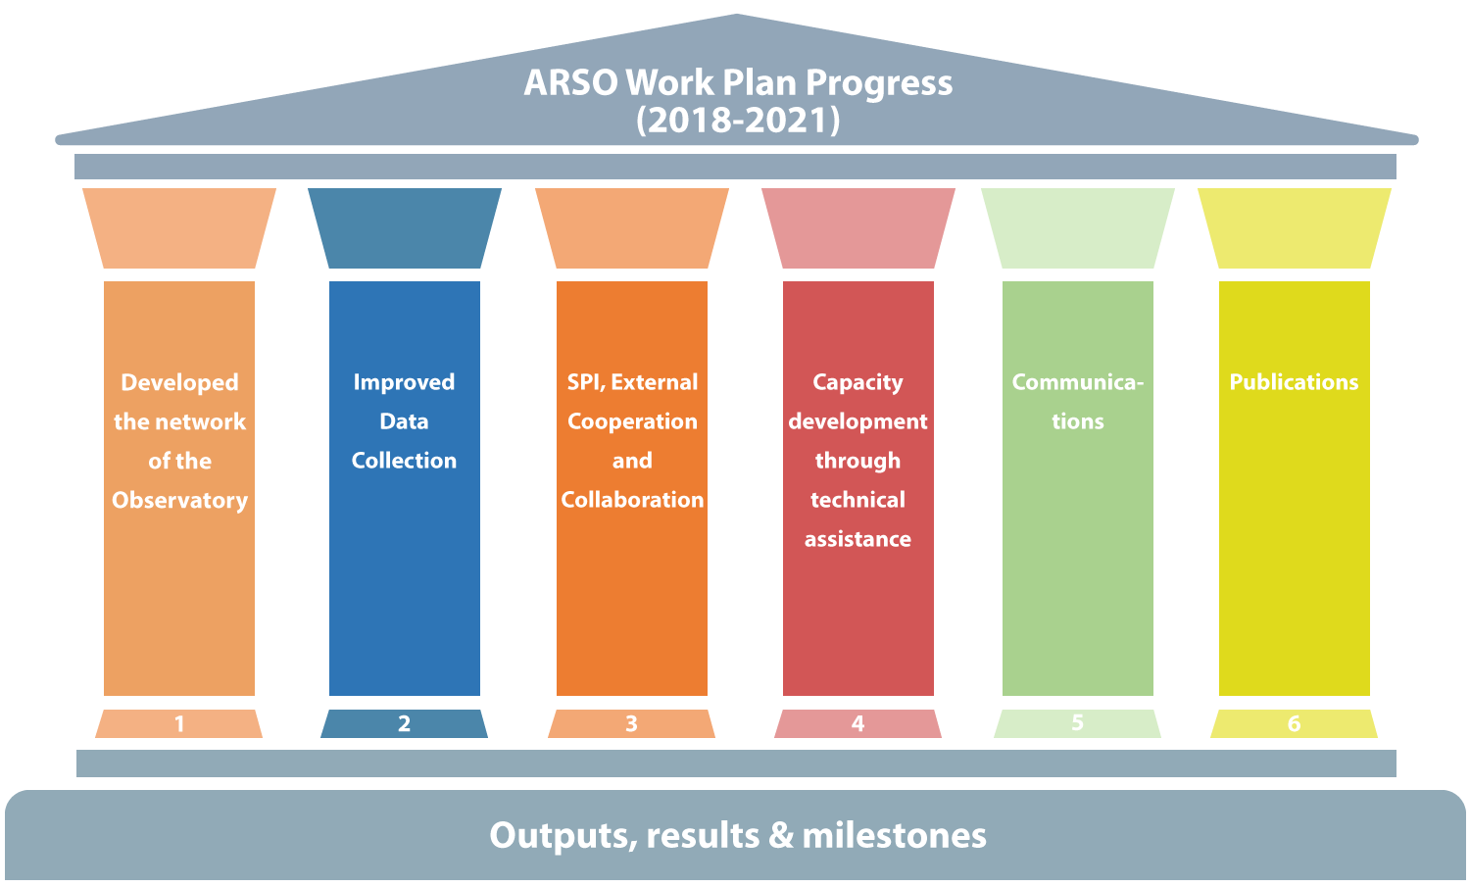

Slide 3
2018-2021
Progress made in accordance with the workplan
1.Developed the network of the Observatory
Maintained a list of members and up-to-date contact details
Holding annual meetings (AGM, NDCs, Global Meeting of Regional Observatories)
Ratification and implementation of the Charter
2.Improved Data Collection
Improved vital registration data
Police-Hospital admission Data Initiative (PDI)
Tools & methodologies
3. Safety Performance Indicators (SPIs), Cooperation
Developed meaningful SPIs that, given the available data, could be applied in all
Identify indicators that deserve work in common
External coordination

Slide 4
2018-21
Progress made in accordance with the workplan
4.Capacity development through technical assistance
Minimum data set (MDS)
12 UN voluntary road safety targets
Webinar training
5.Communications
Articulated indicators of achievement for the decade
Social Networking
6.Publications
Prepared reports
Develop a framework of linkages of road safety data sources and research institutions

Slide 5
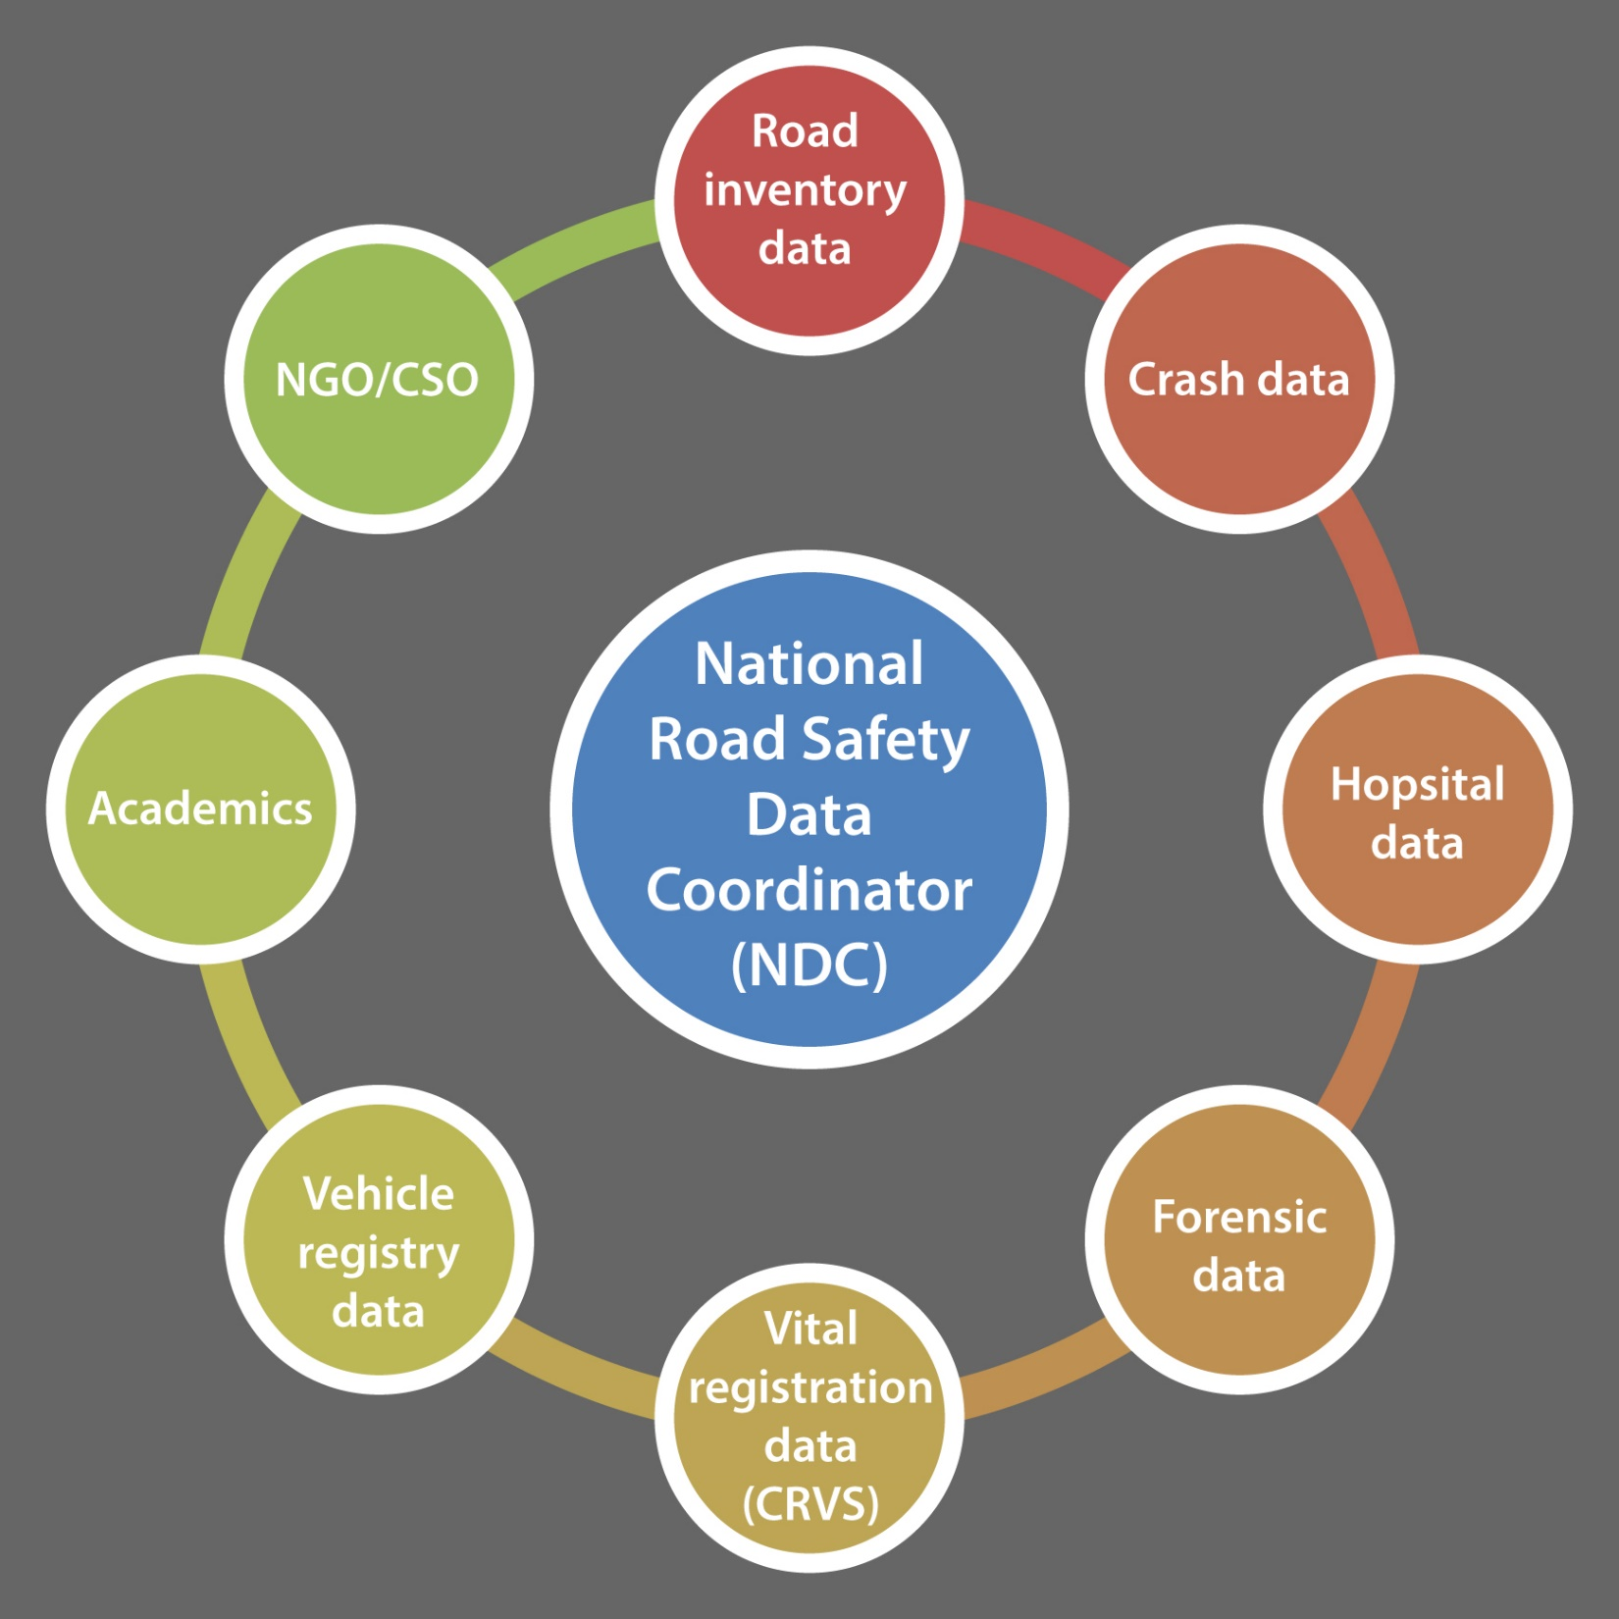

Slide 6
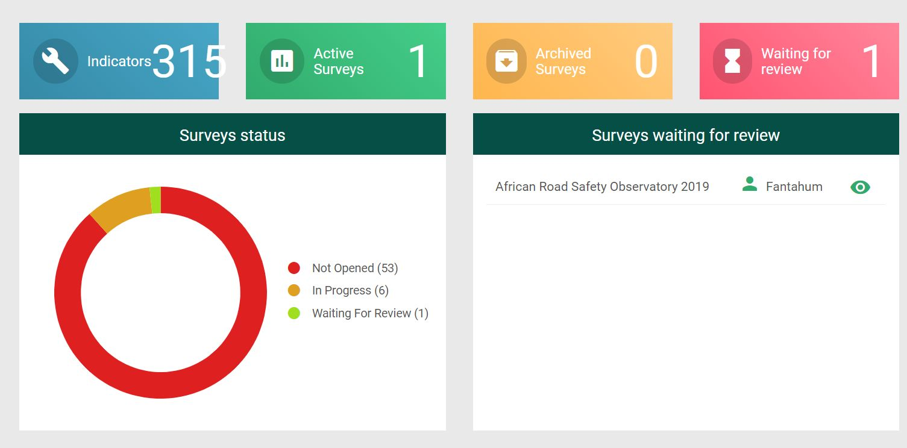

Slide 10
