Slide 1
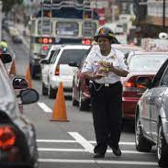
Progress Report and Work Plan
Eric Ntagengerwa
Ag Head of Transport and Mobility
African Union Commission

Slide 2
Institutionalization & Operationalization of the ARSO (work progress)
Governance membership will be tied to Charter ratification;
It is yet to enter into full force due to a shortage of instruments of ratification;
A third of the instruments of ratification, i.e., representing 15 AU states at minimum, has to be deposited with the AUC Chairperson’s office.
12 deposits, 12 ratifications, 21 signatories, & 31 non-signatories.

Slide 3
Status of the 2nd Programme of Work (PoW)
Sr. Nº | Short descriptions of Task (2022-23) | Process/tools Followed | Deliverables/Outcomes/Milestones
1 | MS to sign into AU RS Charter | Advocated ratifications of the Charter | 3 more countries signed. In addition, Senegal and Zambia deposited their instruments of ratification with AU Office of Legal Council (OLC)
2 | Annual GA Meeting (AGM) | TSC called the 2nd GA on March 27, 2022 | Nearly 40 offcials attended the AGM Approved the new PoW 2022-24
3 | WHO-ARSO Collaboration | Compilation and contact of National Data Focal Point from MS for GSRRS 2023 | 5th edition of the Global Status Report on Road Safety 2023
4 | African Continental Workshop on Road Safety: the African RS Action Plan for the 2nd Decade | - Virtually on 18th Nov.’22 | Popularized and disseminated Africa’s post-2020 Strategic Directions for Road Safety and the continent’s Road safety Action plan for the Decade 2021-2030; Discussed the role and provisions of the African Road Safety Observatory (ARSO) in monitoring and evaluating the African Road Safety Action Plan
5 | Dakar Road Safety Congress | Attended as a team & contributed to the discussion | Dakar Communiqué Senegal sign the Charter

Slide 4
Status of the 2nd Programme of Work (PoW)
6 | Technical Assistance | Provided targeted support to MS | Advisory support on a demand basis; e.g., South Sudan, Eswatini, Ethiopia
7 | ARSO TSC Monthly meeting | Every third Thursday of the Month | Minutes with audio-recorded files for each regular meeting
8 | ESRA 3 General Meeting | A hybrid format on Sep’t 2022 to monitor & improve road safety on attitudes in selected African States | An opportunity to learn from in-depth scientific analyses of the ESRA database
9 | Consultative Workshop with selected and relevant stakeholders from African countries, including Ministries of Transport, lead agencies, NDCs, the private sector, CSOs/NGOs, RECs, and Development Partners (DPs). | Virtual discussion/online learning | Interrogated ways to accelerate the ratification of the Instrument of Ratification (accession) on November 17, 2022; A total of 36 participants attended the sessions with an aggregate report on the current RS situation for 24 MS.
10 | Informal meeting of regional road safety observatories | IRTAD side meeting | ARSO attended and learned from other regional observatories.
11 | Celebration of the 7th UN Road Safety Week – 2023: Rethinking Mobility | Make an opening remarks | Share experiences on Urban mobility

Slide 5
Source of finance to implement the remaining work plan activities
Ongoing engagement with EU to support establishment of ARSO as physical Secretariat hosted by AUC
AUC is working with SSATP and ECA to have joint action plan to develop Road Safety in Africa including the operationalization of ARSO

Slide 6
Optimising the role of development partners
There are several areas in which our partners have played a significant role in supporting ARSO, including providing technical assistance to develop national RS strategies and policies & building national capacity within the NDC sphere.
Co-financing options & partner resourcing strategies that complement and enable the strengthening of ARSO.
Integrated financing strategies support ARSO's enabling role that promises value-for-money by supporting the delivery of the broader SDG/Agenda 2063 agenda.

Slide 7
Next Steps:
The ARSO bylaw adoption;
Sill in a draft format & as it needs to wait for entry into force of the Road Safety Charter.
Speeding up the ratification of the road safety charter;
Agree upon the final institutional framework and options for sustainable financing of ARSO
Develop joint work plan that integrates initiatives by the various partners avoiding duplication of efforts
Support the development of a baseline report for the African road safety action plan for the Decade 2021-2030

Slide 8
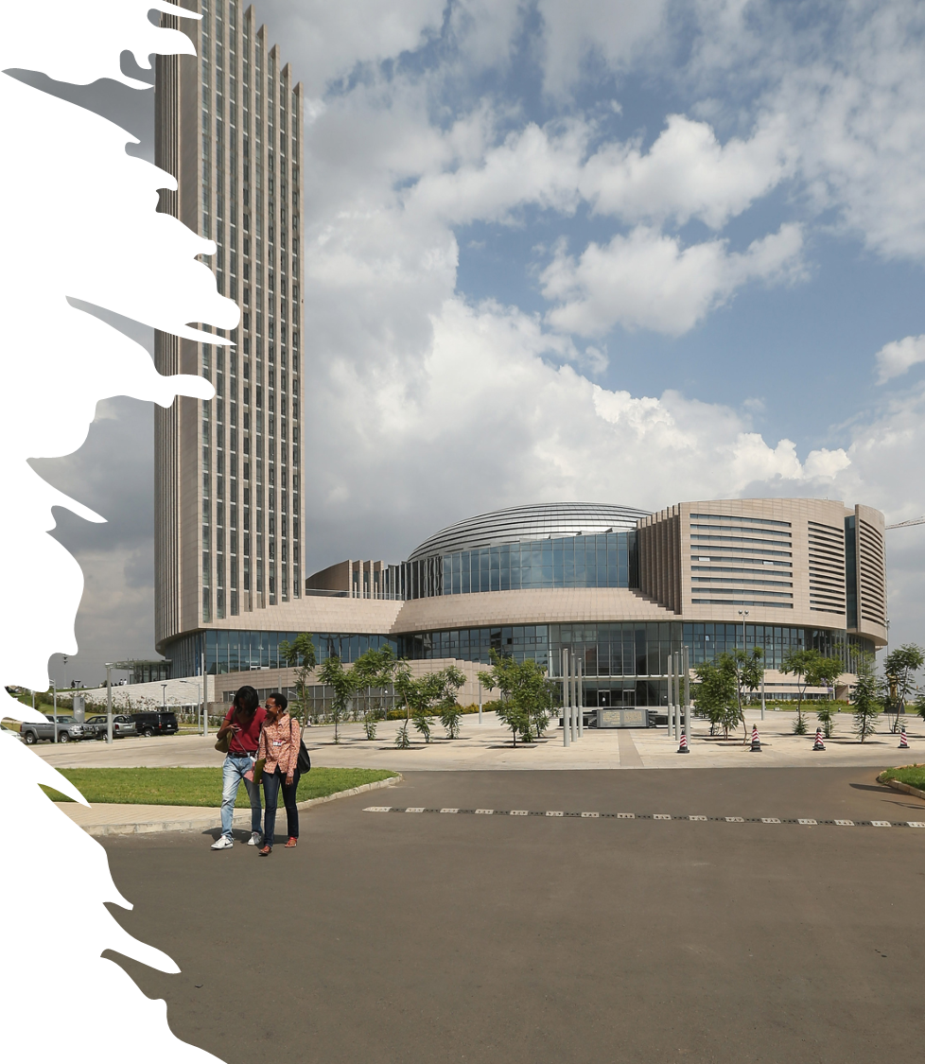
Thank you Merci شكرا Obrigado Asante
Thank you Merci شكرا Obrigado Asante
Thank you Merci شكرا Obrigado Asante
Thank you Merci شكرا Obrigado Asante

