Slide 1
Road safety and digitalization in Africa: an overview
Marrakech, 25 September 2023

Slide 2
African road safety has been worsening, not improving
Percentage change in the number of deaths in Africa from 2000 to 2019
Road traffic injury has been steadily increasing as a cause of death across the African continent. The Global Burden of Disease Study estimates a steady 15% increase between 2000 and 2019.

Slide 3
We have the tools…
Current global and African mandates for road safety which are relevant to national development planning processes today include:
The UN Sustainable Development Goals which recognised that road traffic injury is a major development issue
The African Road Safety Charter which was adopted by the Member States of the African Union in 2016
The Global Plan: Second Decade of Action 2021–2030 which informs national plans tailored to local contexts
The African Road Safety Plan 2021-2030 prepared in 2021 to guide African countries in their road safety efforts.
Transport contribution to SDGs achievement
Source: UNECE Secretariat
The strategic directions for the 2021-2030 decade of the African Union insists on the use of digitalization to accelerate the effective implementation of the African action plan for the decade

Slide 4
The Role of Emerging Technology in Road Safety
AI and Road Safety
AI makes autonomous vehicles possible.
AI helps to monitor the status of the roads, improve the design and make the roads safer
Analyse data and take better decisions
IoT Technology in Road Safety
In-car sensors can monitor driver behavior and provide alerts if a driver appears drowsy or distracted. Various imaging sensors can be used for object detection, reading speed markers, etc.
Telematics
The data sent and received via telematics can be used to analyze driver behavior, particularly when user error creates collisions.
Safety systems need to analyze driving behavior in real time for maximum effect. Telematics provide the data for these analytics.

Slide 5
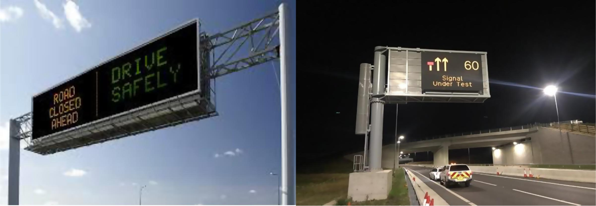
Benefits of digitalizing Road Safety…
Estimated safety benefits for driver status
Estimated safety benefits from OECD countries for speed control technologies
Source: ROAD SAFETY: IMPACT OF NEW TECHNOLOGIES – ISBN-92-64-10322-8 ©OECD 2003

Slide 6
Opportunities
African countries are seizing the "opportunity" presented by the COVID-19 pandemic
"Evidence shows that at the height of the lockdown, 25 per cent of the firms in sub-Saharan Africa accelerated the use of digital technologies and increased investments in digital solutions in response to COVID-19.“
Source: World Bank Group
Number of mobile broadband subscriptions per 100 habitants in Africa, 2010-2020
Number of mobile broadband subscriptions per 100 habitants in Africa, 2010-2020
ICT services become more affordable worldwide in 2022
Source: Statista, "Number of active mobile-broadband subscriptions per 100 inhabitants worldwide from 2010 to 2020, by region", available at https://www.statista.com/statistics/249837/mobile-broadband-subscriptions-per-100 -inhabitants-by-region/
ITU World Telecommunication/ICT Indicators Database

Slide 7
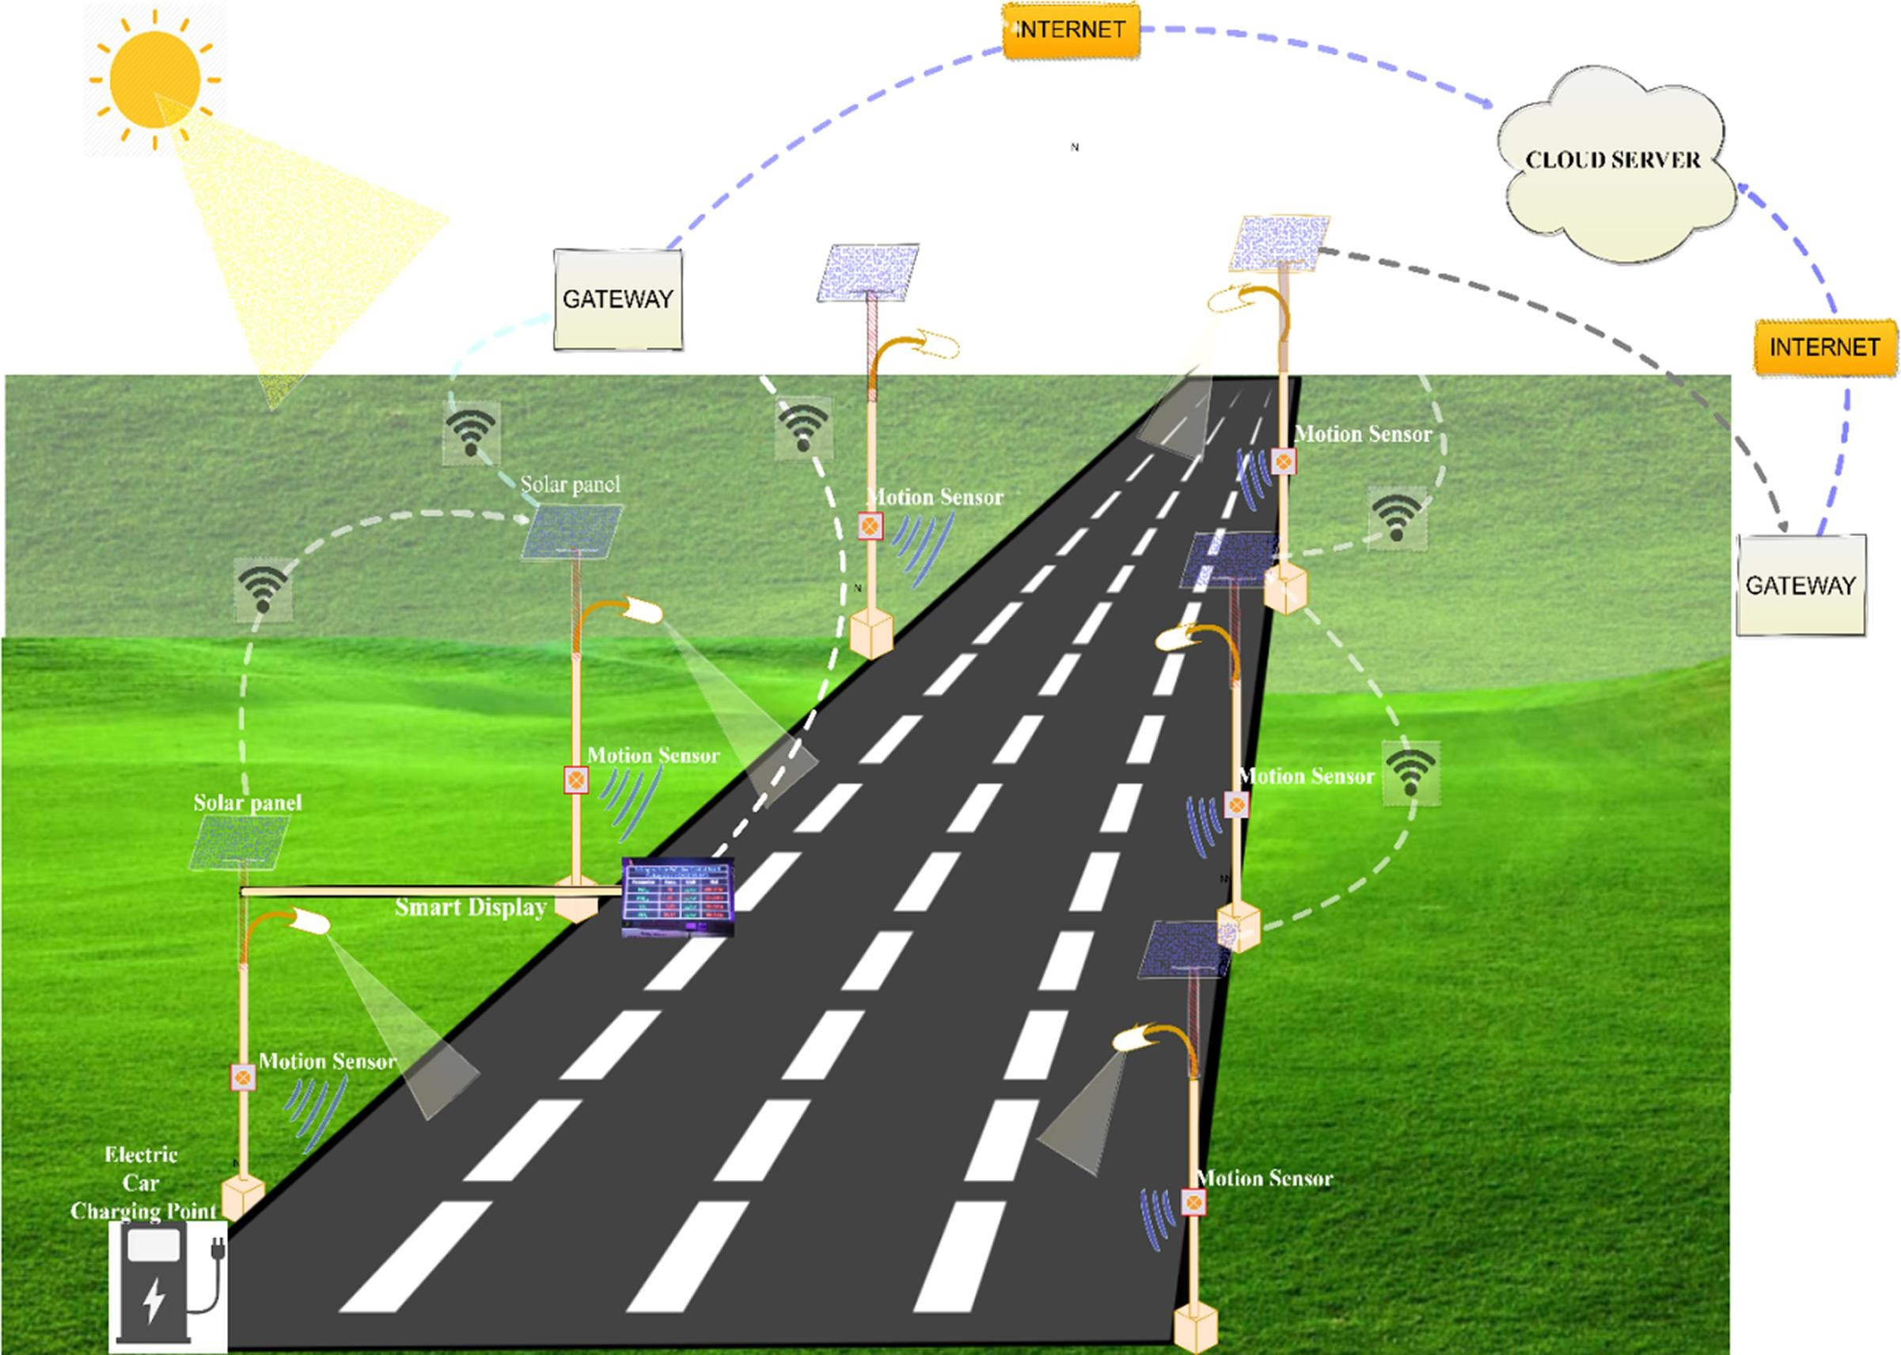
Opportunities
Internet penetration in Africa (% of total population), 2005–2019
https://www.sciencedirect.com/science/article/pii/S0925753521002514

Slide 8
Recommendations
The digitalization of roadway safety is in its infancy. There are still numerous unexplored possibilities and opportunities.
Encourage research and innovation in Africa
Encourage knowledge sharing
Keep expanding internet penetration
Encourage digital skills
Strength road safety management
Work on innovative specific financing tools/mechanisms
https://bigdataanalyticsnews.com/big-data-road-safety-interact/

Slide 9
Thank you

