Slide 1
KOFI ANNAN ROAD SAFETY AWARD Africa’s Digital Transformation Strategy (DTS) Eng. Eric Ntagengerwa Ag Head of Transport and Mobility African Union Commission
Department of
Infrastructure and Energy

Slide 2
OUTLINE
Background
Key Institutions, roles and responsibilities
DTS Policy recommendations and Proposed actions
DTS Implementation framework

Slide 3
Background of the Digital Transformation Strategy for Africa
2020 - 2030

Slide 4
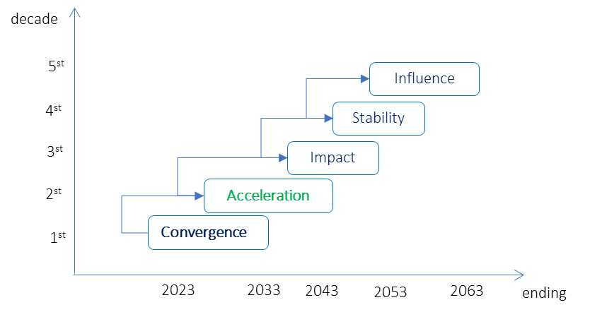
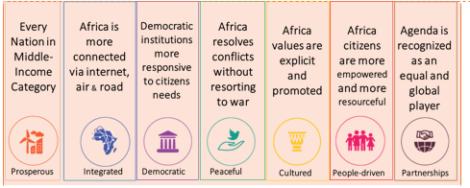
Background
Is the strategic framework for the socio-economic development and transformation of the continent within a period of 50 years has aspired for a prosperous Africa based on inclusive growth & sustainable development.
A1_G1: A high standard of living, quality of life and well-being for all
A2_G10: World class infrastructure crisscrosses Africa improving connectivity through newer and bolder initiatives to link the continent by rail, road, sea and air; and developing regional and continental power pools, as well as ICT
ISD/IED mandated to set up and up date sound policy and strategy to match the technological evolution, on one hand, and, on the other, contribute to build the hard infrastructures that will strengthen integration through internal and external connectivity of the continent thereby ensuring meaningful and secure access towards creating the inclusive society & economy.

Slide 5
Background
DTS:2020 - 2030
Endorsed at the 36th Ordinary Session of the African Union Executive Council in February 2020 in Addis Ababa, Ethiopia.
Vision: An integrated and inclusive Digital Society and Economy in Africa that improves the quality of life of Africa’s citizens, strengthen the existing economic sector, enable its diversification and development, and ensure continental ownership with Africa as a producer and not only a consumer in the global economy
Objective: To harness digital technologies and innovation to transform African societies and economies to promote Africa's integration, generate inclusive economic growth, stimulate job creation, break the digital divide, and eradicate poverty for the continent’s socio-economic development and ensure Africa’s ownership of modern tools of digital management. .

Slide 6
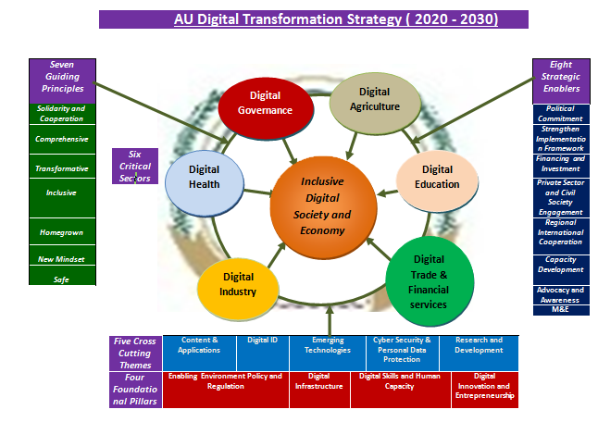
Background
Foundation Pillars: Enabling Environment, Policy and Regulation, Digital Infrastructure, Digital Skills and Human Capacity, Digital Innovation and Entrepreneurship
Critical sectors: Digital Industry, Digital Trade and Financial Services, Digital Government, Digital Education, Digital Health, Digital Agriculture
Cross Cutting Themes: Content & Applications, Digital ID, Emerging Technologies, Cyber Security & Personal Data Protection, Research and Development
Guiding principles: Comprehensive approach, transformative impact, inclusiveness, homegrown, new mindset and safety.
Strategic Enablers : Political Commitment; Strengthen implementation framework; Financing and investment; Private sector & civil society engagement; Regional and International Cooperation; Capacity Development; Advocacy and Awareness; Monitoring and Evaluation Framework
Department of
Infrastructure and Energy

Slide 7
DTS Institutional Architecture (IA)
MS (DTOs)
RECs
Member States are the ultimate responsible for implementing DTS programs and projects and are responsible for:
Mainstreaming DTS programs and project into the national digital transformation strategies and plans and allocate budgets to those projects and programs;
Establishing National Digital Transformation Office of similar body that lead and coordinate the digital transformation across the nation;
Assign a focal person to coordinate and provide regular report on the implementation status of DTS programs and projects in the respective nation through the performance monitoring dashboard;
Mobilizing resources to implement DTS programs and projects
Align DTS programs and projects with the regional priorities;
Sensitize and support Member States through relevant Ministerial Conferences to ensure continued alignment of national digitalization programs and projects;
Assign a focal person to coordinate and Provide regular report on the implementation status DTS programs and projects in the respective regions through the performance monitoring dashboard;
Assess available capacities and gaps to properly and timely implement DTS programs and projects and identify studies and training for human capacity building;
Advocate the DTS implementation and collaborate on resource mobilization
Key Institutions Roles and Responsibilities

Slide 8
DTS Institutional Architecture (IA)
AUDA-NEPAD
AFDB
Mobilize and provide resources for the implementation of DTS projects at continental, RECs, Member States and specialized institutions levels;
Co-Chair the board of African Digital Sovereignty Fund;
Provide support during project preparation of DTS priority projects; Contractual, financial, technical and administrative management of the programme including responsibility for procurement procedures, in conformity with its existing regulations, budget management and disbursements;
Work closely with partner implementing agencies for effective implementation and process management;
Assign a focal person to coordinate and report on the implementation of DTS
Align the DTS digital infrastructure projects with PIDA-PAP2 priority action plans;
Coordinate the implementation of priority DTS infrastructure related projects at a continental, regional and national levels as part of PIDA-PAP2;
Mobilise resources and partners in support of the implementation of DTS priority projects in conformity with the Africa’s priority programmes and projects;
Support, monitor and evaluate the implementation of DTS infrastructure projects.
Assign a focal person to coordinate and report on the implementation of DTS
Key Institutions Roles and Responsibilities

Slide 9
DTS Institutional Architecture (IA)
Key Institutions Roles and Responsibilities
African Special Institutions
African Civil Society organizations and Academia
The African Special Institutions African Telecommunication Union (ATU), the Pan African Postal Union (PAPU) …are primarily responsible for leading the implementation of DTS projects in relation to their mandate in coordination of the relevant stakeholders at continental, RECs and Member States Levels and assign a focal person to coordinate and report on the implementation of DTS.
The African Civil society organizations and Academia through the AUC Citizens and Diaspora Directorate (CIDO) are responsible for providing requirement based on societal needs that can be addressed through DTS programs and provide feedback on the outcome of the implementation of projects at a national, regional and continental level.

Slide 10
DTS Institutional Architecture (IA)
Key Institutions Roles and Responsibilities
Organizations of the United Nations focused on Africa
Private Sectors/Development Partners
Those organizations like UNECA, ITU-ROA, UPU, UNCTAD … are responsible for aligning the DTS programs and projects with the SDGs and provide the required support at continental, RECs and Member States level based on their mandate and assign a focal person to coordinate and report on the implementation of DTS.
Development partners (EU, GIZ, WB, emerging partners...), private sectors includes African and international institutions (AeTrade Group…), & individual countries are invited to support the implementation of DTS through direct contribution to the African Digital Sovereignty Fund or direct funding to specific programs and projects implementation at a national/regional level.

Slide 11
DTS Institutional Architecture (IA)
Key Institutions Roles and Responsibilities
AUC
Assign dedicated technical expert/s that coordinate the implementation of DTS
Ensure that the DTS strategy is aligned with the 1st & 2nd 10 years Implementation Plan of the AU Agenda 2063; and with related Specialized Technical Committees (STCs) decisions;
Lead the development of the DTS implementation Framework and required subsequent revision;
Lead the establishment of the African Digital Think Tank Group;
Support the establishment of the Board of Digital Sovereignty Fund;
Serve as a secretariat for the procedural organs;
Develop and implement the DTS Communication and partnership strategy;
Lead and Coordinate DTS events including the African’s Digital Transformation Summit
Organize regular meetings of the Digital Think Tank Group, Portfolio Review Board and the Board of the Digital Sovereignty Fund;
Support the establishment of a Digital Transformation Offices in each Member States
Coordinate Regional consultation meetings to follow-up on the implementation of projects;
Conduct digital maturity assessment & publish report;
Formulate and propose policies and regulatory frameworks for infrastructure development;
Create and manage the DTS Implementation Performance Monitoring dashboard;
Support the mobilization of domestic and partner funds for the implementation of the DTS
Advocate on the Agenda 2063 and the DTS;
Call for a proposal for projects.

Slide 12
DTS 2020 – 2030 Implementation Framework

Slide 13
DTS Implementation Framework
Vision of the DTS
An Integrated and inclusive digital society and economy in Africa that improves the quality of life of Africa’s citizens, strengthen the existing economic sector, enable its diversification and development, and ensure continental ownership with Africa as a producer and not only a consumer in the global economy
Overall Objectives of the DTS
To harness digital technologies and innovation to transform African societies and economies to promote Africa's integration, generate inclusive economic growth, stimulate job creation, break the digital divide, and eradicate poverty for the continent’s socio-economic development and ensure Africa’s ownership of modern tools of digital management.
17 specific objectives
DTS Policy Recommendations and Proposed Actions
50 policy recommendations and 330 proposed actions

Slide 14
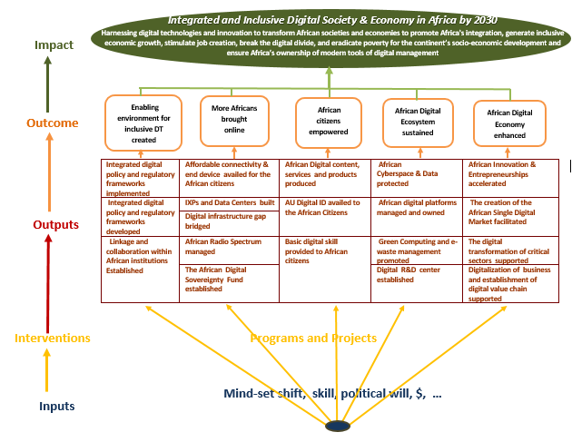
DTS Implementation Framework

Slide 15
DTS Implementation Framework
Phase 1 (2020 – 2023 )
Phase 2 (2024 - 2026)
Phase 3 (2027 - 2030 )
This phase will involve the continued implementation of the programs/projects and scale-up of successful programs/ projects.
Involve the actual implementation of programs/projects. Monitor the implementation, reviewing the plans and lesson learned
Focuses on planning, identify the required resources and coordination and alignment with the relevant implementing bodies. It involves also developing programs/projects and collecting baseline data.
Department of
Infrastructure and Energy

Slide 16
Thank you Merci شكرا Obrigado Asante
Thank you Merci شكرا Obrigado Asante
Thank you Merci شكرا Obrigado Asante
Thank you Merci شكرا Obrigado Asante

