Slide 1
Mobilizing Private Capital for Road Safety
KOFI ANNAN ROAD SAFETY AWARD
Marrakech 2023

Slide 2
Despite the significant burden, only ~$40m in ODA is earmarked as road safety, while the funding need to meet the SDG targets of halving road FSIs by 2030 is ~$26b p.a.
While the Decade of Action set out in 2011 made some progress on road safety, it fell short of achieving its targets of halving road fatalities by 2020
Though road safety targets are embedded within SDGs targeting Health outcomes (3.6) and Sustainable infrastructure outcomes (11.2), funding from health and transport donors is limited, leaving a major gap in funds for road safety
Current commitments towards creating road safety frameworks (WHO 5 pillars), aggregating funds for road safety projects (UN RSF) and embedding road safety in sustainable transport initiatives (MDB WGST) must be coordinated to focus on the key gaps towards strengthening the road safety agenda in L/MICs
The gap in annual funding needed to halve RTIs by 2030 highlights the need to engage the full range of public and private stakeholders already active in health or transport
An 20% increase can cover 50+% of the gap
$71b
4
Transport ODA Grants
Basic & General Health ODA
Road Transport PPP Investment
$26b
MDB/DFI Transport Infrastructure (ODA & non-ODA)
Road Safety Funding Need
Health & Transport Infrastructure Spend¹
Figure: 2018 annual funding or investment
Note(s): [1] sources include PPP database (2014-18 annualized), OECD ODA database, and OECD development initiatives
Notes:
The World Bank estimates a significant funding gap in road safety of $260 billion USD to achieve SDG 3.6 and 11.2 in the next ten years. The World Bank Group recognizes that this gap cannot be closed through public funding alone and thus mobilization of private capital is required.
The World Bank and the International Finance Corporation (IFC) DANIEL PULIDO, in partnership with iRAP, and the FIA High Level Panel, have undertaken a project to investigate the potential for private capital mobilization to close this gap.

Slide 3
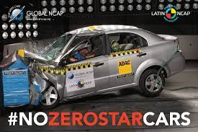
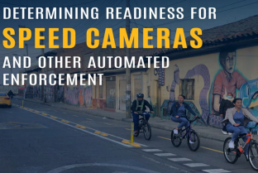
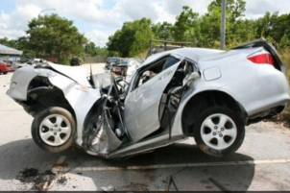
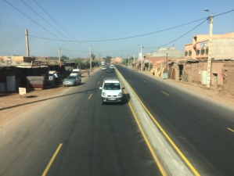
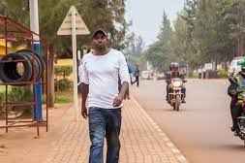
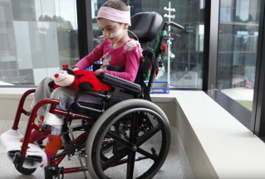
Market failure: Road transport has negative externalities (social costs of road crashes) that are not directly assumed by the agents causing them, while parties affected by crashes and that could benefit from improved safety are not directly funding it, negating incentives to finance interventions
Problem
Who Pays
Where is the source of failure
and who has the solutions
Lack of accountability of stakeholders causing Road Safety market failure
Vehicle standards (incl 2-wheelers)
The Health Sector
Costs born by agents different from those causing road crashes, eliminating incentive to avoid
Enforcement and compliance
Insurance
Evidence-based toad safety interventions can avoid costs (fully or partially).
Road engineering standards and Performance
Workplace compensation (OHS) and productivity loss
Payment can come from the agents causing the externality or from the ones bearing its costs, with the distributional implications very different in each case
Pre-hospital care and compensation
Socio-economic costs and long-term Care
Sustainable finance can facilitate funding of road safety interventions, aligning safety and commercial interests
Solution
Notes:
The poor status of global road safety points to a significant market failure in how roads impact our societies and economies.
The market’s failure to appropriately account for the costs of road crashes is one of the prime reasons for underinvestment from the private sector into road safety
This initiative seeks to address precisely this market failure, which is limiting investment in road safety: The lack of due accountability of the stakeholders is causing Road Safety market failure. Externalities of road transport result in extra (social) costs that are born by agents different from those causing road crashes, eliminating incentive to avoid or reduce them.
Private capital can and must be harnessed to address this failure, not only because of the size of the funding gap, but also because the current ways in which roads are financed requires a realignment of incentives to bring safety and commercial interests in line. Public authorities, development actors and private investors hold the power to change how road safety is regulated, monitored, and invested into.
In the face of this PROBLEM – lack of accountability of stakeholders causing RS market failure, we propose a SOLUTION:
Sustainable finance can facilitate the process of funding the road safety interventions, aligning safety and commercial interests.

Slide 4
Three actors have a key role influencing road safety investment: governments, investors, and development actors; they each see several challenges to investing in road safety
Lack of public accountability
Given the nature of RTIs, road safety is not often seen as a public responsibility in L/MICs
Governments
Limited access to financing
L/MICs have limited access to capital and several competing priorities, tend to underestimate the potential benefits from road safety
Private investors
Road Safety investments
Development actors
Lack of health sector attention
Although road crashes have severe health consequences, preventative measures of road safety are not typically in the domain of the health sector
Low regulatory standards
Private concessionaires adhere to minimum local requirements for road safety, which tend to lag behind in L/MICs
Lack of investible models
In the absence of projects and adequate renumeration, private investors and sponsors do not invest in road safety
Low perceived cost-effectiveness
Road safety investments in infrastructure are perceived to be high investment relative to the impact created
Notes:
Addressing the market failure in road safety
The market’s failure to appropriately account for the costs of road crashes is one of the prime reasons for underinvestment from the private sector into road safety. As the costs of dangerous roads are dispersed across the economy, there is little financial incentive for private road owners to invest into safety beyond the minimum enforced standards, and in cost-competitive environments this can lead important safety investments to become deprioritized. Although many private and public actors will benefit financially from safer roads, such as the health care sector, insurance companies, or operators of commercial fleets, many of these beneficiaries currently face barriers to engaging in crash prevention due to a lack of discrete, investable projects.

Slide 5
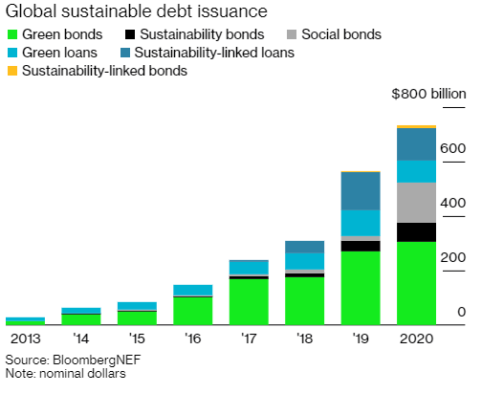
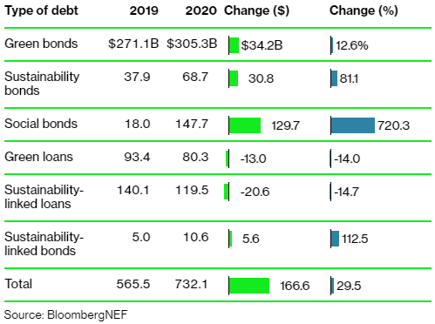
Growing sustainable debt market provides opportunity for channeling private capital into road safety using a new asset class: “Saving Lives” Bond and Loans
Diversified sustainable debt markets with increasing number of financing instruments…
… to meet a growing appetite of financiers who now embed ESG standards in their investment decisions both in the bond and loan markets …
… and with growing prevalence of social bonds to respond to the challenges created by Covid-19
Instruments | Typology | Eligible uses | Framework
Green Bond (2007) | Use of Proceeds | Green transport, climate resilient infra, renewables | Green Bond Principles
Sustainability Bond (2014) | Use of Proceeds | Green or Social assets | Sustainability Bond Guidelines
Social Bonds (2015) | Use of Proceeds | Access to essential services, affordable basic infrastructure, etc | Social Bond Principles
Green Loan (2016) | Use of Proceeds | Green transport, climate resilient infra, renewables | Green Loan Principles
Sustainability-Linked Loan (2017) | General Corporate Purposes | Borrower sustainability goals evaluated against targets | Sustainability Linked Loan Principles
Blue Bond (2018) | Use of Proceeds | Marine/Climate | Under development
Originally dominated by Use of Proceeds instruments where proceeds are invested into specific assets, the sustainable debt market has seen the emergence of General Corporate Purposes instruments where the conditions of the debt are modulated by the attainment of predefined goals
The sustainable debt market has cumulatively surpassed the $2 trillion of issuances and is on the verge to pass the $3 trillion total issuance over the course of 2021 partly due to the covid-19 related stimulus plans
Sustainability market is moving towards becoming a standard for future access to capital
The Green Bonds issuances increased by nearly 13% YoY from 2019 to 2020 while the overall sustainable debt market grew by 30% roughly (and 69% YoY over the last eight years)
While Social Bonds were the second-smallest type of sustainable debt in 2019, they were the second-largest in 2020
Significant contribution of road safety to social objectives (health and equity) and direct linkage to SDGs make road safety investments and associated sustainability programs good candidates for financing in the sustainable debt market
Notes:
The growth of socially responsible investing and the sustainable finance market offers a new opportunity to address this market failure. The sustainable finance movement seeks to capture and internalize the total costs of doing business – including the wider environmental and social impact – thereby accounting for the negative externalities of economic development. Driven by public and investor demand, the sustainable finance movement is growing rapidly. More investors and companies are required or are opting into reporting on their environmental, social and governance (ESG) impact, and the sustainable finance market has seen huge growth in the number of investors seeking pro-social investment opportunities that directly target the Sustainable Development Goals (SDGs). In 2020, new records were broken with total sustainable debt issuance reaching $732 billion USD. Several other areas, such as climate change and COVID-19 relief, have successfully leveraged this growing market to expand their pool of available capital. However, road safety, despite having a clear mandate within the SDGs, is yet to harness this movement.

Slide 6
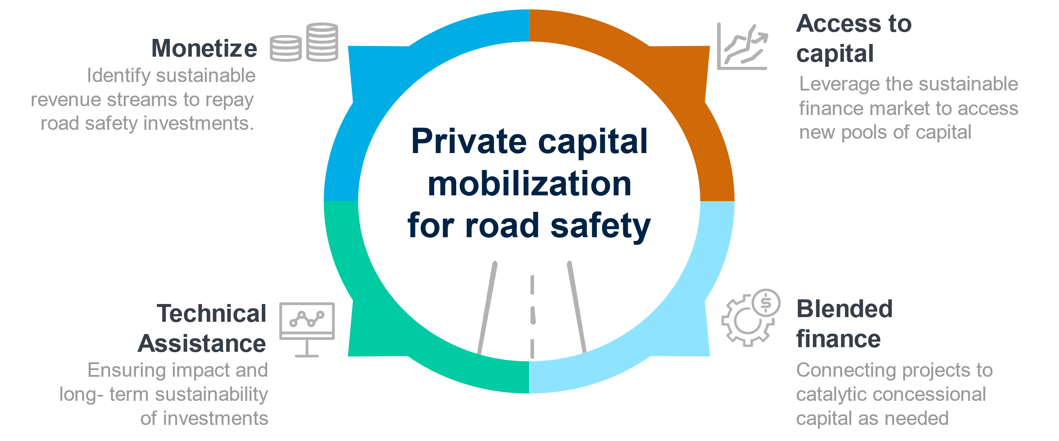
Projectizing Process for Road Safety
Notes:
For capital from the sustainable finance market to flow to road safety, a “projectizing” process will need to occur - whereby priority road safety interventions in L/MICs are structured into discrete projects that offer both life-saving impact and a return on investment for private capital. This paper defines four steps as part of this projectizing process. Firstly, road safety must become an investable area. This requires a monetization of the financial savings from safer roads, where sustainable revenue streams which can repay investments are clearly defined. Once this is achieved, road safety can position itself to access capital through the sustainable finance market, such as through the issuance of social bonds or sustainability-linked loans which tie financing to targeted safety outcomes. Where needed, blended finance can be used to support this process, offering catalytic grant funds to mitigate specific investment risks and help rebalance risk-reward profiles of pioneering, high-impact road safety investments so that they have the potential to become commercially viable over time. Finally, technical assistance is the anchor of the process, supporting governments and implementers and creating the enabling environment needed to ensure the impact and long-term sustainability of road safety investments.

Slide 7
This initiative aims to mobilize private capital to bridge the gap in road safety funding by creating a platform and an asset class for saving lives on the world’s roads
Work with governments and sponsors to create Road Safety projects, funding streams to repay for the investment, and business models to provide the economic incentives to generate investible opportunities for private investors
Investible road safety programs
Projectize
Identify opportunities, scope out transactions, and generate data and develop proofs-of concept demonstrating impact to entice road safety beneficiaries to contribute as investors or funders and governments and corporates to scale use
Proven & Viable road safety investments
Pilot
Develop a platform to build upon pilots to create a pipeline of projects and deploy structured financial products that are attractive to issuers and can leverage sustainable debt market and blended finance in LICs and MICs
Scalable access to capital for road safety
Mobilize

Slide 8
Investible projects: We have identified eight high-impact road safety project types that have potential for private sector participation under different business models
Developing or upgrading a vehicle inspection center network [PPP/Corporate]
Upgrading commercial fleet to vehicles that adhere with international roadworthy standards [Corporate]
Designing new road projects adhering to iRAP 3-star or better rating [PPP]
Upgrading highway infrastructure for protective infrastructure, such as guard rails, crash cushions, and dividers [PPP]
Upgrading roads with speed reducing infrastructure and installing automated speed enforcement devices on high-speeding networks [PPP, Subnational]
Upgrading roads for vulnerable users to an iRAP 3-star or better rating [PPP, Subnational]
Develop or upgrade emergency medical services for road crash victims [PPP, Corporate, Subnational]
Building a network of trauma centers for post-crash care [PPP, Corporate, Subnational]
P1. Vehicle inspection and certification
P5. Speed management & automated enforcement
P2. Commercial vehicle fleet upgrade
P6. Road safety upgrades for protection of vulnerable road users
P3. New road concessions with road safety requirements
P7. Emergency medical services
P4. Upgrade of highway protective infrastructure
P8. Regionalization of specialist trauma centers
Notes:
Initiative puts forward eight road safety project archetypes which are well positioned for private sector engagement, and also have strong potential to save lives. Based on a review of over 100 road safety countermeasures, these eight project archetypes have been selected to span across three of the key pillars of road safety: safer vehicles, safer roads, and post-crash response. Namely, vehicle inspection and certification centers, commercial fleet upgrades, infrastructure upgrades on new road concessions, upgrade of protective highway infrastructure, speed management and automated enforcement, protective infrastructure for vulnerable users, emergency medical services, and specialist trauma centers. Each has been chosen for their measurable impact on reducing fatal and serious injuries, and for the potential to attract private sector participation.
A number of repayment sources can be tied to each of these interventions, and a focus on efficiency and results can be incentivized by tying returns on investment to outcomes. In many scenarios, revenue streams can be generated from users, such as through increased tolls, vehicle inspection fees or speeding infringement fines. Corporate funders who experience savings from reduced crashes can also contribute to revenue streams, and where road safety elements are more challenging to monetize, the government can ringfence funding for road safety from a wider range of sources – such as a new fuel tax, or a levy on motor insurance premiums. Where impact is attributable and measurable, returns on investment can then be tied to the achievement of safety outcomes, ensuring a results-driven approach is taken and that safety remains a first priority.

Slide 9
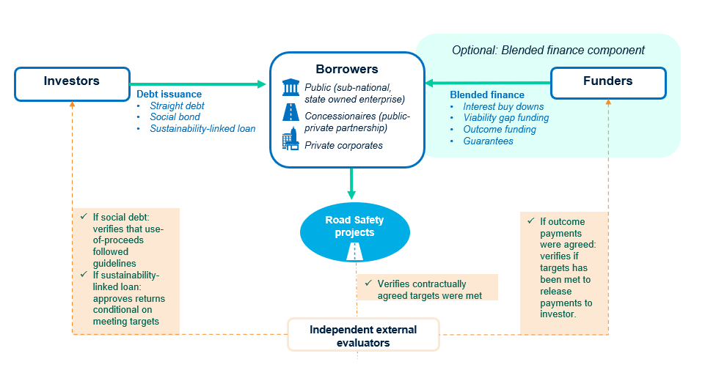
Overarching investment structure opportunities for road safety projects
Notes:
Depending on the project and context specific needs, specific investment structures can be designed which bring in a mix of borrowers, investors, and funders. This SLIDE provides an overarching illustration of the primary components of an investment structure for road safety. There are three key actors – investors, borrowers, and funders - who are supported by independent evaluators. In addition to this core mix, additional technical assistance and monitoring and evaluation (M&E) partners may be brought on board. These actors will come together in different permutations – i.e., ‘investments structures’, or ‘models’ – in order to serve the context specific needs of the road safety market in question. The possible investment structures vary along the lines of private or public borrower, the type of debt used, the type of revenue streams which can be engaged, and the road safety projects which are most suitable. Furthermore, all models can be supported by the optional addition of blended finance, where funders can support the financial viability of the project if the internal revenue streams are not sufficient to create viability alone. Throughout all possible arrangements, independent evaluators will be crucial to supporting coordination and compliance by assessing baselines, verifying if targets have been met, and whether the terms of social or sustainability-linked debt have been fulfilled.

Slide 10
How can the private sector finance road safety? We need to create the business models for road safety investments / projects to be financed by the private sector (“projectize”)
See next page for potential variations in debt structures
Instruments
Potential Applications
Debt
Direct grant
Outcome funding
Guarantee
Road infrastructure
Road Safety projects
Public borrower
Direct financing to subnational entity | Debt issuance to sub-national entity | Interest buy-down | Outcome funding to public entity |  | Road upgrades Bicycle lanes Protective infrastructure for pedestrians | Automated Speed Enforcement (ASE) Vehicle Inspection & Certification (I&C)
Financing new road PPPs or other road safety PPPs | Loan to new concession | Viability Gap Funding to public authority | Outcome payments to concessionaire | Credit guarantee for public issuer obligations | Road upgrades under new road PPPs with road safety KPIs | ASE¹ Vehicle I&C² EMS³, trauma care
Additional debt to existing PPPs | Sub-loan to existing concession |  | Outcome payments to concessionaire |  | Road safety upgrades on existing concessions with associated KPIs | EMS³ on existing road concessions
Financing corporates or sponsors | Debt issuance to private entity |  | Results-based subsidy to private entity |  | Road concessionaires with large portfolios of operating PPPs | Fleet mgt. / upgrades EMS³, trauma care
Results-based financing |  |  | Health aid directed as outcome funding |  | Road upgrades | EMS³, trauma care
A
Private borrower
B
C
D
Public or private
E
Core
Optional
Note(s): Additional details for each business model is described in the annex, pages 12-16; [1] ASE = Automated speed enforcement; [2] I&C = Inspection and certification; [3] EMS = Emergency medical services
Notes:
Different combinations of public and private borrowers, investors and funders can be involved in creating these investments, and this initiative puts forward five potential investment structures. The five investment structures illustrate possible permutations across the private-public spectrum of borrowers, including public-led investments, public-private partnerships, private-led initiatives, and impact bonds. Through these different options, road safety interventions from both inside and outside the public domain can be targeted, and structures can be selected based on the constraints and opportunities of the local market. The investment structures also vary along the lines of type of debt used (straight, social, or sustainability-linked), and each can be supported by the addition of blended finance to bridge any existing viability gaps. In all of the possible arrangements, independent evaluators and sustainability coordinators play a critical role in supporting coordination and ensuring impact.

Slide 11
What are the financing options? Sustainable debt market instruments that could potentially benefit from blended finance to make private sector financing viable or maximize outcomes
Financing Instruments
Suitability of variations
Social loans/bonds
Sustainibility-linked loans/bonds
Impact loans/bonds
Social loans / bonds:
Proceeds exclusively applied to finance or re-finance in part or in full new and/or existing eligible Social Projects
Four core components: use of proceeds, process for project evaluation and selection, management of proceeds, reporting.
Sustainibility-linked financing:
Incentivizes borrowers to achieve predetermined sustainability performance objectives that are measured using sustainability performance targets (SPTs)
Incentive mechanism that lowers/ increases pricing based on achievement of STPs/ KPIs
use of proceeds is not a determinant in its categorization and, in most instances, proceeds are used for general corporate purposes
Impact loans / bonds:
investor directs funding to an implementer for projects that the investor believes will create road safety outcomes and assumes the risk of achieving these outcomes.
If the outcomes are realized, the investor receives an appropriate financial return from an outcome funder such as the beneficiary government or a donor.
Public borrower
Direct financing to subnational entity | Lender restricts use-of-proceeds for investments aligned with Social Bond Principles | Lender adjusts the pricing of the debt based on the borrower’s achievement of pre-determined sustainability KPIs
Financing new road and road safety PPPs |  |  | Lender pre-determines use-of-proceeds and is repaid on the outcomes achieved through the investment
Additional debt to existing road PPPs
Financing corporates or sponsors
Results-based financing | Donor financing
A
Private borrower
B
C
D
Public or private
In the situations where the Road safety Intervention could not generate sufficient resources to repay the debt in full, financings could include blended finance: grants, bonus payments, margin discounts, etc.
E
Note(s): Additional details for each variation is described in the annex, pages 17-19; [1] ASE = Automated speed enforcement; [2] I&C = Inspection and certification; [3] EMS = Emergency medical services

Slide 12
Thank you

