Slide 1
African experiences in the use of digitalization for road safety: the case of Côte d'Ivoire.
KOFFI ANNAN ROAD SAFETY AWARD _ MARRAKECH 2023
25 TH – 26 TH SEPTEMBRE 2023

Slide 2
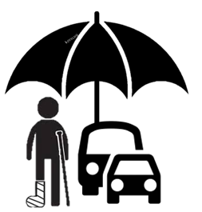
THE NATIONAL ROAD SAFETY STRATEGY 21-25
To address this context and reverse the curve of road insecurity, the Ivorian Governmentenn adopted on July 07, 2021 in the Council of Ministers, the National Road Safety Strategy (SNSR) 2021-2025. At the time, our country, like all UN member states, committed to achieving a 50% reduction in the number of road deaths and injuries by 2030. This national strategy is based on 03 major axes, including 09 strong measures, and a reinforcement of regulatory provisions.
Axis 1
Axis 2
Axis 3
Everyone's commitment to road safety.
Anticipating new technologies for road safety.
The efficiency of Riposte.

Slide 3
Axis 3 on anticipating new technologies to improve road safety
Ministry of Transport
NATIONAL ROAD SAFETY STRATEGY 2021-2025
Addresses two (02) important measures
MEASURE N°9 : INTRODUCTION OF AN INTELLIGENT TRANSPORT SYSTEM (STI)
Encourage gradual changes in road user behavior to significantly reduce the loss of human life.
MEASURE N° 8 :
SAFE ROADS AND SPEEDS
Ensure safe mobility in urban areas and reduce accidents on certain urban roads.

Slide 4
Data as a catalyst for digitalization in road safety

Slide 5
Data as a catalyst for road safety
Integration with technical inspection operators, insurers, authorities, banks
Traffic monitoring
Information distribution
ALPRS
MTV
Social Media
Internet
DTRS
Mobile phones
Third party
Partners
MIE /MIE / AGEROUTE / BNETD / OSER /OFT
Mobile unit
Registration number
Driving
licence
Transport
ALPRS=Automated License Plate Reading System MTV= Monitoring transport vehicles DTRS= Traffic Data Regulation System SS= Speed Signs

Slide 6
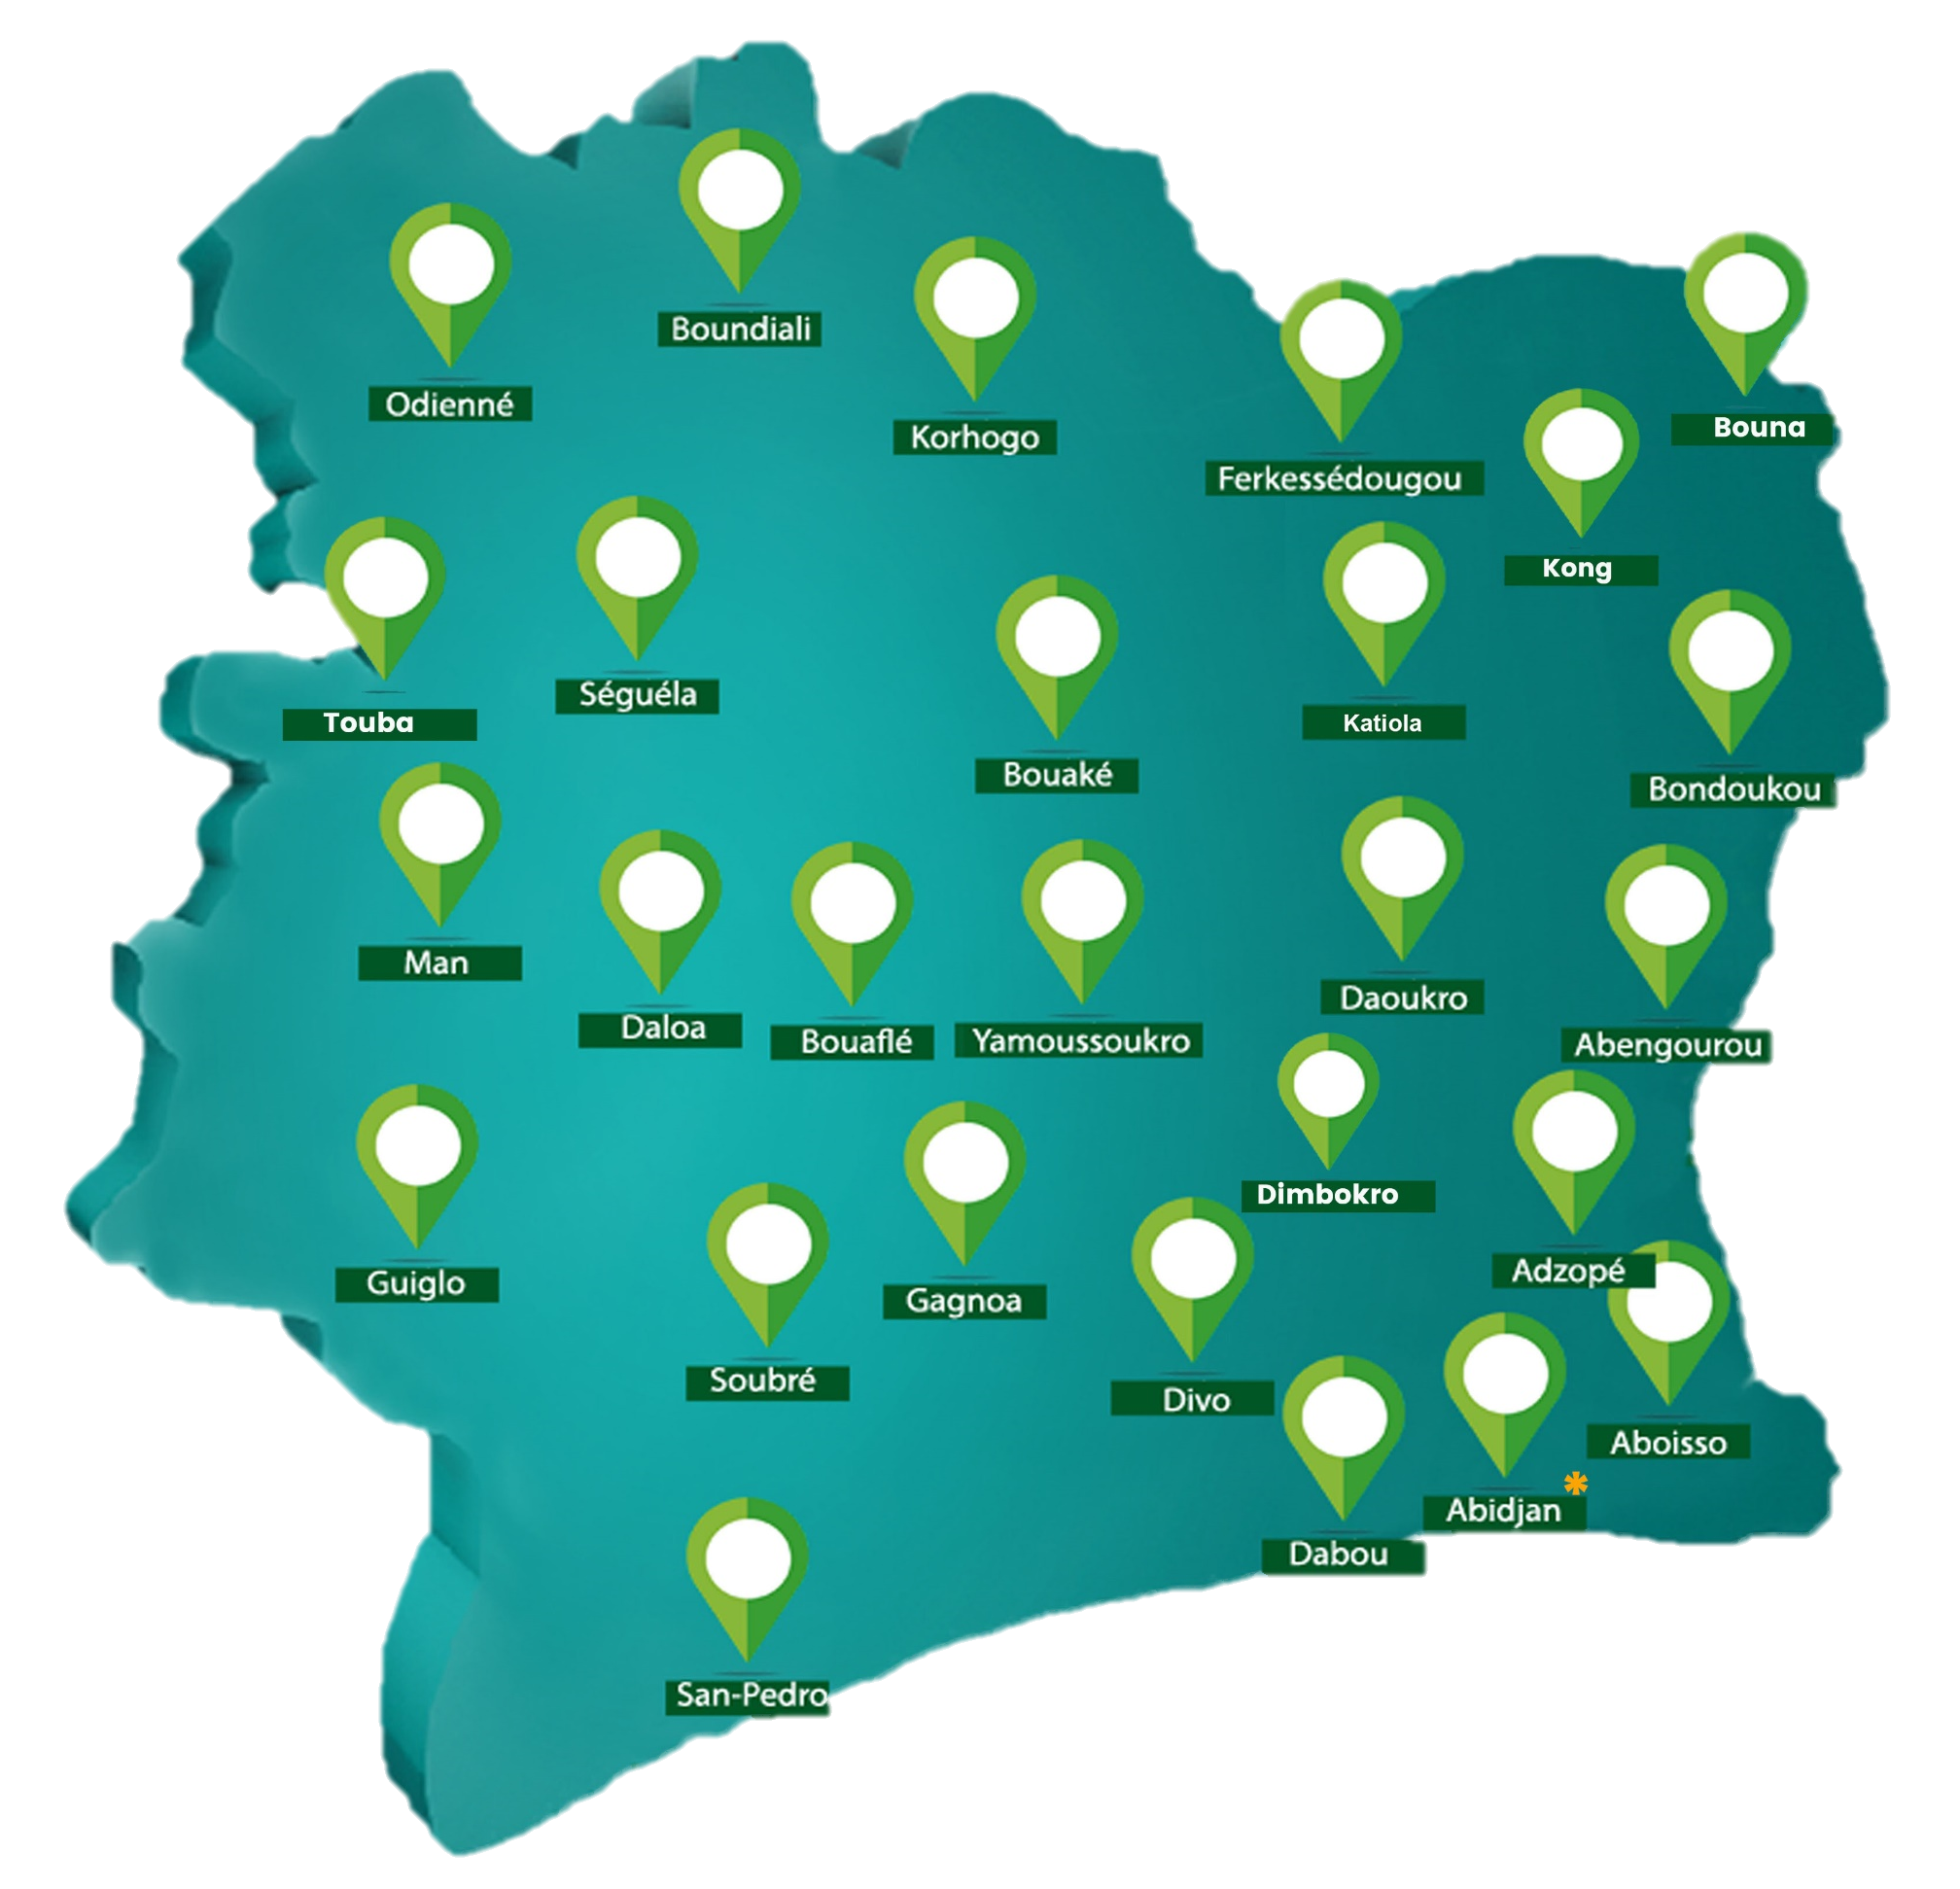
Improving accessibility to public services
For
34
Building service centers
Optimization of ticket processing and issuance processes
Across the country

Slide 7
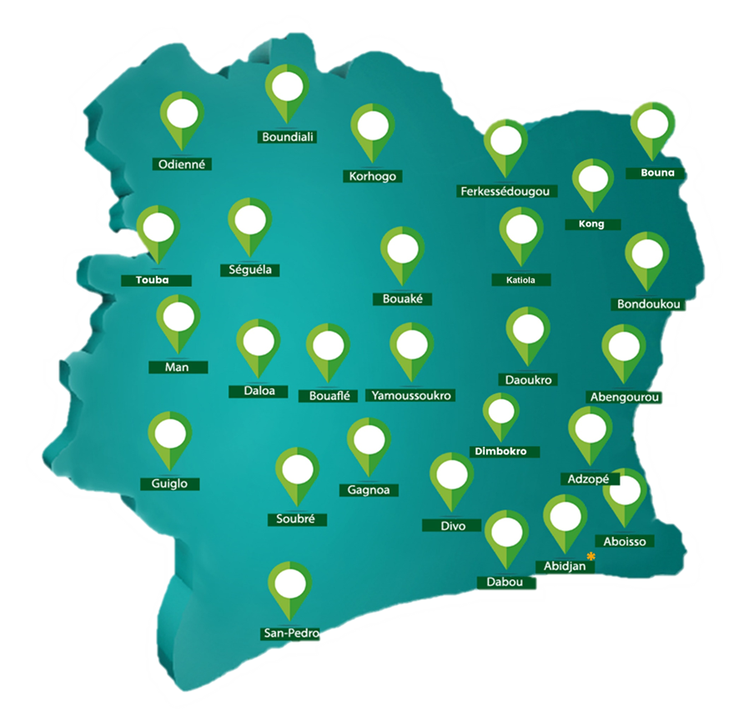
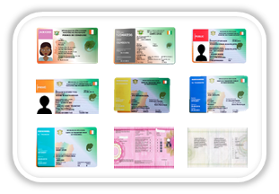
Pass production from 2014 to 2023
5 979 900
Titles delivered over the10 years
On average
597 990
/ Year
DRIVING LICENCE
REGISTRATION DOCUMENT
TRANSPORT CARD
HAULAGE PERMIT

Slide 8
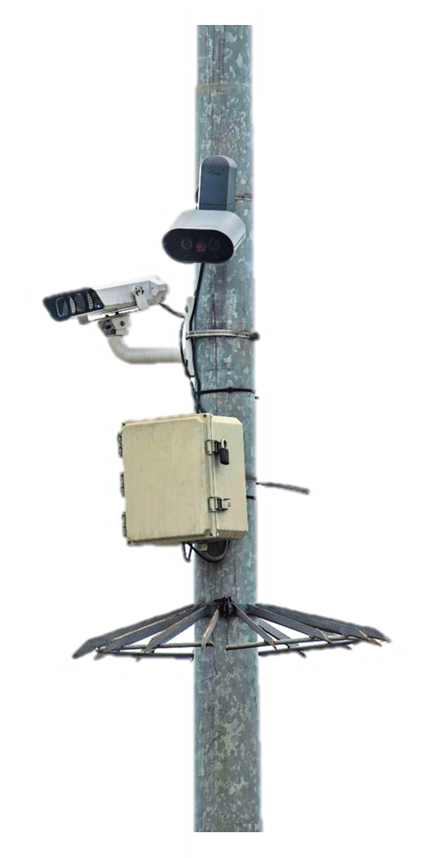
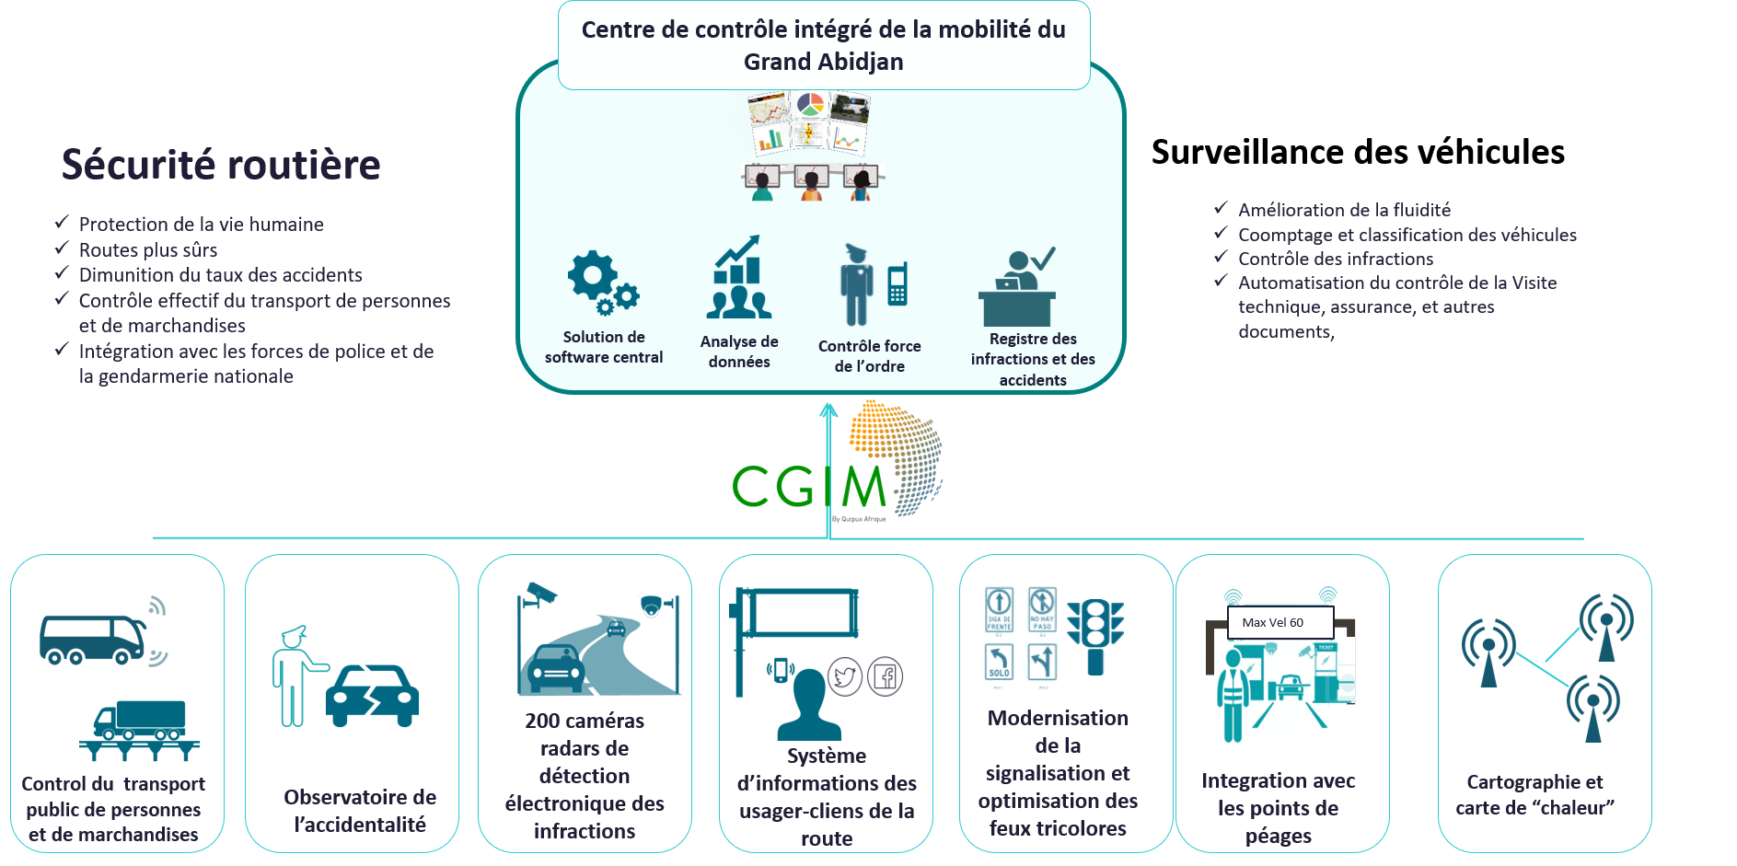
The Intelligent Transport System global offering (ITS)
Integrated mobility control center of the District of Abidjan
Vehicle monitoring
Improving traffic flow
Vehicle counting and classification
Infringement control
Automated control of technical inspection, insurance and other documents
Road safety
Protecting human life
Safer roads
Lower accident rates
Effective control of passenger and goods transport
Integration with police and gendarmerie forces
Central software solution
Data analysis
Law enforcement control
Register of offences and accidents
200 radar cameras for electronic infrastructure detection
Road user-customer information system
Modernization of traffic signals and optimization of traffic lights
Control of public passenger and goods transport
Observation of accidents
Integration with toll booths
Mapping and heat maps

Slide 9
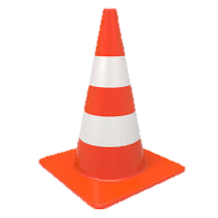
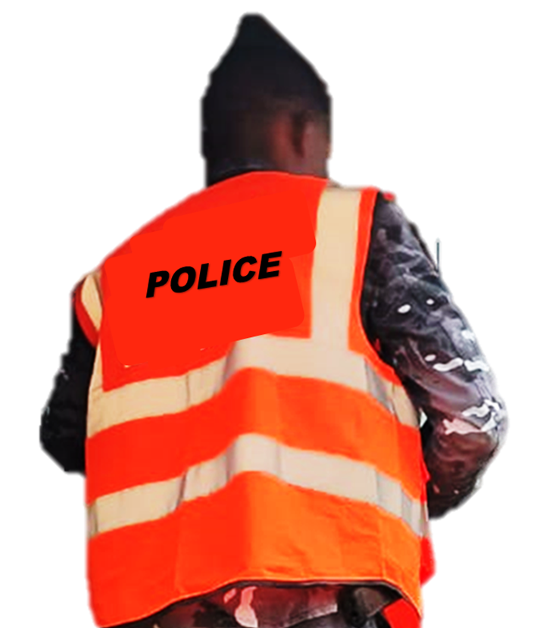
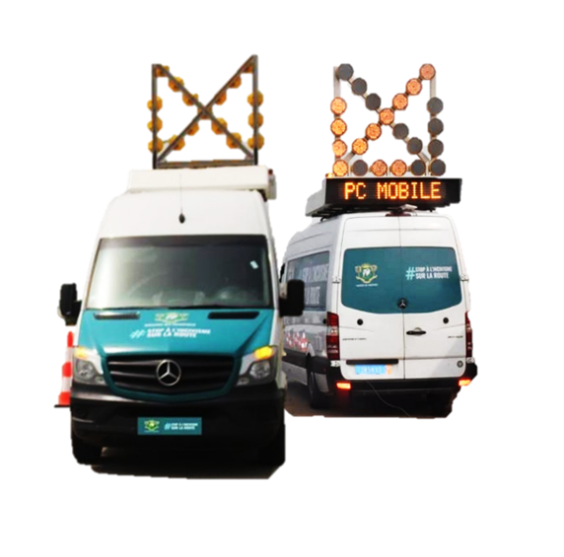
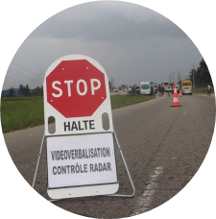
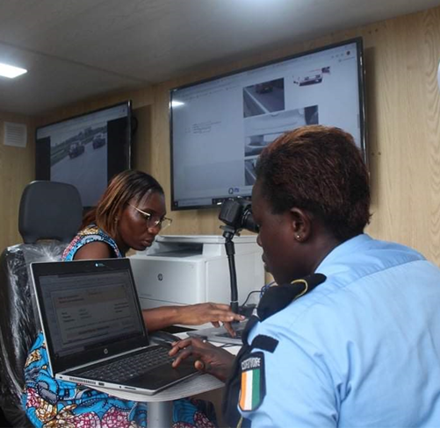
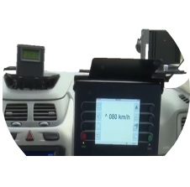
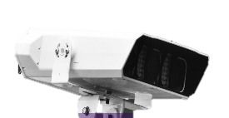
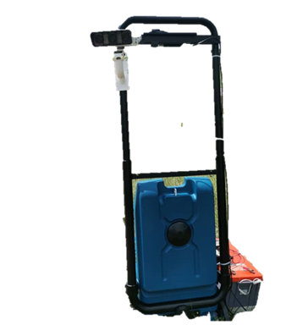
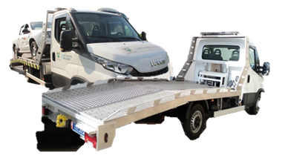
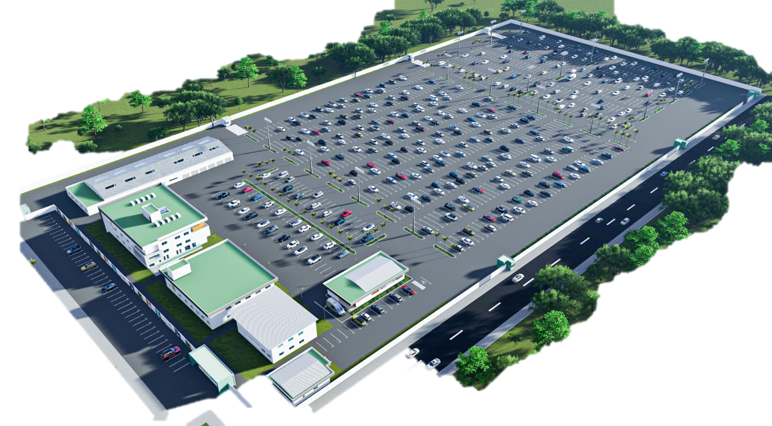
The interception unit
DETECTION TECHNOLOGY AND
UNITS
D’INTERCEPTION
2
INTERCEPTION
3
Law enforcement officers safely intercept vehicles flashed by the outpost's detection system. Thanks to the alerts generated.
THE MOBILE UNIT
Detection Technology
Fitted out to counter standards, this vehicle enables the operational teams (ticketing officer and CGIPARK operator) to process, notify and pay fines electronically.
1
DETECTING
4
5
A fixed, mobile or on-board camera in a police or gendarmerie vehicle detects moving and parked traffic in an outpost
by automatically capturing moving and parked offences in both directions on a traffic lane
IMPOUNDMENT OF VEHICLES
REMOVAL
It handles all cases requiring impoundment.

Slide 10
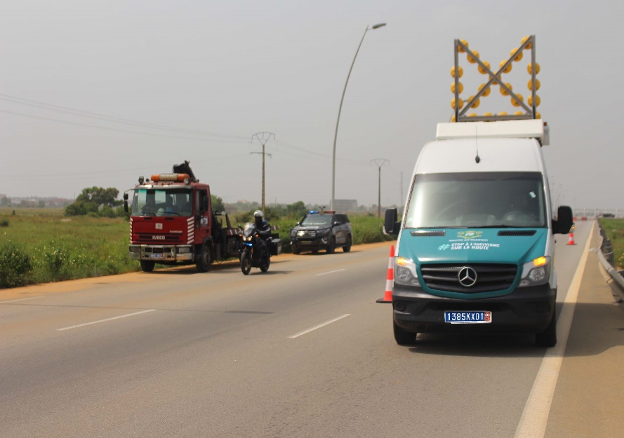
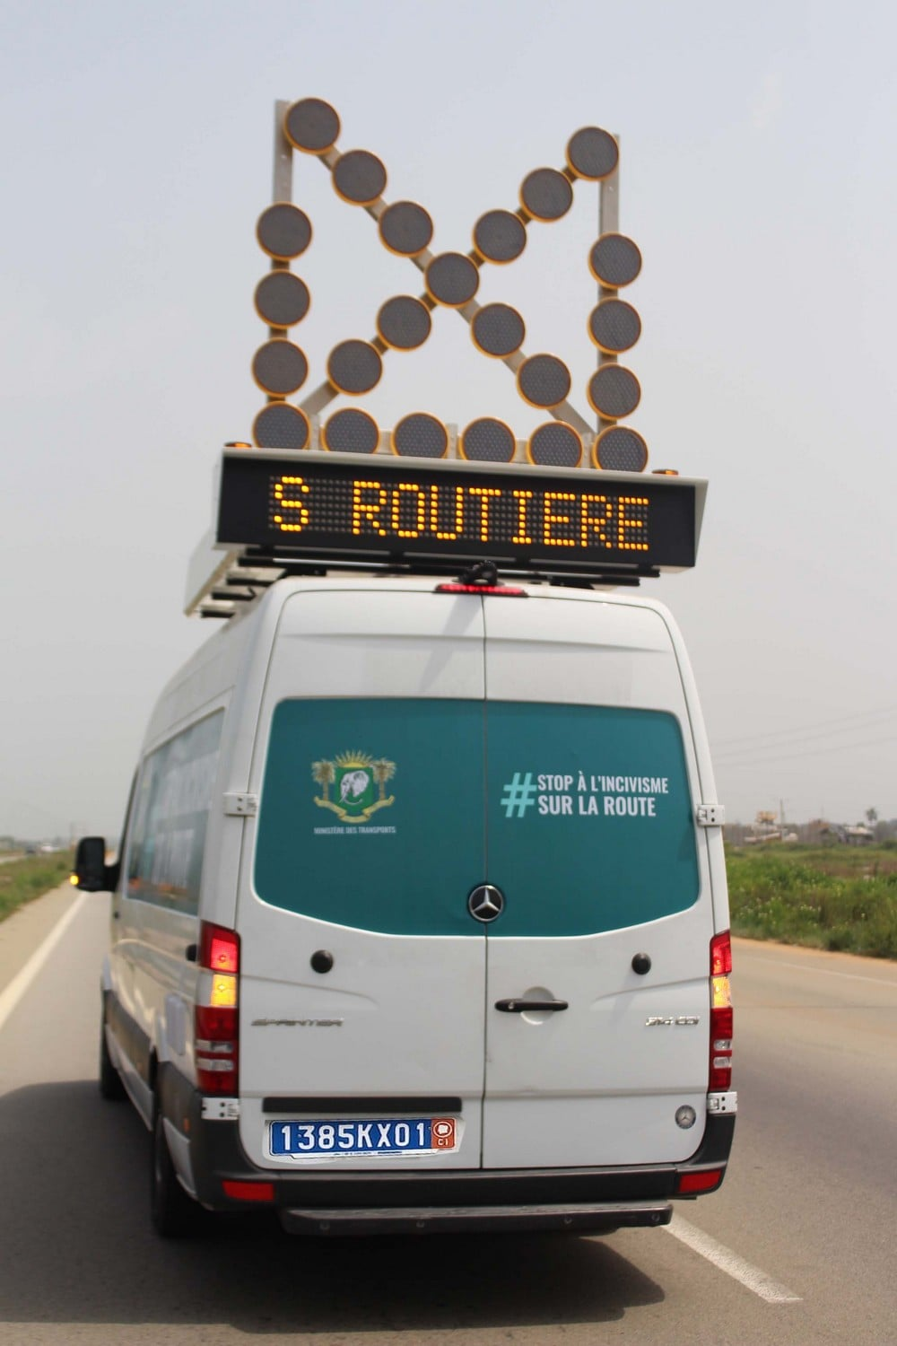
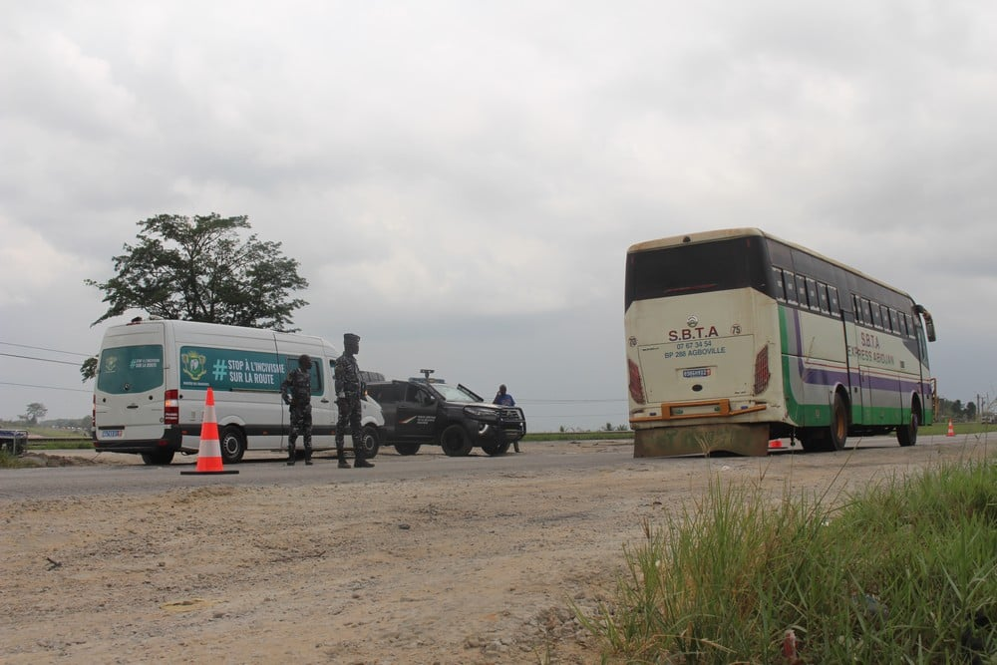
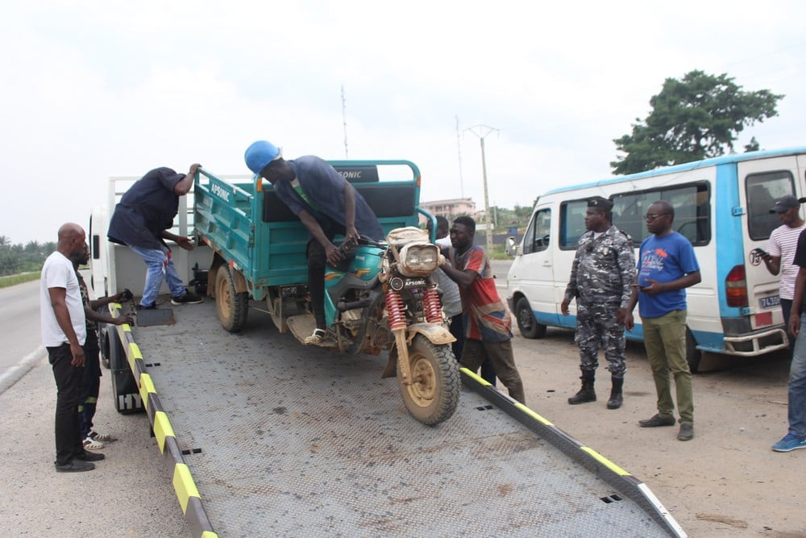

Slide 11
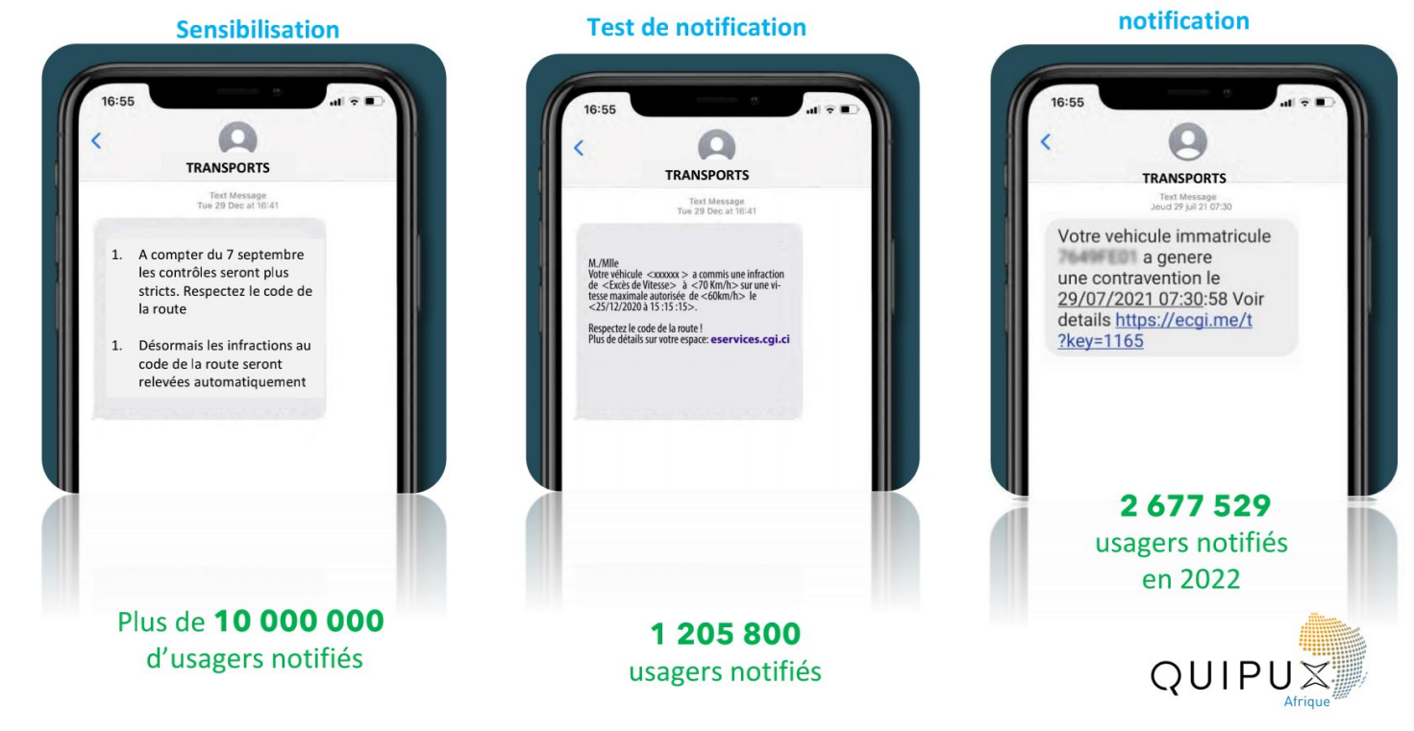
Implementing intelligent mobility: SMS campaigns
Sensitization
Sensitization test
2 677 529 users notified in 2022
Over 10,000,000 users notified
1 205 800 users notified

Slide 12
All requests are handled through various channels
The Ministry of Transport's online helpdesk (1302)

Slide 13
Some key SNSR results

Slide 14
In 2022, The District of Abidjan recorded a decline of:
44 %
in accidents
64 %
In fatalities
10,39 %
In injuries

Slide 15
STOP INCIVILITY ON ROAD
Awareness-raising and, where necessary, enforcement actions will focus on recurring offences such as speeding, using the telephone while driving, failing to illuminate the vehicle, not wearing a seatbelt, and drink-driving,
_______Key figures _______
Focus on National Road Safety Week
On average 1208
vehicules intercepted
On average
204
Impoundments
6 Edition have taken place since January 2023

Slide 16
STOP INCIVILITY ON ROAD
Thank you for your kind attention

