Slide 1

Road Safety Experience of the Kingdom of Eswatini
25 September 2023
Marrakech, Morocco
Mandla P. Ntshalintshali
Director Road Transportation
Ministry of Public Works & Transport

Slide 2
Outline
Legislative Framework
State of Road Traffic Crashes
Defining Moment on Road Safety in Eswatini
Response to the Defining Moment
Conclusion

Slide 3
Legislative Framework
Road safety mandate derived on the Road Safety Council Act, 1983
Object of the Act is to ‘…establish the Road Safety Council, to promote road safety, to set up a Road Safety fund and to provide for matters incidental thereto.’
The Act is up for Review following the adoption of the Eswatini National Road Safety Strategy (ENRSS) 2023 - 2030

Slide 4
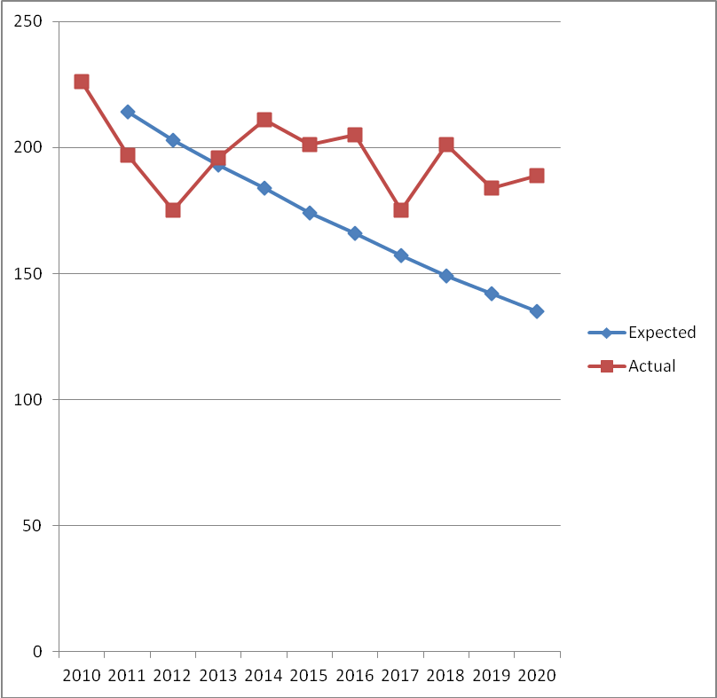
State of Road Traffic Crashes
Year | 2010 | 2011 | 2012 | 2013 | 2014 | 2015 | 2016 | 2017 | 2018 | 2019 | 2020
Expected Road Deaths | 226 | 214 | 203 | 193 | 184 | 174 | 166 | 157 | 149 | 142 | 135
Actual Road Deaths | 226 | 197 | 175 | 196* | 211* | 201* | 205* | 175* | 201* | 184* | 189*

Slide 5
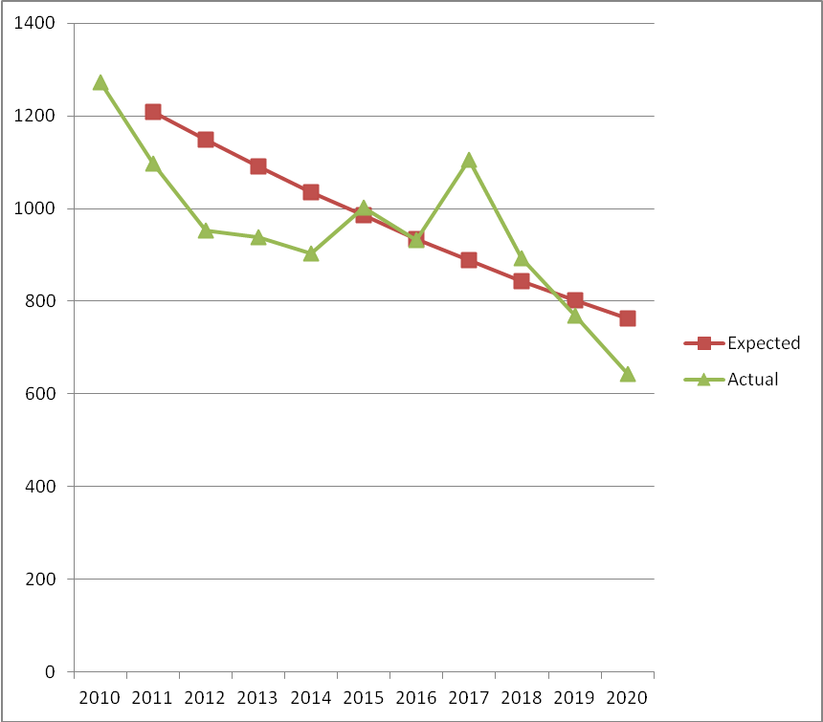
State of Road Traffic Crashes
Year | 2010 | 2011 | 2012 | 2013 | 2014 | 2015 | 2016 | 2017 | 2018 | 2019 | 2020
Expected Serious Injuries | 1273 | 1209 | 1198 | 1091 | 1036 | 985 | 935 | 888 | 844 | 802 | 762
Actual Serious Injuries | 1273 | 1098 | 952 | 938 | 903 | 1003* | 932 | 1105* | 893* | 769 | 643

Slide 6
Defining Moment on Road Safety in Eswatini
The wreckage of the truck that crashed when the first truck was being removed from the crash scene
2014 Malagwane Tragedy (MR3)
Occurred 29th April 2014 afternoon peak hour
A catastrophic road traffic crash occurred at the foot of Malagwane Hill (MR3) on the descend, Manzini bound lane.
Scenes never imagined experienced
Articulated truck full of coal crashed into several stationery vehicles that were stopped whilst another earlier, truck which had crashed, was being removed to open way to traffic.

Slide 7
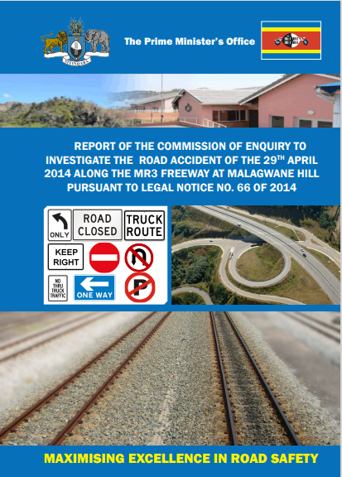
Response to the Defining Moment
The 2014 Malagwane Report
The then Prime Minister, H.E. the Right Honourable Dr. Sibusiso B. Dlamini promptly appointed a four-member Commission of Enquiry to investigate the crash.
The resultant “2014 Malagwane Report” provided useful recommendations which formed the foundation for taking serious steps to improve road safety.

Slide 8
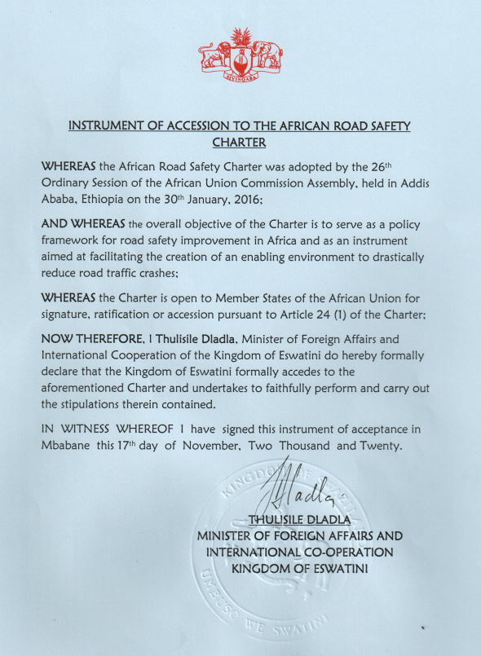
Response to the Defining Moment
The Instrument of Accession
Took serious steps to ratify the adopted 2016 African Road Safety Charter
Consultations:
  Road Safety Stakeholders
  Parliament (both houses; Assembly and Senate)
14 November 2020: Charter Ratified in line with Constitution of Swaziland Act, 2005, Section 238.
December 2020: Accession instrument deposited in terms of Article 27 of the Charter.

Slide 9
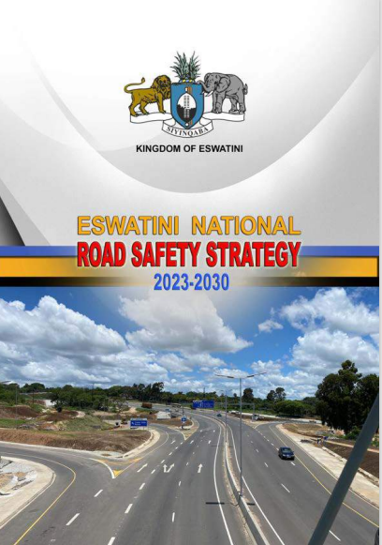
Response to the Defining Moment
The Eswatini National Road Safety Strategy 2023 -2030
2022 June: Launch of Eswatini’s commitment to the 2nd Global Decade of Action for Road Safety 2021 -2030 by H. E. the Right Honourable Prime Minister Cleopas Sipho Dlamini
2023 June: Eswatini National Road Safety Strategy (2023 – 2030) publicly launched by H. E. the Right Honourable Prime Minister Cleopas Sipho Dlamini
Demonstration of High Political Will

Slide 10
Conclusion
Let all Fellow African countries yet to Ratify the Charter
do so urgently.
LINK TO ESWATINI NATIONAL ROAD SAFETY STRATEGY 2023 – 2030
www.gov.sz/images/FINAL-ESWATINI-NATIONAL-ROAD-SAFETY-STRATEGY-2023-2030_final.pdf

