Slide 1
Digital Transformations and Innovations for Safer Roads
September 25, 2023

Slide 2
Road traffic injuries are a global health challenge
Source: The Lancet.

Slide 3
Africa has the highest mortality rate caused by road traffic accidents
Africa (Share in 100,000 inhabitants)
Source: World Bank, Gomez et al., 2019.

Slide 5
Africa has 2% of world's cars but 20% of road deaths
Distribution of road deaths (%)
Children aged 0 - 19
Source: WHO, UNICEF.

Slide 6
Large variance within countries – South Africa example
Large variance within cities - DC

Slide 7
Large variance within countries – South Africa
Source: Statistics South Africa.

Slide 8
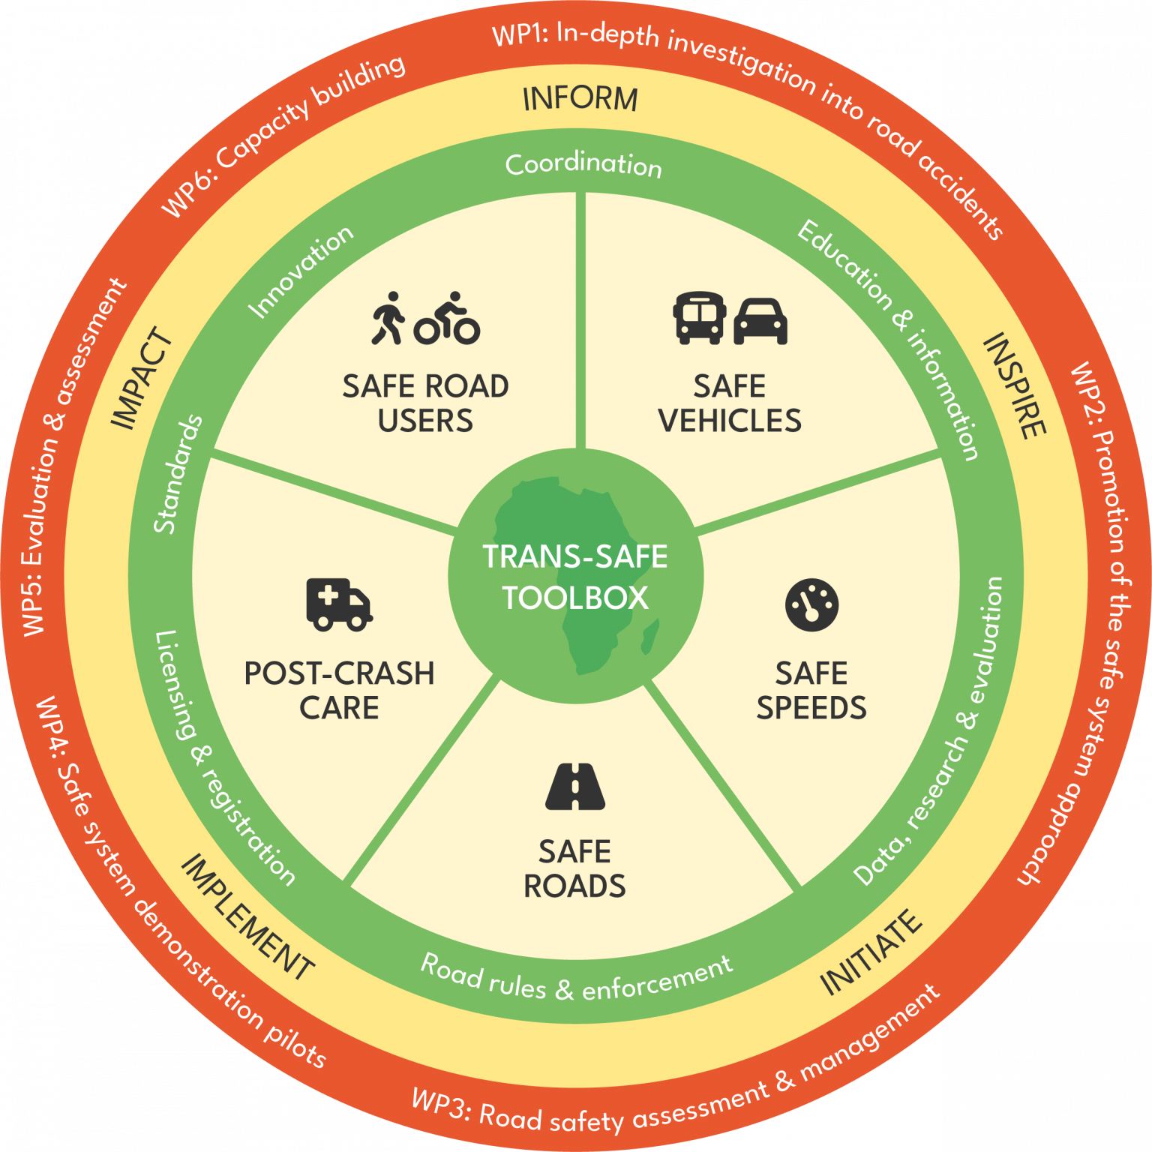
5 pillars of the safe system approach

Slide 9
Key challenges to road safety
Source: The Lancet.

Slide 10
How can digital technology help?

Slide 11
How can digital technology enhance road safety?

Slide 12
How can digital technology enhance road safety?
African nations are experiencing a mobility revolution, utilizing digital technology to bolster road safety
South Africa, Kenya, Nigeria, Algeria, Morocco, and Uganda have all initiated digital strategies targeting the transport sector
Governments are piloting and implementing digital number plates and electronic driver’s licenses
Examples:
South Africa’s Department of Transport is to kickstart a pilot program for new digital driver’s licenses in November 2023
RSA launched an online vehicle licensing system, with nearly one million out of eleven million vehicles digitally registered and licensed
Kenya is issuing chip-embedded smart licenses that maintain real-time records of individual drivers, including their traffic offenses.

Slide 13
Challenges to data management and sharing
Transport sector to benefit from implementing AfCFTA,
Policies need to promote data sharing between public, private and civil society entities
Concerns: data privacy, cybersecurity
Data standards, measurement techniques

Slide 14
AI and road safety
AI to predict when collisions on the road might happen and therefore prevent them, by sending information to road mobility participants
Combining 2 types of data
1. dynamic data, including traffic data, weather data and other data sources that are changeable and temporary in nature.
2. maps with higher granularity than would have been possible a few years ago.
AI role: sharing data with each other and transferring information to participants

Slide 15
UNECA and Road Safety
member of Global Road Safety Partnership
reviews of the status of implementation of the African Road Safety Action Plan (2011-2020) by ECA and the African Union Commission
Sustainable transport a key pillar among ECA’s activities:
ECA assists MSs strengthen their national road safety management systems
tracks the performance of MSs in implementing the African strategic directions for the Second UN Decade of Action for Road Safety 2021-2030
recognizes those that contribute significantly to reduce road deaths on the continent through the Kofi Annan Road Safety Award.

Slide 16
Thank you for your attention.

