Slide 1
UNECA’s support to the Battery and Electric Vehicle
initiative in the DRC and Zambia
Jean-Luc Mastaki
Director ECA -CA

Slide 2
About UNECA
VISION
Mission
OVERALL OBJECTIVE
Ideas
for a prosperous Africa
Delivering ideas and actions for an empowered, inclusive and transformed Africa
Promote inclusive & sustainable development in support of accelerating the economic diversification & structural transformation of Africa, in line with the A2030 and A2063

Slide 3
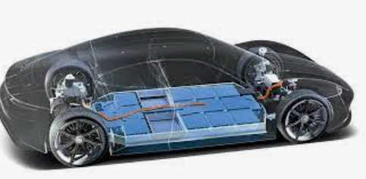
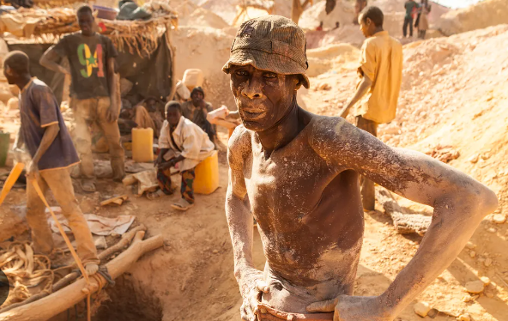
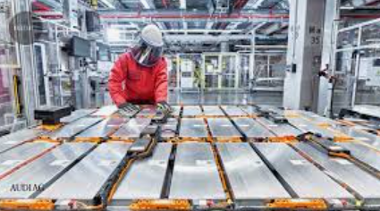
BEV Initiative in DRC: Moving up the ladder
Achieve a disruptive innovation

Slide 4
Africa’s automotive sector
AfCFTA could support Africa’s auto sector by improving cross-border manufacturing and sales.
Original equipment manufacturers (OEMs) sold 44% of the vehicles assembled on the continent in South Africa, 26% in Egypt and 16% in Morocco.
Electric vehicles are already assembled in Africa: South Africa, Egypt, Morocco, Ghana.

Slide 5
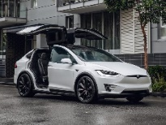
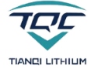
BEV initiative in the DRC : moving up the ladder … why?
Understanding the supply chain
Africa’s focus
Mining
Metals
Precursor
Production
Cell
Production
Cell Assembling
Electric Vehicles
Nickel
Lithium
Cobalt
Smelt and refine
Precursor
Cells
Battery
$11b
$44b
$271b
$387b
$1.18t
$7t+
Market Value by 2025
Notes:
Toyota, Nissan, Ford, Volkswagen, Isuzu, Mazda, BMW, Mercedes Benz, BYD, Chery, Geely, Hyundai, Mitsubishi, Chevrolet, Nissan, Lada, Jeep, KIA, Renault, Dacia and BYD

Slide 6
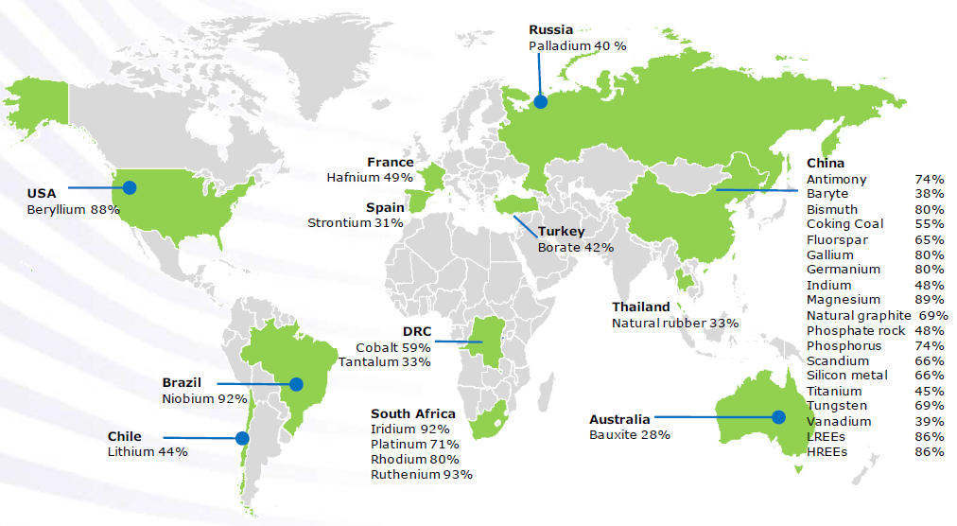
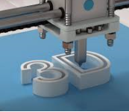
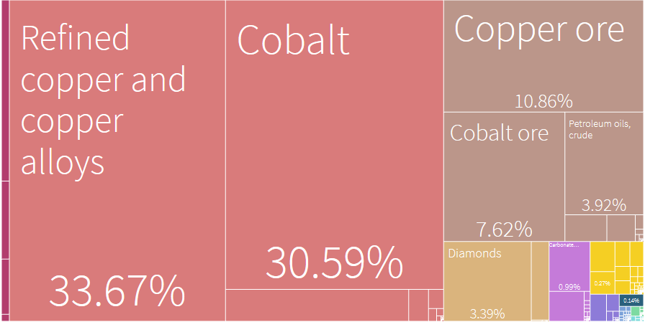
Megatrends
Source: EU on CRMs, 2020
Geological Scandal
Agri Potential (2e after Brazil) …
But
Very Poor population: ±¾ of people live with < 1.90$/day
Doing Business : 184/190.
GDP per capita: $501
Massive Unemployment
Energy transition metals: copper, nickel, cobalt and lithium
Top 3 export destinations
51.01%
China
12.51%
Zambia
7.63%
UAE
Notes:
The energy transition requires substantial amounts of metals such as copper, nickel, cobalt and lithium.

Slide 7
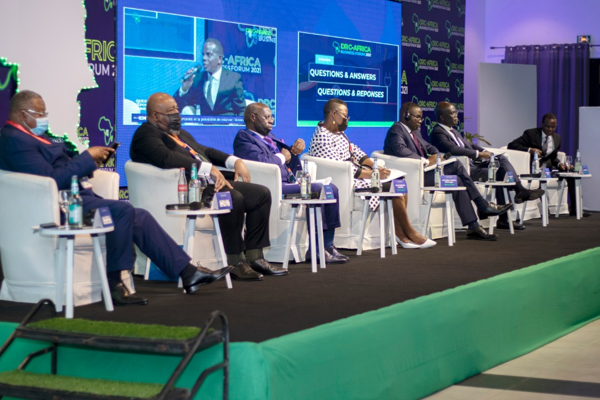
ECA supported the organisation of the DRC-Africa Business Forum on the battery value chain
In November 2021, the government of the Democratic Republic of Congo (DRC) organized in Kinshasa, with the support of the Economic Commission for Africa (ECA) and other partners (Afreximbank, AFC, the AfDB, BADEA and the United Nations Global Compact) the DRC-Africa Business Forum on the theme “Fostering the development of a battery, electric vehicle and renewable energy industry value chain and market in Africa”.
During the opening ceremony, BloombergNEF presented the results of a study demonstrating the potential competitive advantage of the DRC in the manufacture of battery precursors whose market is estimated at 271 billion US dollars, while that electric vehicle is around US$7 trillion (by 2025).
During this political dialogue, under the high patronage of HE Mr. Felix-Antoine Tshisekedi, President of the DRC, the President of Zambia, HE Mr. Haikinde Hichilema, expressed his willingness to contribute to the development of this industrial project, considering the strategic mineral endowments of the DRC and Zambia

Slide 8
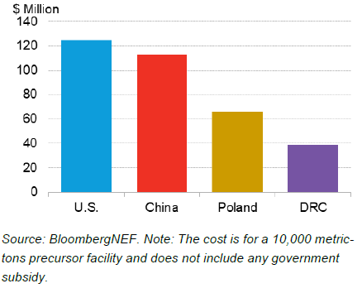
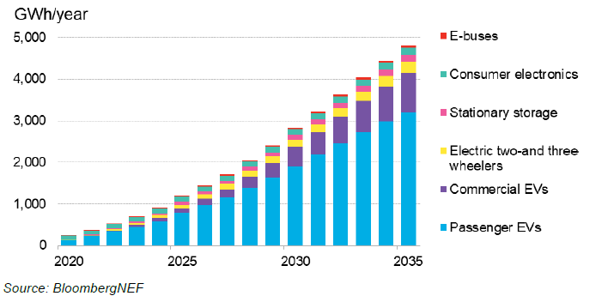
BloombergNEF study reveals DRC comparative advantage for battery precurssors
CA 1 – production costs
Lithium-ion battery demand outlook
NMC 622 cathode chemistry
CA 2 – labour costs
CA 3 – ecological footprint

Slide 9
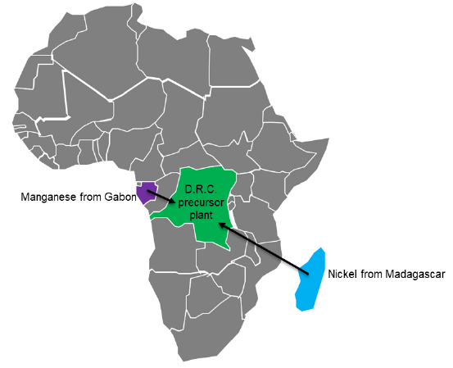
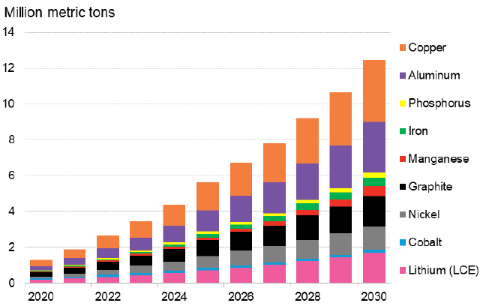
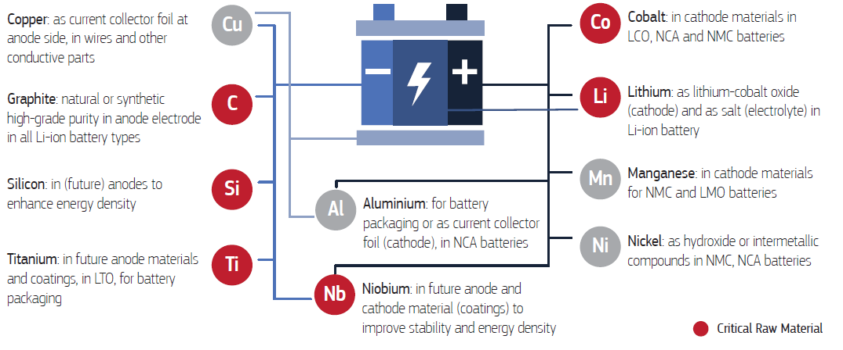
BEV and AfCFTA
Raw materials supply chain
Metals demand from lithium-ion batteries
Cote d’Ivoire, Zambia, Ghana
Source: BloombergNEF, 2021
Source: EU on CRMs, 2020
Notes:
Target markets: Nigeria, Morocco

Slide 10
Resolutions from the DRC-Africa Business Forum

Slide 11
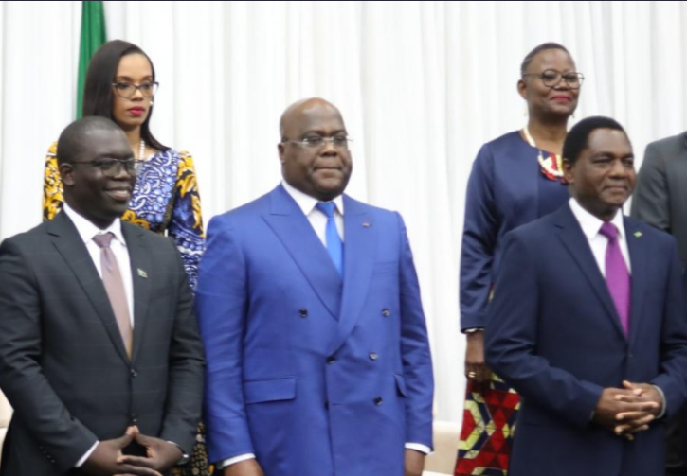
ECA supported the creation of the Centre of Excellence for batteries and the signing of the cooperation agreement between DRC and Zambia
In April 2022, the two countries signed a cooperation agreement in Lusaka, with a view to developing a cross-border Special Economic Zone (SEZ) to house the value chain of batteries and electric vehicles (BEV) and clean energies.
To ensure the success of this initiative, the DRC committed to building the necessary skills for the electric battery industry. With ECA’ support, the African Center of Excellence for Research and Innovation on Batteries (CAEB) was officially launched on April 22, 2022, in Lubumbashi by the Minister of Industry of the DRC. The Minister of Scientific Research signed on April 19, 2022, a ministerial decree establishing the CAEB, which is housed within the polytechnic faculty of the University of Lubumbashi, under the direction of Professor Jean-Marie Kanda.
A round-table was also organized with local financial institutions to gauge their appetite for financing local content and develop innovative financial instruments for local participation in the capital of this project.
In October 2022, a joint mission of ECA SRO-CA and the EU delegation in the DRC visited Haut-Katanga and Lualaba to assess vocational and technical training. Both two institutions agreed to support the development of professional and technical training programs relevant to the BVE sector, in partnership with the CAEB.
Following ECA’s advise, DRC’ head of state established the DRC battery council, with a technical/executive committees composed of ECA, AU, Afreximbank, AfDB, AFC, BADEA.

Slide 12
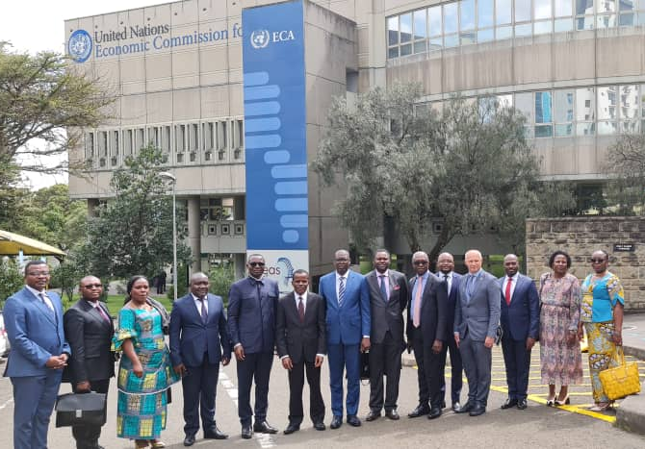
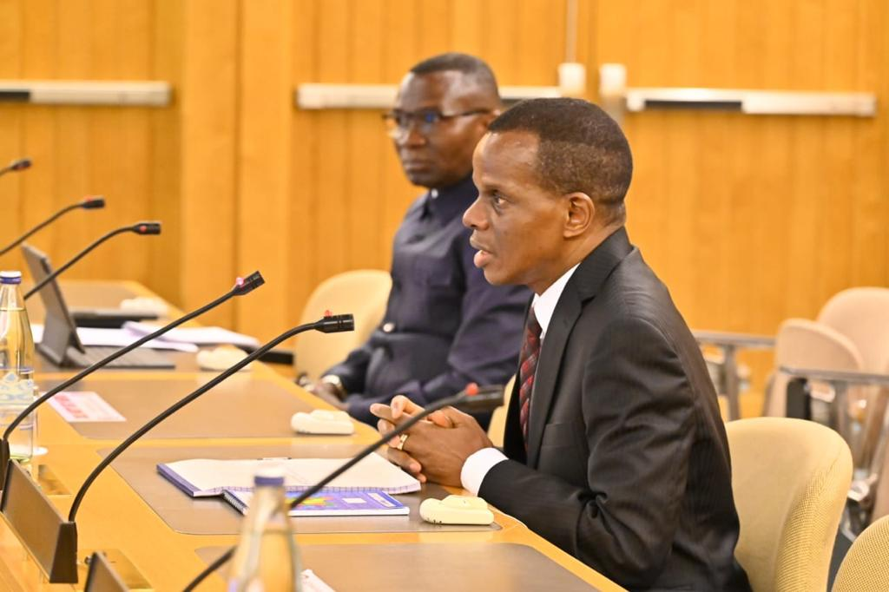
DRC Minister of industry and his delegation visits ECA to discuss the roadmap of the battery initiative
In October 2022, the Congolese delegation led by the Minister of Industry, H.E. Mr. Julien Paluku Kahongya, accompanied by the Governor of Upper Katanga, H.E. Mr. Jacques Kyabula Katwe, had a working session with the ES a.i., Mr. Antonio Pedro. This meeting provided an opportunity to review the battery initiative, in addition to presenting ECA menu of services.
This meeting followed the High Level Panel Discussion on Leveraging Africa’s Battery and Technology Minerals for Development of Battery and Electric Vehicle Value Chains, organized by the AU during the Launch of AMDC Phase II and the 2nd AFRICAN FORUM ON MINING. The panel was moderated by the acting ES, Antonio Pedro; the DRC Minister of industry participated as panelist.
Besides, ECA experts participate also to a parallel session on Building Institutional and Human Capacities required for the energy transition and digitalization, where they presented to the audience ECA’s support in creating the Centre of excellence for batteries in the DRC.
Together with ECA experts, the Minister met with the AU Commissioner of industry and trade to whom he presented the battery project and secure AU support.
Notes:
AMDC: African Minerals Development Center

Slide 13
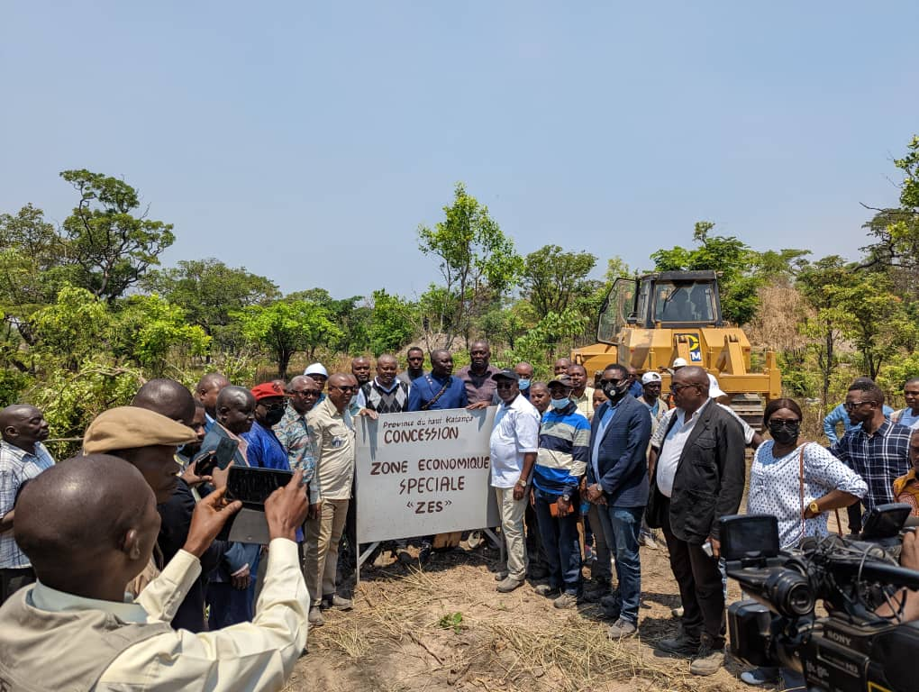
Identification of the space to host the SEZ in the DRC and Zambia
In its efforts to turn ideas into action, ECA has, through its sub-regional office for Central Africa (SRO-CA), intensified its support to the DRC in the establishment of the SEZ of the value of electric batteries.
In addition, ECA organized a dialogue with the Congolese banking sector, with a view to mobilizing national savings to finance the BEV initiative, in particular through special purpose vehicles.
The governor of Haut-Katanga, HE Jacques Kyabula, reserving 2000 ha for the BEV SEZ

Slide 14
Advocacy and promotion of the battery initiative
August, 2022, Kinshasa, DRC: Panel at the 6th Annual SADC Industrialization Week
October 2022, Katanga, DRC
ECA mission in the DRC to meet with Governors of Haut-Katanga and Lualaba to promote the BEV initiative
November 2022,
Sharm-al-Sheikh: ECA-Afreximbank side-event with DC-Minister of industry
Niamey, Niger: side-event at AU industrialization week with the DRC Ministry of Industry, Governors of Haut-Lomami and Haut-Katanga.
Seychelles: Meeting of the Committee of Senior Officials and Experts of Central and Easter Africa
February 2023, Addis-Ababa, Ethiopia:
On the margins of the 36 session the AU, the DRC Minister of industry organized a side-event moderated by ECA experts.
After the Africa Business Forum on carbon credit market in Africa, the DRC Deputy Prime Minister of environment had a working session with the acting ES at ECA.
March 2023, Goma, DRC : working dinner on natural resources in the organized by the MONUSCO with members of the UN Security Council

Slide 15
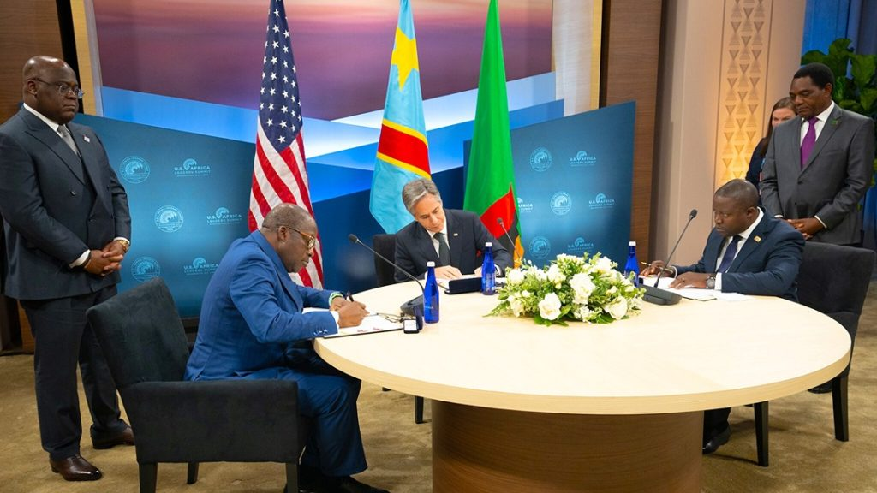
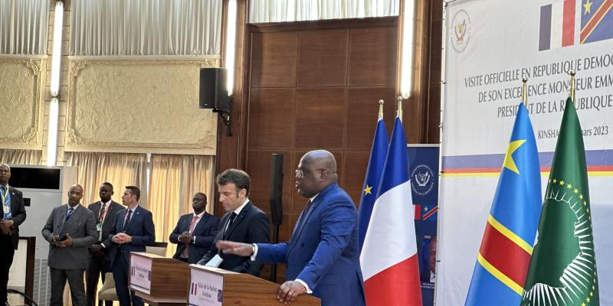
MoUs signed by DRC and Zambia with partners
In December 2022, a U.S.-Zambia-DRC Agreement on EV Batteries Production was signed during the visit of both African heads of state in the US.
In March 2023, President Macron from France visited the DRC; during his visit, a MoU between the Eu and DRC was signed with some clauses on the development of the battery initiative.

Slide 16
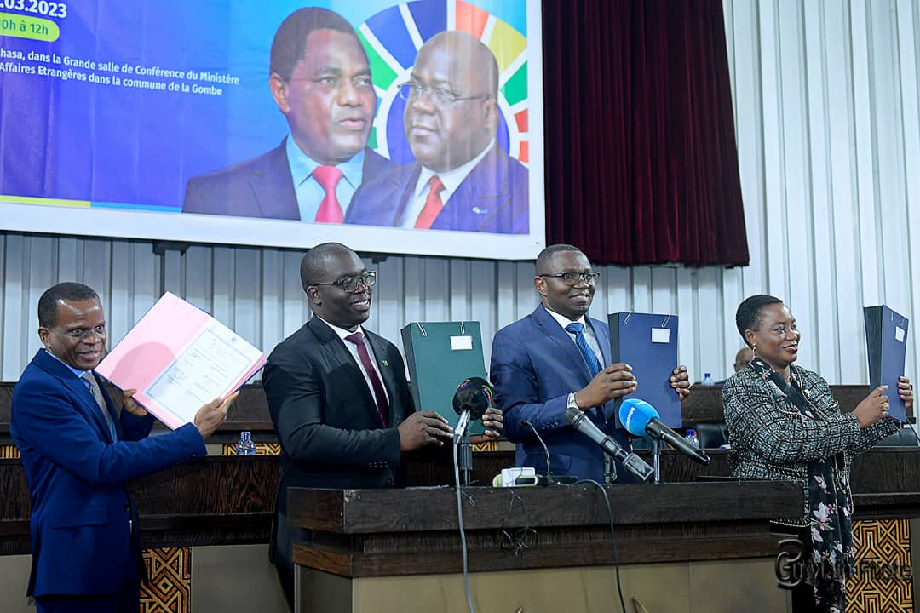
Signing Framework Agreement to establish SEZ for the production of BEVs in DRC and Zambia
On March 2023, signing of the Agreement between DRC, Zambia, ECA and Afreximbank.
Partners of course include also ALSF, AfDB, BADEA.
ARISE Integrate Industrial Platform (ARISE IIP) – a pan-African infrastructure developer was nominated as the selected technical consultant to conduct the pre-feasibility study.
On April 2023, launch of the prefeasibility in DRC and Zambia.

Slide 17
Preparing the ground for local entrepreneurs to benefit from the BEV initiative.
On April 2023, ECA starts engaging some key players to structure the local entrepreneurship to secure their participation into the development of the SEZ.
FOGEC expressed its willingness to support local entrepreneurs.

Slide 18
Policy dialogues
Presentation of the BEV initiative to Parliamentarians of the Grand Katanga space (June 2023).
Consultations with the financial sector and business associations on Promoting local content and financing in the DRC’s Battery Special Economic Zone (SEZ) (June 2023).

Slide 19
Way forward
Forum of the ‘Grand Katanga’ space on the theme ‘developing an interprovincial value chain of strategic minerals and the electric battery industry in Grand Katanga’ (June 2023).
Prefeasibility study to be completed in September 2023.
RDC-Africa Business Forum II: Developing the battery and electric vehicle transboundary special economic zone between DRC and Zambia (November 2023).
Global African Business Initiative (GABI)

Slide 20
THANK YOU!

