Slide 1
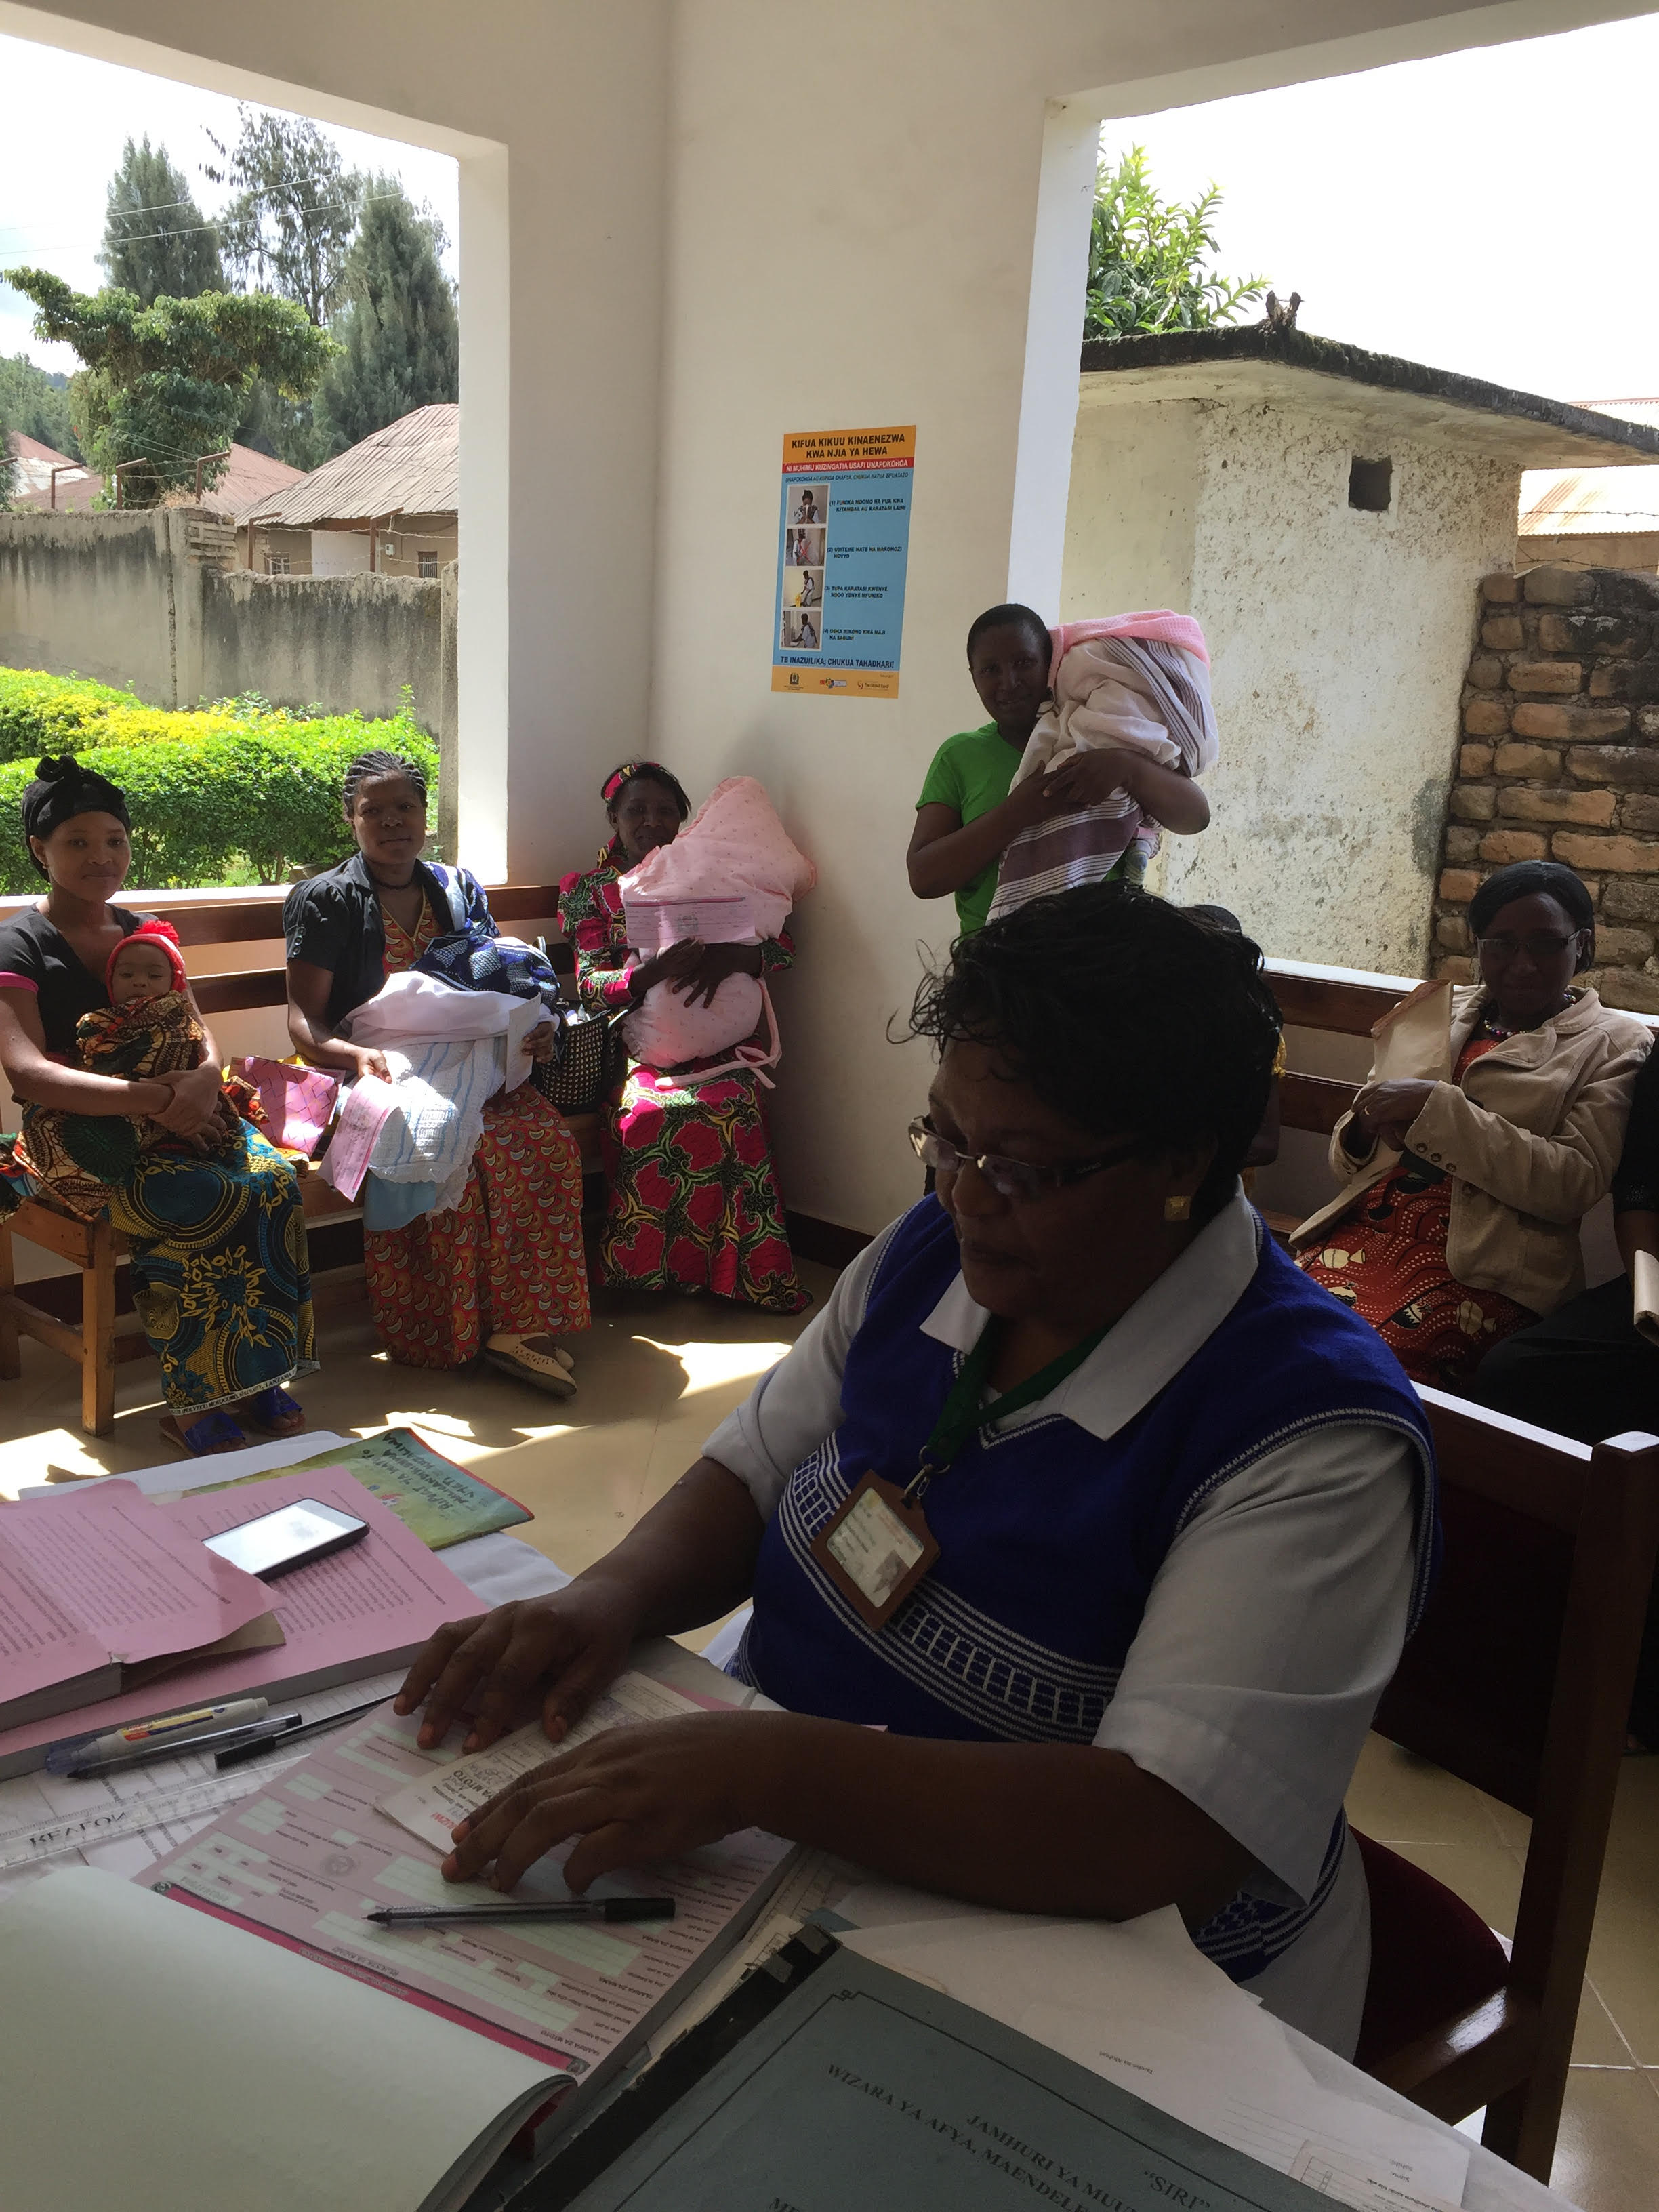
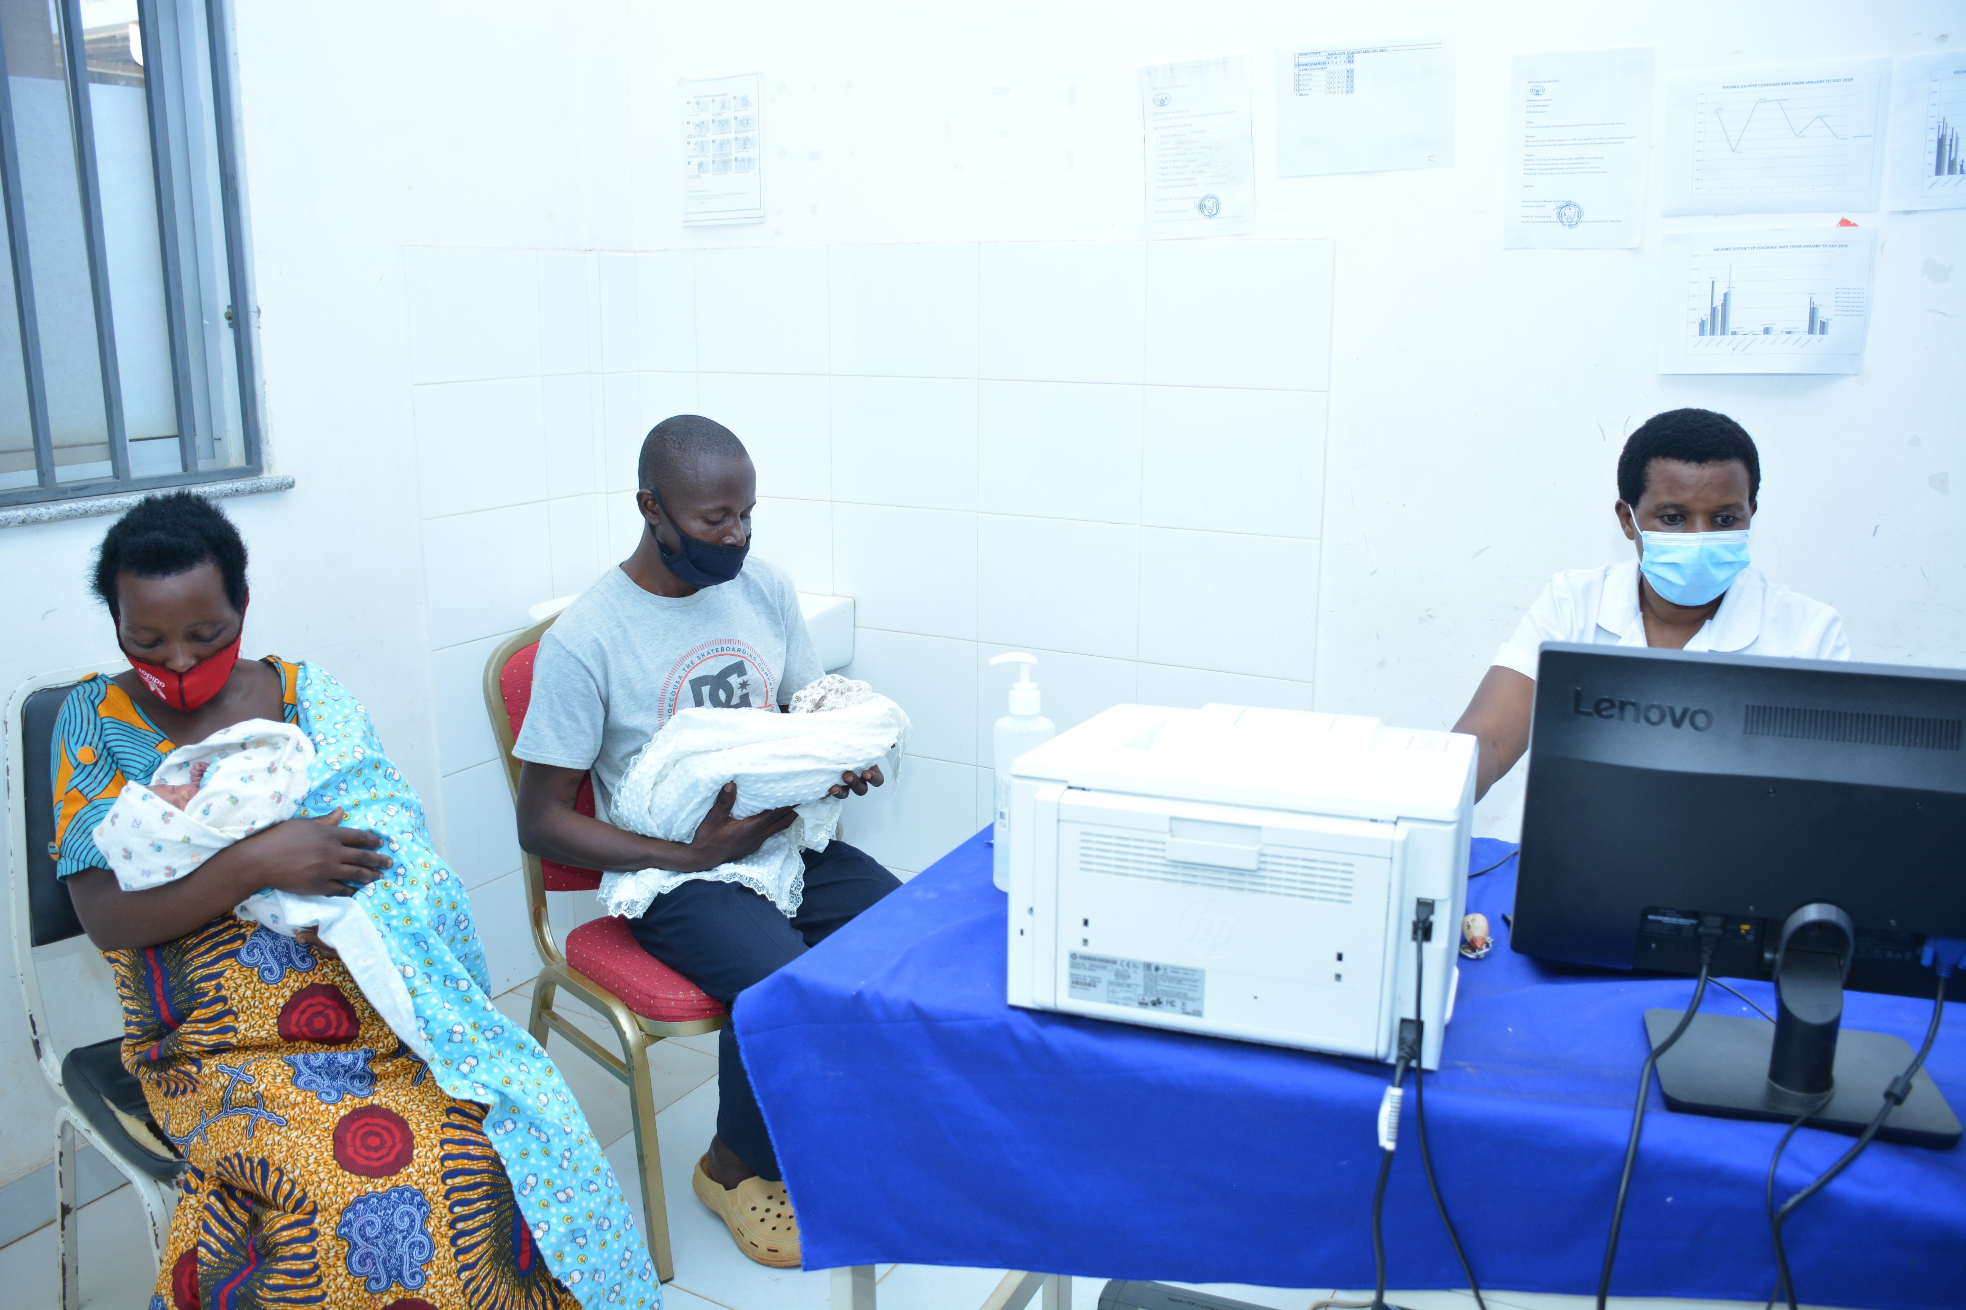
Engaging the health sector in building efficient civil registration and vital statistics systems

Slide 2
Engaging the health sector for CRVS strengthening
Why it’s important to link CRVS services with health service
Why strong CRVS systems is important for the health sector
The health sector is already responsible for the notification of births and death occurring in health facilities, and certification of causes of death.
High coverage of child health services; and globally about 40% of deaths occur in health facilities.
Health structures at community level are in place for events occurring at home.
Health sector typically has a more decentralized structure than Civil Registration Authorities.
Health officials are close to, and are trusted, by the communities they serve, and can validate the occurrence of a birth.
There is potential for interoperability between the CRVS and the health information systems.
Can be linked to existing systems (MPDSR, registers of notifiable, diseases, mortuary records, medical records).
Medical certification of causes of death responsibility of health officials.
CRVS system provide routine and disaggregated data to monitor health outcomes (e.g., MMR, U5MR, NNMR, ABR)
Data are available at national and subnational levels, critical for government planning and policy-making.
Improve service delivery (identification of individuals for social services, e.g., to health services; unique ID numbers for interoperability of systems and enrolment in health insurance)

