Slide 1
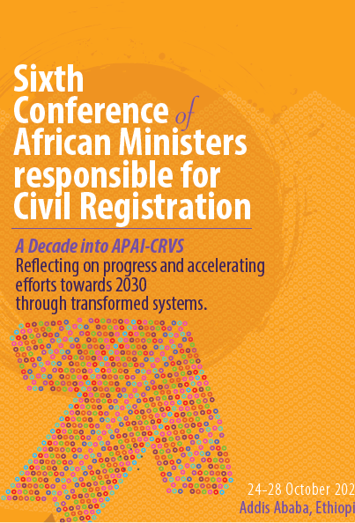
Best practices and strategies for accelerated progress in death registration-Kenya Experience
By: Janet Mucheru, MBS,MKIM
Registrar General
Civil Registration Services
Kenya

Slide 2
Outline
Background
Death Registration in Kenya
Challenges
Lessons learned
Recommended Best Practices

Slide 3
Background
The Civil Registration Services (CRS) Department in Kenya is under the Ministry of Interior & Coordination of National Government.
The department derives its mandate from:
The Constitution of Kenya 2010 Chapter 3 on Citizenship, Article 53 (1) on the rights of a child
The Births and Deaths Registration Act CAP 149
The legitimacy Act Cap 145
Other related statutes, eg, the Children's Act
Core Functions
Registration of all Births & Deaths occurring in Kenya and of Kenya Citizens occurring abroad
Custody, Security and Preservation of Births and Deaths records created through registration
Issuance of Births and Deaths Certificates
Analysis and dissemination of Vital Statistics from registered events.
Mandated to register births and deaths occurring in Kenya and of Kenyans occurring abroad

Slide 4
Purpose of Civil Registration
Civil Registration is carried out primarily for creating legal identity documents for both legal and administrative purposes.
NB: Marriages are under the Attorney General’s office.
Its also a reliable source of vital statistics (VS) which are essential for:
i. understanding of population growth dynamics.
ii. planning and implementing effective social and economic programmes.

Slide 5
Death Registration
In Kenya registration of deaths is done on an agency basis.
Health Facilities
Health personnel register death events using D1 forms
Community
Assistant Chiefs register events using D2 forms

Slide 6
Archival & Dissemination
MoH
IPRS/NPR
KNBS
Dissemination of official Statistics
CRS
Registration & Certification
SUBCOUNTY CIVIL REGISTRATION OFFICE
Registration of Event
Issuance of Certificate
Archival at District Registry
Compilation of Vital Statistics
Forward duplicate record to CRS (HQ)
Notification
Village Elder
Notification of Birth by Assistant Chief
Notification of Birth by Health Facility
Notification of Death by Hospital
Notification of Death by Assistant Chief
Family
Member
Village Elder
CHW
CHW
Family Member

Slide 7
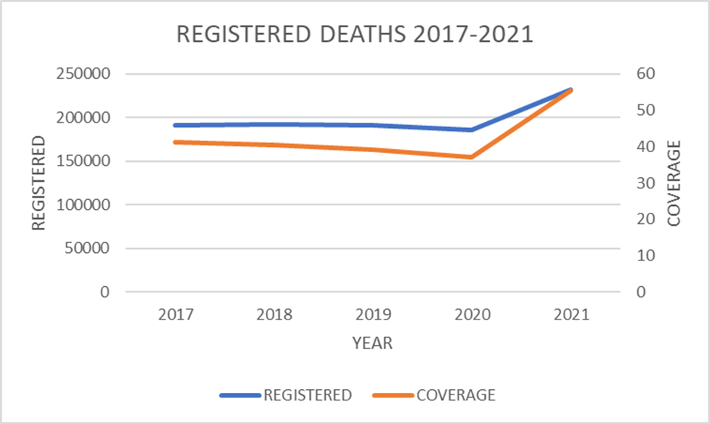
REGISTERED DEATHS 2017-2021
Year | REGISTERED | COVERAGE %
2017 | 190,877 | 41.2
2018 | 192,019 | 40.5
2019 | 191,495 | 39.1
2020 | 185,385 | 37
2021 | 231,944 | 55.4
Death registration coverage has been on a downward trend from 41.2% in 2017 to 37% in 2020 and rose to 55.4 percent in 2021.

Slide 8
Key CRVS Milestones for the last 5 Years
Digitization of 46m Civil Registration and Vital Statistics manual records envisioned to full automation.
Development and roll out of a web-based application; Civil Registration and Vital Statics System (CRVSS) in 8 Counties.
Review of CRVS business process.
Use of online platform for birth and death application in Nairobi.
Formation of a National Technical Working group(CRVS TWG).
Close collaboration Health Sector and National Statistics Office.
Reviewed Strategic Plan 2018-2023.
Review of the current birth and death registration tools.
Development of birth and death registration SOPs and policies.
Trained Registration Agents on data collection.
Introduced a one
day service.
Implementation of Rapid Mortality Surveillance in six counties.

Slide 9
Key Challenges
Manual and paper-based CRS business processes.
Low registration coverage with regional differentials.
Data quality issues especially with Cause of deaths.
Inadequate resources; human and financial.
Social barriers: Cultural, religious and community values.
Low demand and appreciation of the value of vital statistics.
Inadequate ICT network coverage countrywide to enable the use of a computerized system across the entire country.
Inadequate capacity for certification of causes of deaths.

Slide 10
Recommended Best Practices
Full end-to-end automation of civil registration services.
Generation of regular Vital Statistics report (i.e. Annual).
Lobby for Increase resources (HR & Funding).
Strong collaboration with health sector.
Improving death notification and cause of death certification in health facilities.
Improve death notification and their probable causes at community level.
Advocacy and awareness campaigns for Civil Registration.
High Political goodwill.
Conducting mobile registration in marginalized and hard to reach areas.
Use of short message alerts for appointments with clients to collect their certificates.
Conducting hospital audits and monitoring across the country.

