Slide 1
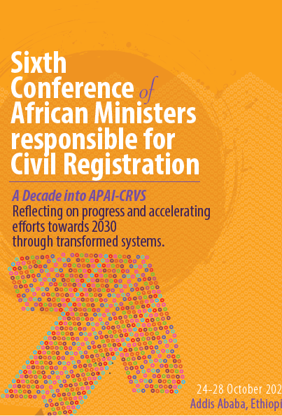
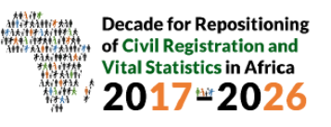
Experiences in implementing the UN Legal Identity Agenda in Kenya
By: Janet Mucheru,MBS,MKIM
Registrar General
Civil Registration Services
Kenya

Slide 2
Experiences in implementing the UN Legal Identity Agenda in Kenya
Government of Kenya & United Nations

Slide 3
Outline
Background - Civil Registration, Vital Statistics
Background- UN LIA in Kenya
GoK & UN LIA Joint Implementation Achievements
Lessons learned

Slide 4
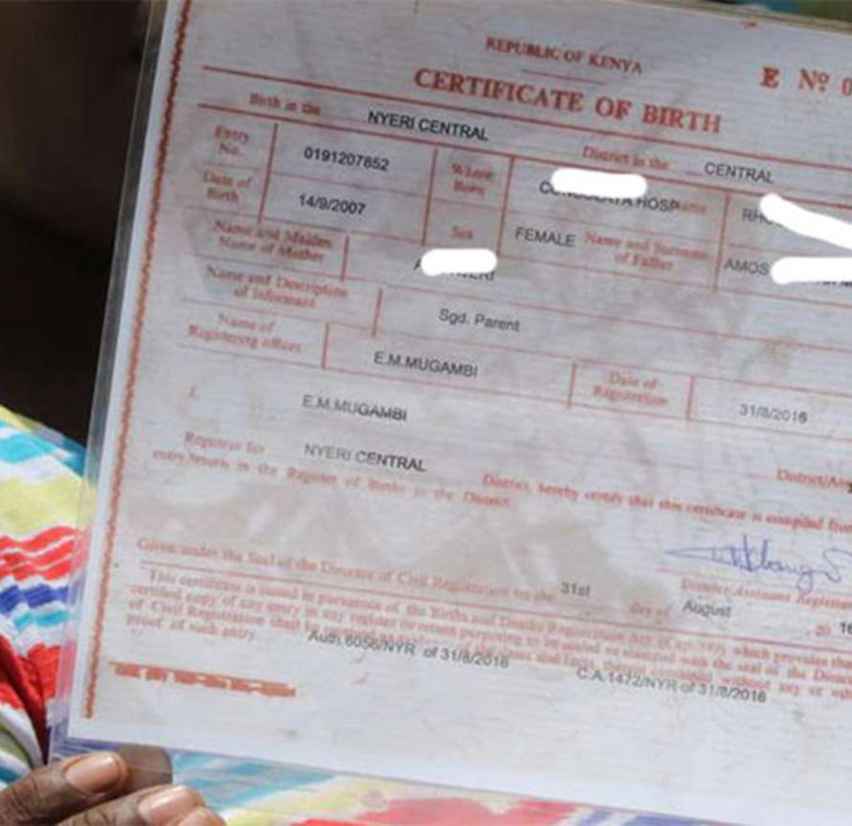
Background-Civil Registration, Vital Statistics in Kenya
Registration of births and deaths was introduced in Kenya in 1904. At that time, registration of births and deaths only applied to Europeans and Americans. In 1928, the Births and Deaths Act was enacted and provided only for the registration of Europeans, Americans and Asians resident in Kenya. Registration for Births and deaths for Kenyans was started after independence in 1963. At the onset, registration was manual.
Currently, 46 million records were digitized in readiness for full automation.
The Service has availability of web-based application for birth and death registration in 8 out of 47 counties.
CRS analysis and disseminates vital statistics annually since 2013.

Slide 5
Background-Civil Registration, Vital Statistics in Kenya Contd.
Legal Provisions
The Constitution of Kenya;
The Births and Deaths Registration Act (Cap 149);
Civil Registration Services also administers part of the Legitimacy Act;
Civil Registration Services operates under some provisions of the Children’s Act 2022;
Other legal frameworks include the Data Protection Act, 2019, Evidence Act cap 80, Criminal Procedure Act cap 75, Kenya Citizens and Foreign Nationals Management Act, the Public Health Act, and the Registration of Persons Act cap 107.

Slide 6
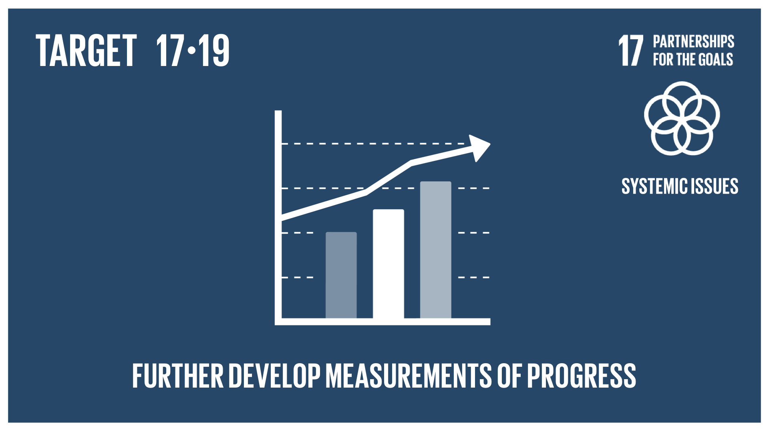
Background- UN Legal Identity Agenda
The UN promotes conferment of Legal identity for all from birth.
Inspired by the Secretary-General's determination to tackle the global problem of statelessness.
The UN Legal Identity Agenda Taskforce was established from September 2018 to operationalize the decision of the Executive Committee.
The UN Legal Identity Expert Group, also established in 2018, is tasked with developing instruments, and supporting efforts to strengthen coordination of the UN response to the issue of legal identity.
The goal is to support Member States to achieve target 16.9 of the SDGs.
UNECA.ORG
Notes:
NOTES;
Its starts with a birth certificate:
Well-functioning Civil Registration and Vital Statistics Systems, birth registration is essential to fulfill the promise to Leave No One Behind, and deliver on the 2030 Agenda
Eliminating Invisibility
Its efforts focus on closing the global identity gap with a benchmark goal of ‘more than 300 million by 2025 and, in turn, providing Member States with the vital statistics and demographic information needed for socio economic gains, better public administration, planning monitoring
Magnitude of the Problem
In Africa, around 95 million children under five have never had their births recorded, and 120 million children do not have a birth certificate.
Delivering the SDGs
civil registration and vital statistics (CRVS) systems are the preferred source of data for the measurement of over 65 of the SDG indicators

Slide 7
Background- UN Legal Identity Agenda in Kenya
In December 2019, UNECA conducted a rapid assessment for Kenya.
The rapid assessment was a check of preparedness to implement an integrated civil registration, vital statistics and identity management system.
The assessment’s highlight was that: Kenya was prepared for the implementation of the UN LIA but needed to improve on four things:
The legal framework;
Interoperability of systems;
Improve on coordination of various actors in identity management and;
Improve on advocacy and communication.
Notes:
Notes:
The work of the UN LIA is anchored within SDG 16.
More specifically; target 16.9 -by 2030 provide legal identity for all including “free” birth registrations
and target 17:19.2 (b) Proportion of countries that have achieved 100 percent birth registration and 80 percent death registration
The implementation is on going under overall leadership of the global UN LIA Taskforce & regional coordination by UNECA.
In Kenya, the UN LIA taskforce coordinates the implementation of planned activities for civil registration strengthening and the legal identity agenda

Slide 8
Background- UN Legal Identity Agenda in Kenya Contd..
Following the assessment in February 2020​, the UN Legal Identity Agenda Task Force was established.
The Taskforce is supporting the Government’s work to strengthen Civil Registration, Vital Statistics and Identity Management.
Notes:
Notes:
The work of the UN LIA is anchored within SDG 16.
More specifically; target 16.9 -by 2030 provide legal identity for all including “free” birth registrations
and target 17:19.2 (b) Proportion of countries that have achieved 100 percent birth registration and 80 percent death registration
The implementation is on going under overall leadership of the global UN LIA Taskforce & regional coordination by UNECA.
In Kenya, the UN LIA taskforce coordinates the implementation of planned activities for civil registration strengthening and the legal identity agenda

Slide 9
UN Legal Identity Agenda Taskforce
Notes:
This slide shows different UN agencies, funds and programmes working alongside the Government

Slide 10
GoK & UN LIA Joint Implementation Achievements
Improve on coordination of various actors in identity management
Development and review of the GoK/ UN LIA framework for joint collaboration.
Quarterly Technical Working Group Meetings with CRVS stakeholders.
Review of the Civil Registration Services Strategic Plan.
Annual national civil registration forum.

Slide 11
GoK & UN LIA Joint Implementation Achievements Contd.
The legal framework
Development of the Huduma Bill 2021 and joint legal commentary.
Sensitization on special populations (stateless persons, populations on the move) for inclusion into the Bill.

Slide 12
GoK & UN LIA Joint Implementation Achievements Contd.
Interoperability of systems
Purchase and distribution of equipment for on-going automation of the Civil Registration and Vital Statistics Systems.
Development of Standard Operation Procedures for Civil Registration and Vital Statistics.
Review of business processes for Civil Registration, Vital Statistics and Identity management.

Slide 13
GoK & UN LIA Joint Implementation Achievements Contd.
Improve on advocacy and communication
Knowledge, Attitudes and Practice study on Birth and Death Registration.
Gap assessment on birth registration for children in statutory and charitable institutions.
Conduct of a Rapid Mortality Surveillance in six counties- in the COVID 19 context.

Slide 14
Lessons learned & Challenges
Legal identity is of critical importance including during emergencies and pandemics.
A complete CRVS system is a critical component of the population register for data, accuracy and reporting.
Emergencies and disasters have a potential long-term impact on the development and performance of CRVS systems hence the need to put in place resilient systems.
During the COVID-19 pandemic, the importance of Civil Registration became apparent as a source of mortality data.
Lack of dedicated funding.
Data quality issues especially with cause of deaths.
Social barriers: Cultural, religious and community values.

