Slide 1
PROGRESS MADE PURSUANT TO THE FIFTH MINISTERIAL CONFERENCE DECLARATIONS
William Muhwava
UNECA

Slide 2
Introduction
Since the first session of the African Ministers' Conference on Civil Registration in 2010, African countries have embarked on a remarkable journey to improve their CRVS Systems.
The Conference was established as a statutory organ of the African Union Commission to report to the Assembly of Heads of State and Government of the African Union every two years on progress made in civil registration.
Five sessions of the Conference have been held so far, in 2010, 2012, 2015, 2017 and 2019.
The expert group meeting is held within the framework of the COM to discuss in detail technical issues to address the challenges and leverage opportunities for improving CRVS on the African continent. The recommendations feed into the ministerial meetings to set policy guidelines.
The APAI-CRVS Secretariat is responsible for the day-to-day coordination of technical assistance to countries to implement the recommendations.
Forty-one recommendations were made at the EGM-COM5. Where are we in the implementation of these recommendations? We present a detailed analysis of country feedback and responses from CRVS core group members on the implementation of the recommendations.
All recommendations are structured around seven themes that need to be prioritised for countries.

Slide 3
Improving legislative and regulatory frameworks
Period during which laws were enacted | Countries
After 2010 | Angola, Cameroon, Cabo Verde, Chad, Côte d’Ivoire, Democratic Republic of the Congo, Eritrea, Ethiopia, Ghana, Guinea, Kenya, Mauritania, Mozambique, Niger, Rwanda and Sudan
Between 1990 and 2009 | Benin, Burundi, Central African Republic, Comoros, Djibouti, Egypt, Gambia, Malawi, Mali, Morocco, Nigeria, Sao Tome and Principe, Seychelles, South Africa, United Republic of Tanzania, Togo, Zambia and Zimbabwe
Before 1989 | Algeria, Botswana, Burkina Faso, Congo, Equatorial Guinea, Eswatini, Gabon, Guinea-Bissau, Lesotho, Liberia, Libya, Madagascar, Mauritius, Namibia, Senegal, Sierra Leone, Tunisia and Uganda

Slide 4
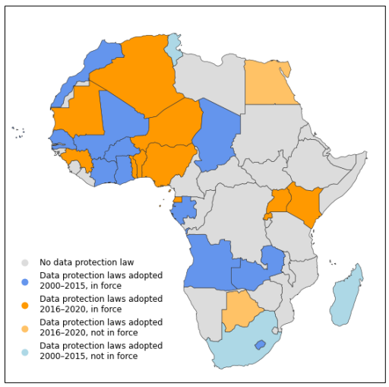
The Landscape of Data Protection Laws in Africa by June 2021

Slide 5
Percentage of countries using ICT in civil registration and vital statistics

Slide 6
Strengthening the national coordination mechanism & Development of national plans
Of the 25 countries that responded to the questions in the 2021 survey on the establishment of a functional coordination committee, only 10 (40 per cent) reported having such a committee.
74% of countries have developed costed plans to improve their systems. Three countries (5%) have started to develop plans, while in 11 countries (20%) plans have not been developed or their status is unknown. In only 8 countries (14%) a full assessment has not been carried out or the status of the assessment was unknown.

Slide 7
Perception of countries regarding the provision of support to strengthen CRVS

Slide 8
Status of implementation of the recommendations, by country

Slide 9
Formalization of the committee of African Registrars General & the CRVS Regional Core Group
Efforts were also made by the African Union Commission to foster the institutionalization of the committee of African Registrars General within its relevant frameworks;
The establishment of the regional core group is being formalized through a memorandum of understanding that will ensure a more sustainable engagement of partners in the implementation of the Africa Programme on Accelerated Improvement of Civil Registration and Vital Statistics Systems

Slide 10
Other Initiatives Implemented
The United Nations Legal Identity Agenda (In 13 countries)
The CRVS Mentorship programme (In 14 countries)
Annual commemoration of the African Day of Civil Registration and Vital Statistics on 10 August (The commemoration is an opportunity to raise awareness about the importance of civil registration across population groups.
Efforts to mitigate the impact of the COVID-19 pandemic (Assessments of the impact of the pandemic on civil registration operations and technical guidance on maintaining CRVS programmes during the pandemic, Webinars)
Promoting the sharing of knowledge (website that provides a platform for the sharing and exchange of knowledge products and information on CRVS).
Establishment of a CRVS improvement monitoring framework (The APAI-CRVS secretariat developed a framework to document and monitor the progress made.
Other resources developed for countries (See the issue paper online)

Slide 11
Overall status of implementation of the recommendations

