Slide 1
Sixth Conference of African Ministers Responsible for Civil Registration Sixth session Addis Ababa, 24–28 October 2022 Item 2 of the provisional agenda for the expert segment* Election of the Bureau and adoption of the agenda and programme of work
APAI-CRVS 5-year Strategic Plan: 2023-2027
William Muhwava, Chief DSSB/ECA
Yacob Zewoldi, Senior Adviser, APAI-CRVS

Slide 2
Scope of CRVS in Africa
To facilitate the establishment of the vital events registration system, priority is assigned to selected vital events.
The international recommendation for high priority vital events to be recorded, which is also endorsed by African Ministers Responsible for Civil Registration are live births, marriages, divorces and deaths.
The strategy and action plan is developed around these four vital events.
Notes:
Not every country records all vital events recommended by the UN, although it remains the eventual goal.
To facilitate the establishment of the vital events registration system, priority is assigned to selected vital events. The international recommendation for high priority vital events to be recorded is live births, marriages, divorces and deaths (UN, 2014). The African Ministers Responsible for Civil Registration have also recommended the recording of the four events. In line with these recommendations, the scope of the civil registration and vital statistics improvement process is set to deal with live births, marriages, divorces and deaths.

Slide 3
Guiding principles of APAI-CRVS
APAI-CRVS guiding principles
Country ownership & leadership
Phased, holistic & integrated approaches
International best practices
Coordinated approaches & partnership
Strengthened capacities
Innovation, research & knowledge sharing
Use of register-based vital statistics
Notes:
The plan, while keeping in view country contexts, is anchored to the identified guiding principles, with additional points that need consideration to bring about a viable civil registration and vital statistics system in member States, namely: (i) Promoting country ownership and leadership; (ii) Promoting coordinated approaches and partnership at the regional and country level; (iii) Promoting phased, holistic and integrated approaches; (iv) Stimulating strengthened capacities of national and regional CRVS institutions; (v) Promoting innovation, research and knowledge sharing; (vi) Encouraging the use of register-based vital statistics for evidence-based policy making; and (vii) Bringing international best practices to Africa.

Slide 4
The purpose of the strategy and action plan
The strategy and action plan identifies pillars of change or strategic outcomes that would bring accelerated improvement in CRVS systems in the next five years, from 2023 to 2027.
The period overlaps with the second half of the African CRVS Decade, covering 2015 to 2024, launched with the goal of “leaving no child out” and “no country behind” in the effort to register all births and vital events in Africa.
The strategy and action plan addresses the questions: Where are we now with respect to the on-going CRVS improvement initiative? Where do we want to be by 2027, taking into consideration the targets set by SDGs for 2030? and How are we getting there?

Slide 5
Current environment: Where are we now?
Where do we want to be in 5 years?
Consultative meetings:
Registrars General’s meeting Kigali, Rwanda in Nov 2021; and
Core Group Meeting in Brazzaville, Congo in June 2022.
Questionnaires completed by countries (39) and Core Group members (11)
Desk research
S
W
T
O
Notes:
Analysis of the current environment indicates where the ongoing CRVS improvement initiative is now. This step is essential in providing the evidence base from available sources and knowledge to inform the development of the strategy. It builds on the achievements of the Medium-Term Plan of 2010 to 2015 and the APAI-CRVS Costed Strategy and action plan 2017-2021. It provides an assessment of the present environment in which it operates by examining the strengths and weaknesses of the programme and the opportunities and threats in the external environment. The plan is based on consultative processes and through a survey conducted by the APAI-CRVS Secretariat in July and August 2022 involving Registrars General from 32 African countries and the Africa CRVS Core Group. Information was also collected through desk review that looked at achievements and major weaknesses identified by those countries that have conducted comprehensive assessments in the last five years.

Slide 6
Strategic direction for the improvement of CRVS in Africa
Vision: Everyone visible in Africa !!!
Mission: To be the foundation for the acquisition of legal identity for all from birth in order to ensure the realization of universal basic human and civil rights; improved service delivery through interoperable systems; and provide solid basis for informed evidence-based planning and decisions through an efficient and complete civil registration and vital statistics system.
Notes:
5.1 Strategic direction
The strategic direction is cast by stating a vision and mission for the desired CRVS system in all African countries. This envisioning process is an essential element of strategic planning because it establishes the direction of and the means for growth of APAI-CRVS and CRVS system of each country.
Vision: The vision that will guide all actions and activities related to civil registration functions in Africa is:
…
The vision statement presents the main goal of the CRVS system, by taking cognizance of the current state of the system and indicating the direction where the system should be in the future. “Everyone visible in Africa” implies that the events identified within the scope of the registration activities will be recorded as they occur in all countries, in line with the “leave no one behind” principle. It addresses the sad state of invisibility of millions of Africans to their own governments, and at the same time guaranteeing that the legal requirements of citizens are met and quality vital statistics, including information on causes-of-death, produced regularly and on time.
Mission: The mission statement of the African CRVS Decade strategic plan is:
The mission statement defines the fundamental purpose of the CRVS system, describing why it should exist and what has to be done to achieve the vision of the system. It summarizes the core business of APAI-CRVS and national, regional and international stakeholders and the public. The mission statement is meant to express the core desire of transforming the prevalent ad hoc and uneven way of organising civil registration to a holistic and comprehensive systemised organization. It echoes the notion that these key stakeholders are in agreement on what the strategy should achieve.

Slide 7
Strategic outcomes
Strategic Outcome 1: Foundation for the acquisition of legal l rights, privileges and identity for all
Goal statement: By 2027 at least 40 African countries would have in place reformed legal framework, aligned to international standards, that provides a firm foundation for comprehensive CRVS and identity systems.
Strategic Outcome 2: Reliable data and vital statistics
Goal statement: By 2027, quality and timely registration-based vital statistics, underpinned by sound statistical methodologies are available and accessible to users for informed planning, monitoring and decision making in at least 40 countries.
Strategic Outcome 3: Improved governance in public administration services
Goal statement: By 2027, CRVS government stakeholders of at least 30 countries are benefiting from sharing of information across robust and interoperable systems whose access is governed by an adequate data protection regulation and framework.
Strategic outcome 4: Modernization of CRVS systems
Goal statement: By 2027, at least 30 countries have enhanced capacity to develop or improve digitization and promote interoperability of CRVS and other related systems at national levels.

Slide 8
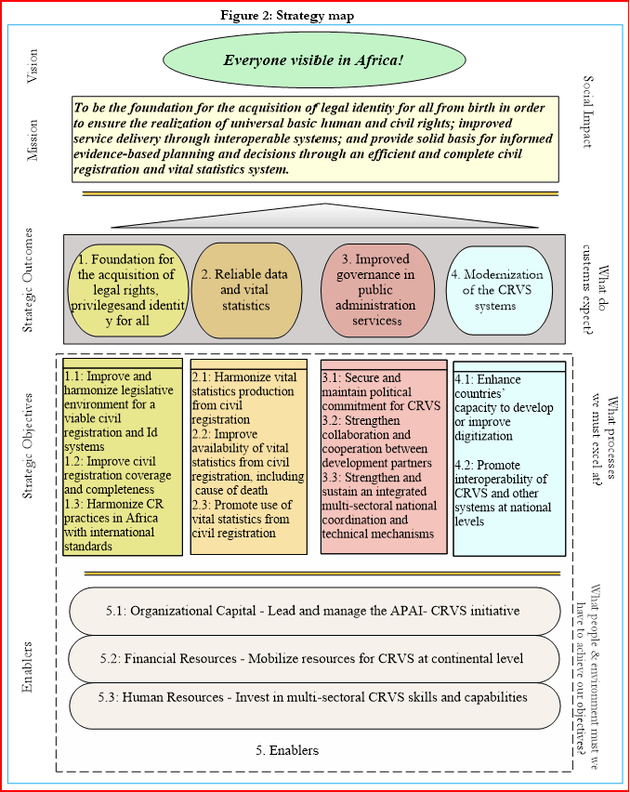
Strategy map
Notes:
The strategy formulation is about how we are going to get there. This section presents the strategic map of the plan and then links the identified strategic objectives with a series of activities that are necessary to achieve them. The strategy map is a graphical representation of what needs to be done in each of the four scorecard perspectives in order to effectively execute the identified strategies. The Strategy Map gives an overview of how key stakeholders aim to achieve the desired vision. It shows the chain of causes and effects that would lead to the desired strategic outcomes, which in turn would bring the fulfillment of the desired vision and mission.

Slide 9
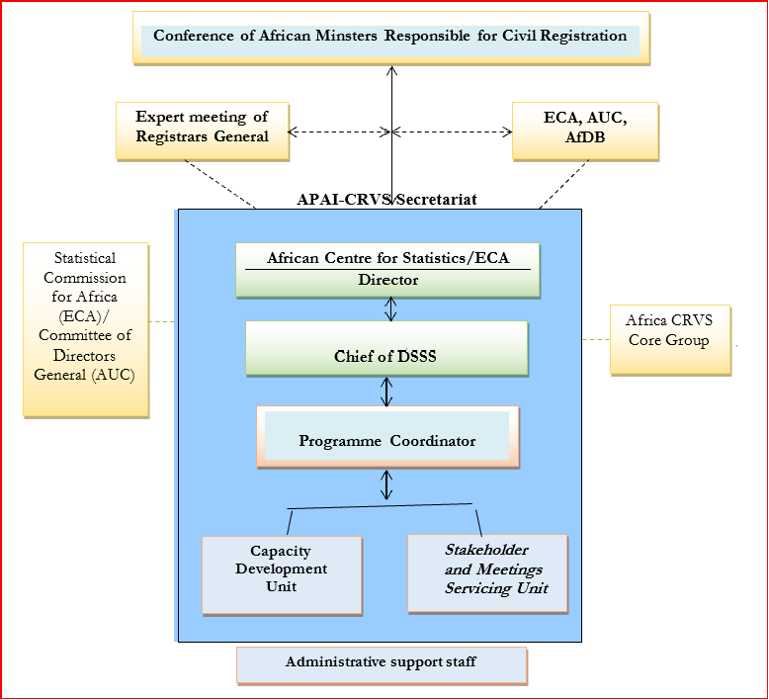
Governance structure for APAI-CRVS Secretariat
Notes:
The Secretariat requires a management and technical structure that would facilitate the strategic shift required to drive the desired change in the registration of vital events and the supply of the much-needed vital statistics to inform decisions in the countries and at continental level. This calls for revisiting the existing APAI-CRVS structure and staffing conditions.
It is worth noting that the Secretariat is not well structured and adequately staffed to undertake the expanded responsibilities and heavy scaled-up activities recommended by the Conference of Ministers and the activities proposed in this document. The identified strategic outcomes and objectives require a revamped organizational structure to advance the CRVS agenda in Africa.
The proposed revised structure, as shown in Figure 3, has two units with an outline of the functions for each of them. The Secretariat will continue to operate from the African Centre for Statistics (ACS) in ECA. It will be managed by the Chief of the Demographic and Social Statistics Section of ACS. The manager reports to the Director of ACS and the CRVS Africa Core Group. The Secretariat will work closely, through the Director of ACS, with the proposed Committee of Registrar Generals.

Slide 10
Thank you

