Slide 1
Towards Universal Legal Identity:
Presentation on Experiences in Implementing the UN Legal Identity Agenda for Migrants and Vulnerable Mobile Populations in Cameroon
Addis Ababa, Ethiopia| 27 October
IOM Cameroon Chief of Mission, Mr Abdel Diop
and Representative of the Cameroonian Government

Slide 2
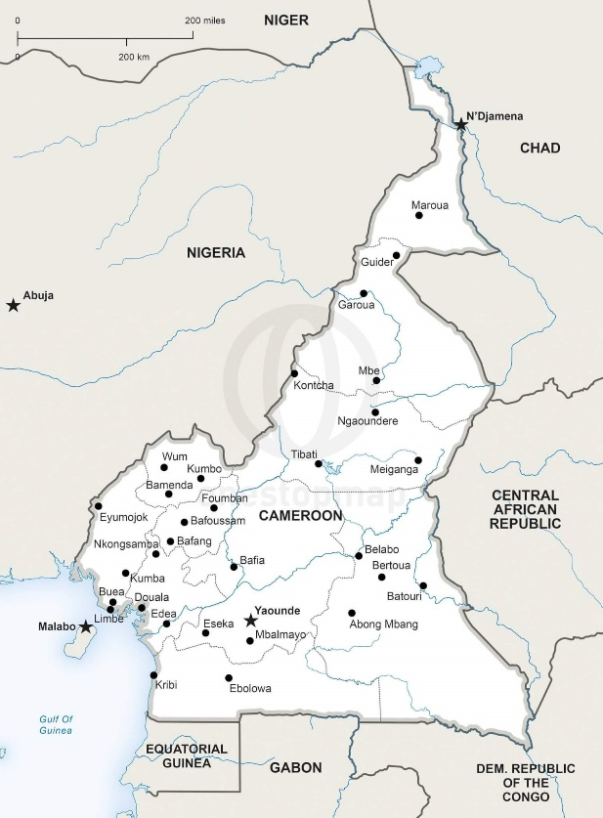
CAMEROON CONTEXT
Socio-political crisis with secessionist demands in the North-West and South-West regions
731,138 displaced populations
  347,542 IDPs
  383,596 Returnees
Security crisis linked to armed groups designated as terrorist organisations in the Far-North region
544,885 displaced persons
  357,631 IDPs
  135,257 Returnees
  51,997 out-of-camp refugees
Refugee crisis from neighbouring Central African Republic in East region
- Over 300,000 Refugees
Key cities of Douala and Yaounde where large number of urban IDPs are now settling (IOM MSNA 2022 forthcoming)

Slide 3
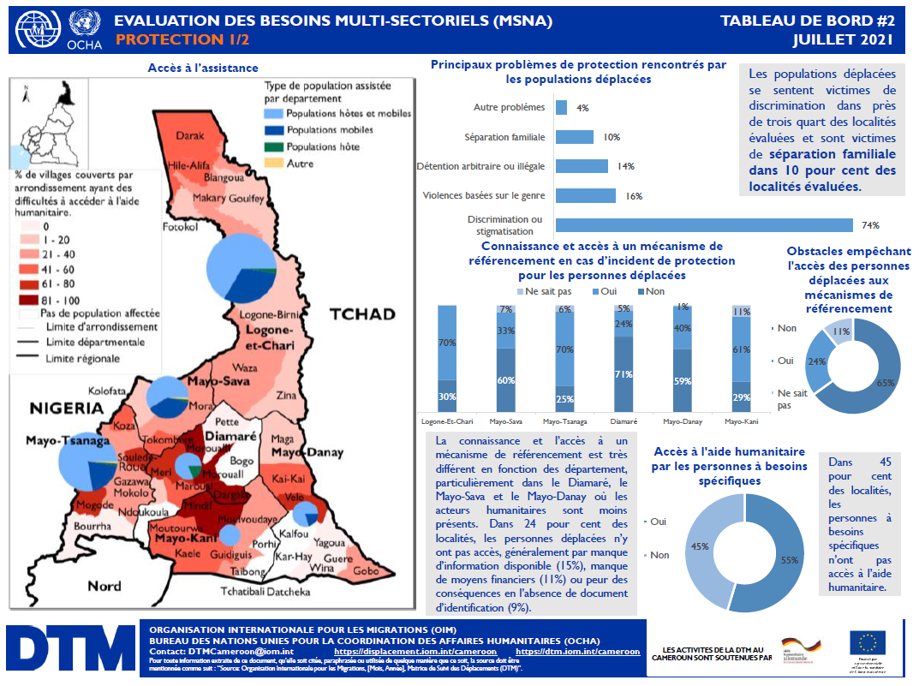

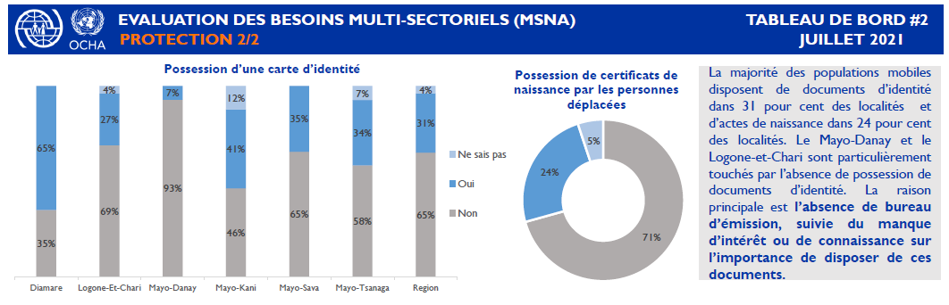
CAMEROON CONTEXT
GCM Objective 1
Data as first element to properly understand needs and identify opportunities

Slide 4
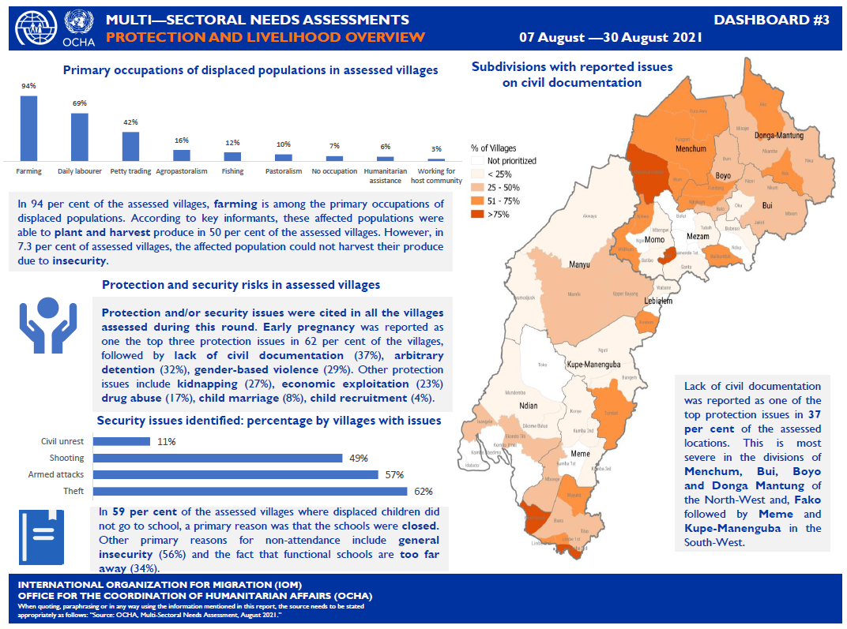
CAMEROON CONTEXT
The MSNA: A powerful tool to identify gaps in legal identity regarding IDPs

Slide 5
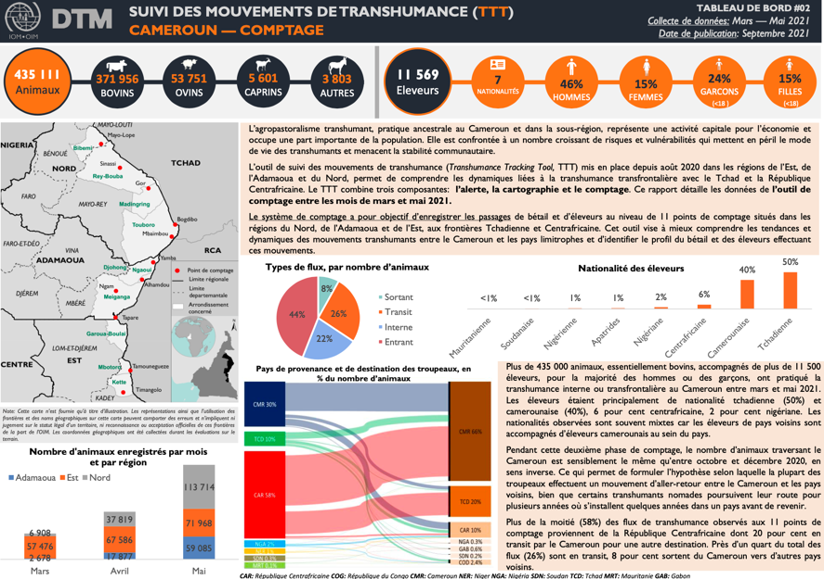
A tool for monitoring transhumance movements, specifically adapted to issues of transhumance and agro-pastoral practices.
Serves to:
Have a general idea of the situation of agro-pastoral flows and conflicts
Provide the information necessary for the implementation of support programs for populations involved in transhumance

Slide 6
CAMEROON CONTEXT
Multiple reasons why vulnerable mobile populations do not have access to their legal identity:
Cultural barriers
Fleeing their areas of origin without their legal identities
Destroying their legal identities to avoid any protection risks
Destruction of state infrastructure during crisis that has destroyed local communal records
Persons born into situations of crisis who are never given a birth certificate
At the local level there are many state actors involved in the civil registration process to work with
MINSANTE
Secondary Centres
Communes
MINDDEVEL
BUNEC
DGSN

Slide 7
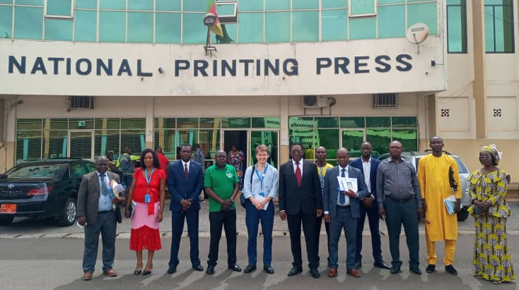
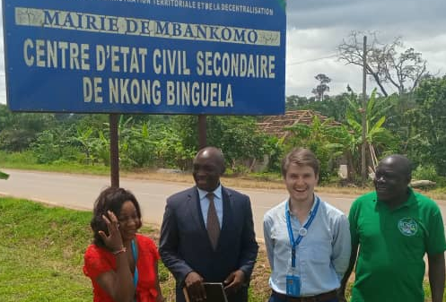
JOINT APPROACH WITH GOVERNMENT FOR PROJECT DESIGN
Consultations with MINDDEVEL, BUNEC, DGSN
Legal Identity Roadshow to Cameroon
Meetings with local Communes with High Level of Urban Based IDPs
Project Design and Launch with

Slide 8
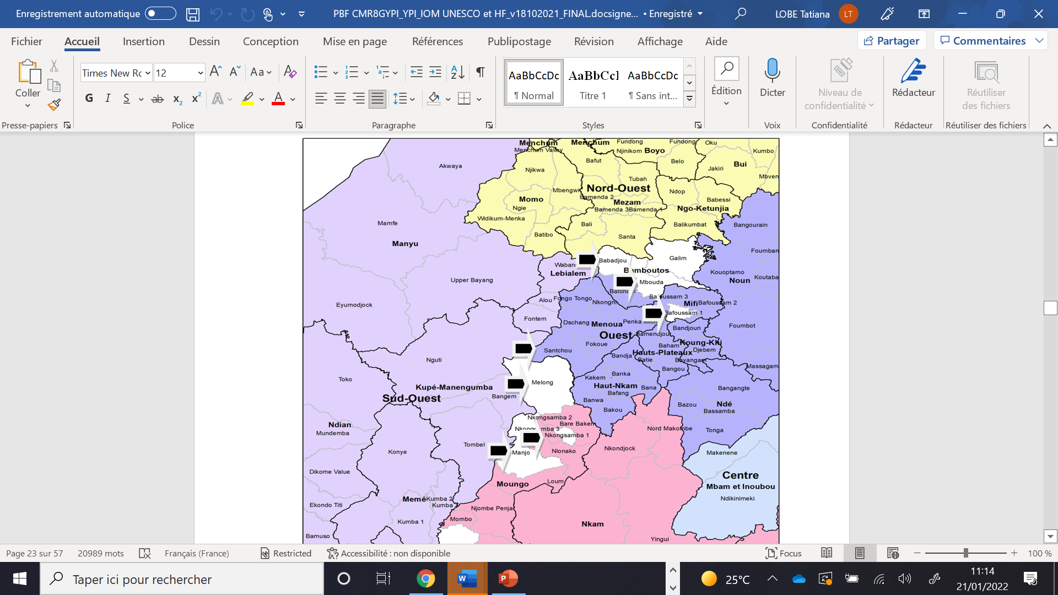
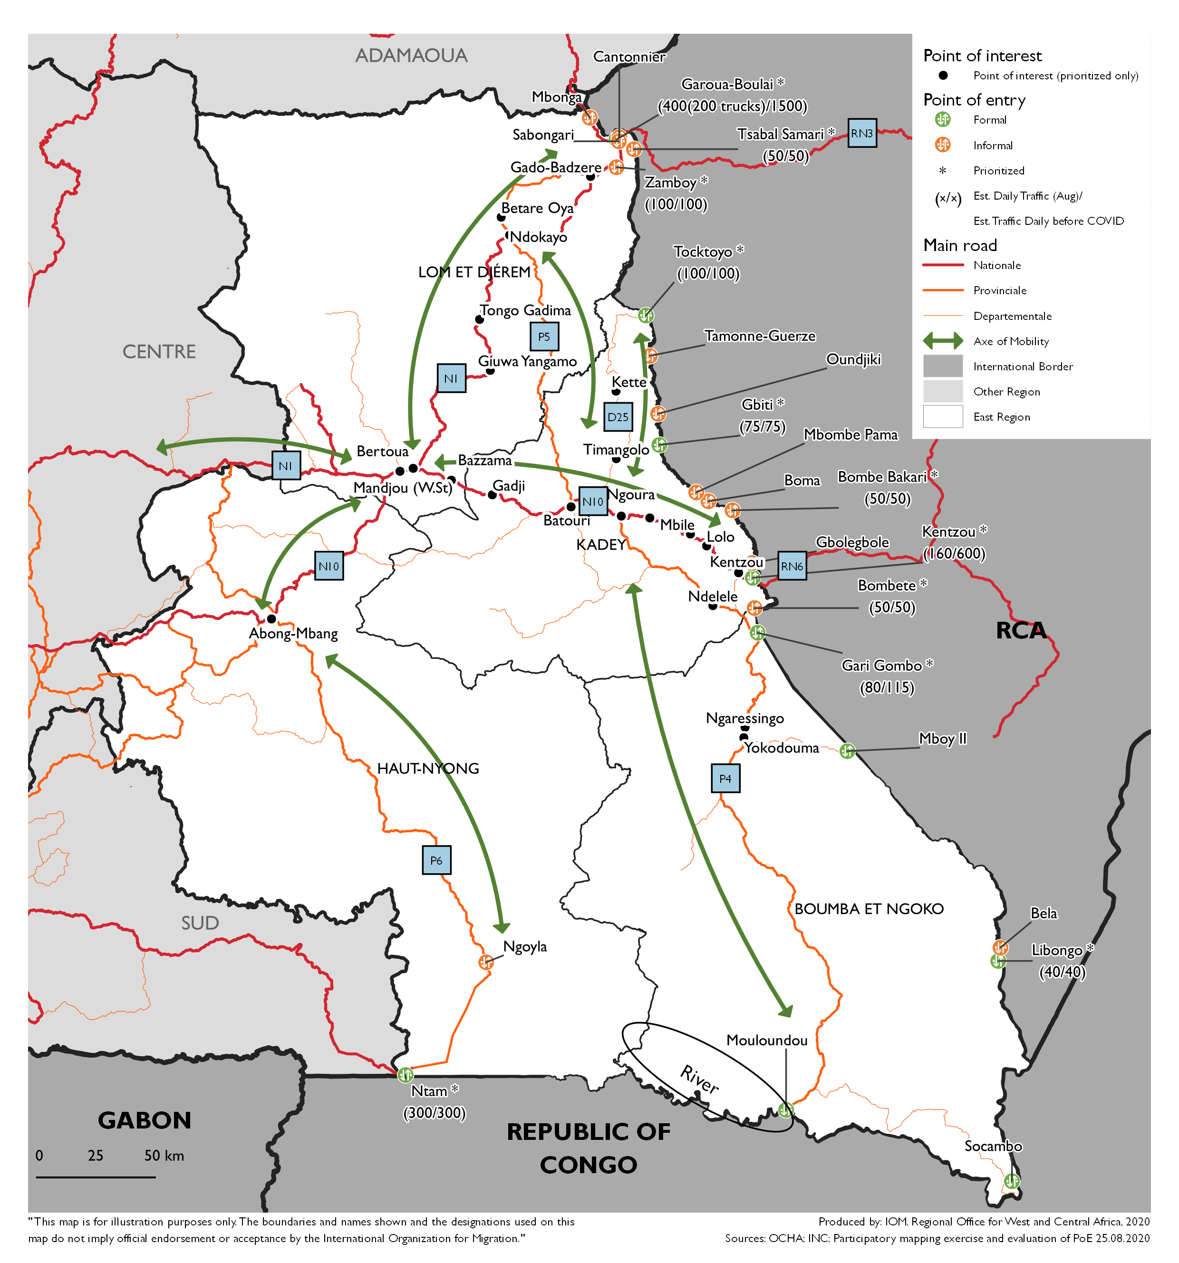
IOM ACTIVITIES FOR A NEW MODEL FOR EAST, CENTRE, LITTORAL AND WEST REGIONS
Establishment of a technical committee composed of IOM and all regional delegation reps. to establish an SOP for active registration for vulnerable mobile populations
Pilot initiative to use direct intervention modalities by IOM for supporting 500+ IDPs and vulnerable mobile populations in Centre and East regions
Usage of pilot model to expand and upscale

Slide 9
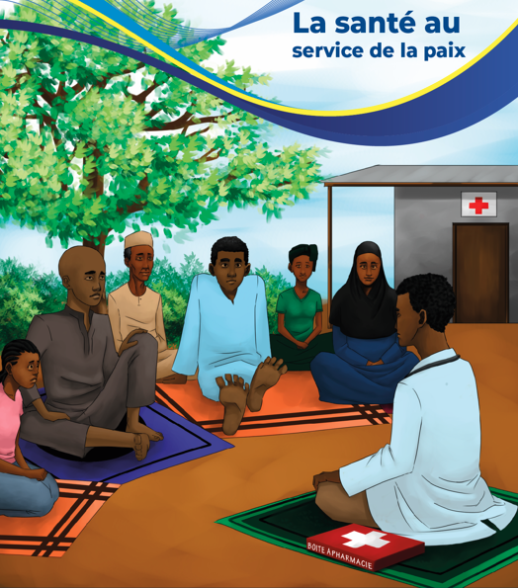
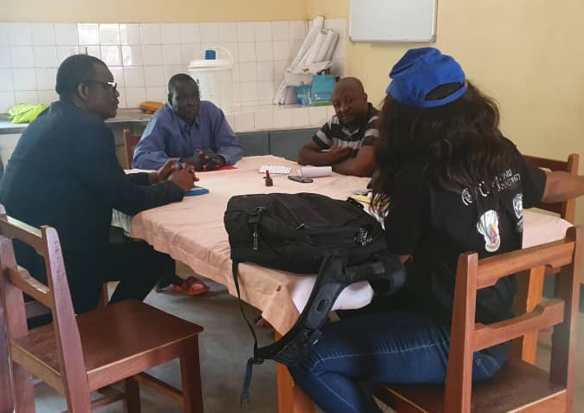
Case Study: Peace through health
To ensure a community-based approach, flexibility and new partnerships, IOM is working with ‘comites de la santé’ or COSA for the development of community action plans
Why COSA?
COSA are seen as the health governance structures which has the closest links to the communities themselves.
The aim of the project is to promote health actors are agents of peace in the Far-North, and COSA are therefore seen as the best entry point for facilitating community-based planning processes.
Following the participatory targeting of 15 COSA in Far-North region, IOM trains facilitation teams (COSA) on exercises for community-based planning and action plans, providing direct and indirect support on some projects within their plan.

Slide 10

THANK YOU

