Slide 1
IOM Institutional Legal Identity Strategy: Global Mobility
Immigration and Border Management Division
Presentation by: Mme Mariama Mohamed Cisse, Director IOM Special Liaison Office to the AU and ECA

Slide 2
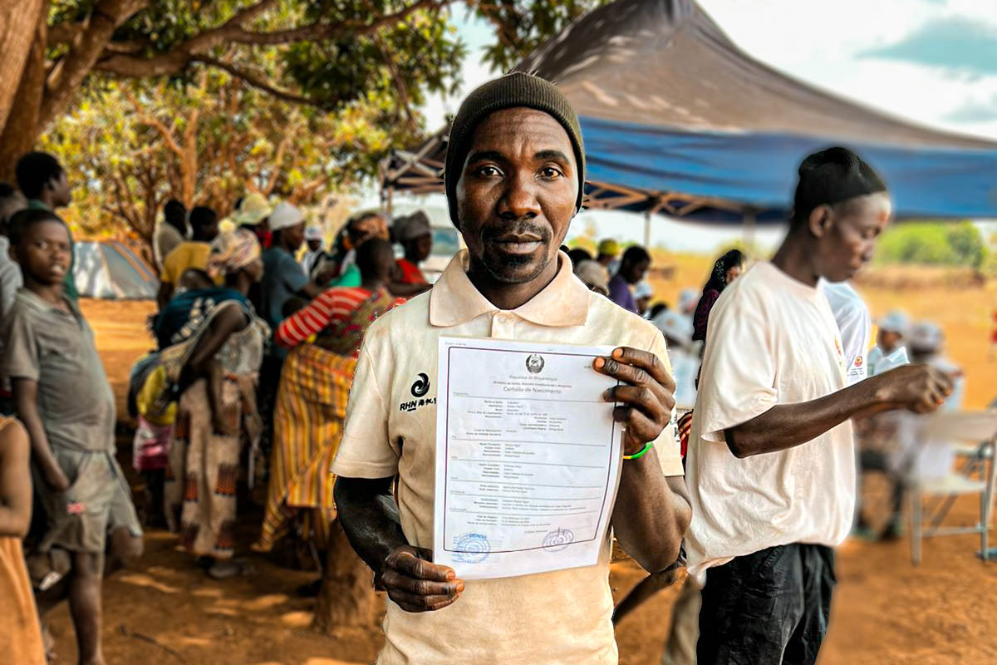
Outline
LI Frameworks
Definition Legal identity
Legal identity for mobile populations
LI Strategy: Principles, Population Categories and Pillars
Capacity Development Tools
UNLIA Next steps
Key Recommendations

Slide 3
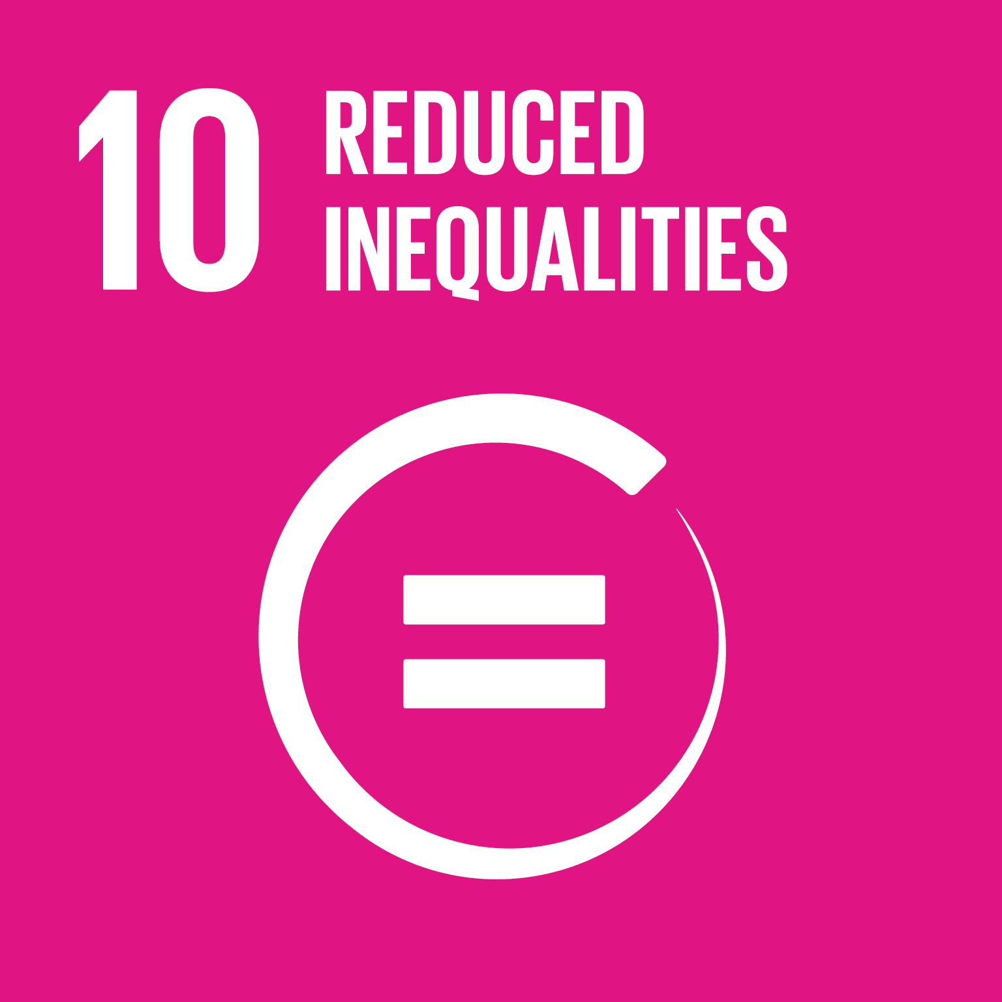
LEGAL IDENTITY – GLOBAL AND REGIONAL FRAMEWORKS
ACHPR
ACRWC
Notes:
Everyone has the right to be recognized as a person before the law, as enshrined in Article 6 of the Universal Declaration on Human Rights and several international human rights instruments.
LI is seen as prerequisite for a person to enjoy basic rights and access services.
The SDGs established a specific target for 16.9 – legal identity for all, including birth registration.
This Target - 16.9 - is in fact an enabler of 12 of the 17 SDGs. Also, 67 of the 230 indicators require data from CRVS systems directly or indirectly.
Target 10.7 in particular, looks to facilitating orderly, safe, regular and responsible migration and mobility of people, including through the implementation of planned and well-managed migration policies to which CRVS and Legal Identity is pertinent.
Also, from a global perspective and reflected in several Objectives of the Global Compact on Migration
Objective 4: Ensure that all migrants have proof of legal identity and adequate documentation
Objective 7: Address and reduce vulnerabilities in migration
Objective 14: Enhance consular protection, assistance and cooperation throughout the migration cycle
At the regional level, Article 5 of the African Charter of Human and Peoples Rights and Article 6 of the African Charter on the Right and Welfare of the Child are regional legal frameworks that call on Member States to ensure access to legal identity for their nationals.

Slide 4
UN Operational Definition of Legal Identity
Legal identity is defined as the basic characteristics of an individual's identity. e.g. name, sex, place and date of birth conferred through registration and the issuance of a certificate by an authorized civil registration authority following the occurrence of birth.
In the absence of birth registration, legal identity may be conferred by a legally-recognized identification authority.
This system should be linked to the civil registration system to ensure a holistic approach to legal identity from birth to death.
Legal identity is retired by the issuance of a death certificate by the civil registration authority upon registration of death.
Notes:
There is no standard definition of LI. The operational Definition points to biographical information, acknowledged by a legal authority. As civil registration provides an official record of the existence of the person and the recognition of that individual before the law, it has been the fundamental means of granting legal identity.
In January 2018, The Secretary General's Executive Committee, requested to "convene UN entities to develop, in collaboration with the World Bank, a common approach to the broader issues of registration and legal identity".
This to say that LI is not a new topic, but gained traction since 2018
IOM is a founding member of the inter agency task force working on legal identity (#23) which is a lead entity

Slide 5
Legal Identity for migrants and mobile populations
Currently, an estimated 1.1 billion people worldwide of which 50% is within Africa, cannot officially prove their legal identity, impeding them from accessing services. Reliable access to services depends on proof of legal identity. Making access to legal identity – and thus to basic services and essential rights – easier for more people can play an important role in improving development outcomes and safer migration.
Lacking proof of legal identity is particularly concerning for people on the move. People without this essential identifier are more susceptible to risky, irregular migration – often at the hands of human traffickers and criminal smuggling groups.
Equally, lack of proof of identity will result in the inability to return, integration in the host or departure country, family reunification, readmission, and reintegration.
The overarching pledge of Agenda 2030 – ‘leave no one behind’, depends on counting all people, including along the mobility continuum/migratory routes.

Slide 6
Free download
Notes:
In 2021, IOM developed a LI Strategy which aims to tackle several challenges related to people on the move and access to documentation, presenting an approach that will allow for legal identity to be addressed more consistently as part of existing and upcoming IOM interventions.
As the sole UN LIA Task Force member with a Legal Identity Strategy and going further to develop capacity development tools which are poised to leverage and expand IOM and Member States institutional and technical capacities, IOM continues to commit itself to increasing its focus on legal identity:
as an enabler of Global Mobility of migrant population;
as an enabler of trade and development and link with the Free Movement Protocols & Free trade areas:
as an enabler to access fundamental rights (justice, education, health, etc).

Slide 7
Legal Identity Strategy - Principles
Equality and non-discrimination
Nobody may be discriminated against (in law or in practice) on the basis of their age, origin, nationality, ethnicity, language, religion, beliefs, opinions, political activity, trade union activity, family relationships, state of health, disabilities, sexual orientation, sex or other personal characteristics
People-centered
IOM promotes and works to protect the dignity, well-being and rights of the populations and individuals it serves and keeps them at the center of its activities and approaches, in accordance with its mandate
Rights Based approach
IOM work on legal identity will be rights-based in that it will respect the human rights and other rights of migrants in all its endeavors linked to legal identity
“Do no harm”
With the view to upholding the human dignity and well-being of migrants, programming on legal identity will be subject to context analysis to avoid exposing migrants and other affected communities to additional risks
Protection of privacy and personal data
IOM can support States in the development of statewide computerized national legal identity systems that respect the right to privacy and align with international, regional and national data protection law and standards

Slide 8
Legal Identity Strategy - Population Categories
This Strategy focuses on legal identity affecting four population categories:
Nationals in their countries who need registered legal identity to access regular migration or travel abroad
Migrants in foreign countries who require access to civil registration in the host country and in the country of origin
Vulnerable mobile populations, inclusive of displaced persons and victims of trafficking, for whom legal identity intersects with protection concerns and international humanitarian law
Irregular migrants for whom determining legal identity is linked to a specific country situation

Slide 9
Legal Identity Strategy- Four Pillars
1. Supporting development of consular civil registration, citizenship certificates, ID and travel document issuance services
2. Assisting migrants without proof of legal identity
3. Supporting national civil registration and identity management systems to facilitate regular migration and mobility
4. Provide thought leadership on the nexus between migration, displacement, and legal identity including their impact on the protection of migrants
Notes:
The IOM Legal Identity Strategy is hinged on four pillars:
Pillar 1
Provision of civil registration and identity management services at consular representations facilitates international migrants’ access to services.
This also includes the implementation of digitized civil registration and identity management services that are linked online with national legal identity system, which also supports issuance of civil registration-related certificates and documentary evidence to support migrants with immigration-related procedures, including visa or permit application, renewal and extension, or family reunification.
The digitalization of biometrics for border management and visa services is a clear example of utilizing technology to establish identity and facilitate access to services while putting in place appropriate data governing frameworks to protect the rights to privacy, data integrity, and security.
Pillar 2
Assisting migrants without legal identity documents
Lack of access to identity documents is a key factor of vulnerability for migrants caught in crisis situations. Lack of legal identity and loss and destruction of documents might prevent migrants from accessing services and assistance, reduce their willingness to seek help for fear of arrest and deportation, and reduce their ability to leave a crisis-affected country.
Addressing only the lack of legal identity without also addressing statelessness, or other rights of migrants related to protection, is insufficient from the point of view of international law and States’ obligations to respect, protect and fulfil rights.
Given the vulnerabilities undocumented migrants, displaced persons, and mobile populations may face, States must ensure that documentation and registration are not used as tools of persecution or repression.
Although legal identity does not in itself confer nationality to persons, including migrants, legal identity documentation can facilitate administrative and migration-related processes to access other rights, which could in some cases lead to the issuance of protection status and measures, travel documents, visas, permits and proof of nationality or granting of nationality, on a case-by-case basis and in conformity with national laws and international law obligations.
Pillar 3
Supporting national civil registration and identity management systems to facilitate regular migration and mobility
Crucially, legal identity is a precondition to accessing mobility and travel, through admission and stay procedures. In migratory contexts, documentary proof of legal identity is essential for meeting the criteria in permit or visa applications and being able to enter a third country or return to the country of origin in a regular, orderly and safe manner, as well as for facilitating, among others, effective, equal access to justice, the right to family unity, or the right to property
One of the impediments to implementing the African Union Protocol on Free Movement of Persons in Africa (FMP) is the issue around the integrity and legitimacy of travel documents from some African countries. Increased integrity of travel documents will therefore facilitate, to a large extent, the implementation of the FMP, as member states will be confident about the identity of travelers entering their territories. In the same vein, this will also facilitate the implementation of the Agreement Establishing the African Continental Free Trade Area (AfCFTA).
Pillar 4
Provide thought leadership on the nexus between migration, displacement, and legal identity including their impact on the protection of migrants
Essential to improved legal identity systems in accordance with international law include research, dialogue and sharing of good practices and information.
Cross-border bilateral and multilateral cooperation enables sharing of information on registered vital events in civil registers of their nationals residing abroad.

Slide 10
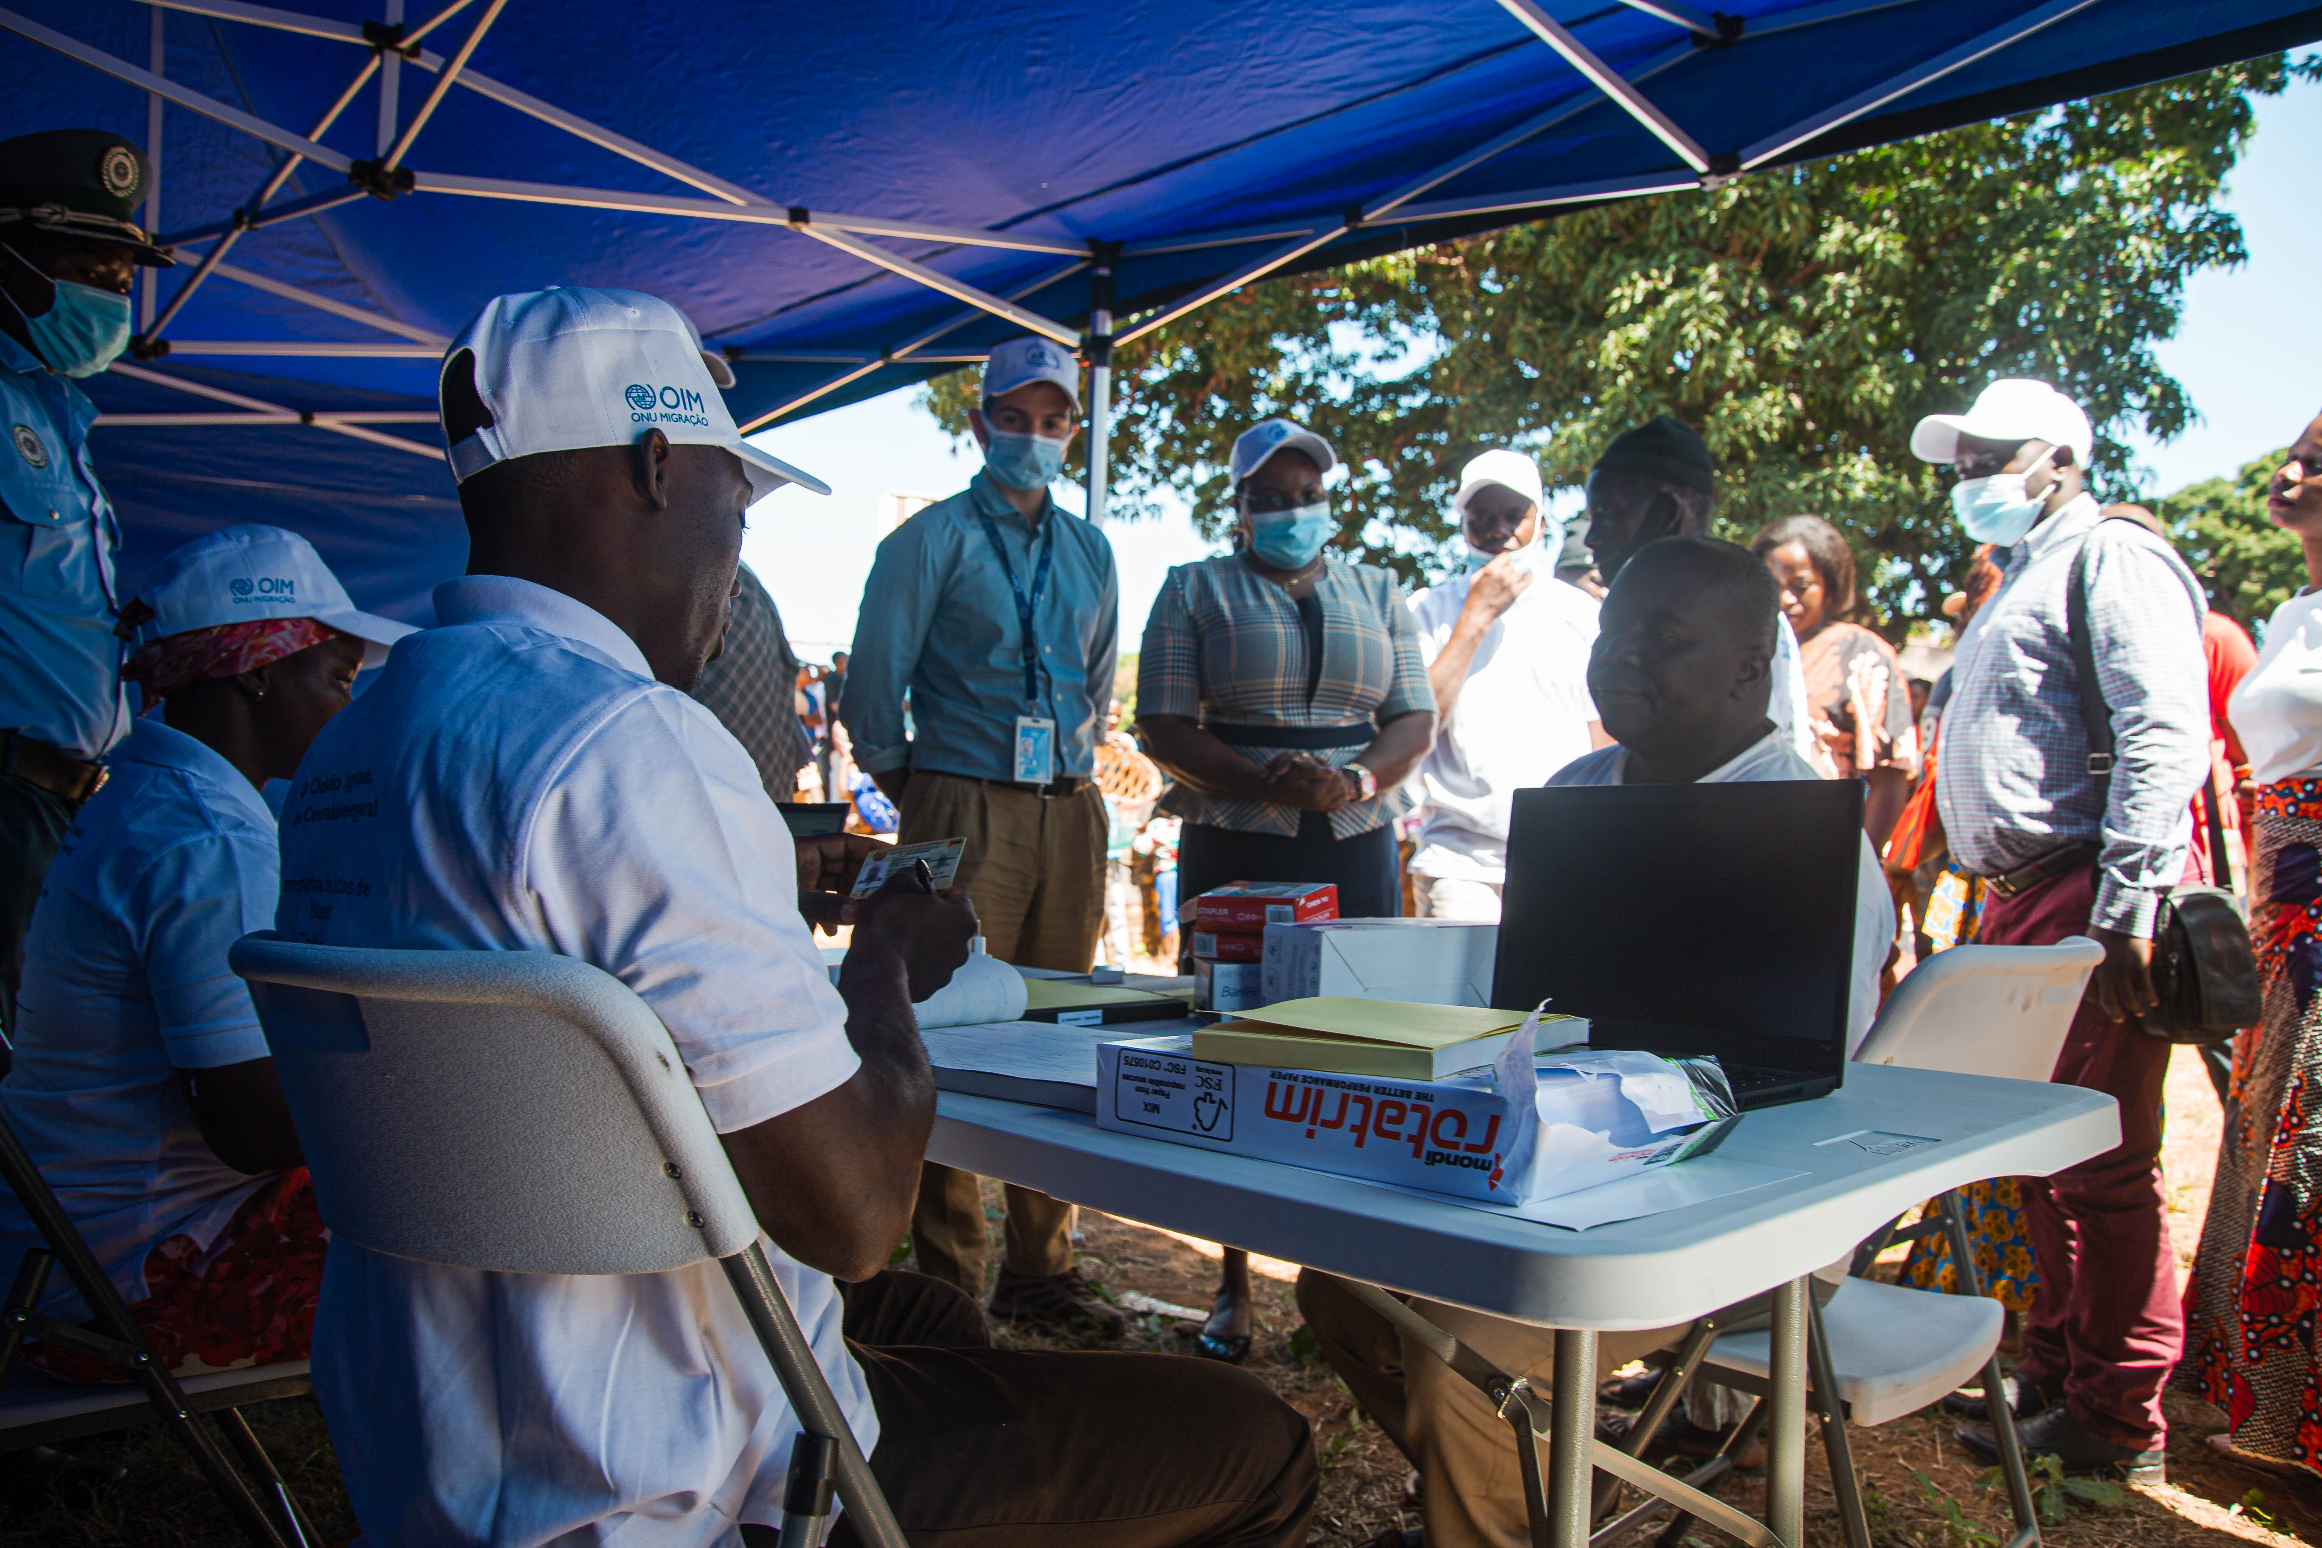
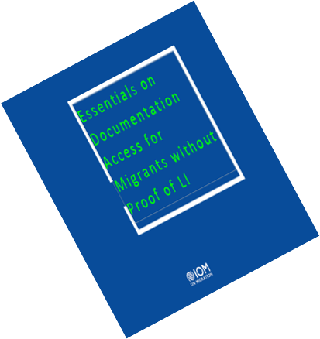
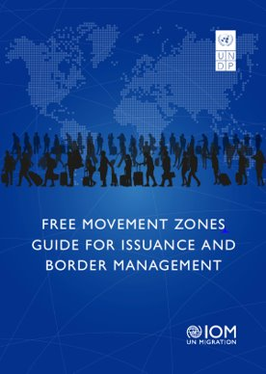
IOM LEGAL IDENTITY STRATEGY
CAPACITY DEVELOPMENT TOOLS
LI Toolkit
LI Master Class (formative)
LI Roadshows (informative)
ID Management Master Class
LI Assessment questionnaire
Free Movement Zones Guide for Issuance and Border Management
Essentials on Documentation Access for Migrants Without Proof of Legal Identity
Movement Zones Guide for Issuance and Border Management
Notes:
Furthermore, IOM has been instrumental in developing Capacity Development tools which aims to leverage and expand as needed on existing IOM and Member States institutional and technical capacities; to pursue and strengthen a “Whole of UN approach” in delivering a holistic and concerted support to strengthen inclusive national legal identity systems that conform with international law and standards;

Slide 11
ACHIEVEMENTS
Legal Identity Interventions
Chad
Cameroon
Libya
Mozambique
Niger
Notes:
Some key achievements just to name a few are:
A sub-regional Conference on Legal Identity was convened in Mozambique, with the participation of over 70 speakers from 16 delegations of SADC countries, UN Agencies, and international organizations, as well as the private sector, bolstering the exchange of information and good practices on legal identity between SADC member countries.
In Libya, Burkina Faso nationals wanting to return to their country and not holding proper documents were registered using mobile MIDAS kits (through the collection of biographical and biometrical information) and were provided with an ID card. This information was shared with databases in Burkina Faso, allowing their identification and return to their country, after prior verification that the document they were carried was genuine and issued by MIDAS.
In advocating novel approaches and procedures for determining proof of nationality or permanent residence to expedite the delivery of the necessary documents, IOM has supported consular visits to enable countries wishing to send a mission to transit countries such as the Niger to provide travel documents to their nationals and, at the same time, to establish mechanisms for the issuance of travel documents.

Slide 12
Whole-UN-approach with MS
Develop capacity development tools
Develop Guidance Material
Conduct workshops and field assessments
Multi Partner Trust Fund
Human rights-based approach
Data privacy / protection
Regional Legal Identity Conferences
What’s next?
Notes:
The question now is ‘what’s next? in advancing the UNLIA. Here are some focus areas within which context I would like to pose some questions for reflection:
• How can Africa contribute to global safe and orderly migration by eliminating lack of legal identity and resulting lack of integration into mainstream society as a push factor for irregular migration?
• What are the challenges that countries face in registering vital events of migrants on their territory?
• What options countries can explore to extend their civil registration services in consular representations abroad?
Recommendations
National strategies for strengthening civil registration and vital statistics system should reflect the importance of inclusion of marginalized and excluded populations, with emphasis on migrants, in accordance with the central promise of the 2030 Agenda and its SDGs to leave no one behind.
States should aim to develop policies aimed at strengthening their capacity to provide services to issue civil registration, proof of nationality and travel documents to their nationals abroad. Policies should for the implementation of digitized civil registration and identity management services that are linked online with national legal identity system and as such support issuance of civil registration-related certificates and documentary evidence with the goal to support migrants with immigration-related procedures.
States are encouraged to actively explore options to conclude bilateral and multilateral agreements to:
- Mutually recognize certificates of registered vital events, and where appropriate
- share data on registered vital events of migrants between country-of-residence and home-country authorities to ensure that these events are reflected in the identity systems of both countries.
States should work with other government non-governmental actors to promote good practices on policies to facilitate access to legal identity for irregular and forcibly displaced migrants including for those whose legal identity cannot be determined

Slide 13
Key Recommendations
(1) Increased Political Commitment
Member States to increase their political commitment to legal identity and to prioritize resources
towards the strengthening of relevant technical expertise in Civil Registration and Legal Identity
systems.
(2) Inclusive and effective legal identity management
Call on Member States to enhance interoperability based on the development of global trust
frameworks to ensure a strong legal basis and authentication systems, protection of personal data
and privacy including data minimization principles, migrant friendly processes and technology
including clear and accessible information in multiple languages, mobile registration, evidence-based
measures derived from up-to date scientific knowledge with a strong overall focus on migrants in
vulnerable situations.
(3) Foster human mobility and regional integration
Promote safe orderly and regular migration including through reinforcement of identification
documents and enhance preparedness to domesticate continental integration agendas such as the
Free Movement of Persons Protocol and the African Continental Free Trade Area Agreement
Notes:
There are 3 key recommendations, I would like to posit for Member States’ consideration to ensure that no one migrant, trafficked victim, stateless person, displaced person and mobile populations overall, are without an identity and is left behind.

Slide 14
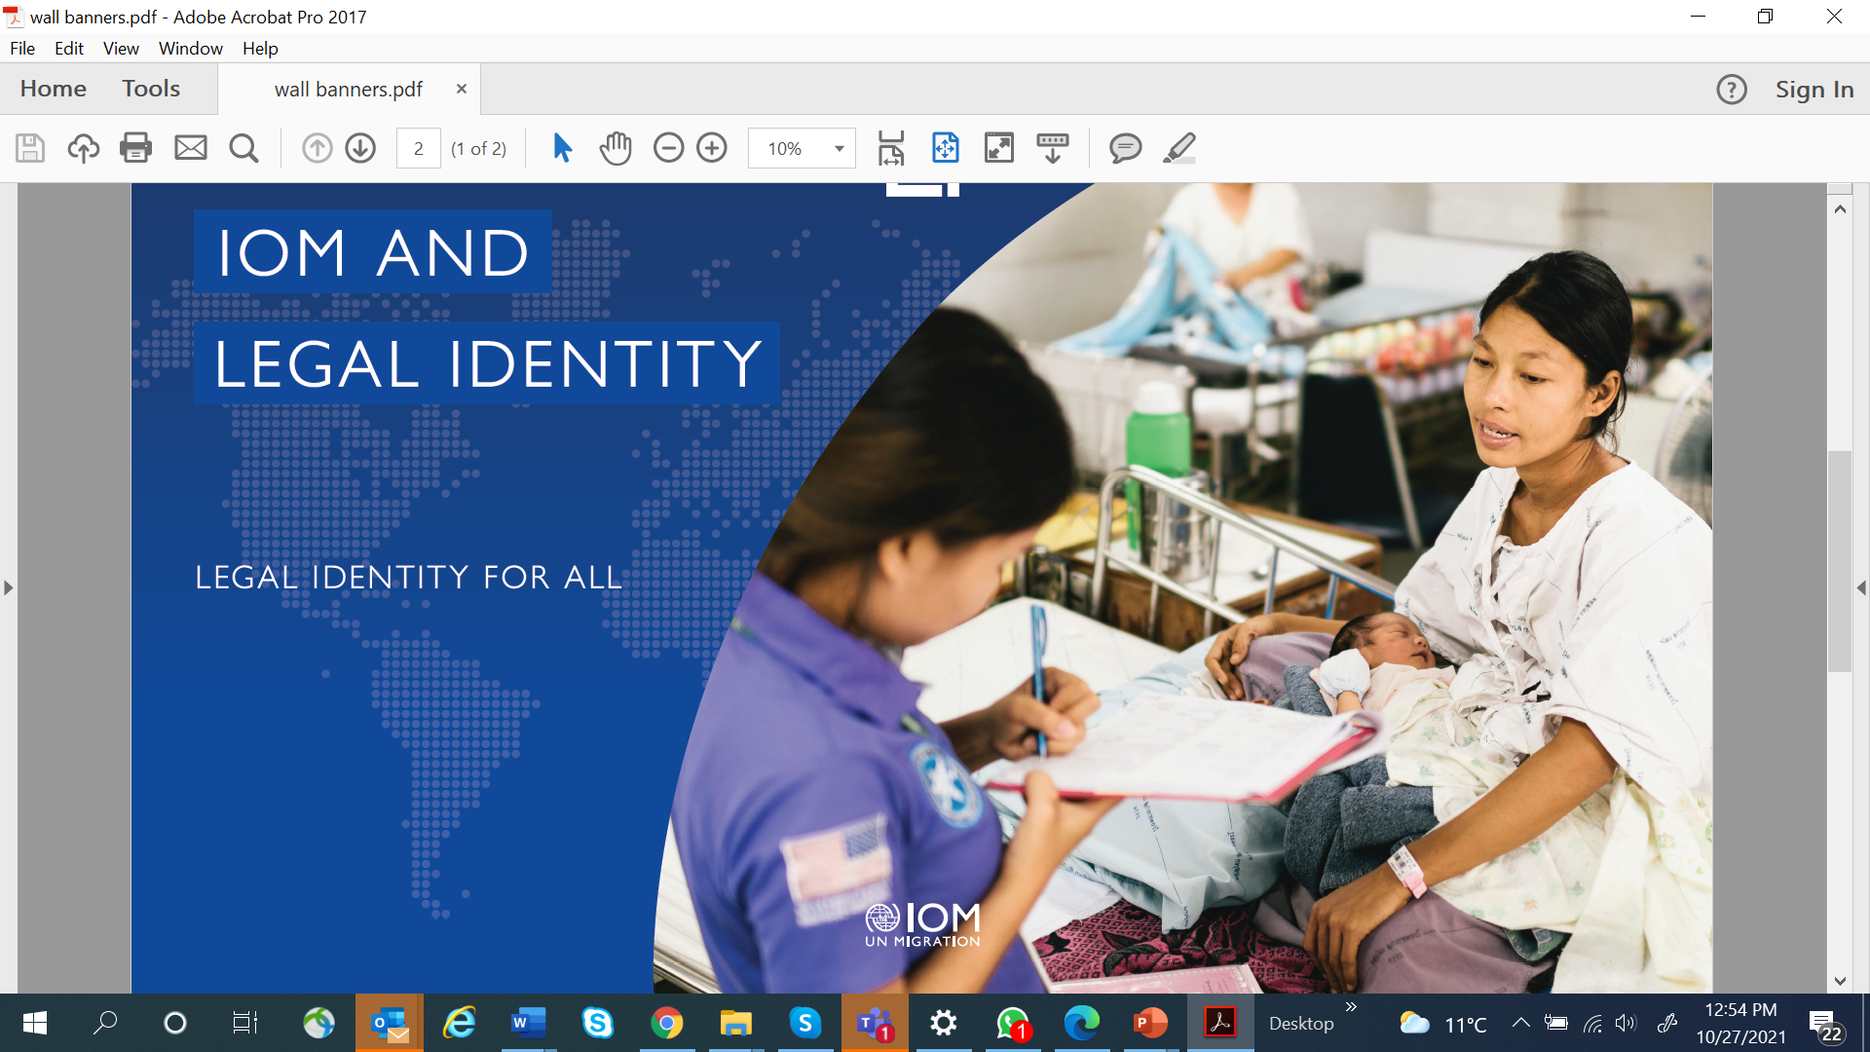
Thank You

