Slide 1
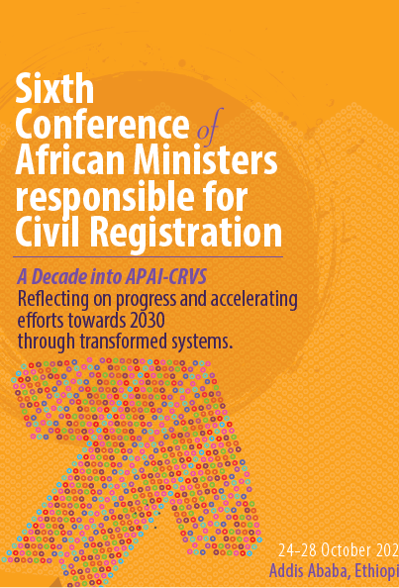
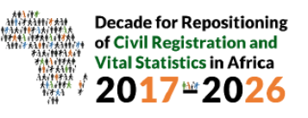
The United Nations Legal Identity Agenda
Name of presenter:
Kirsten Di Martino, Senior Child Protection Adviser
Institution:
UNICEF-HQ

Slide 2
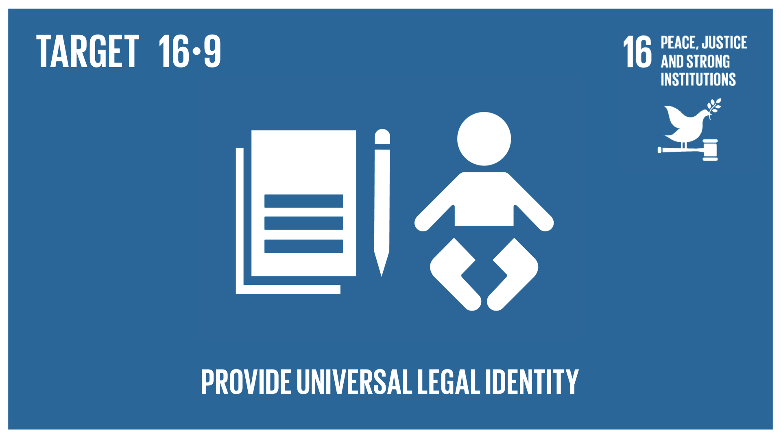
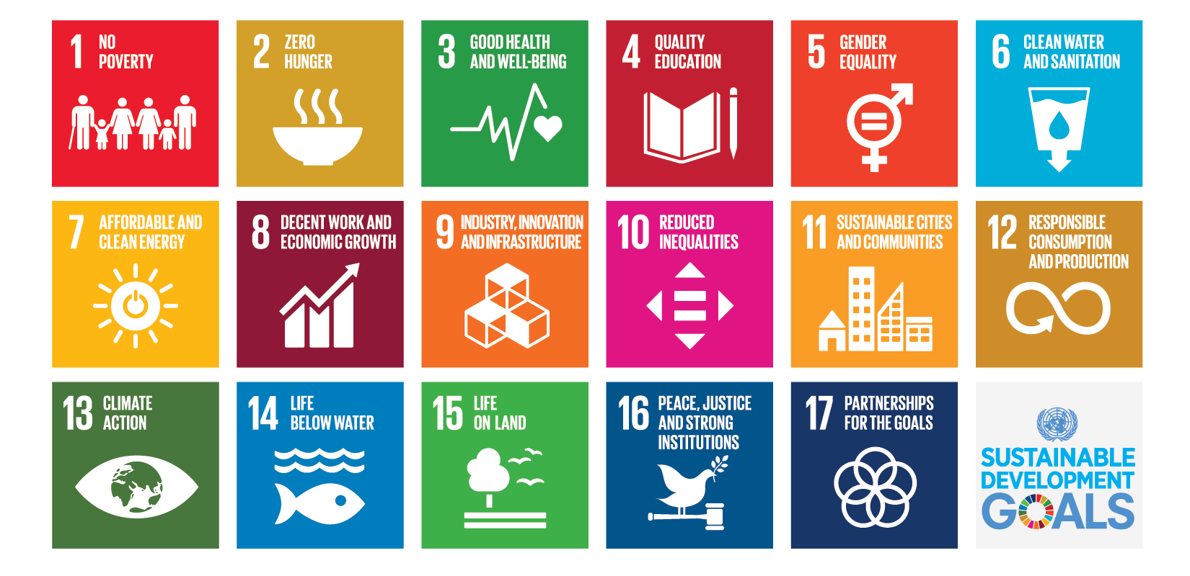
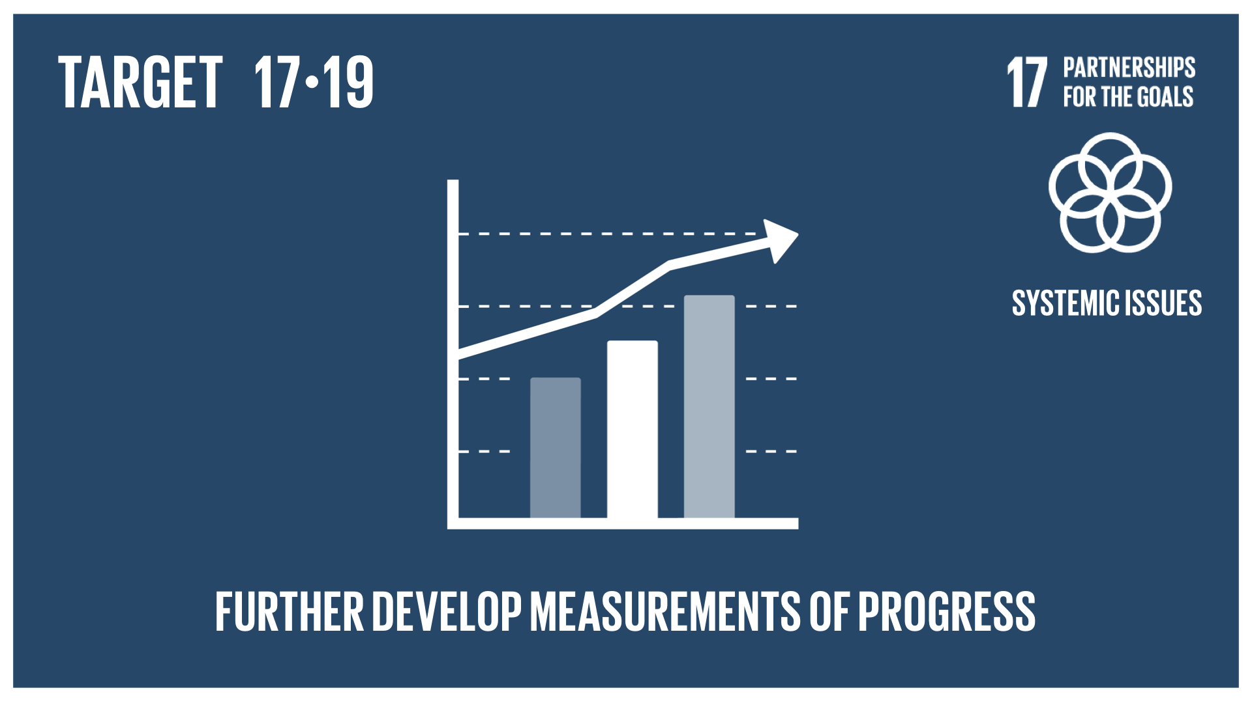
The United Nations Legal Identity Agenda Fulfil the promise to Leave No One Behind

Slide 3
United Nations Legal Identity Agenda
Objectives
Promote a coherent approach to legal identity across the UN system and with the World Bank
Build on existing global, regional and country efforts
One UN Voice for joint strategic advocacy and communications
Enable joint UN support to countries for implementation
Benchmark Goal: Close the global identity gap by 2030

Slide 4
A Common Definition to Legal Identity
Legal identity is defined as the basic characteristics of an individual’s identity. e.g. name, sex, place and date of birth conferred through registration and the issuance of a certificate by an authorized civil registration authority following the occurrence of birth.
In the absence of birth registration, legal identity may be conferred by a legally-recognized identification authority. This system should be linked to the civil registration system to ensure a holistic approach to legal identity from birth to death. Legal identity is retired by the issuance of a death certificate by the civil registration authority upon registration of death.
Source: Economic and Social Commission, E/CN.3/2020/15

Slide 5
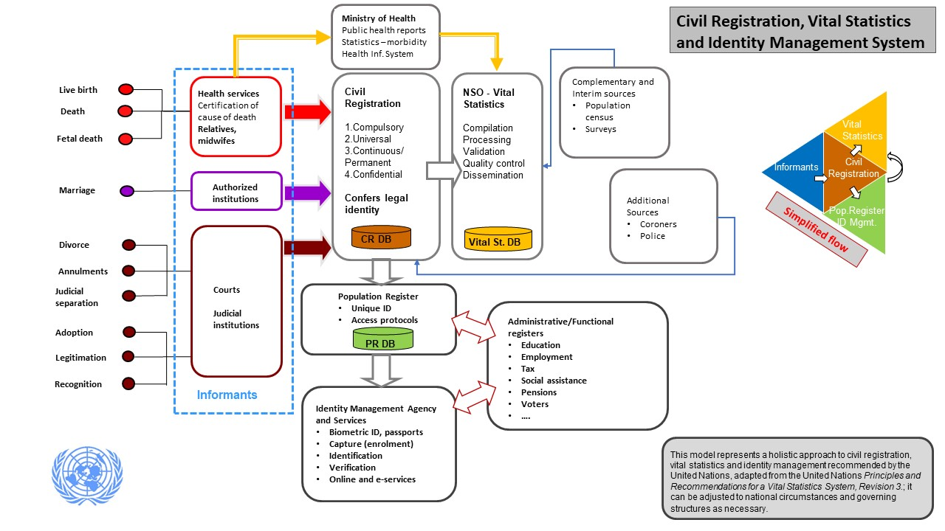

Slide 6
UN Legal Identity Task Force
13 UN Agencies and Departments
Co-Chairs: DESA, UNDP, UNICEF
Members: IOM, OHCHR, UNDESA, UNDP, UNECA, UNESCAP, UNFPA, UN Global Pulse, UNHCR, UNICEF, UN Woman, WFP and WHO
Working modality:
Works through an Annual Workplan
Task Force meets quarterly
UN LIA Secretariat meets every week (UNICEF, UNDP, DESA, UNECA)
Engages with countries through Regional Economic Commissions
Reports on progress to SG under ‘Our Common Agenda’

Slide 7
Accelerating country-level implementation
At COM5 13 countries committed to accelerate implementation of the UN LIA on the African continent:
Cameroon Mozambique
Côte d’Ivoire Niger
Democratic Republic of Congo Nigeria
Ethiopia Senegal
Guinea Sierra Leone
Kenya Zambia
Liberia
The # of unregistered children under age 5 in these 13 countries is about 60 million: more than 1 in 3 of all unregistered children globally

Slide 8
Government owned and led implementation
States leading UNLIA implementation efforts:
Full life-cycle approach
Holistic CRVSID approach
UN LIA Country Task Forces established to ensure coordinated support to implementation efforts
UN LIA TF providing strategic guidance/support to reform processes:
UNCT guidance to operationalize the UN LIA for “One-UN” approach
Country assessments of CRVSID landscape with recommendations for reform/action
Research and guidance on critical issues impacting reforms: digitization of systems, cost of inaction, data protection and privacy etc.
UN LIA TF providing technical guidance and limited seed funding

Slide 9
What has been the impact so far?
Over 12 million children received a birth certificate in 2021 in Cote d’Ivoire, Mozambique and Nigeria
More than 3600 new registration centers were opened in these 3 countries in 2021
Game changer: enhanced interoperability with the health sector
Other countries are also making progress:
Kenya - strengthened coordination, capacity and interoperability between CRVS and national ID system
Mozambique - costed UNLIA implementation plan
Sierra Leone - SOP that enable vital event registration and the conferral of legal identity to refugees, migrant, displaced, stateless and unregistered populations

Slide 10
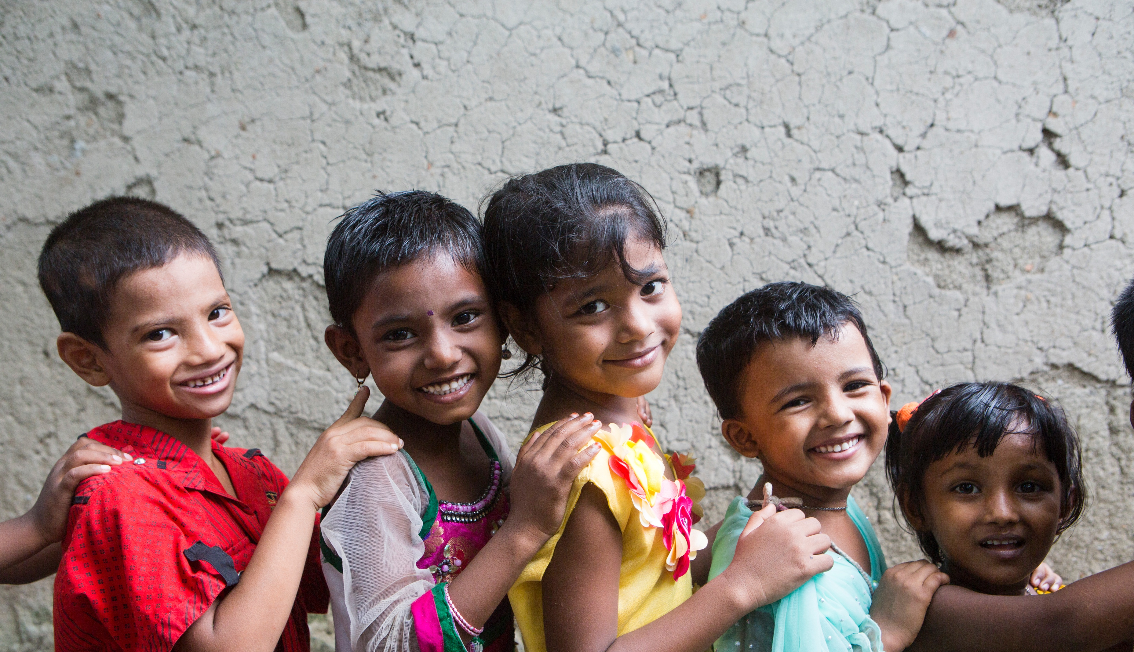
Thank you!

