Slide 1
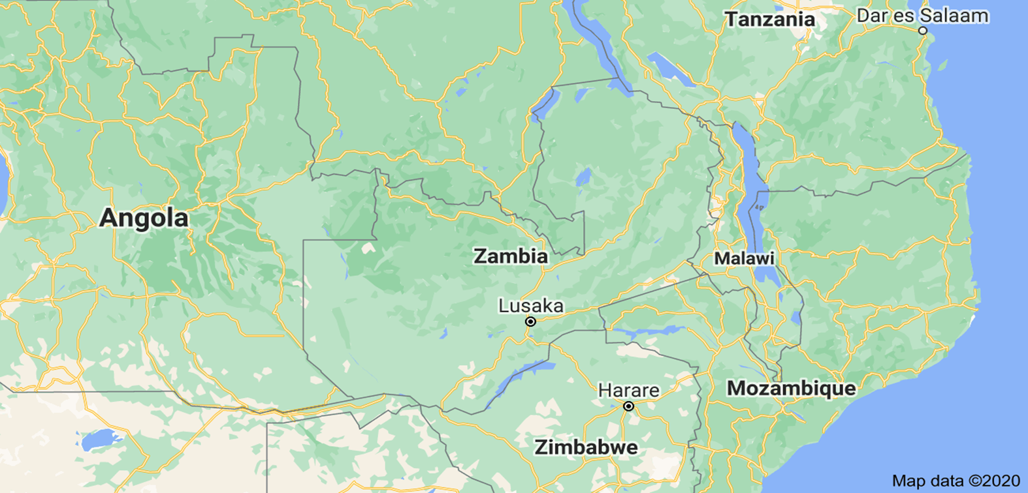
IMPLEMENTATION OF THE LEGAL IDENTITY AGENDA
ZAMBIA
PRESENTED BY
PETER MOYO
PRINCIPAL REGISTRAR FOR CIVIL REGISTRATION
27TH OCTOBER, 2022, ADDIS ABABA

Slide 2
OUTLINE
Back ground
Access to Legal Identity
Strategic Direction
Linkages with other systems
Lessons learnt

Slide 3
Background - Legal Identity
Zambia has embarked on transforming the Legal Identity system since 2012
Strategic actions have been anchored on developing and strengthening systems, and improving and expanding service delivery
Strategies were informed by comprehensive assessments and evaluation of programme implementation
Development of first NSAP (2015- 2019) and Second NSAP (2021 – 2025)
All strategic plans are aligned toward achieving SDG target 16.9 and to the 8th National Development plan for Zambia
Notes:
Major strides in the improvement of the Legal Identity System in Zambia have been recorded since the Ministerial Conference of 2012 in Durban, South Africa.
This was a conference that encouraged Member States to develop Country owned Strategic Action Plans for improving CRVS systems. In Zambia, after conducting a comprehensive assessment, the 2015 – 2019 National Strategic Action Plan for improving and reforming the CRVS system was developed. Areas of focus in the first plan and the major success recorded was to create an enabling environment (i.e review of the existing laws and policies), improve coordination by establishing a steering committee and improving service delivery by automating processes and capacity building.
At the expiry of the 1st NSAP, Zambia developed the 2021 – 2025 NSAP with focus on three things (a) Expanding the scope of vital events registered and increasing coverage of the registered events (b) Enhancing operational efficiency by digitization and capacity building, and (c) Improving the quality of vital statistics from Civil Registration.
All strategic plans are aligned toward achieving SDG target 16.9

Slide 4
ACCESS TO LI : PREVAILING STATISTICS (2019)
Estimated Population: 18 Million
National Registration
88%
46% GAP – WITHOUT LEGAL IDENTITY
Birth Registration; 20%
Legal framework
Birth and Death Registration Act – Registration from birth
National Registration Act – Registration from 16 years
Passport Act – National Travel Documents
Refugees Act – Recognition & documentation of refugees and asylum seekers
Notes:
We estimate more than 40% identity gap in the Country given the fact that Zambia has a young population and given that less than 20% birth are registered and national registration takes place at the age of sixteen.
This situation has informed the next course of action for the Country

Slide 5
STRATEGIC DIRECTION TOWARDS Target 16.9: By 2030, provide legal identity for all, including birth registration

Slide 6
(a) Strengthen CRVS system
Enhance Operational Efficiency in the development, implementation and maintenance of the CRVS system
Enhance effectiveness and efficiency in the CRVS institutional framework
Improve Legal and Policy Framework
Improved human capital
Provide Legal Identity for all through effective and comprehensive registration of all vital events
Improve registration coverage of vital events
Improve registration coverage of vital events among refugees
Enhance coordination and collaboration among stakeholders

Slide 7
Quick wins 2015 - 2025
ENABLING ENVIRONMENT
SERVICE DELIVERY
DEMAND CREATION
2015 2020 2025

Slide 8
Towards Universal Birth Registration (SDG 16.9)
Heath facility Based Birth Registration
Electronic Birth registration
Under-five Clinic
Mass enrolment through INRIS
Routine enrolment
Mass enrolment
Stakeholders participation
Targeted interventions
Child health week
School enrolment
Village registration
2021 – 2025 TARGET 50% BIRTH REGISTRATION

Slide 9
(a) Strengthen CRVS system…ctd
Generate vital statistics from civil registration
Improve timeliness and quality of vital statistics
Improve the quality of causes of death information

Slide 10
(b)ID Management and CR linkage - INRIS
Progress Made
Routine enrolment and decentralised BC in 40 /116 districts
Commenced mobile enrolment in 2 provinces
*Support from UNLIA

Slide 11
Success factors
Political will
Civil Registration and Vital Statistics Policy
Presidential directive to implement INRIS within 2 Years
Increase in government funding towards Legal Identity
Support by partners: Under UNLIA, D4H, UNFPA, WHO, GF

Slide 12
Lessons learnt
Legal identity is multisectoral
One government approach will deliver results
Beneficiaries are ready….start and perfect
Home grown solutions are sustainable
Make civil registration as the foundation of identity management

Slide 13
Thank you…
Ameseghinalehu..
Merci…..
Gracias….
Obrigado…
Shukran..
Asante sana…

