Slide 1
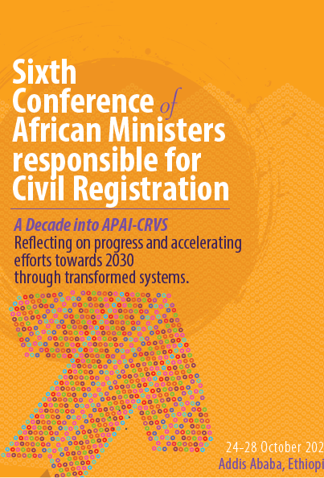
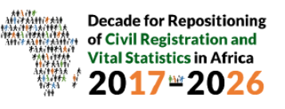
United Nations Guidelines on the legislative framework for civil registration, vital statistics and identity management systems
Srdjan Mrkić
United Nations Statistics Division
Co-chair of the United Nations Legal Identity Agenda Secretariat
United Nations, New York

Slide 2
Content of presentation
What is United Nations Legal Identity Agenda
UN LIA methodological framework
Guidelines on legislative framework

Slide 3
UN Legal Identity Agenda
Everyone has the right to be recognized as a person before the law, as enshrined in Article 6 of the Universal Declaration on Human Rights and a number of international human rights instruments
To address this, the 2030 Agenda for Sustainable Development established SDG Target 16.9 – legal identity for all, including birth registration
Civil registration establishes the existence of a person under the law and is fundamental to granting legal identity
It is recognized as the ultimate source for production of comprehensive, regular and reliable vital statistics
In an effort to increase civil registration coverage worldwide the 2030 Agenda for Sustainable Development established SDG Indicator 17.19.2 – proportion of countries that have achieved 100% birth registration and 80% death registration

Slide 4
UN Legal Identity Agenda
The UN operational definition of legal identity
Legal identity is defined as the basic characteristics of an individual’s identity, e.g. name, sex, place and date of birth conferred through registration and the issuance of a certificate by an authorized civil registration authority following the occurrence of birth. In the absence of birth registration, legal identity may be conferred by a legally-recognized identification authority; this system should be linked to the civil registration system to ensure a holistic approach to legal identity from birth to death. Legal identity is retired by the issuance of a death certificate by the civil registration authority upon registration of death
In the case of refugees, Member States are primarily responsible for issuing proof of legal identity. The issuance of proof of legal identity to refugees may also be administered by an internationally recognized and mandated authority

Slide 5
UN Legal Identity Agenda
The UN Legal Identity Agenda consists of the holistic approach to complete and universal civil registration of all vital events, production of vital statistics, the establishment and maintenance of population registers and identity management apparatus from birth to death, and there should be full interoperability between these functions in a simultaneous manner, according to international standards and recommendations, thus ensuring legal identity for all from birth to death
All Member States should adopt and implement this agenda as a systematic and perpetual mechanism for ensuring legal identity for all
UN LIA was launched in Rome, May 2019 at a conference dedicated to MDG 16
Officially adopted as internationally recommended model by UN Statistical Commission in March 2020, and subsequently by ECOSOC in June 2020

Slide 6
Ministry of Health
Public health reports
Statistics – morbidity
Health Inf. System
This model represents a holistic approach to civil registration, vital statistics and identity management recommended by the United Nations, adapted from the United Nations Principles and Recommendations for a Vital Statistics System, Revision 3.; it can be adjusted to national circumstances and governing structures as necessary.
Live birth
Civil
Registration
Compulsory
Universal
Continuous/ Permanent
Confidential
Confers legal identity
NSO - Vital
Statistics
Compilation
Processing
Validation
Quality control
Dissemination
Complementary and Interim sources
Population census
Surveys
Health services
Certification of
cause of death
Relatives, midwifes
Death
Fetal death
Vital Statistics
Civil
Registration
Pop.Register
ID Mgmt.
Marriage
Authorized
institutions
Additional
Sources
Coronary
Police
Informants
CR DB
Simplified flow
Divorce
Vital St. DB
Annulments
Judicial
separation
Courts
Judicial
institutions
Population Register
Unique ID
Access protocols
Administrative/Functional registers
Education
Employment
Tax
Social assistance
Pensions
Voters
….
Adoption
PR DB
Legitimation
Recognition
Informants
Identity Management Agency and Services
Biometric ID, passports
Capture (enrolment)
Identification
Verification
Online and e-services
Civil Registration, Vital Statistics and Identity Management System

Slide 7
UN Legal Identity Agenda Methodological Framework
Principles and Recommendations for a Vital Statistics Systems, Revision 3, United Nations, 2014
Handbook on Civil Registration and Vital Statistics Systems: Management, Operation and Maintenance, Revision 1, United Nations, 2018
Guidelines on the Legislative Framework for Civil Registration, Vital Statistics and Identity Management, United Nations, 2019
Handbook on civil registration, vital statistics and identity management systems: Communication for development, United Nations, 2019
Implementation of the United Nations Legal Identity Agenda: United Nations Country Team Operational Guidelines, United Nations, 2020

Slide 8
Legislative guidelines
Overview of Civil Registration, Vital Statistics and Identity Management Systems
Human Rights and Civil Registration, Vital Statistics and Identity Management Systems
Institutional Arrangements for Civil Registration, Vital Statistics and Identity Management Systems
Legislative Framework
General provisions
Civil Registration
Identity Management
The Population Register
Vital Statistics
Data Protection, Privacy and Security
Compliance, Enforcement, Rights and Remedies
Other Laws and Policies that Support CRVSID Systems: Incentives, Medical Profession Training and Technology
Guidelines on the Legislative Framework for Civil Registration, Vital Statistics and Identity Management, United Nations, 2019

