Slide 1
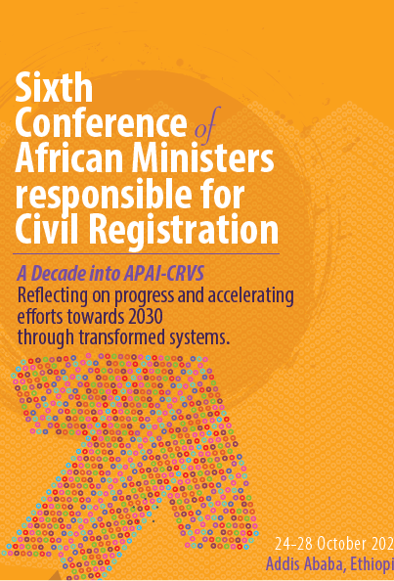
Medical Certification of Causes of Death- South African Experience
Presenter: Mosidi Nhlapo
Statistics South Africa
South Africa

Slide 2
Content of presentation
Key Stakeholders
Applicable legal instruments
Key interventions
Quality of certification
Current challenges

Slide 3
Key interventions
South Africa has a long history of registering vital events, particularly the recording of births and deaths. Statistics South Africa (Stats SA) has been processing, coding and disseminating mortality and causes of deaths information from the South African civil registration system since 1997.
Regulation on sealing of DNF for confidentiality
Training of medical practitioners in certification (2012)
Development and dissemination of the MCCOD online/e-learning training program
Establishment of the Clinical and Diagnostic Coding TWG- prioritise improving quality of MCCOD for NHI

Slide 4
Key stakeholders in death registration
Co
Confirmation of death
Certification death (including causes of death)
Completion of relevant sections of DHA-1663
Administration of the Health Act and Inquest Act.
System is well coordinated and largely manual (paper based)
Dept. of Health
Funeral undertakers -Private Doctors (certification of CoD)
Key stakeholders in deaths registration
Dept. of Home Affairs
Registration of deaths
Issuance of death certificate
Update the National Population Register
Births and Deaths Act 51 of 1992 as amended
Traditional Leaders
Confirmation of death occurrence in cases where Dr is unavailable. (Sec 22 Officers)
Completion of Death Report DHA-1680
Recording CoD based on information from deceased family members
Statistics SA
Collects DHA- 1663 from Department of Home Affairs (DHA)
Data Processing
Data analysis & report writing
Return the forms to DHA

Slide 5
Applicable legal instruments
Births and Deaths Act 51 of 1992 as amended - all deaths must be certified by a medical practitioner and registered with the DHA.
Section 15 of the Act stipulates that medical practitioner is satisfied that the death was due to natural causes, hall issue a prescribed certificate stating the cause of death.
Subsection (1) and (2) provides for reference to non-natural deaths and involvement of the a police officer as to his opinion in that regard.
The Act stipulates authority of traditional leader or induna to complete the Death Notification DHA 1680) and describe the circumstances that led to the death.

Slide 6
Applicable legal instruments…..cont.
The National Health (Act No. 61 of 2003) as amended: provides a framework for a structured uniform health system within South Africa
Section 66 provides the framework for dealing with post-mortem examination of deceased bodies, to determine the cause of death of the deceased person.
Inquests Act, 1959 (Act No. 58 of 1959) as amended:
Provides for investigation of circumstances of a death due to non-natural causes
The Statistics Act 6 of 1999:
The SG is responsible for the collection, production and dissemination of official and other statistics

Slide 7
Maintaining quality of certified data
The requirement for deaths to be certified by medical practitioner
Adherence to international standards:
Use of WHO international DNF
Use of the ICD coding focusing mainly on the underlying causes of death
Estimate the completeness of registration
Anacod
CodEdit
Clear documented processing and editing business rules
Experienced ICD coders (regular training updates)

Slide 8
QA monitoring- No. causes mentioned (2018)
Number of the reported causes of death | Number of death notification forms | Percentage
No cause | 2 528 | 0,6
One cause | 234 239 | 51,6
Two causes | 115 997 | 25,6
Three causes | 67 166 | 14,8
Four causes | 25 355 | 5,6
Five causes | 8 729 | 1,9
Total | 454 014 | 100,0

Slide 9
Current challenges
Less than 1% of DNF’s have no cause of death mentioned, almost 52% had one cause mentioned, while only 2% had five causes (consistent over time);
High proportion of deaths have unspecified method ascertainment (54%) in 2018, assumed to be associated with community deaths;
Deaths occurring outside health facilities (45-50%);
About 13% of deaths have ill-defined causes of deaths,- International standard is 10%
Symptoms, signs and abnormal clinical and laboratory findings, not elsewhere classified (R00-R99)
Ambiguous terms and illegible handwriting
System still manual

Slide 10
Who certifies deaths
Method of ascertainment | Frequency | Percent %
Autopsy | 34 643 | 7,6
Post mortem examination | 78 418 | 17,3
Opinion of attending medical practitioner | 47 759 | 10,5
Opinion of attending medical practitioner on duty | 5 955 | 1,3
Opinion of registered professional nurse | 36 084 | 7,9
Interview of family member | 3 258 | 0,7
Other | 3 972 | 0,9
Autopsy results may be available later | 221 | 0,0
Unspecified | 243 704 | 53,7
Total deaths | 454 014 | 100

Slide 11
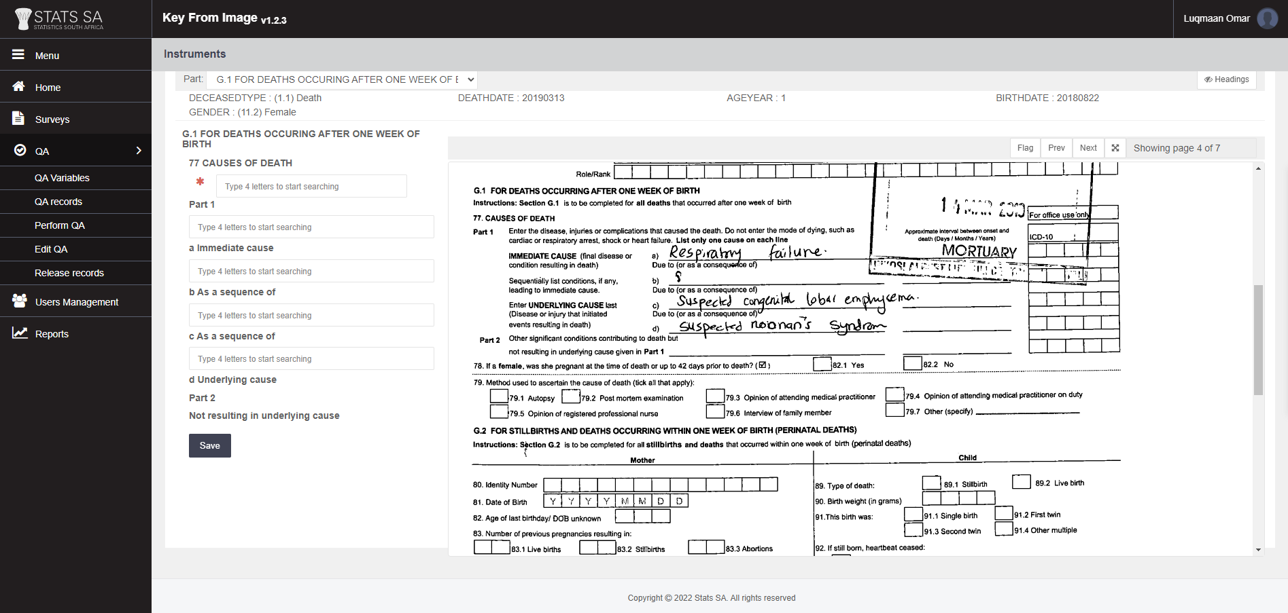
Automation of Coding

Slide 12
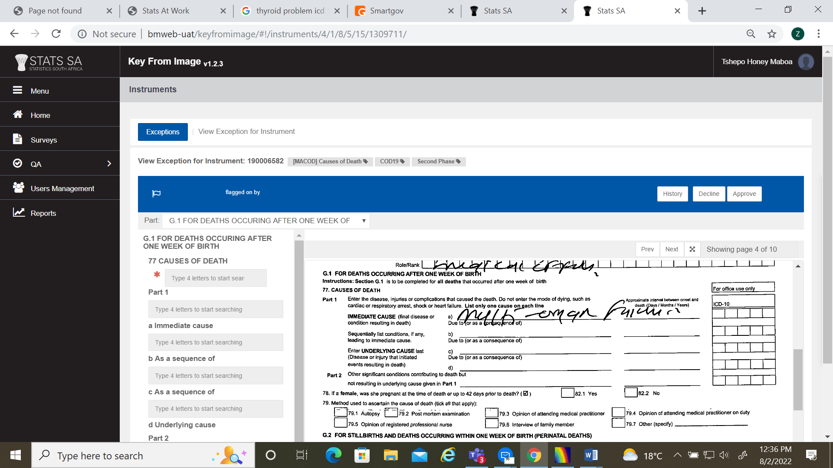
Coding - Illegibility

Slide 13
Other challenges
Insufficient information on DNF e.g., Coding to fourth character (reporting third character);
Usage of unstandardised abbreviations E.g. PWA, ARD
Misreporting of causes of death
E.g. HIV disease, immunosuppression

Slide 14
Deaths assigned to symptoms, signs and abnormal clinical and laboratory findings not elsewhere classified and year of death, 1997–2018

Slide 15
Critical considerations
Development of key institutions for the implementation of CRVS nationally
Create and implement legal instrument that will sustain the system
Institutionalising coordination mechanisms
Leveraging on critical institutions (universities) and use of incentives to encourage training and improving learning systems
Institutionalise the training of Doctors

