Slide 1
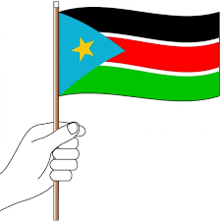
Republic of South Sudan
Toward Robust Civil Registration System
Lt. Gen. Atem Marol Biar
Director General
Directorate of Civil Registry, Nationality, Passports and Immigration

Slide 2
Background
Republic of South Sudan gained independence in 2011.
Population- 14,234,977
Languages- English, Arabic and Swahili with the East African Community integration agenda
Ministry of Interior is the LEAD Government institution for Civil Registration- Directorate of Civil Registration, Nationality, Passport and Immigration (DCRNPI)
Ministry of Health is a major player in the provision of vital events such as birth, death and causes of death.

Slide 3
Legal Framework in South Sudan for CRVS
Transitional Constitutional 2011, as amended, Article 45.
Nationality Act 2011, and its regulations 2011.
Passports and Immigration Act, 2011, and its regulations.
Civil Registry, Act 2018, regulations partially developed.
Child Act, 2008.

Slide 4
Key Progress on CRVS
In 2019, The President of the Republic of South Sudan launched the Civil Registry law, 2018 ( Political will).
Establishment of Infrastructure (office space for HQs, and States)
Formation of Technical Committee as a coordination Mechanism.
2011 to date- Ministry of Health to provides Birth notification to children, a key identify document to obtain nationality and passport
Rapid assessment conducted by UNCEA on CRVS in September 2022 on the invitation of Government viewed as opportunity to determine status and gaps in CRVS.

Slide 5
Progress so..
International engagements- participated at 5 CRVS ministerial conferences ( South Africa, Ivory Coast, Mauritania, Zambia and Ethiopia) with complete composition of ministries of Interior, Health and National Bureau of Statistics
Inter- Agency public consultation has been conducted, and strategic objectives identified.
Partial development of Regulations on Identity Management

Slide 6
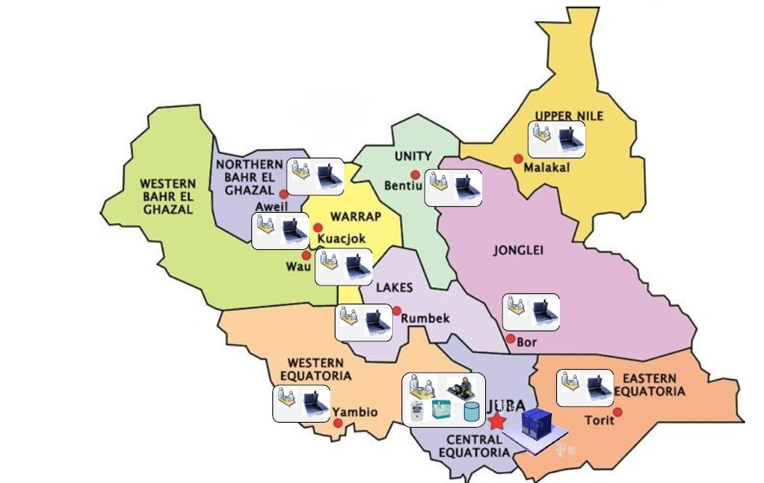
Current Coverage
10 states & 3 Administrative Areas.

Slide 7
CHALLENGES
Budgetary constraints – as the operationalization of the Civil registry Act is delayed.
lack of capacity (Institutional and personnel) .
Limited ICT Infrastructure.
Accessibility to remote areas of the country due to Mobility.
Limited Coordination Mechanism among agencies with mandate on CRVS.
Lack of harmonization of procedures across Government institutions.

Slide 8
Way Forward
Strengthen the Interoperability with Health Sector.
Harmonize procedures and requirement for civil registration.
Operationalize civil registration in all the 10 states’ capital of South Sudan with immediate effect.
Establish the advisory council for inter – ministerial coordination as stipulate in the Law.
Development partners to provide technical support to boost Government efforts.

Slide 9
Thank you!
Shukran!
Asante Sana!
Merci !

Slide 10
ANY
QUESTION!

