Slide 1
Developing Statistical CAPACITY together in 2021
A PARIS21 PERSPECTIVE
Forum of Statistical development in Africa (FASDev IX)
14 December 2020

Slide 2
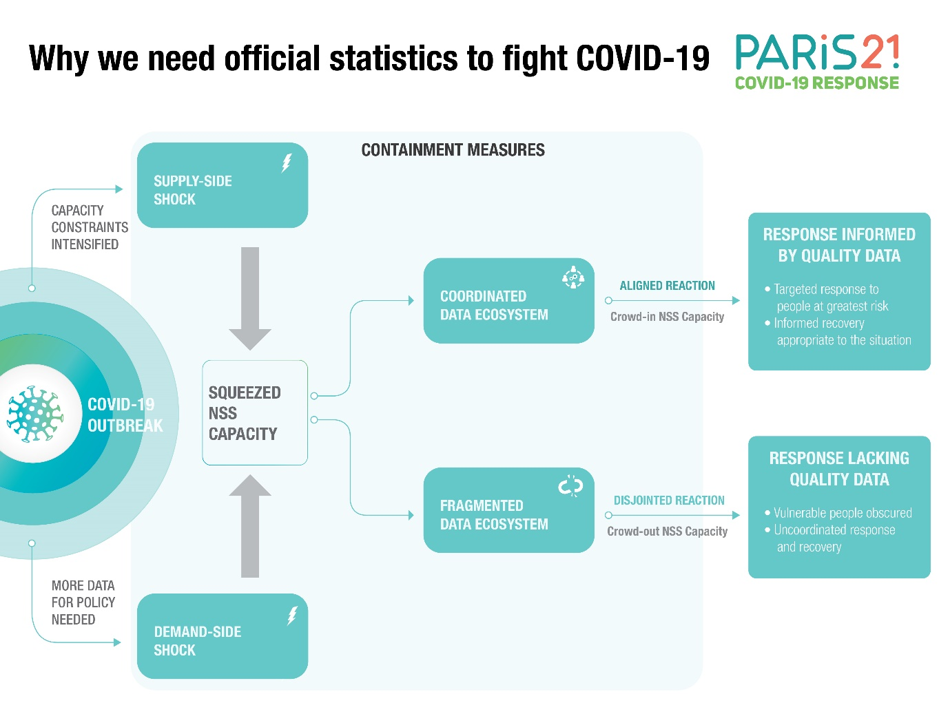
STATCAP MATTERS MORE THAN EVER
NSS Capacity is under pressure
Data gaps, and policy makers flying blind
Misinformation: trust in data in polarized societies
Strategic development of statistical capacity
Data use and re-use

Slide 3
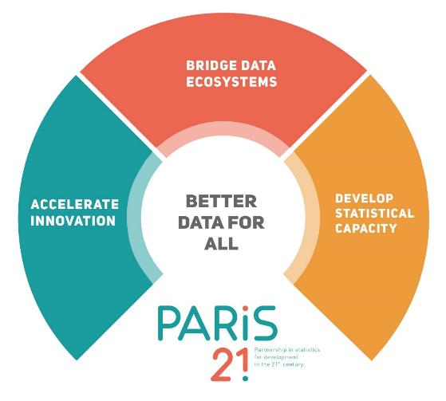
NEW STRATEGY IN TIMES COVID-19
3 STRATEGIC PILLARS
5 OBJECTIVES
- National statistical systems are fit for purpose
- Data use for policymaking is strengthened
- Data ecosystems are equipped to leave no one behind
- More and better financing for development data is available
- Partnerships for data-driven sustainable development are enhanced
1 VISION
Better data for all - a world where all countries produce and use high-quality data and statistics to advance sustainable development

Slide 4

CLEARINGHOUSE FOR FINANCING DEVELOPMENT DATA
In focus!
ISSUES
ACTION
Provide timely information on donor funding & country needs
IMPACT
Fragmented data funding landscape
Difficulty accessing relevant information
Weak business cases
Features/functionalities:
Visualising near real-time funding flows & opportunities
Nowcasting & forecasting
Country/donor profiles
Good practices & peer exchanges
Key resources for advocacy
Matching supply & demand for support
Better funding coordination & alignment
RESULT
More & better funding for development data

Slide 5

IN FOCUS! Gender statistics
3x
Data literacy and scaling capacity
New resource for journalists and statisticians to:
Promote the use of gender statistics in the media
Strengthen communication skills of statisticians
Data Literacy 2021 Initiative
Mainstreaming in NSDS
Women do times as
much unpaid work as men.
    Who planned and prepared the meals for your family?
    Did you
    care for a child today?

Slide 6
Thank you
www.paris21.org
@ContactPARIS21

