Slide 1
FUNDING Statistical CAPACITY
2020 PRESS report
PARIS21
Forum of Statistical development in Africa (FASDev IX)
14 December 2020

Slide 2

Partner report on support to statistics (press)
PRESS is the most comprehensive global analysis of financial flows to data and statistics
For the first time, we provide a nowcasting & forecasting to show funding to data and statistics during the COVID-19 pandemic
www.paris21.org

Slide 3
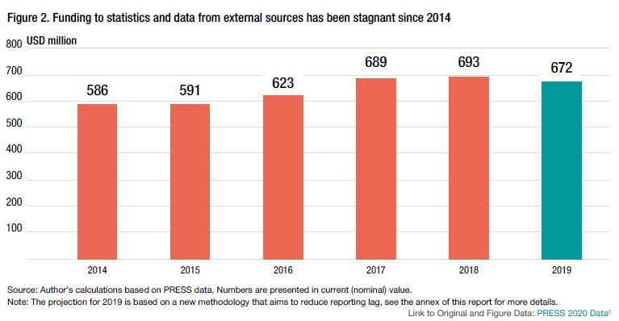
Funding is stagnant since 2014
Official funding flows to data & statistics amounted to $693m (0.34% of total ODA) in 2018 and are projected to not increase in 2019.

Slide 4
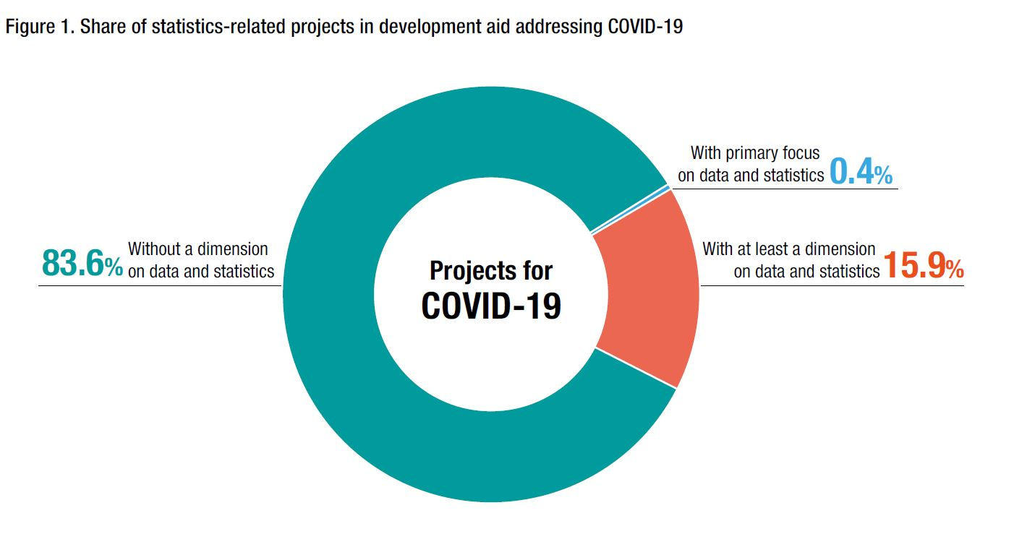
Share of covid-19 aid
Only 0.4% of international COVID-19 aid has a primary focus on data and statistics

Slide 5

The clearinghouse will increase aid effectiveness
The Clearinghouse on Financing Development Data can make financing for development and statistics smarter

