Slide 1
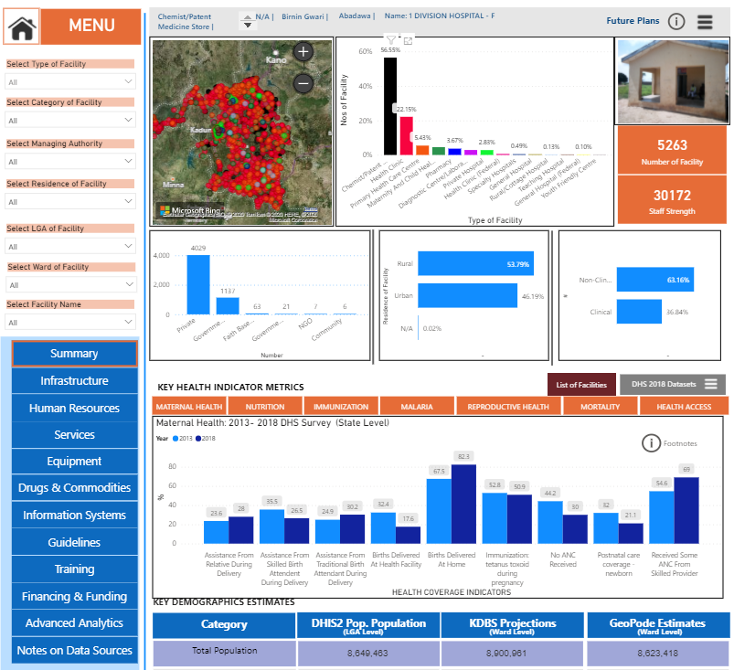

Dec | 2020
Improve Partnership & Direct Funding To NSOs through Coordinated Funding Through Pan-African Partners (SASHA)
Invest In Local, African Led Data Ecosystems Especially Public-Edu-Private Partnerships Incorporating More Youth Across The Data Value Chain
Innovate and Experiment On Improving Data Quality, Flow, Openness, Analytics & Actionable Use Especially At Sub-National Level
Co-Invest in Shared Public Good Infrastructure Where Efficiency Gains Possible While Ensuring Country Sovereignty
Africa Focus Areas
Evidence Generation and Lesson Learning, Especially To Distinguish Between Technological “Hype” and Reality
Do Less Harm (Less Fragmentation / Duplication of Efforts/Institutional By-pass) And Coordinate Internal Data Investments Better On The Continent
ash.shah@gatesfoundation.org

Slide 2
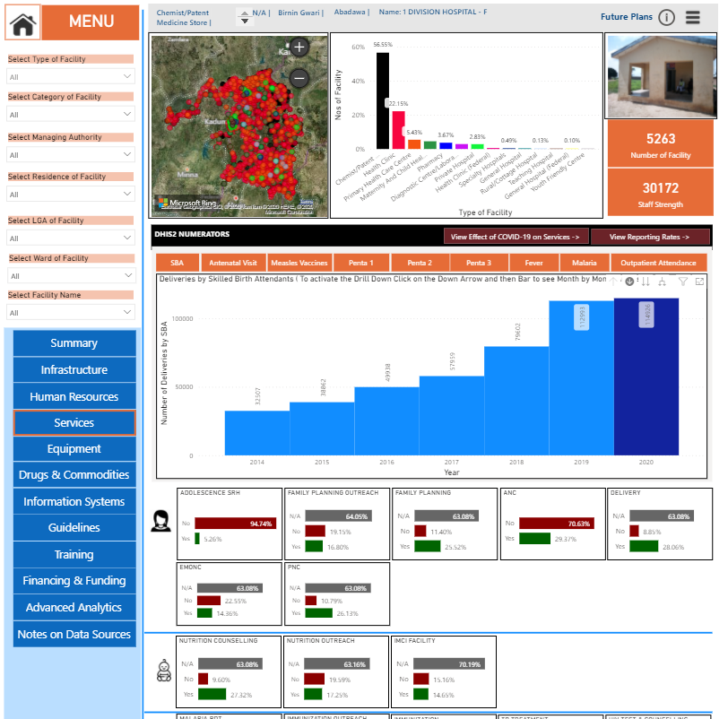
Dec | 2020
https://hefa.kdbs.ng/
Africa Focus Areas
ash.shah@gatesfoundation.org

