Slide 1
Challenges faced by African NSS in responding to data demands amidst the COVID-19 pandemic
Edem Kossi Kludza
Associate Statistician, African Centre for Statistics
Economic Commission for Africa
14 December 2020
Addis Ababa, Ethiopia

Slide 2
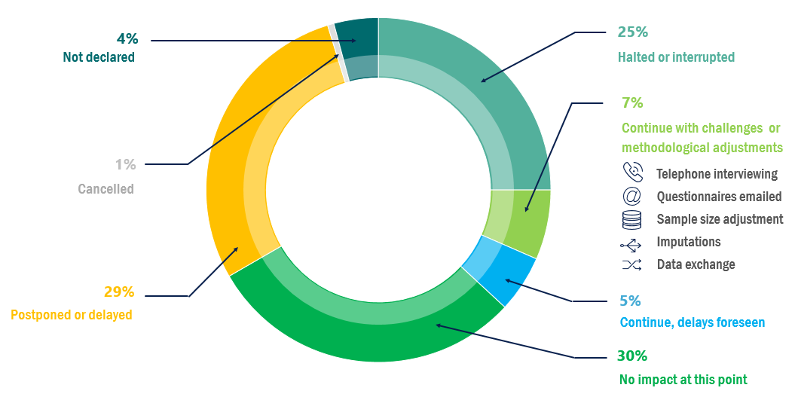


Operational challenges
Is your main office currently closed?
Compared to March and May, the situation has considerably improved in July with 8 NSOs out of 10 opened to all staff, and the remaining closed only to non-essential staff.
Status of surveys planned for 2020 as a consequence of COVID-19 – March 2020
Stopped face-to-face data collection?
In March 2020, 66% of planned surveys were affected by the pandemic.
Face-to-face data collection is still severely disrupted despite a gradually relaunch/recovery in few NSOs.
Stopped face-to-face data collection?
Notes:
New normality

Slide 3
Operational challenges
ICT readiness during the COVID-19 pandemic (July 2020)
Remote trainings amidst the COVID-19 crisis
ICT equipment and infrastructure still an important constraint in Africa.
Despite constraints in ICT infrastructure and equipment, NSOs have nevertheless managed to remotely strengthen their staff capacities in several areas.
Notes:
ASD 2020

Slide 4
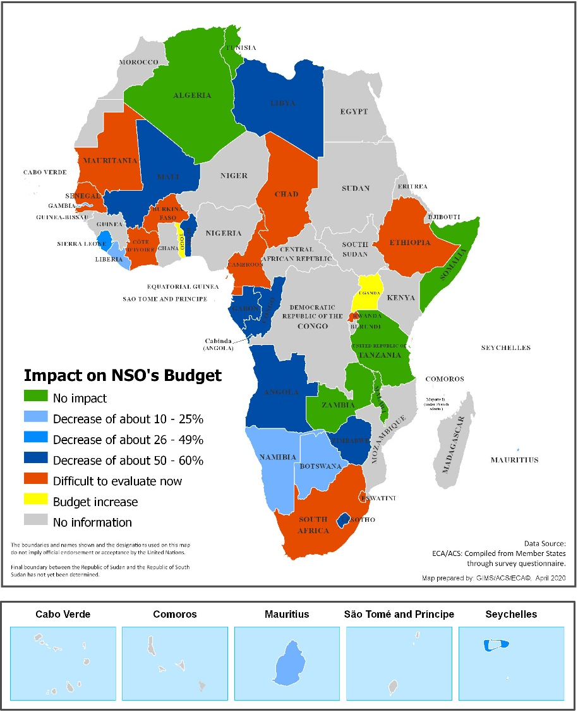
Funding challenges
Foreseen change in budget allocation due to COVID-19 in March 2020
Foreseen change in budget allocation due to COVID-19 vs actual impact in May 2020
Funding of NSOs in Africa has been severely affected nonetheless it was less than foreseen at the onset on the pandemic.
77% of offices reported changes in funding, which mainly consist of a decrease.
International organizations and partners are actively supporting NSOs to face the challenges posed by the COVID-19 pandemic.
Support received (July 2020)
Notes:
The force of the war

Slide 5
THANK YOU!

