Slide 1
Statistics Norway – cooperation projects in Africa
Session III: Contributions to statistical development in African countries within the context of the current and post-COVID-19 scenarios
14.12.2020

Slide 2
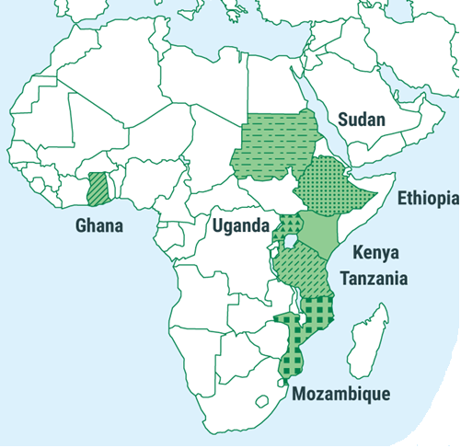
Cooperation projects in Africa - Statistics Norway
Support to national statistical systems – built on institutional cooperation with sister agencies.
Provide support in subject areas identified by the partner countries and where SSB has special competencies – use our own experts.
Traditionally economic statistics/national accounts, macro economic models, living conditions surveys.
Now a shift towards more register based statistics?
General statistical cooperation (Sudan, Ethiopia)
Oil for Development/Petroleum statistics (Uganda, Ghana, Mozambique, Kenya)
Energy statistics (Mozambique, Tanzania)
Developing software for a statistical business register
Support to National accounts systems - NADABAS
Food security (COMESA)

