Slide 1
Making Every Women and Girl Count
(Women Count)
Admin data initiatives
June 2022

Slide 2
UN Women’s strategy for change on gender data: Women Count
Three Inter-related Challenges
Women Count Solutions
Weak policy space, legal and financial environment to produce and use gender statistics at the national level
Technical Challenges within NSS that limit the production of gender data and statistics
Lack of access and limited capacity on the part of users to analyse gender statistics to inform policies
Enabling policy environment
Promoting a supportive policy environment to prioritize gender data and effective monitoring of the SDGs
Increasing Data Production
Supporting efforts to improve the regular production of gender statistics
Improving data accessibility and policy use
Improving access to data to inform policy advocacy through solutions such as and user-producer dialogues.
SP Outcome 6 on Gender Data and Statistics

Slide 3
WHERE WE WORK
Europe & Central Asia
Global Policy Support Project
Kyrgyz Republic
Georgia
Mongolia
China
Albania*
Tajikistan
Morocco
Nepal
Centre of Excellence on Gender Statistics
Barbados, MCO
Jordan
Bangladesh
Egypt
UAE
West & Central Africa
Saudi Arabia
Ethiopia
Senegal
Uganda
East & Southern Africa
Cambodia
Viet Nam
Philippines
Colombia
Sierra Leone*
DRC
Maldives
Kenya
Asia & the Pacific
Cote d’Ivoire
Cameroon
Rwanda
Tanzania
Malawi
Fiji
Pathfinder countries
Zimbabwe
Palau
Non-pathfinder countries
Regional projects
Global projects
Direct technical support

Slide 4
Women Count Phase I in ESA
Stage 1: assessment in completed work being initiated
Stage 2: assessment completed and some work completed
Stage 3: Integrated multi-year interventions

Slide 5
Moving forward Women Count Phase II in ESA
Expand the support towards the improvement of gender data production through administrative data sources
Support the work of the collaborative on administrative data
Develop a quality assessment framework for administrative data
Assess and develop improvement plans at country level for administrative data that is relevant to gender sector
Emphasis on admin data related to trade, land ownership, GBV. If no other support is available through other Un partners also CRVS and education.
Mobilize resources to support the modernization at country level of administrative data sources.

Slide 6
Inter-agency collaboration and partnerships are key to the programme’s success
NSOs

Slide 7
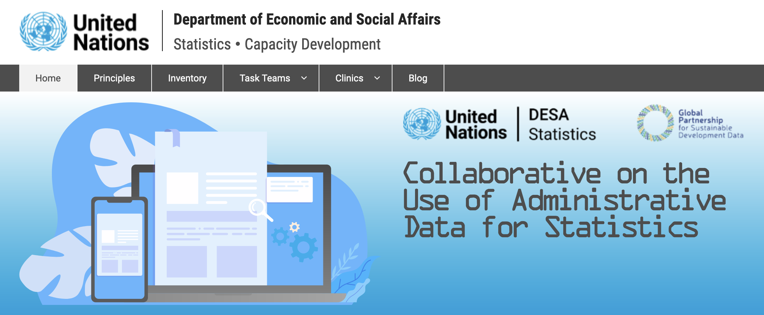
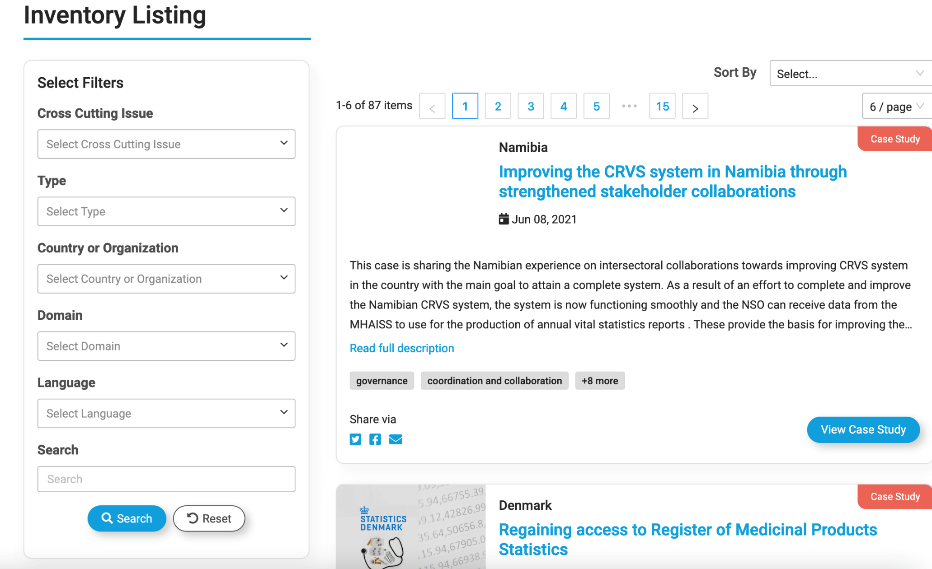
Collaborative on Administrative Data
40+ members, countries and intern. Organisations
Sharing of learning and best practice around admin data
Member-driven activities
Inventory of resources

Slide 8
Dialogue with and awareness-raising among admin data owners
Full access to and transfer of admin data can be a challenge
Quality of the input data a second potential challenge
A strong need for dialogue, political buy in and support from the top to improve both
Time invested in advocacy and awareness-raising can ultimately result in better-quality data
Guidance and tools needed for the work

Slide 9
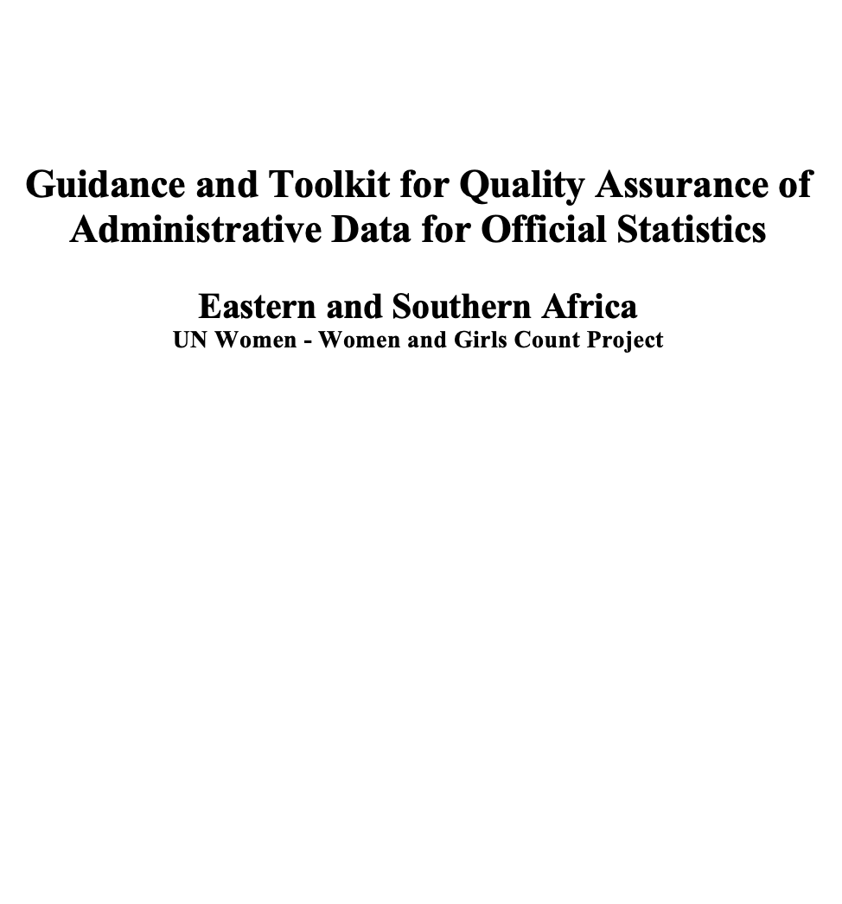
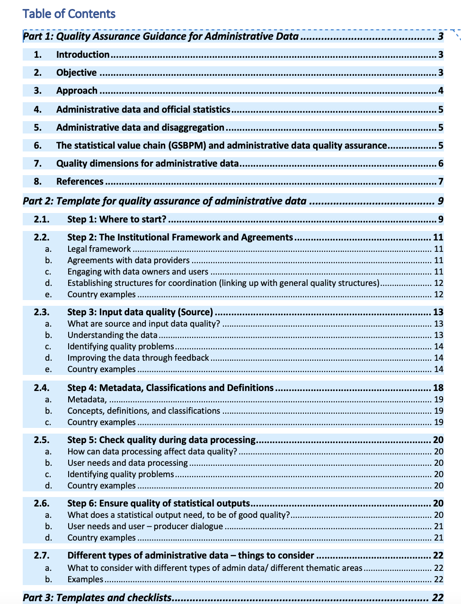
The admin data quality assurance toolkit and e-learning materials for data owners
1. Admin data training course for ministries, departments and agencies
2. Admin data quality assurance toolkit

Slide 10
Training course for data owners / Ministries, Departments and Agencies
4 modules for piloting with selected countries
Introduction to admin data and the NSS
Different forms of engagement
Mapping of sources
Quality management
More modules planned for later
IT infrastructure
Data linking
Initially started and financed
under the UNSD Dev. Account 13
Notes:
The work was started and initially financed by UNSD under the Development Account 13 project

Slide 11
Timeline

Slide 12
Quality Assurance and Admin Data
Quality assurance frameworks normally designed for survey/census based statistical systems
Increasing interest in admin data all over the world
NQAF updated to include chapter on admin data and references to it throughout the document
Handbooks and guides on specific topics (census, business statistics) and admin data exist
No official guidance or collection of practical tools and practices yet

Slide 13
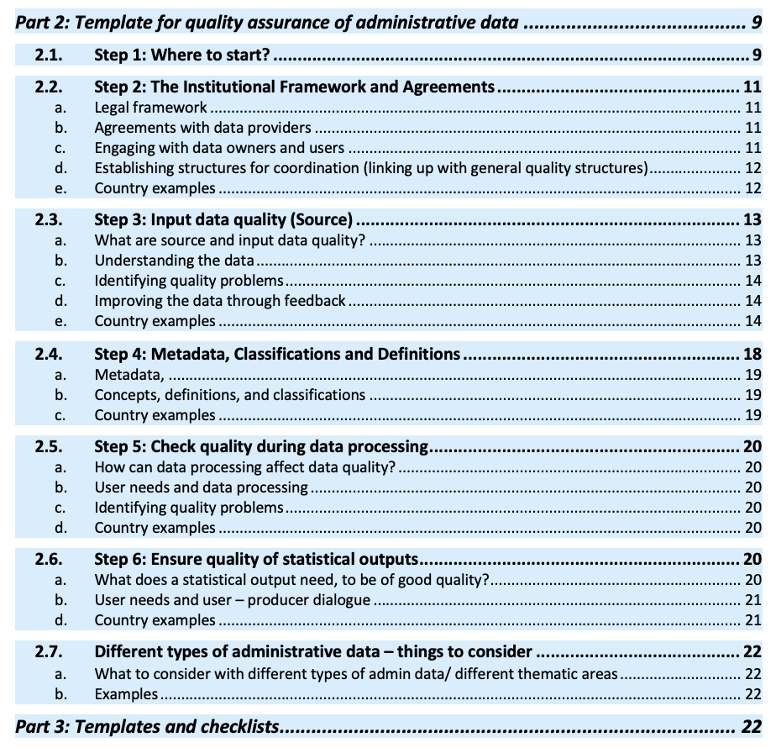
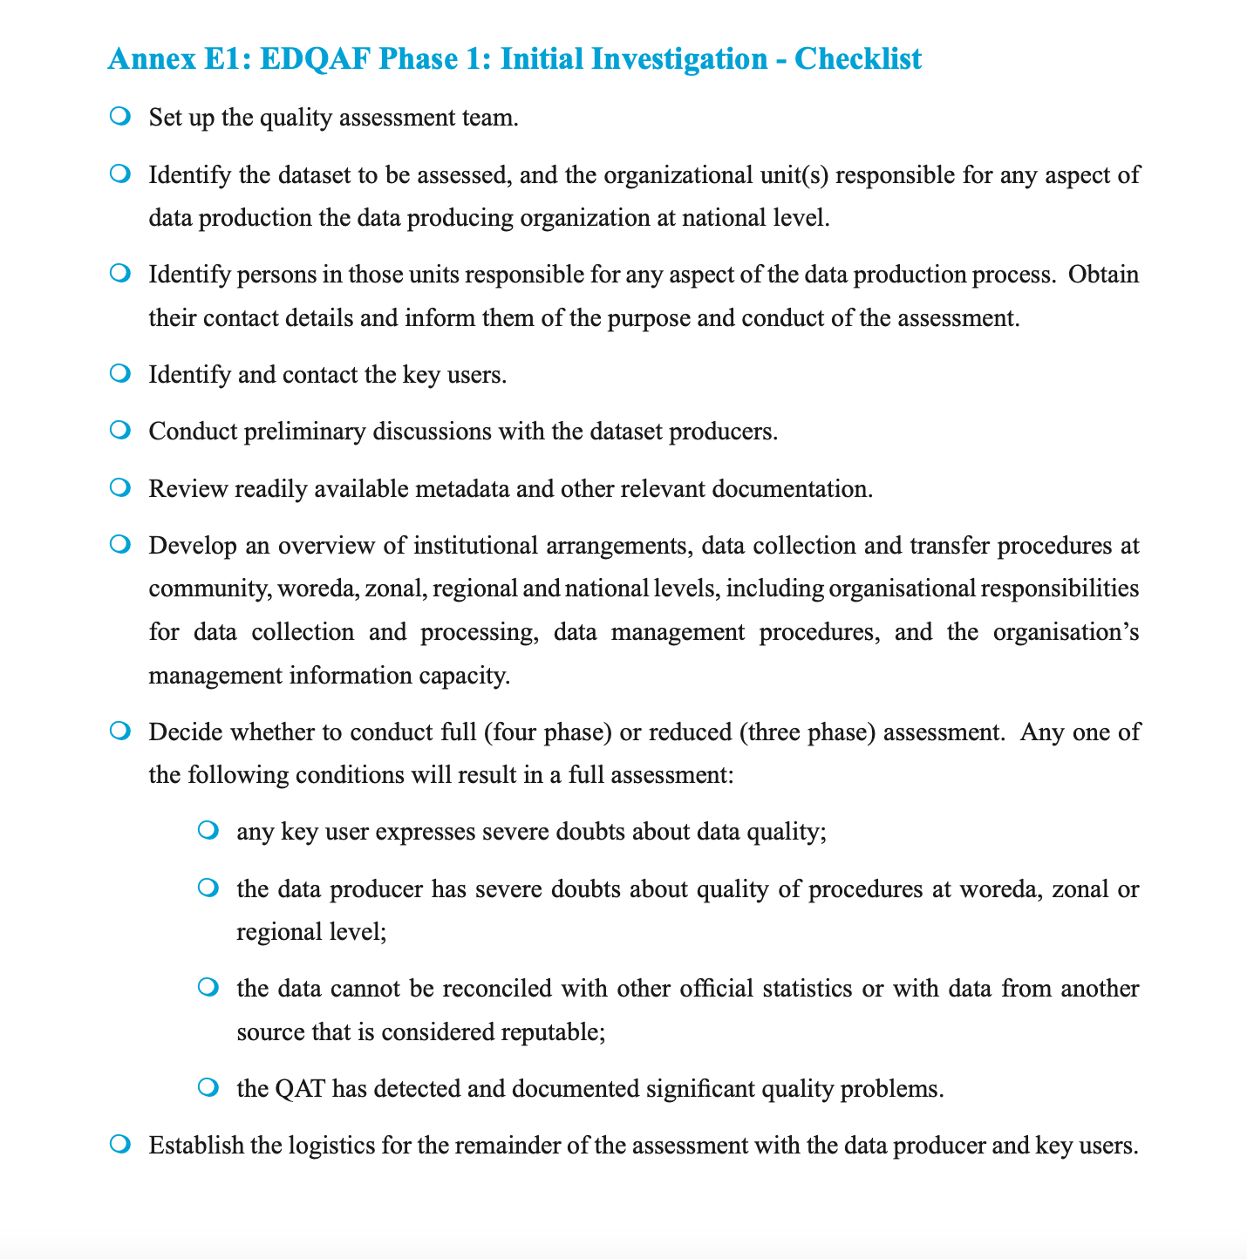
Admin Data Quality Assurance Toolkit
Practically oriented
3 parts:
a background document,
a step by step guide and
a collection of existing tools
Ideally in the end endorsed by the NQAF group

Slide 14
Development Process of the Guidance and Toolkit
So far:
1st round of consultations with countries of the region
Review of international guidance/ best practice
Linking up with UNSD NQAF group
Next steps:
Draft for review in various fora
Adjustment and country testing

Slide 15
Country example: Uganda
GBV Admin Data Support for Justice, Law, and Order Sector
ASSESSMENT
TRAINING
Assessment of JLOS GBV administrative data collection mechanisms and management systems
Trained data management personnel on GS concepts and definitions, instrument design, data collection, analysis and presentation.
01
02
03
04
05
MOU AND TECHNICAL WORKING GROUP
TOOL REVIEW AND DEVELOPMENT
ROLL-OUT
UBOS led establishment of technical Working Group building on existing data structures in JLOS and PNSD.
Reviewed and updated the GBV data collection tools; Development of a catalogue of crime data concepts and indicators
Roll out and institutionalization of the tools across agencies

Slide 16
Achievements
ENABLING ENVIRONMENT
DATA PRODUCTION
DATA ACCESS, USE & IMPACT
Six JLOS-MDAs namely; UPF, Judiciary, Office of the ODPP, UPS, DGAL, and MGLSD have become more responsive to GBV & related GS & data requirements
New data are filling critical gender data gaps to monitor GBV, VAWG and related SDGs and influence national policies
GBV and related gender data are increasingly accessible and used to shape policies
Policy Briefs developed based on mining & analysis of administrative data from UPF, ODPP and Judiciary and have triggered policy debate on increased access to justice.
MDA staff have enhanced data collection and management, analysis, presentation & reporting skills through training by Economic Policy Research Centre and UBOS.
Data collection tools revised, GBV requirements integrated and quality GBV data produced.
The reviewed tools for collection of GBV Data have been institutionalized.
Improved coordination mechanisms for production of quality GBV/VAWG & related gender data for GEWE & SDGs.
Improved planning of GBV and related gender statistics through strategic for statistics.
Comprehensive Data available from the VAWG /VAC/Family survey to support monitoring GBV and related gender-responsive GEWE and SDG indicators.
Citizen Generated Data (CGD) Guideline/Toolkit has been developed and launched to support generating alternative data to complement official statistics.
Adoption of national set of gender indicators, used to monitor GBV, GEWE and SDGs.
Equipment for data capture provided to 18 JLOS MDAs.
UPF, Judiciary, ODPP, UPS. DGAL & MGLSD Data Management Personnel have strengthened capacity to produce and use GBV & GS.
Training on GBV and GS production is being rolled out by the UPF, Judiciary and ODPP.
Notes:
N.B Six Justice, Law and Order Sector (JLOS) Ministries, Departments and Agencies (MDAs) namely; Uganda Police Force (UPF), Judiciary, Office of the Directorate of Public Prosecution (ODPP), Uganda Prison Services (UPS), Department of Government Analytical Laboratory (DGAL), and Ministry of Gender, Labour and Social Development (MGLSD)

Slide 17
Lessons Learned & Challenges encountered
What worked well
Challenges
Timing and Positioning for development of GBV and related GS & Data for the JLOS.
Increased demand for financial and technical support for emerging data needs due to COVID 19 effects and GEWE and SDG priorities.
Alignment with national, regional, global best practices.
Human and financial resource constraints
Partnerships are worth the investment for synergy and enhanced coordination & harmonisation of data management.
Inadequate technical capacity and infrastructure
Internal UN Women demand driven collaboration and synergy in programming with EVAW Team with support and funding from the Spotlight Initiative.
Need to find more and strengthen synergies with other UN and UN Women Programmes.

Slide 18
Outcomes and Impacts
1
GBV, related GS & Data is being used for monitoring of National Development Plan (NDP III) and update of SDG Indicators and National Priority Gender Equality Indicators (NPGEIs), shared on Gender Statistics Web – Based Portal hosted by UBOS and National GBV Database Hosted by MGLSD.
2
GBV and GS & data requirements have been integrated into UN Women SN by Pillar; UN System-UN Sustainable Development Cooperation Framework by Strategic Pillar and UN Joint Programme on Data and Statistics that is being designed.

Slide 19
THANK YOU
Isabella.Schmidt@unwomen.org
Silja.Emmel@unwomen.org
Grace.Gulere@unwomen.org

