Slide 1
The legal environment in the UK enabling the use of admin data and our experiences in applying this
Simon Whitworth
Head of Data Ethics and Research Governance

Slide 2
The UK’s largest independent producer of official statistics and the recognised national statistical institute of the UK.
Responsible for collecting and publishing statistics related to the economy, population and society at national, regional and local levels.
Plays a leading role in national and international good practice in the production of official statistics.

Slide 3
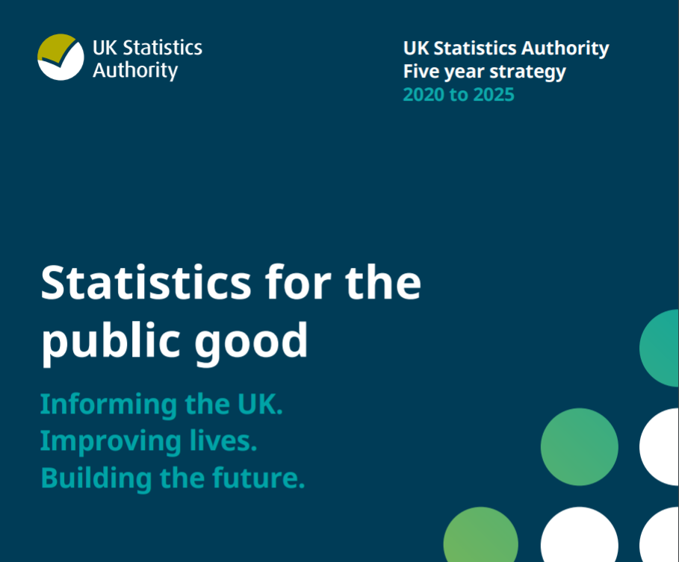
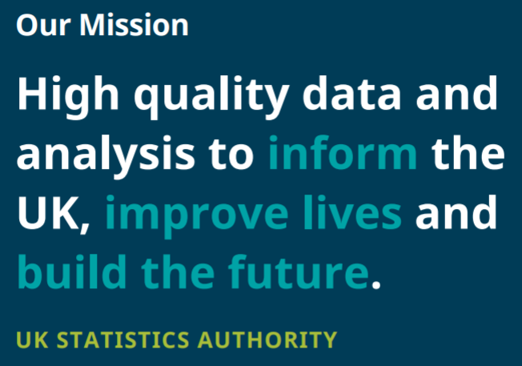
Strategy

Slide 4
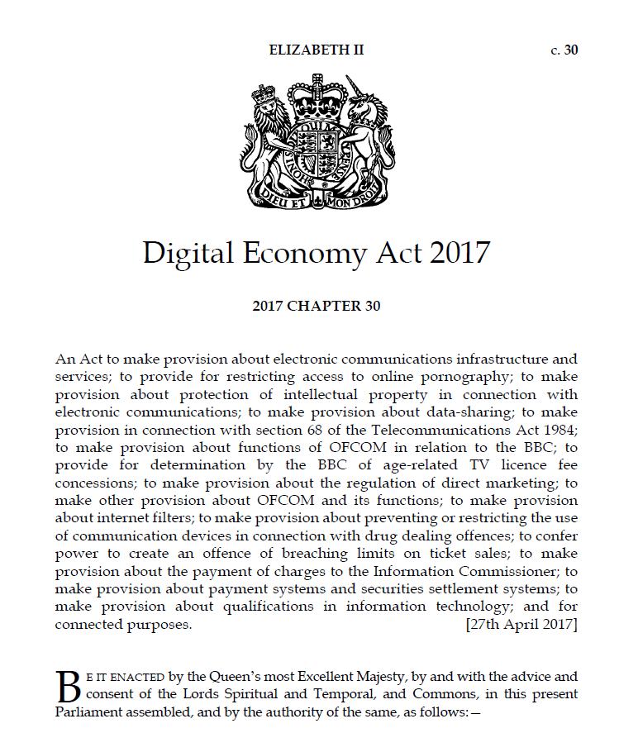

Slide 5
Legislation to overcome barriers
Structural factors
Legislation itself – Information Sharing Orders were restrictive and time-consuming
↓ survey response rates
Cultural factors
Culture of risk-aversion towards data sharing
Driven by doubts about the public acceptability of data sharing.
Data sharing seen to be of secondary importance.
Minimize respondent burden by using administrative data

Slide 6
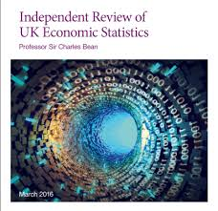
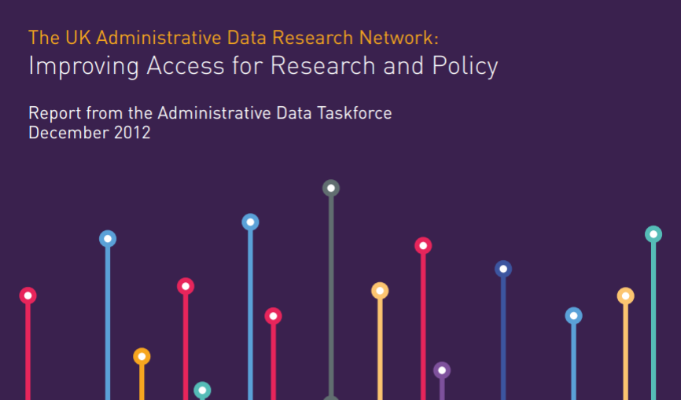
Nudges
“primary legislation should be sought to provide a generic legal gateway for research and statistical purposes that enables efficient access to, and linkage between, administrative data held by different government departments, agencies and other statutory bodies.”
“The UK significantly lags many other advanced economies in its exploitation of administrative data … This reflects both the cumbersome nature of the present legal framework governing the sharing of such data and a cultural reluctance on the part of some departments and officials to data sharing.”

Slide 7
Design and operationalisation of the DEA
2014
Draft policy and legal framework (2014-16)
Open policy-making (2014-16)
Draft legislation (2015-16)
Public consultation (2016)
2016
2017
Codes of Practice (2017-18) and parliamentary approval
Public consultation (Sept-Nov 2017)
Government response (March 2018)
Parliamentary review (May-June 2018))
2018
Parliamentary approval (July 2018)
Operationalisation – from Summer 2018
Legislative phase (2016-17)
Parliamentary review (October-December 2016)

Slide 8
Digital Economy Act
Legal clarity – A right of access to data for statistical and research purposes
Devolved statistics – Enable secure data shares with Devolved Administrations to support their statistical needs.
Data protection and security – Protect the privacy and ensure secure and ethical use of data.
Data integrity – A duty on data providers to consult statisticians on changes to data systems.
Data access for non-government research - Provides a permissive gateway for public authorities to make deidentified data available to researchers from outside government for analytical purposes that are in the public interest.

Slide 9
Underpinned by Code of Practice
Collaboration – consult with data suppliers and find collaborative solutions.
Confidentiality – maintain appropriate security controls.
Transparency – publish information on how we use the Digital Economy Act.
Ethics and the law – observe highest ethical standards.
Public interest – seek access to data based on an ability to produce statistics with a clear public interest.
Proportionality – ensure costs of providing access to data are proportionate to the statistical benefits from using the data.

Slide 10
Successes
Greater legal clarity and understanding of what data can be shared and how it can be shared
New datasets since April 2019…
NHS Digital (health conditions, hospital episodes)
HMRC Self Assessment (measuring household income, self-employment analysis)
Council tax data (Census, population statistics)
Exit checks (migration statistics)
Credit reference (financial statistics)
Retailers/scanner test datasets (price statistics, retail sales)
DWP demographic data (population statistics)
HMRC EC sales/VAT (trade statistics)
HMRC PAYE (labour market statistics)
43 administrative datasets made available to non-government researchers.

Slide 11
Challenges
Engagement
Collaboration takes time
Finding the right people to talk to
Overcoming different organisational ways of working
Capability
Understanding the data (what, why, when, how…)
Developing new ways of working to meet our legal obligations
Building the confidence of departments in the new legislation
Communicating the benefits of using a permissive generic legal gateway rather than department specific gateways for enabling efficient research access to linked data

Slide 12
Code of Practice
Collaboration
Confidentiality
Transparency
Ethics and the law
Public interest
Proportionality

Slide 13
Centre for Applied Data Ethics
Developed an self-assessment tool and guidance to enable researchers to consider the ethics of their research.
Ethics training for the research and statistical community across Government, academia and the commercial sector.
An ethics user support service for the research and statistics community to provide ethics advice at the research design phase.
Publish new guidance on cross cutting ethical issues in research and statistics.

Slide 14
Data Ethics Guidance
Geospatial data
Public good
Synthetic data
Machine Learning

Slide 15
simon.whitworth@statistics.gov.uk
Or visit our website: https://uksa.statisticsauthority.gov.uk/data-ethics/

