Slide 1
Eighth Session of Statistical Commission for Africa
Document E/ECA/STATCOM/8/2022/12
Road map for the transformation and modernization of official statistics in Africa
24 - 26 October 2022
Addis Ababa, Ethiopia
StatCom-Africa VIII

Slide 4
How to use the roadmap?

Slide 6
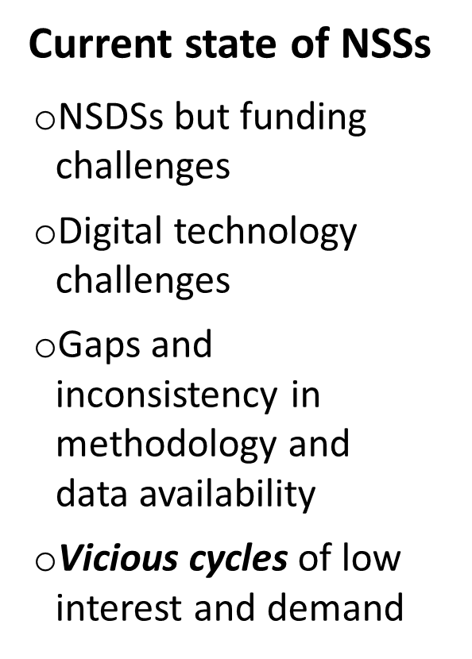
Key findings

Slide 7
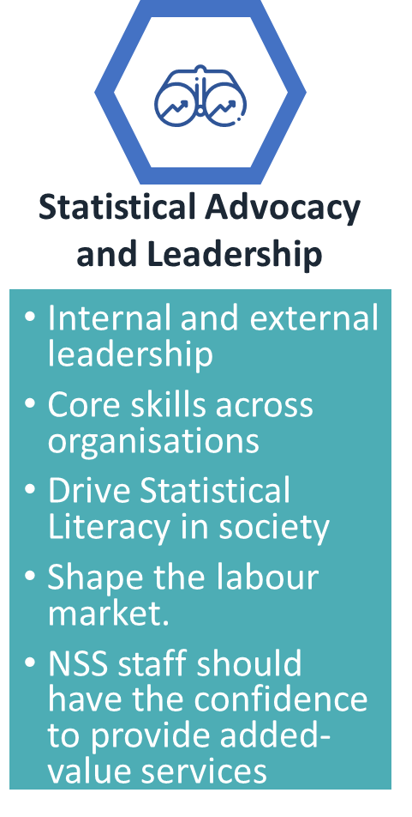
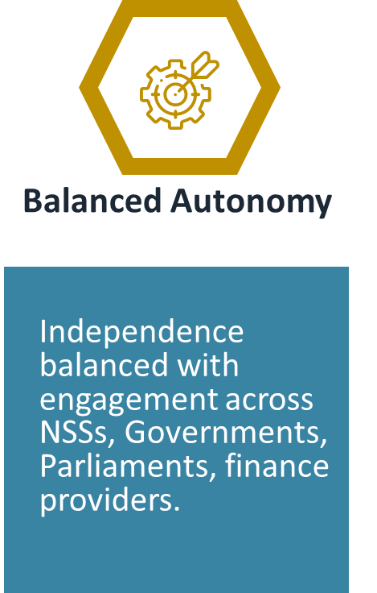
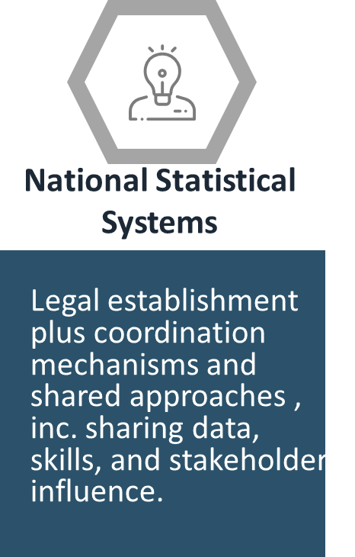
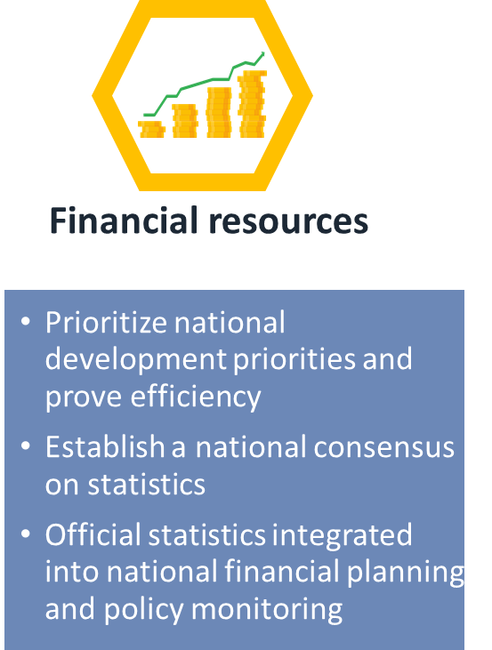
Foundational Enablers

Slide 8
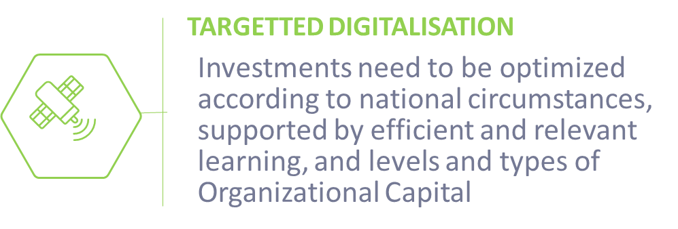
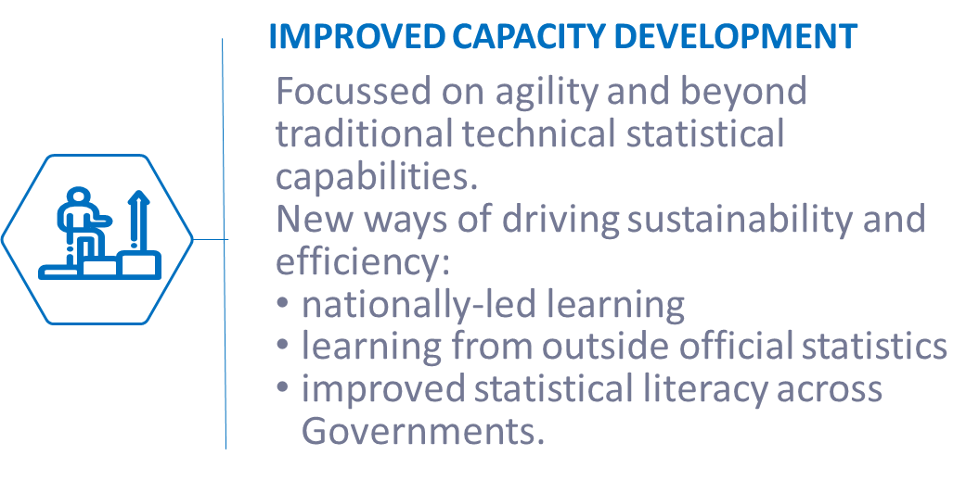
Priority Enablers

Slide 9
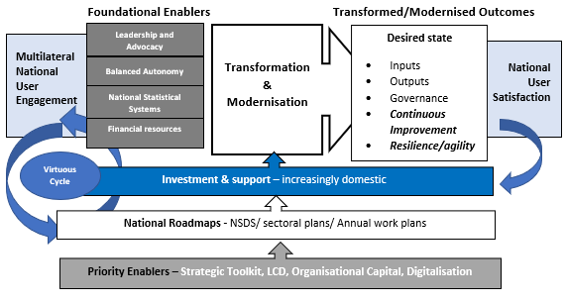
Using the Enablers to drive success

Slide 12
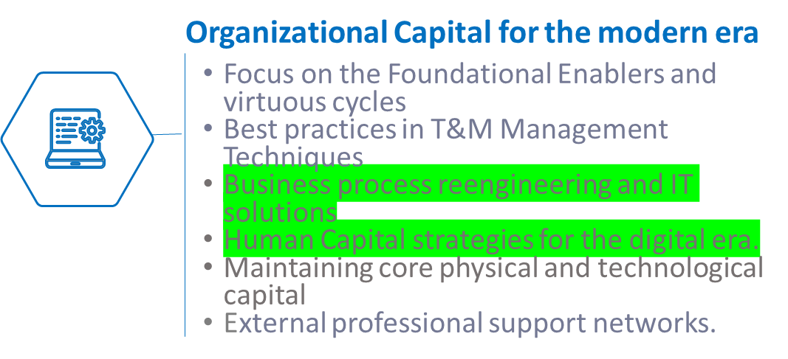
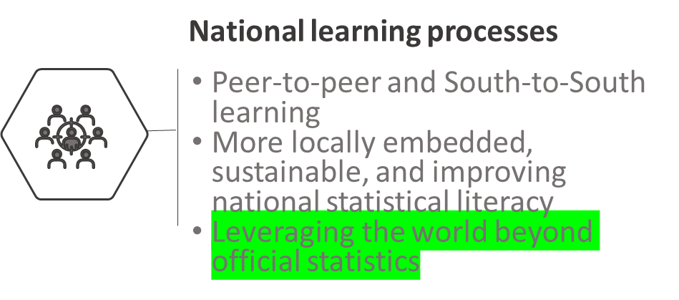
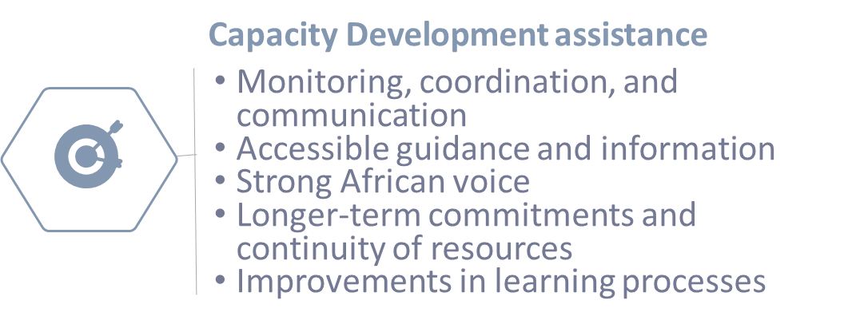
Strategic action plan
(and digitalisation)

Slide 13
THANK YOU!
Follow the conversation: #
More:

