Slide 1
UN-GGIM: Africa | Activities Report
UN-GGIM: Africa 8th Session
Addis, 26 October 2022
Oumar H. Ka
Chair, Executive Board
National Land-use Planning Agency (ANAT, Senegal)
Oumarka.anat@gmail.com

Slide 2
Africa Regional Committee | Where we Come From
…From cartography as a standalone activity
CODI II
UN-GGIM
IGIF
...To information for development
Resolution urging Member States to adopt National Spatial Data Infrastructures
8/2015 - UN-GGIM-4 Resolution 5/112
Endorsed the establishment of UN-GGIM:Africa
7underpinning principles,
8 goals
9 strategic pathways.
1961
2001
2013
2015
2017
2018
…To integrated frameworks
UNRCCA
CODIST
Action Plan: Gi4SD
Resolution 816 (XXXI) of ECOSOC to convene a UNRCCA
second session of the UNRCCA held in Tunis in 1966
Recommends that the oversight and supervisory functions of the of CODIST-Geo be transferred to an equivalent subcommittee of StatCom Africa with the name of UN-GGIM:Africa
Action Plan
Strategy for integration GIS & Stats
.

Slide 3
UN-GGIM: Africa | The Journey So far…
Preparatory Meeting
First Meeting
Fifth Meeting
Seventh Meeting
Africa agrees to take part in the nascent process of UN-GGIM.
Formal endorsement by the UNCE.
Endorsement by Member States
Constitution of Working Groups
Revamping the action plan
Engendering Member States participation
Review of Management and Governance
2014
2017
2020
2011
2015
2019
2021
Third Meeting
Sixth Meeting
Look at policies, measures and steps that African countries could take to ensure a successful implementation of the UN-GGIM.
Strategies for a geospatial response to COVID-19 Pandemic
Inaugural Meeting
Transitional Bureau Working Groups
.

Slide 4
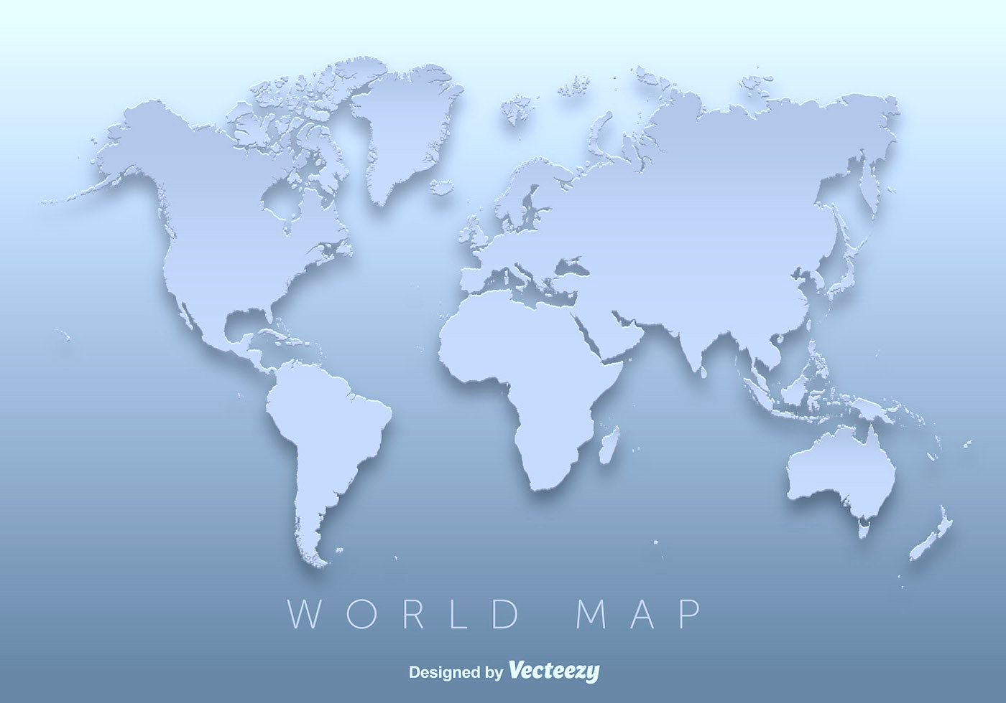
UN-GGIM: Africa | Governance & Arrangement
Executive Board
Chair: Senegal
1st Vice-Chair: Botswana
2nd Vice-Chair: Algeria
1st Rapporteur: Cameroon
2nd Rapporteur: Uganda
Secretariat: UNECA
Algeria
Senegal
Cameroon
Uganda
Botswana

Slide 5
UN-GGIM: Africa | Mechanisms & Frameworks
UN-GGIM Africa
Executive Board 2022)
Working Group (20202) | Chair | Members | NON Voting Members
WG1: African Geodetic Reference Frame | 1. Kenya | Burkina Faso Morocco Botswana Cameroon | Madagascar Nigeria Senegal South Africa AFRIGIST RCMRD UNECA
WG2: Fundamental Geospatial datasets and Standards | 1. South Africa | Cameroon South Sudan Burkina Faso Algeria | Côte d’Ivoire Madagascar Mali Niger Nigeria Senegal UNECA
WG3: Institutional arrangements and Legal frameworks | 1. Algeria | Nigeria South Africa Ethiopia | Burkina Faso Morocco UNECA
WG4: Capacity and capability development | 1. Nigeria | Kenya E-swatini Côte d’Ivoire | South Africa Burkina Faso AFRIGIST RCMRD AARSE UNECA
WG5: Integration of Geospatial and Statistical Information for Sectoral Applications | 1. South Sudan | Namibia Mali Cameroon | Burkina Kenya Niger Senegal Togo UNECA
SENEGAL
BOTSWANA
ALGERIA
CAMEROUN
UGANDA
ECONOMIC COMMISSION FOR AFRICA
WG 1: Geodetic infrastructure Standards
WG 2:
Fundamental Datasets and Standards
WG 3:
Institutional
& Legal
WG 4:
Capacity Building
WG 5:
Integration of Geospatial & Stats

Slide 6
UN-GGIM: Africa | Focus AReas
NSDI
Standards
FDS
AFREF
SALB
GeoNyms
Geo4Stats
Frameworks with related policies & structures
Standardization and Interoperability
Fundamental Geospatial Datasets
African Geodetic Reference Frame
Second Administrative Level Boundaries
Geographic Names
Linking NSDI and NSDS
African action Plan : Published.
African Geospatial Policies: dimensions of geospatial overarching policies for Africa – Editing underway
Development of a guiding document on key geospatial standards for Africa – Editing underway
Contribution to UN-GGIM Working Group on FDS
Development of Policies Guidelines on Standards for Africa
Implementation of the Digital Earth Africa initiative
Organization of the 2nd Meeting of the AFRFE Working Group
Strategy for revamping the programme – Editing underway
Data received from only a few countries
Revamping the Standard Web-based application
Mainstreaming GIS in NSOs

Slide 7
UN-GGIM: Africa | Activities Carried out
Dialogue
Operations
Knowledge
Partnership
Capacities
Elaboration of the African Geospatial Development Index to benchmark countries readiness
Organization of the 7th Session of the Regional Committee (21-24 Nov.2021)
#
Contribution to activities of the global UN-GGIM
1. UN-GGIM 11th Session
2. Expanded Bureau
3. HLG - IGIF
E-learning courses on evaluating the socioeconomic benefits of investing in geospatial information
IGIF | National Action Action Plans : CAM, ESW, MOZ, RWA, SEN, TUN
Contribution to the work of the thematic, expert and working groups
EG | ISGI
WG | Disasters Services
#
#
#
Workshop on Value Proposition of Geospatial Data
Nov. 2021
Development of Guidelines on Geocoding as part of the implementation of the
Strategy for integration of GIS & Stats
National Trainings:
- Geocoding schemes
- Census Data Dissemination Strategy
#
.#

Slide 8
UN-GGIM: Africa | NEXUS Issues & Challenges
1. Programmatic
[Deliver]
How do we ensure that Gi4SD is implemented to its fullest potential?
How do we link Gi4SD with the society day-to-day delivery of services, decisions.
2. Management
[Amplify]
3. Sustainability
[Sustain]
Mobilization of resources
What are the Financial Appropriation Mechanisms?
Member States Engagement and contribution
Developing ground level support actions
Working Groups
1. Revamping the modus operandi
2. Alignment with the Thematic Groups and Networks
Inadequacy between planned activities and resources allocation
Ownership Establishment of Effective National Leadership
Does UN-GGIM serve African nations interest?

Slide 9
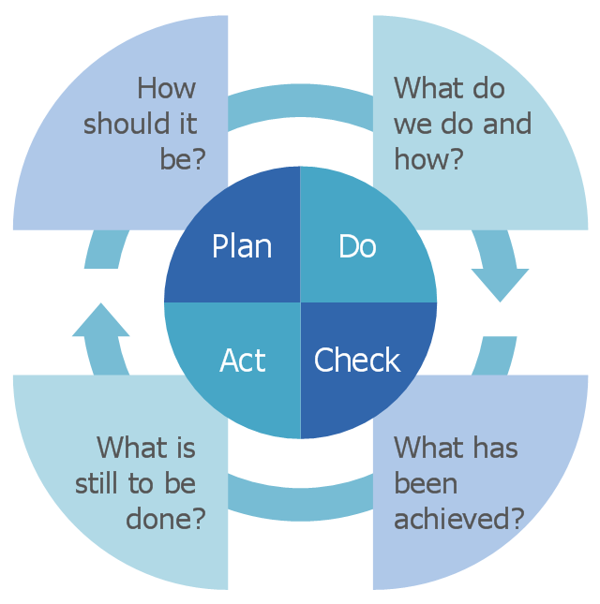
UN-GGIM: Africa | Looking Forward
Consolidate the consensus and critically resolve to maintain the current structure, functions and operations.
Define Strategies for the future of UN-GGIM: Africa | How to maintain and sustain the Committee.
Adapt to changes through the modernization of the national mapping agencies for more agility, more relevance and more responsiveness to contemporary challenges and new trends.
Continue to foster the integration of geospatial and statistical information for the SDGs.

Slide 10
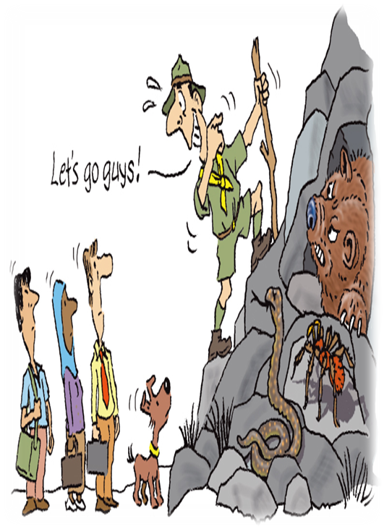
reference
The African Action Plan.
English: www.uneca.org/sites/default/files/PublicationFiles/un-ggim_-_geospatial_information_for_sustainable_development_in_africa-20171115.pdf
French : www.uneca.org/sites/default/files/PublicationFiles/geospatial_information_for_sustainable_development_in_africa_fre-20171115.pdf

