Slide 1
PRESENTATION OF REPORTS
WG5: INTEGRATION OF STATISTICAL AND GEOSPATIAL INFORMATION
1. Namibia 2. South Sudan - 3. Liberia - 4. Cameroon - 5. Morocco - 6. UNECA
8th Meeting of UN-GGIM Africa Regional Committee
24-28 October 2022
Addis Ababa, Ethiopia

Slide 2
Outline
StatCom-53 and GGIM-12: Integration of Statistical and Geospatial Information
Global Survey on Readiness to Implement the Global Statistical Geospatial Framework
Recommendations

Slide 3
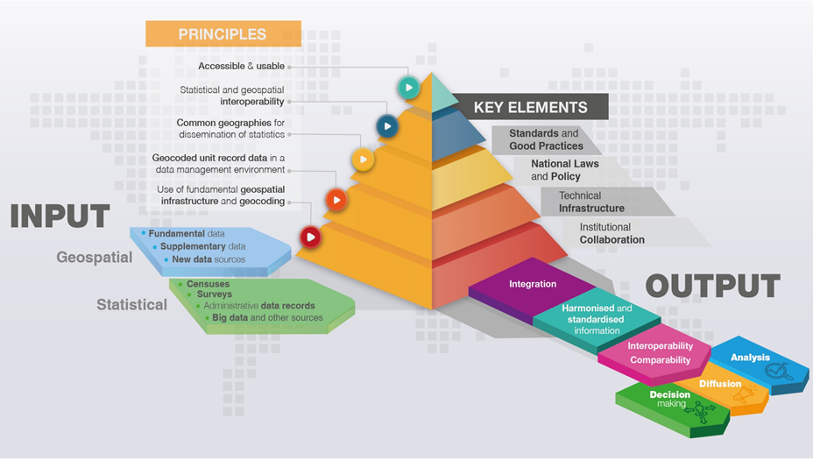
THE GSGF
…UN-GGIM & StatCom endorsed in 2020

Slide 4
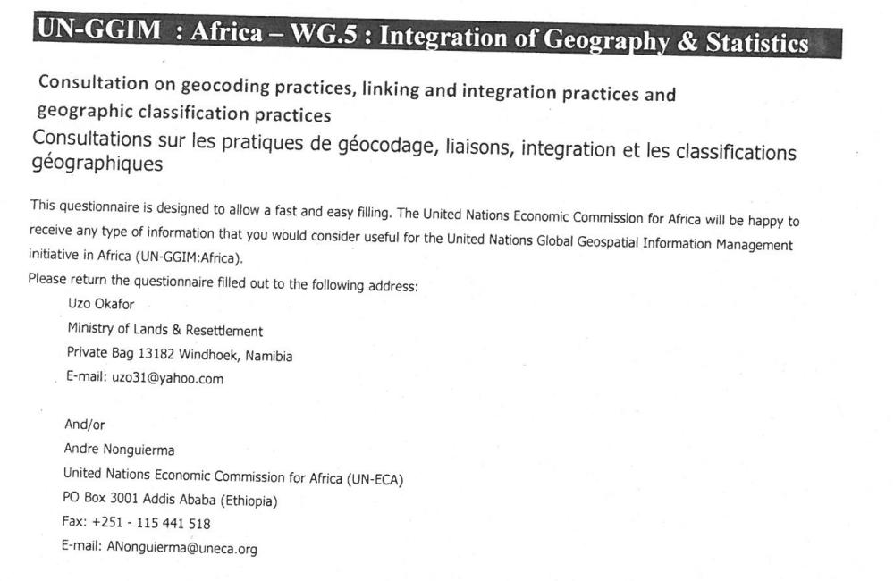

Slide 5
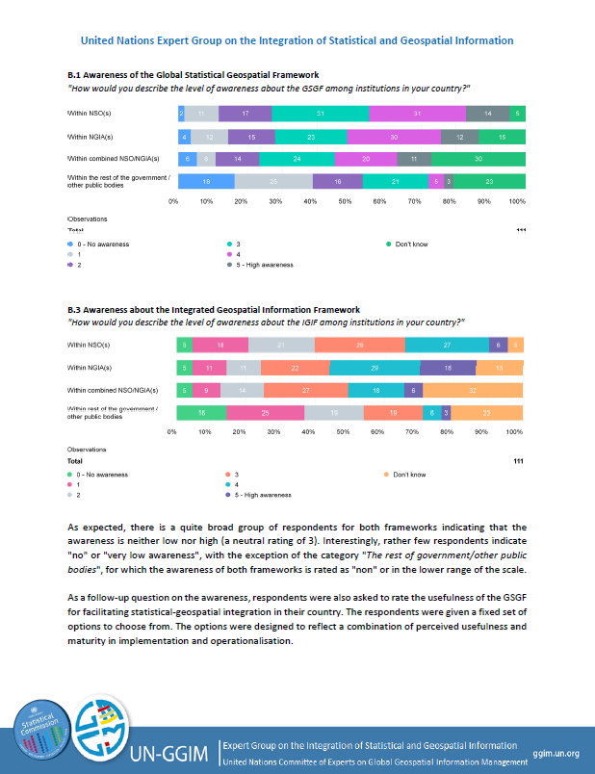
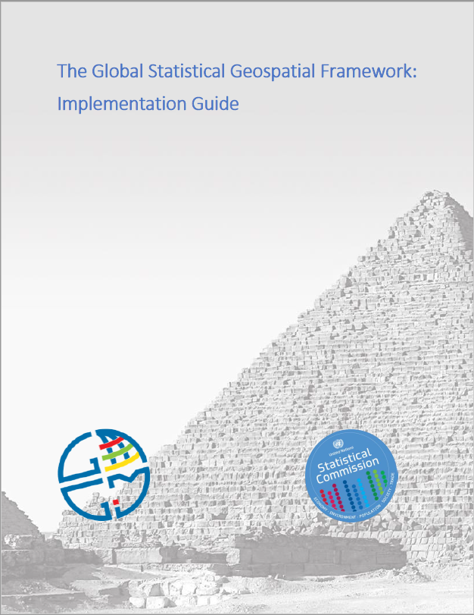
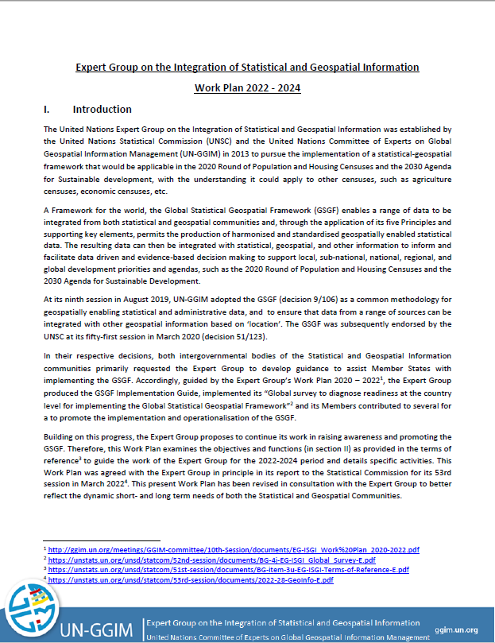
Three Documents submitted to the StatCom-53 and GGIM-12
Final results from the Global Survey on Readiness to Implement the Global Statistical Geospatial Framework
The GSGF
Implementation Guide
The EG-ISGI’s
Work Plan 2022 - 2024

Slide 6
The GSGF Implementation Guide UNSC Decision 51/123: “…welcomed [the Expert Group’s] continuing efforts to provide guidance to Member States to support the adoption and implementation of the GSGF” UN-GGIM Decision 9/106: [Encouraged the Expert Group] “…to continue its work to develop guidance on and support the promotion, awareness-raising and implementation of the Framework, and its work on statistical geospatial integration and coordination, in particular with regard to the Sustainable Development Goals and the 2020 round of population censuses, and encouraged Member States and other stakeholders to participate in, and contribute to, these important elements”

Slide 7
The GSGF Implementation Guide Document Structure Guidance Implementing Geocoding Implementing Common Geographies Fostering Interoperability Ensuring Privacy and Confidentiality Terminology of the Integration of Statistical and Geospatial Information Experiences of Implementation 30 National Experiences 5 Regional Experiences

Slide 8
Global Survey on Readiness to Implement the Global Statistical Geospatial Framework
UN-GGIM Regions | Member States | Responding Member States | Response rate (%)
UN-GGIM: Asia and the Pacific | 62, [15] | 23 | 37
UN-GGIM: Americas | 38, [2], (9) | 25 | 66
UN-GGIM: Arab States | 22, [8], (1) | 14 | 64
UN-GGIM: Europe | 56, [15] | 35 | 63
UN-GGIM: Africa | 51, [8] | 11 | 22
Total | 203 | 95 | 47

Slide 9
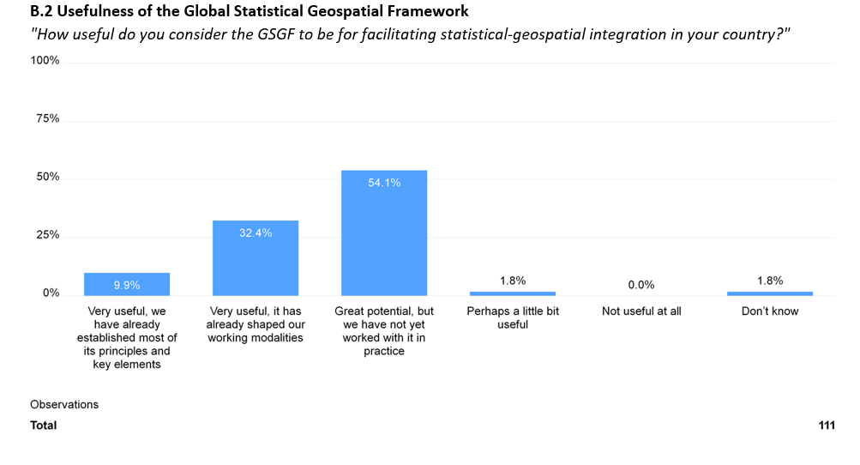

Slide 10
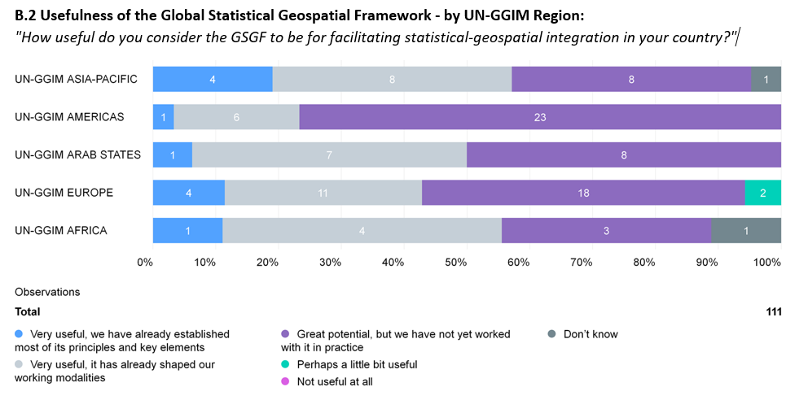

Slide 11
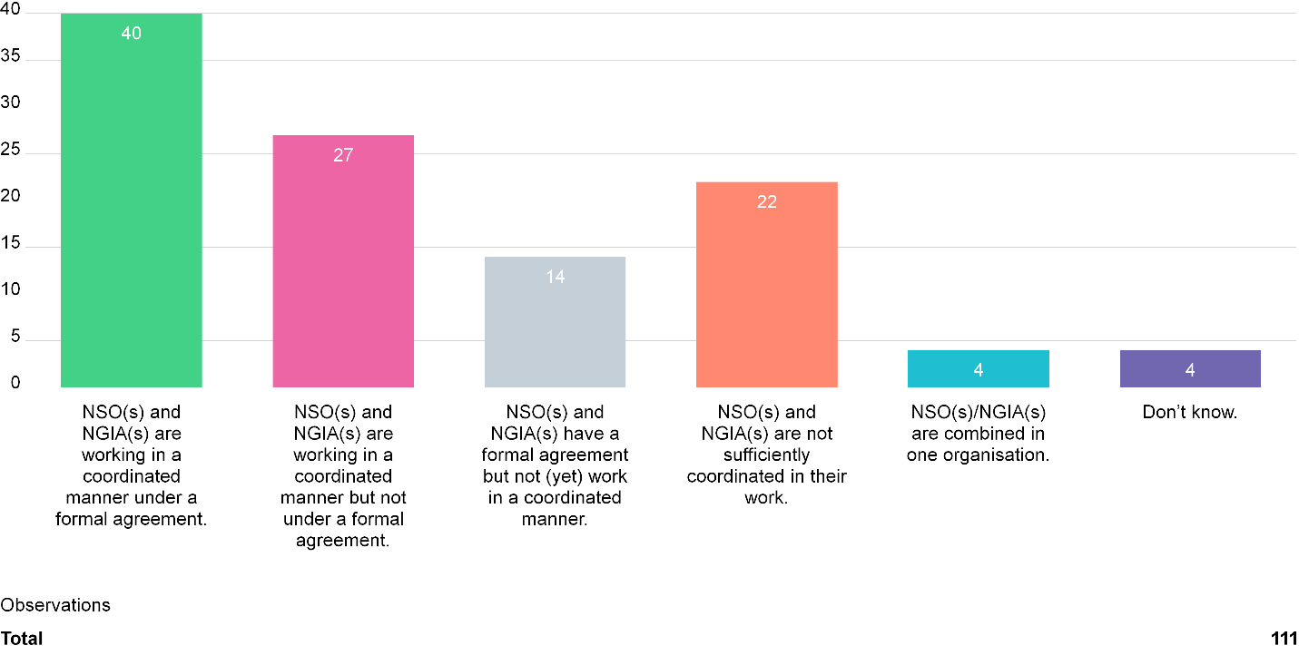
C.2 Working relations between NSO(s) and NGIA(s) "How would you describe the working relationship between NSO(s) and NGIA(s) in your country?"

Slide 12
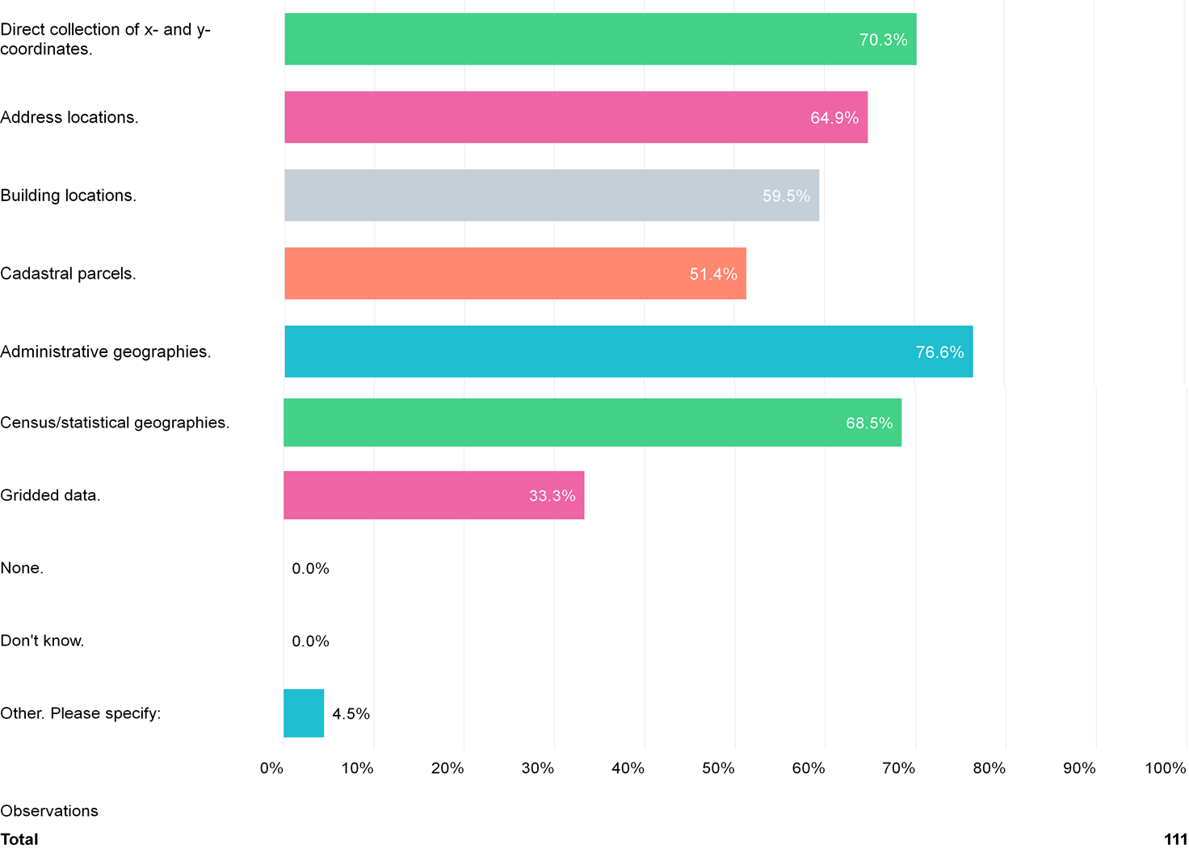
C.4 Fundamental geospatial data for geocoding "What fundamental geospatial data are being used to geocode (sometimes called georeference) statistical and/or administrative data in your country?"

Slide 13
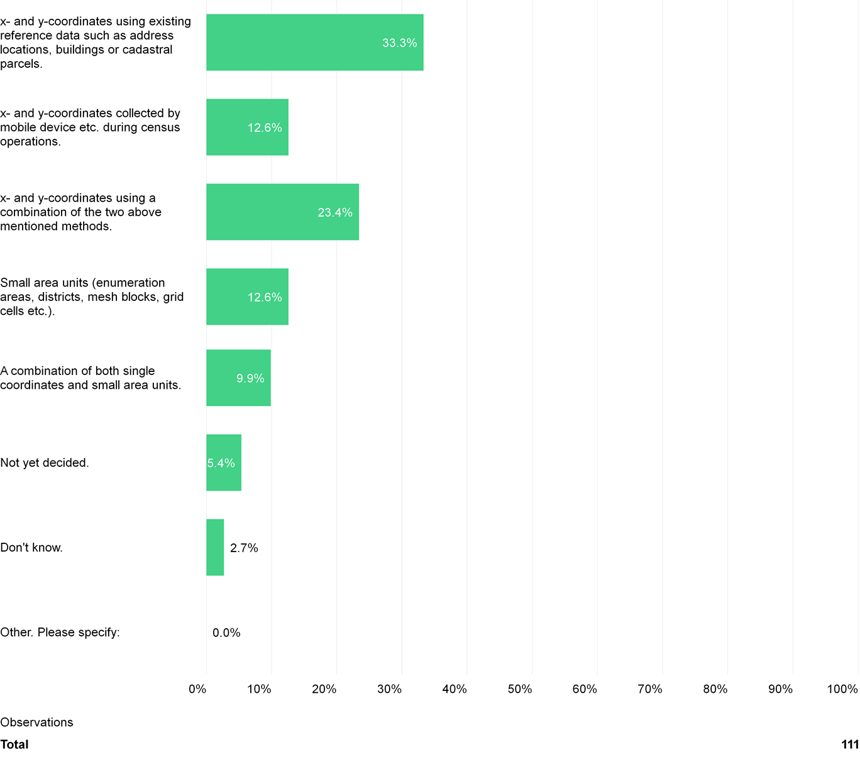
C.7 Lowest geographical level to capture and geocode unit record data in the next Census: "What is the lowest possible geographical level at which your country will be able to capture and geocode unit record data in the next Population and Housing Census?"

Slide 14
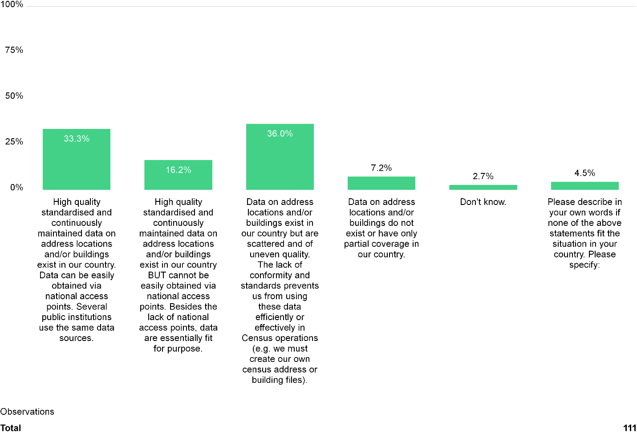
C.8 Sustainability of the data infrastructure for geocoding and integration of statistical and geospatial data: "How would you describe the sustainability of the data infrastructure used for geocoding and integration of statistical and geospatial data in your country?"

Slide 15
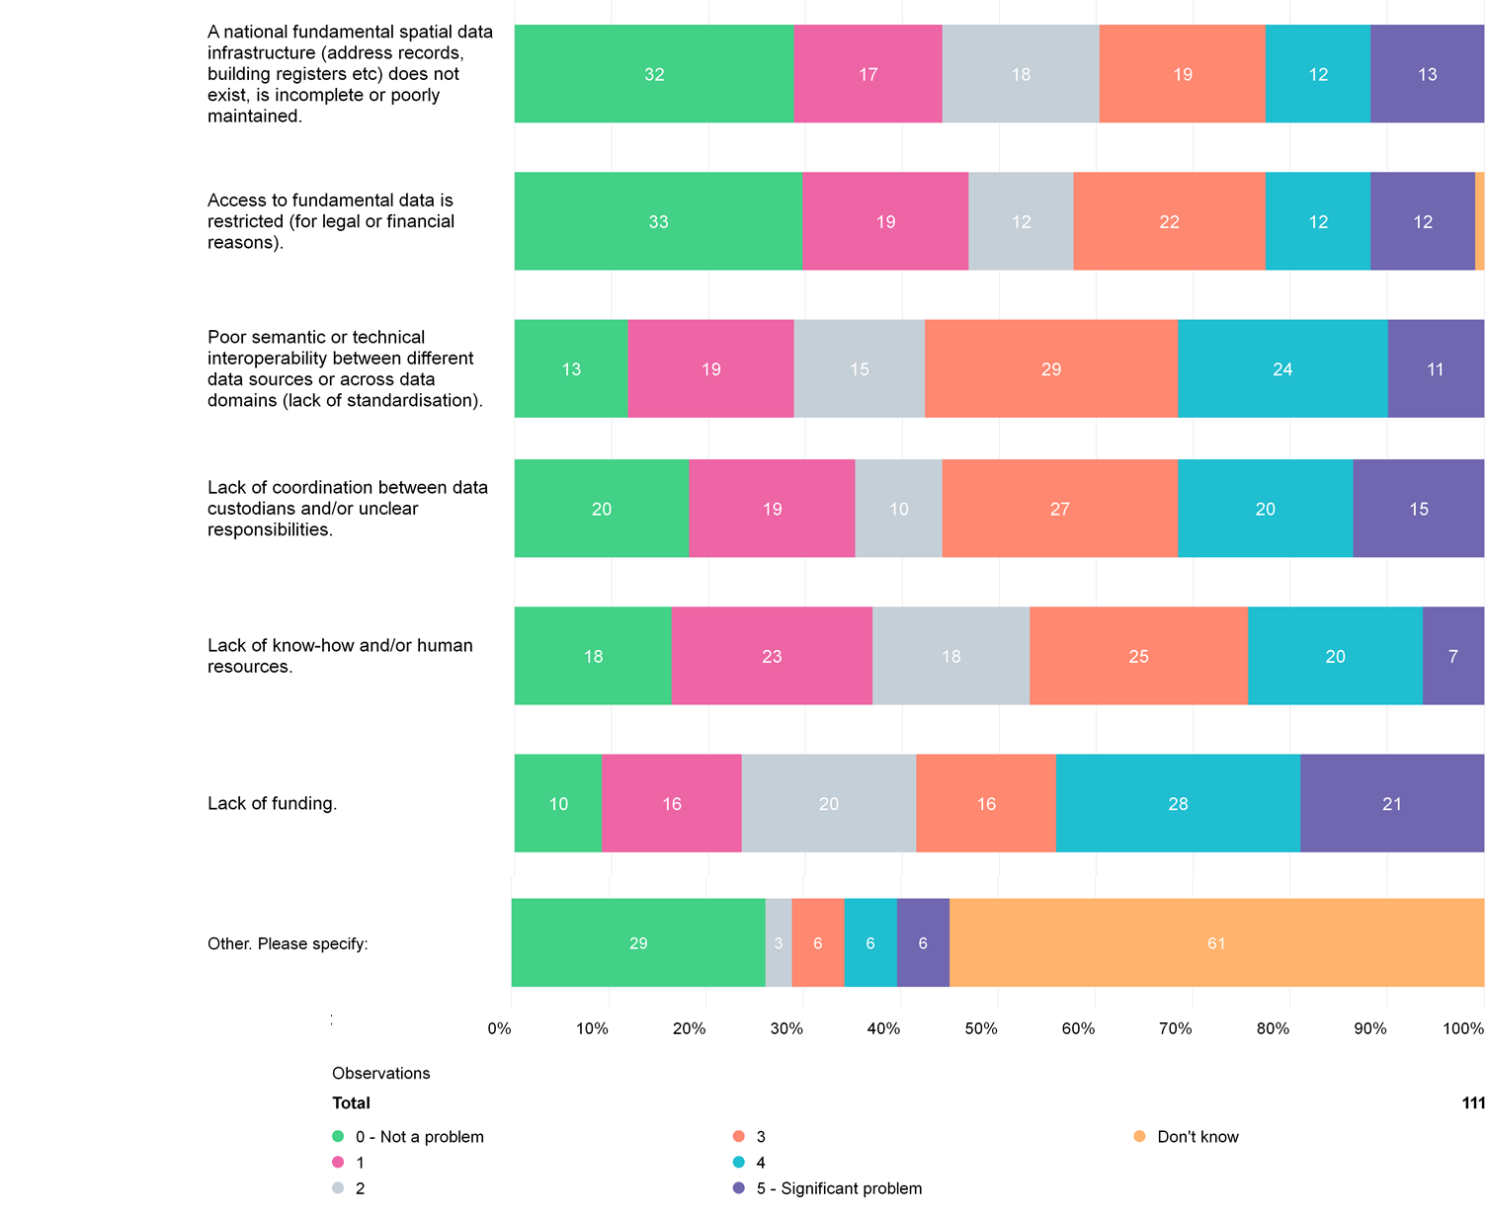
C.11 Obstacles to statistical-geospatial data integration
“What are the obstacles in your country that prevent an effective and systematic integration of statistical, administrative and geospatial data?"

Slide 16
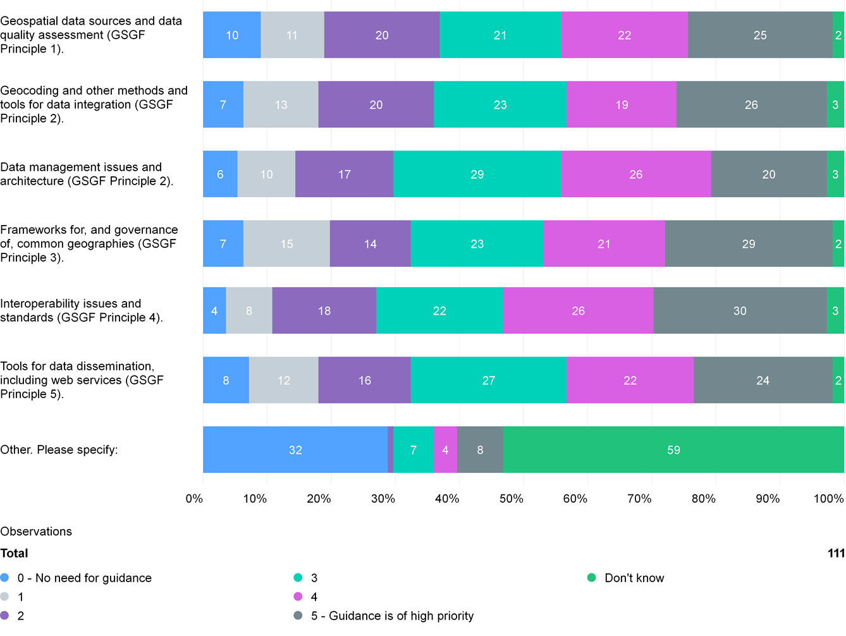
D.1 Need for guidance
"Please rate the following themes to help the EG-ISGI prioritise its work so the most relevant guidance can be developed and provided to countries to support the implementation of the GSGF

Slide 17
Recommendations
Need for working group to unpack the global survey to Africa (11 responses)
Low African response (skewed outcome for Africa, 5 in Abidjan, 11 finally)
Regional Committee through the working group 5 should re-run the survey to all Africa member states (Secretariat should seek assistance from the EG-ISGI)
Proposal for UN-GGIM Africa thematic area on standard for addressing system for Africa
Moving towards the sustainable and highest level of geocoding
Geographic registers of dwellings and businesses as future sampling frames
Location of persons (geographic registers of households)
Linkage to population registers to reduce on cost of future censuses and surveys.

Slide 18
Thank you

