Slide 1
Use of JICA Technical Cooperation
Kaoru Tsuda
26 Oct. 2022
UNGGIM AFRICA
Addis Ababa, Ethiopia
* Japan International Cooperation Agency

Slide 2
Self-Introduction
1st Visit in Africa in 1995
4 Grandchildren
17 times in Ethiopia
37 Countries in Africa

Slide 3
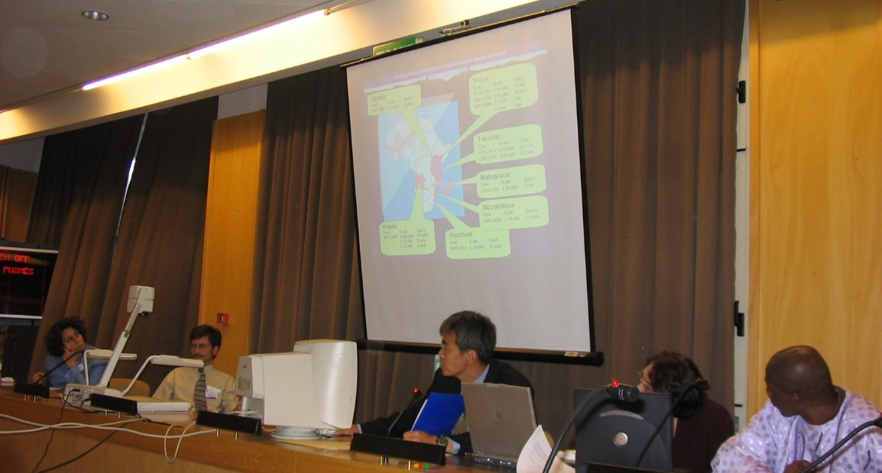
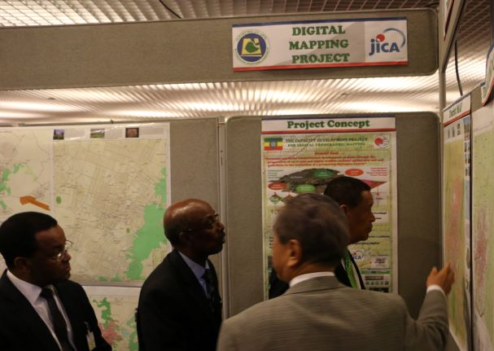
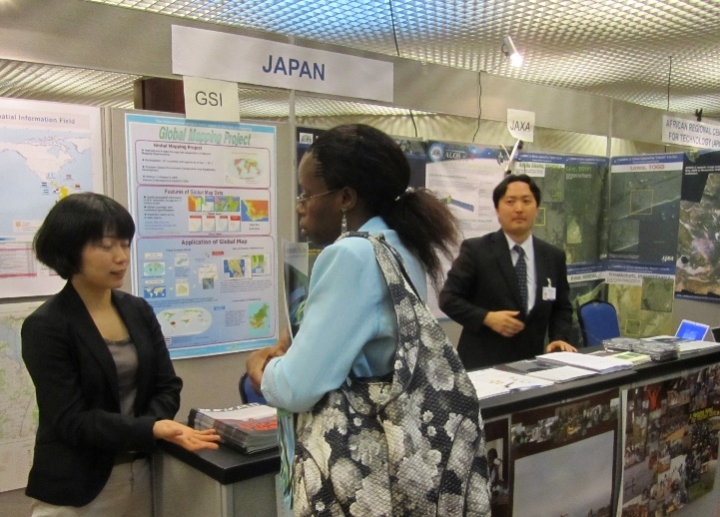
My Participation of Geo-Info Conference in africa
 | My Participation
2001 | CODI 2
2003 | CODI 3
2007 | CODI 5
2009 | CODIST 1
2011 | CODIST 2
2014 | GGIM Tunisia
2015 | GGIM Kenya
2016 | GGIM Ethiopia
2017 | GGIM Ethiopia
2019 | GGIM Rwanda
2022 | GGIM Ethiopia
2003
2011
2016

Slide 4
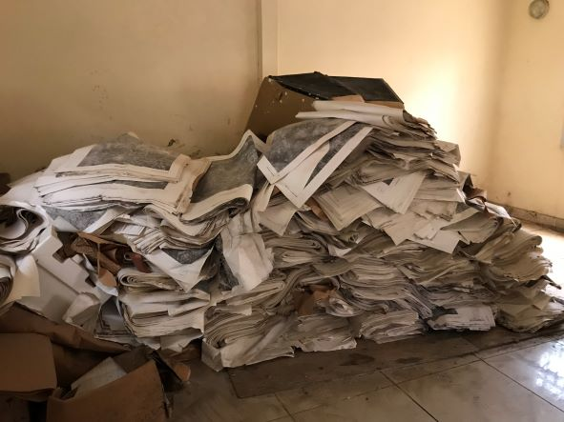
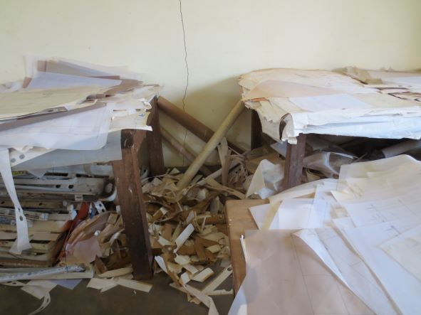
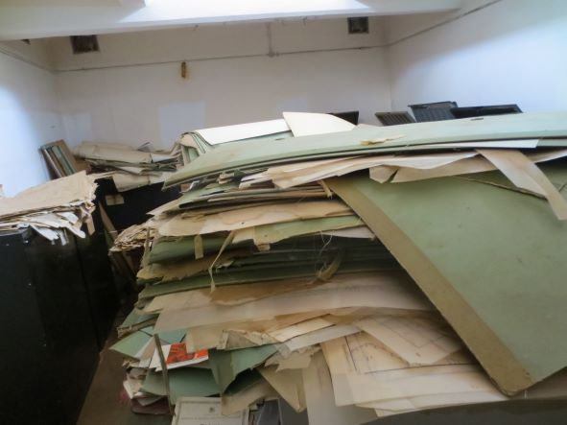
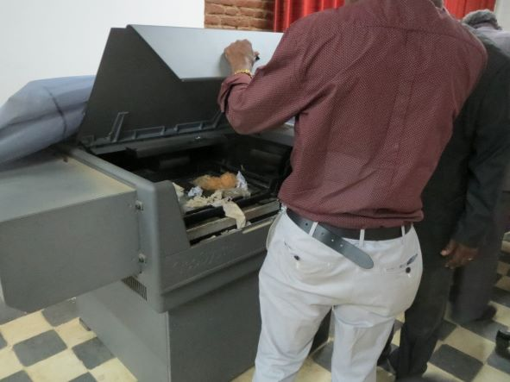
Challenges of Geospatial information Org.
Lack of
Engineers
Budget
Equipment
Understanding
Data
IT
Reality

Slide 5
Think about Technical cooperation “Grant aid” project

Slide 6
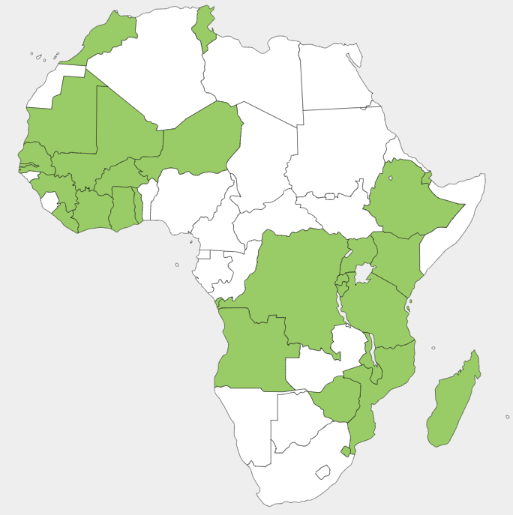
Geo-Spatial Info Projects in 26 Countries
Technical Transfer
Equipment Supply
Training in Japan

Slide 7
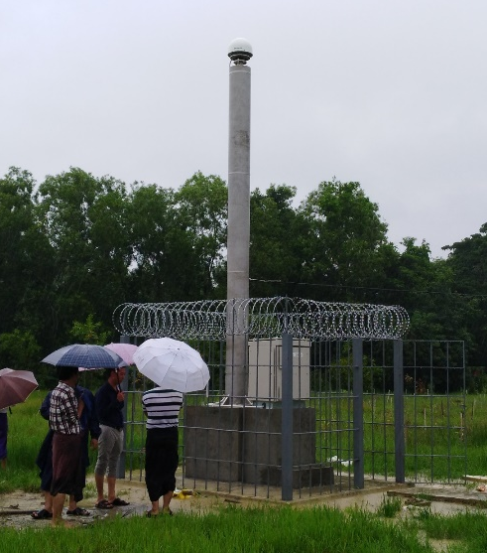
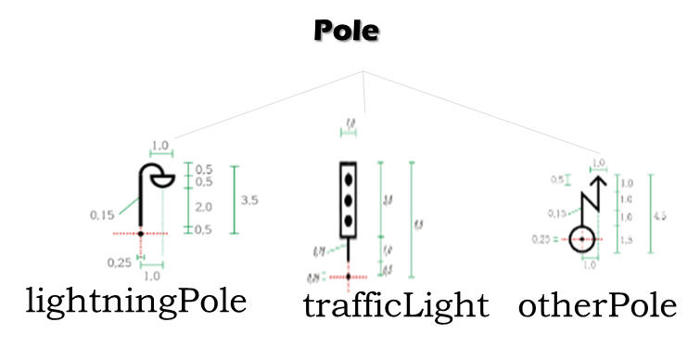
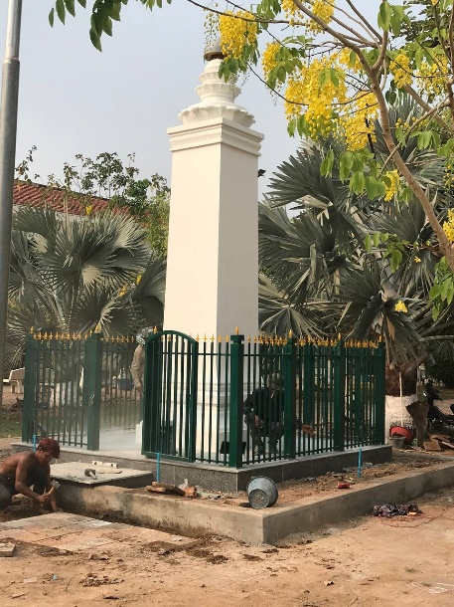
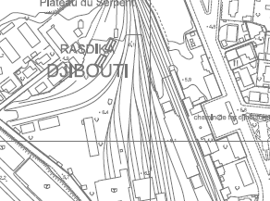
Variety of projects
Mapping/LiDAR
GIS
CORS
NSDI
Data Sharing
Data Update

Slide 8
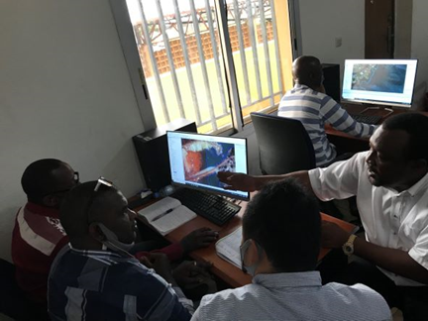
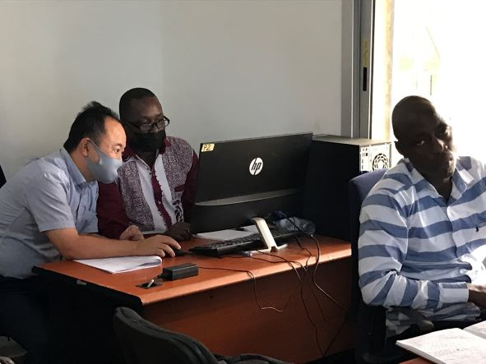
Recent Projects in Africa
2021～23 | Rwanda | 1000, 2500,10000 Map Production
2021～22 | Guinea | 5000 Map Update
2019～22 | Djibouti | 2500 Map Update GIS Development
2013～18 | Ethiopia | 10000, 25000 Map Production NSDI
2015～17 | Zimbabwe | 5000 Map Production

Slide 9
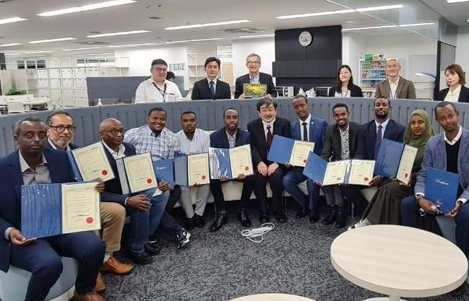
Training in Japan in 2022
(Group)
1 Ethiopia
1 Zimbabwe
12 trainees in total
Training NOW !
(Country)
11 Djibouti
Finished last Friday!
I’m here

Slide 10
geospatial information agency in Djibouti
No Agency
GIS Committee
Geospatial Information Agency
Future
JICA’s Cooperation
GIS Committee Would Like to Join Geospatial Info. Society !

Slide 11
Road map to implementation
Request
Evaluation by JPN Gov.
Implementation
Rejection
Consultation (Tsuda)
Acceptance

Slide 12
Preparation of request
Request Required
Use of JICA Form
Via Diplomatic Channels
Punctuality

Slide 13
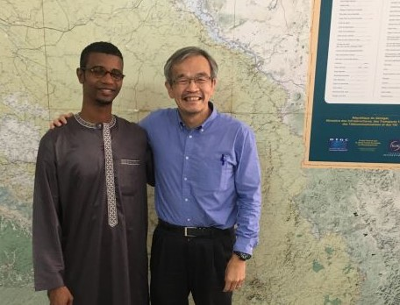
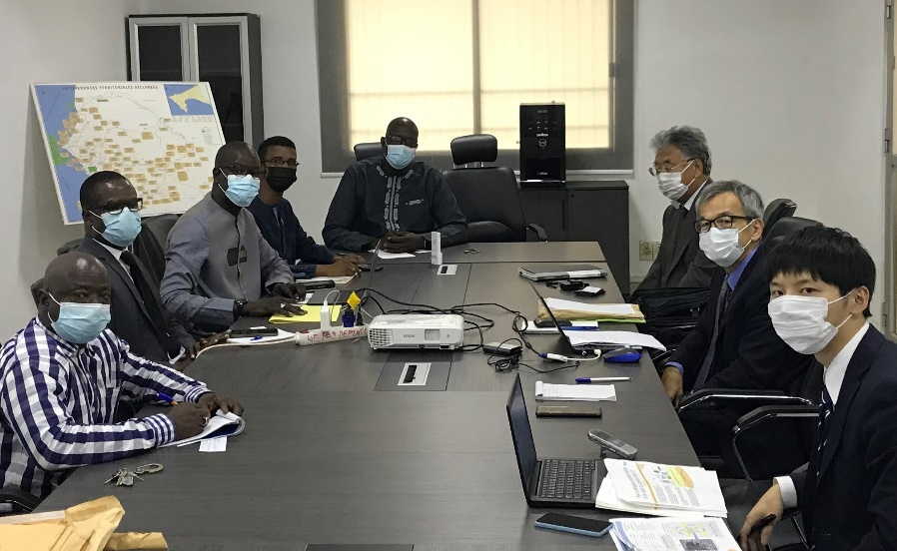
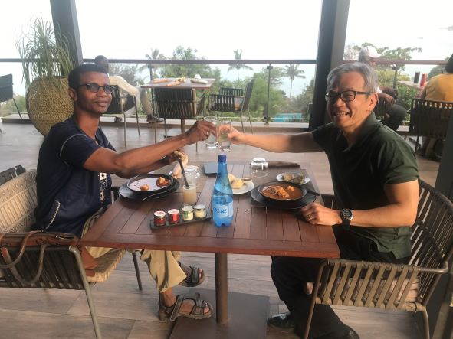
Case study: Project formulation in senegal
2019 GGIM AFRICA
Visit Senegal
2021 Visit Senegal
2022 Visit Senegal
Under Evaluation
SUBMIT REQUEST
Notes:
Currently, JICA is in the process of evaluating the contents of the request.
The result will be officially communicated to the Senegalese government next March.

Slide 14
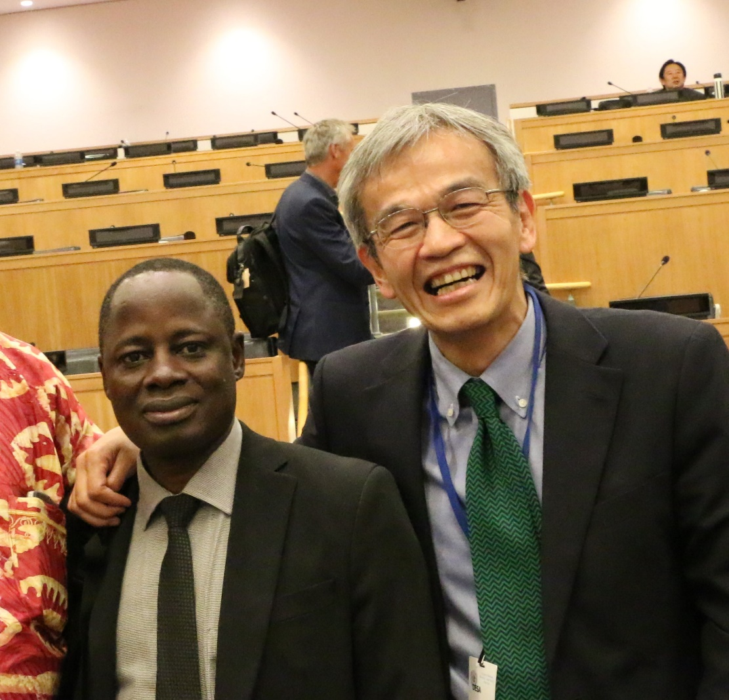
Contact me at any time
+81 90 9305 7188
Messenger
WhatsApp
Viber
Telegram
2015 New York

