Slide 1

Eighth Meeting of UN-GGIM: Africa
October 2022
Assessment on the Availability of Geospatial Datasets for the Sustainable Development Goals in Africa
(A project of UNECA)
Dr Derek Clarke
derek.clarke.dr@gmail.com

Slide 2



















This work is a follow on of the report of ECA, of 2021- data taxonomy of geospatial information.
Geospatial Data Taxonomy
for the Sustainable Development Goals in Africa
Strengthening the capacities
of selected African countries to develop geospatial information resources and services in support of the implementation and monitoring of the Sustainable Development Goals

Slide 3
Further, in support of the work towards the ‘African Action Plan’

Slide 4
Paragraph 48 of the resolution on the 2030 Agenda for Sustainable Development states that “quality, accessible, timely and reliable disaggregated data will be needed to help with the measurement of progress and to ensure that no one is left behind”.
“greater investment in data and strengthened data capabilities will be crucial. Only through data-informed decisions can we get ahead of crises and trigger earlier more effective responses that both attend to the present and build better for the future. Only with better disaggregated data can we ensure that these decisions and responses account for all sectors of society, leaving no one behind” UN Secretary-General, Opening Statement on the Progress Report on the SDGs High-level Political Forum, June 2022

Slide 5
To measure and monitor the Indicators towards achieving the targets of the SDGs requires geospatial information for 123 of the Indicators across all 17 SDGs.
Countries must ensure that they have the required geospatial information for this purpose – which can be available from national geospatial agency, other Ministries and local government.

Slide 6
As part of its programme of work in strengthening the capacities of African countries to develop geospatial information resources and services in support of the implementation and monitoring of the SDGs, the ECA is assessing the availability of geospatial information in countries – an inventory.
This inventory of available geospatial information provides the current status of the geospatial information.
It will assist countries to determine the gaps in their geospatial information.
Such gaps will inform the countries on their programmes of work to collect the required geospatial information.

Slide 7
More importantly, this inventory provides the country with an assessment of which of the Indicators have the required geospatial information for the measurement of the Indicator.
Which indicators have geospatial information and which do not!

Slide 8
Data Collection for the Inventory
Done by questionnaire survey between August and October 2022, using online questionnaire (Google Form) and Adobe Acrobat (pdf) form sent by email.
Questionnaire in both French and English.
Two further reminders to countries to return the completed questionnaire were sent.
The contact list of UNECA for all 54 countries was used to email the information and questionnaires to all 54 countries. Where alternate emails were available those were also used.

Slide 9
Responses to questionnaire:
The emails for 5 (9%) countries failed, namely:
  Angola
  Central African Republic
  Djibouti
  Eritrea
  Liberia
The above countries then would not have received the request to complete the questionnaire.

Slide 10
Responses were received from 19 (35%) countries by 23 October 2022, namely:
  (* Not included in subsequent analysis)
Botswana | Mali
Burkina Faso (partial) | Mozambique
Cameroon | Nigeria
Comoros | Rwanda
Cote d'Ivoire | Senegal
Eswatini | Somalia* (no data)
Ethiopia | South Africa
Ghana | Uganda
Lesotho | Zambia
Madagascar

Slide 11
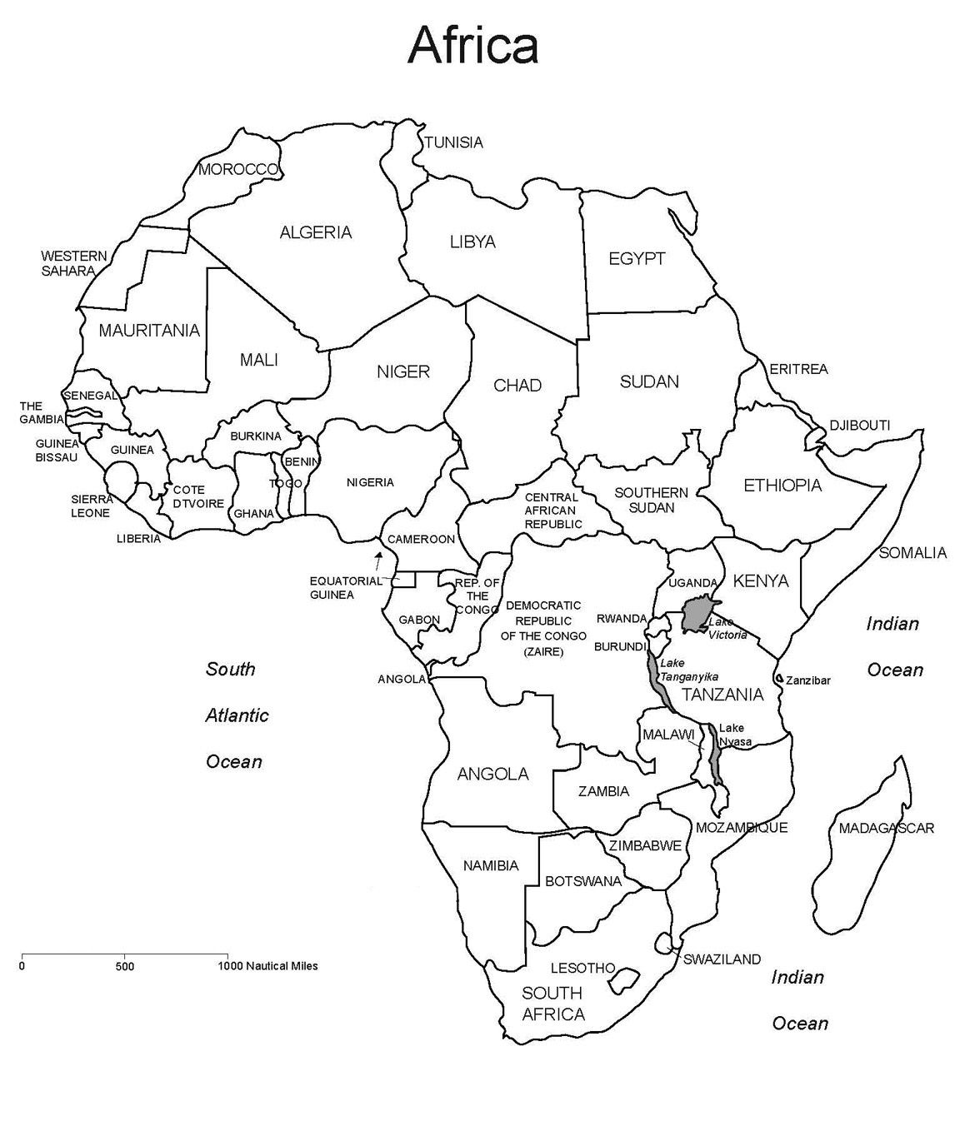
Responding countries

Slide 12
Analysis of Inventory of Geospatial Information
Responses entered into spreadsheet for each country showing the percentage of available geospatial information for each feature class (55 or 48 for land-locked countries).
Some feature classes ‘not applicable’ for some countries.
Where no response (blank) given – marked as ‘no data (response) given’.

Slide 13
Responses coded:
Data Value | Code
Not applicable to country | 0
0% available | 1
1% to 25% available | 2
26% to 50% available | 3
51% to 75% available | 4
76% to 99% available | 5
100% available | 6
No data (response) provided | 7
Item not included | -1

Slide 14
Based on coding system two different data representations are given:
  1. For each country – availability of feature class (55 feature classes): number of feature classes / availability categories

Slide 15
2. For each feature class (55) - number of countries (out of 54) with available geospatial information – number of countries / availability categories

Slide 17
Based on the inventory of available geospatial information and the geospatial information required for each of the Indicators of the SDGs (123, or 115 for land-locked country), an analysis was done, for each country, and categorized as follows:
  - Level of availability of geospatial feature class:
< 75% available: Inadequate
75% - 94% available: Marginally adequate
95% - 100% available: Adequate
The number of feature classes, required for each Indicator, deemed to be adequate was calculated as a percentage of the total number of feature classes required for that Indicator.
For an Indicator to be deemed to have the required geospatial information, it must score 90% or more.

Slide 18
Indicator | No. of Features | 75% - 94% | 95% - 100% | Adequate
Goal 5
5.2.2 Proportion of women and girls aged 15 years and older subjected to sexual violence by persons other than an intimate partner in the previous 12 months, by age and place of occurrence | 6 | 0% | 100% | 1
5.3.1 Proportion of women aged 20–24 years who were married or in a union before age 15 and before age 18 | 6 | 17% | 83% | 0
5.3.2 Proportion of girls and women aged 15–49 years who have undergone female genital mutilation/cutting, by age | 6 | 0% | 100% | 1
5.4.1 Proportion of time spent on unpaid domestic and care work, by sex, age and location | 8 | 13% | 88% | 0
5.6.1 Proportion of women aged 15–49 years who make their own informed decisions regarding sexual relations, contraceptive use and reproductive health care | 5 | 0% | 100% | 1
5.b.1 Proportion of individuals who own a mobile telephone, by sex | 6 | 17% | 83% | 0

Slide 19
Findings of the Inventory of Availability of Geospatial Information for the SDGs
Only 5 of the countries that responded (19), completed the information required for all of the geospatial feature classes – ‘missing’ information for analysis.
No country indicated that they have all of the feature classes fully available (100%).
Possibility of lack of understanding of definition of feature class by some, resulting in complete information.

Slide 20
4. The feature classes with the highest availability across all the countries (>10) are:
Geodetic Network
Elevation
Country
Second Level Administration Area
Third Level Administration Area
Government Functional Administration Area
Statistical Area
Orthoimage
Airport/Aerodrome
River
River Basin
Lake
Ocean/Sea - Coastline

Slide 21
5. Six countries have more than 50% of the feature classes fully available (100%), namely:
Botswana
Ethiopia
Mozambique
Senegal
South Africa
Zambia
This indicates a low level of availability of geospatial information across African countries.

Slide 22
6. Adequate geospatial information for the measurement of the Indicators:
Country | No. of SDG Indicators with Adequate Geospatial Information
Botswana | 17
Burkino Faso (partial reporting) | 14
Cameroon | 7
Comoros | 0
Cote d’Ivoire | 15
Eswatini | 11
Ethiopia | 16
Ghana | 15
Lesotho | 0
Madagascar | 5
Mali | 1
Mozambique | 14
Nigeria | 13
Rwanda | 3
Senegal | 33
South Africa | 62
Uganda | 0
Zambia | 15

Slide 23
7. Findings provide a baseline for African countries in the availability of geospatial information for the measurement of the SDG Indicators.
8. Provides the gap in available geospatial information for each country. Knowing the gap will assist countries to determine their priorities for the collection and maintenance of the geospatial information required for the SDGs.
9. Needs to be acknowledged that the national mapping or geospatial agency is not the only collector of the required geospatial information, and therefore greater collaborative efforts are required between the various Ministries, local government and other agencies.

Slide 24
Monitoring of Progress towards the Availability of Geospatial Information (going forward)
Need to close the gap in availability of the geospatial information to measure and monitor the Indicators of the SDGs.
Need to keep the geospatial information relevant by updating the geospatial information based on the temporal characteristics of the various feature classes.
ECA will manage the inventory of availability of geospatial information for the SDGs going forward.
Questionnaire survey to be completed annually by all African countries.

Slide 25
A few points:
For those countries who have not yet completed and returned the questionnaire on the status of available geospatial information for the SDGs, it is requested that they consider to do so (as soon as possible).
Is the coding used for the response of availability of geospatial information appropriate?
Is the classification of availability of geospatial information for each Indicator appropriate?
Is an annual questionnaire survey, conducted by ECA, reasonable and acceptable for the purpose to update the inventory of available geospatial information for the SDGs (Closing the gaps and keeping the geospatial information relevant).

Slide 26
The participation and contributions of the countries is acknowledged and appreciated.
Dr Derek Clarke
derek.clarke.dr@gmail.com

