Slide 1
AFRICAN REGIONAL INSTITUTE FOR GEOSPATIAL INFORMATION SCIENCE AND TECHNOLOGY (AFRIGIST)
Fifty years of excellent services to Africa!
AFRIGIST

Slide 2
Introduction
Well trained and motivated Human resources
Key of the successful implementation of any programme
Geospatial Information
Need for integrated multidisciplinary approaches
Reliable, accurate and relevant information and services when and where-ever needed

Slide 3
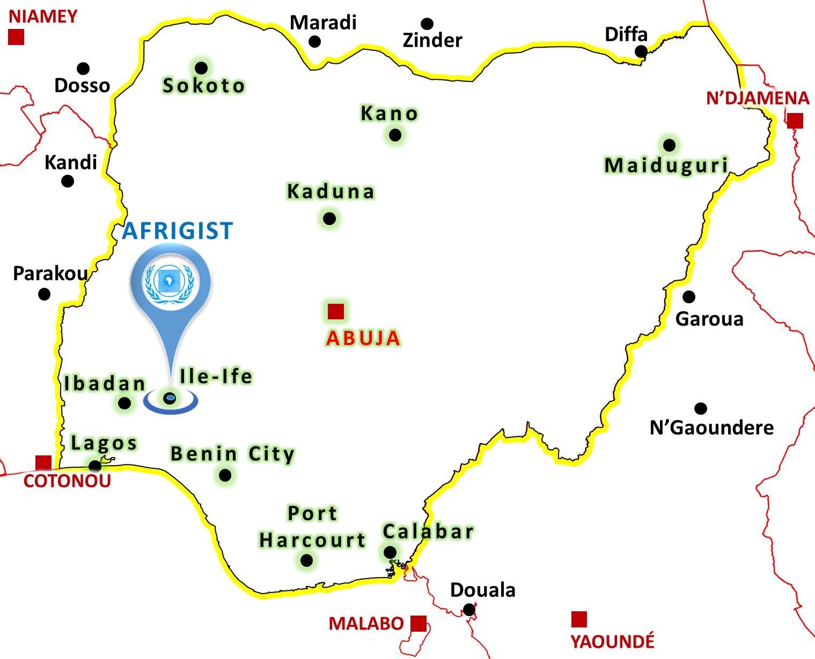
Introduction
Need to build the capacity of African professionals in Space-based and geospatial information science and technology and the application in different areas of endeavor
AFRIGIST
Campus of Obafemi Awolowo University,
Ile-Ife, Osun State, Nigeria
7°30'20" N
4°31'25" E

Slide 4
Content
❶ History
Creation
Member Countries
Name
❷ AFRIGIST Today
Mandate
Facilities
❸ AFRIGIST in Africa
Trainings
Contribution to UN-GGIM
Regional programmes

Slide 5
HISTORY Creation
1st UN Cartographic Conference, 1963 in Nairobi
Need for a Regional Cartographic Centre
8th Session of the ECA Conf. of Ministers, 1964 in Addis-Ababa
Resolution 164 (VIII) |> Creation of Regional Centres for Training in
Photogrammetry | Photo-Interpretation | Airborne Geophysical Surveys
21 Oct. 1972 under the auspices of the UNECA
educational “one-stop” solution institution that trains highly skilled manpower in geospatial information science and technology, and its applications.

Slide 6
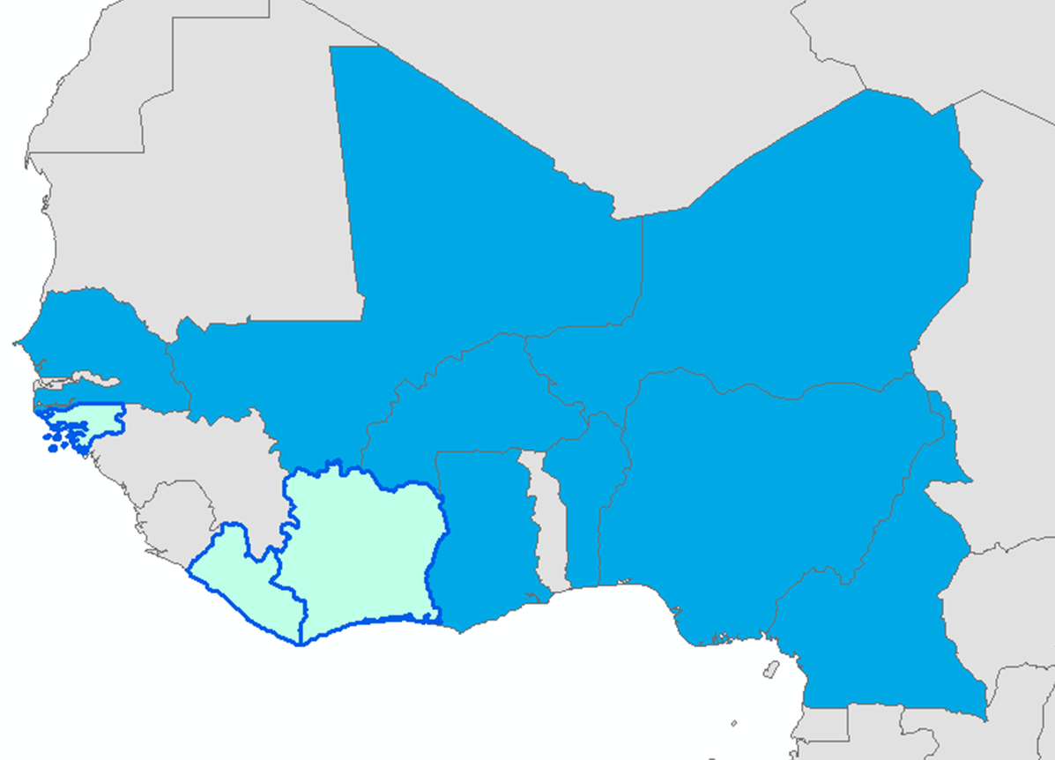
HISTORY Member Countries
Membership open to all
African countries
Membership at the moment
Benin, Burkina,
Cameroon, Ghana, Mali,
Niger, Nigeria, Senegal
Cote-d’Ivoire, Guinea-Bissau and Liberia.

Slide 7
History Name
Starting > Regional Centre for Aerial Surveys
1986 > Regional Centre for Training in Aerospace Surveys
2016 > African Regional Institute for Geospatial Information Science and Technology (AFRIGIST)
Take the pace of the new trends in geospatial information science and technology, and incorporate academic transformation

Slide 8
AFRIGIST Today Mandate
VISION OF AFRIGIST
To be a leading Institute of Excellence providing one-stop solution for quality geospatial information science training, education and research and critical capacity for sustainable development in Africa.
MISSION STATEMENT
To contribute to rapid sustainable development of member states in particular and Africa in general, through the development of critical capacity for timely delivery and responsible use of appropriate geospatial information.

Slide 9
AFRIGIST Today Mandate
OBJECTIVES OF AFRIGIST
(i) provide theoretical and practical training in the field of Geospatial Science and Technology including in particular photogrammetry, remote sensing, cartography and geographic information systems and their applications in geophysical surveys, environmental studies, natural resources management, mapping, land administration, etc;
(ii) conduct seminars and courses with a view to providing an opportunity to government officials in the region to exchange information and experiences in the field of Geospatial Science and Technology;

Slide 10
AFRIGIST Today Mandate
OBJECTIVES OF AFRIGIST (2)
(iii) carry out studies and research in the field of Geospatial Science and Technology, and;
(iv) provide advisory and consultancy services to member states of the ECA and other institutions concerned with the production and/or use of geospatial data and information.

Slide 11
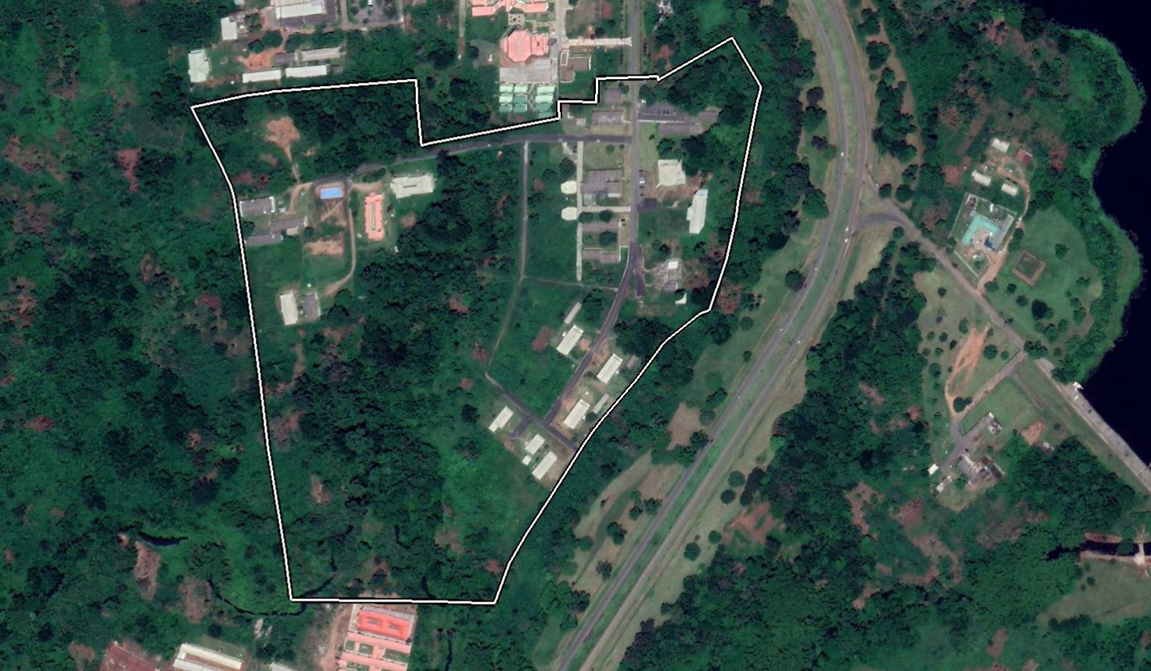
AFRIGIST Today Facilities
25 ha

Slide 12
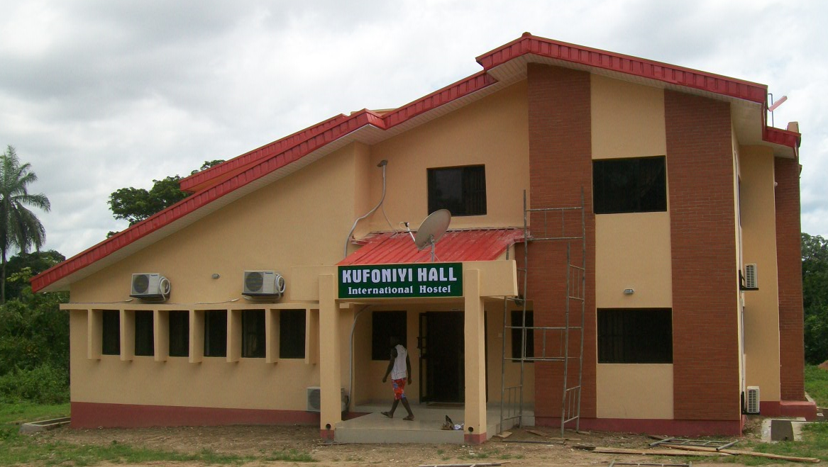
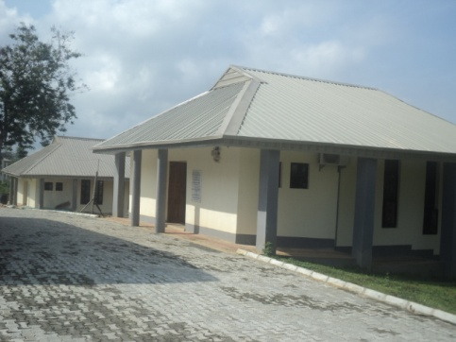
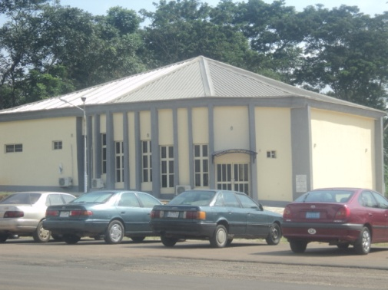
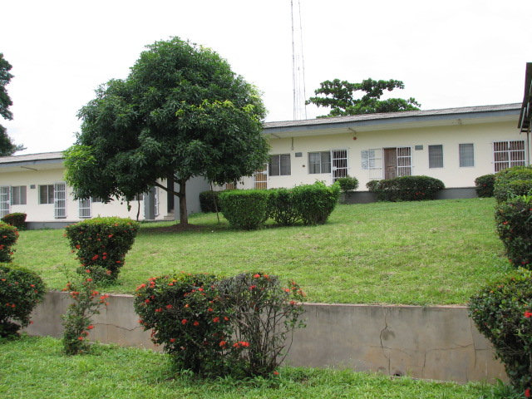
AFRIGIST Today Facilities
International Hostel
New Administrative Building
Lecture Theaters
250 Seater Auditorium
Block of Classrooms

Slide 13
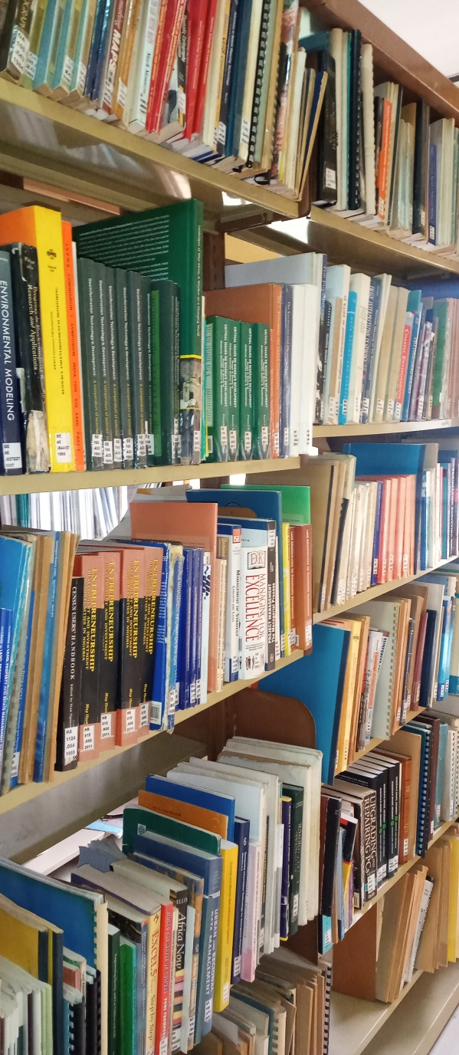
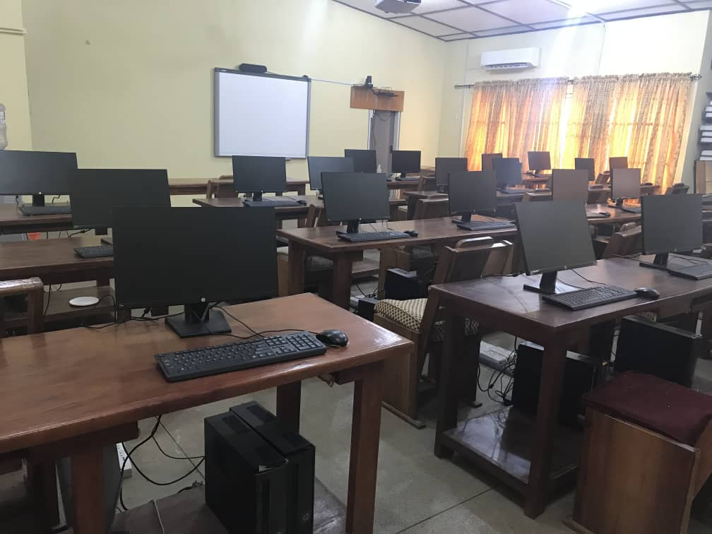
AFRIGIST Today Facilities
Library
Classroom

Slide 14
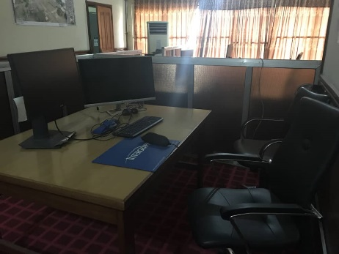
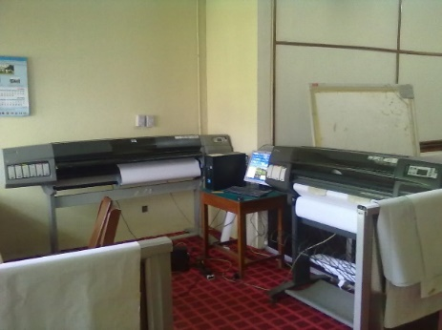
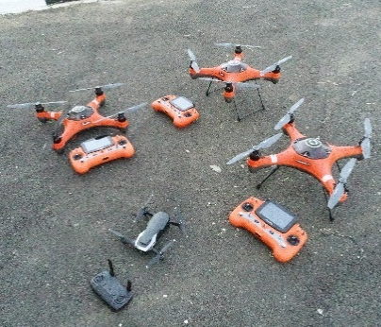
AFRIGIST Today Equipment

Slide 15
AFRIGIST in AFRICA Trainings
50 years of skills and capacity building excellence in Geoinformation Sciences and its applications in Africa.
29 African countries impacted.
More than 3,500 alumni.
Growing number of research oriented faculty with students admitted into the Ph.D degree programme

Slide 16
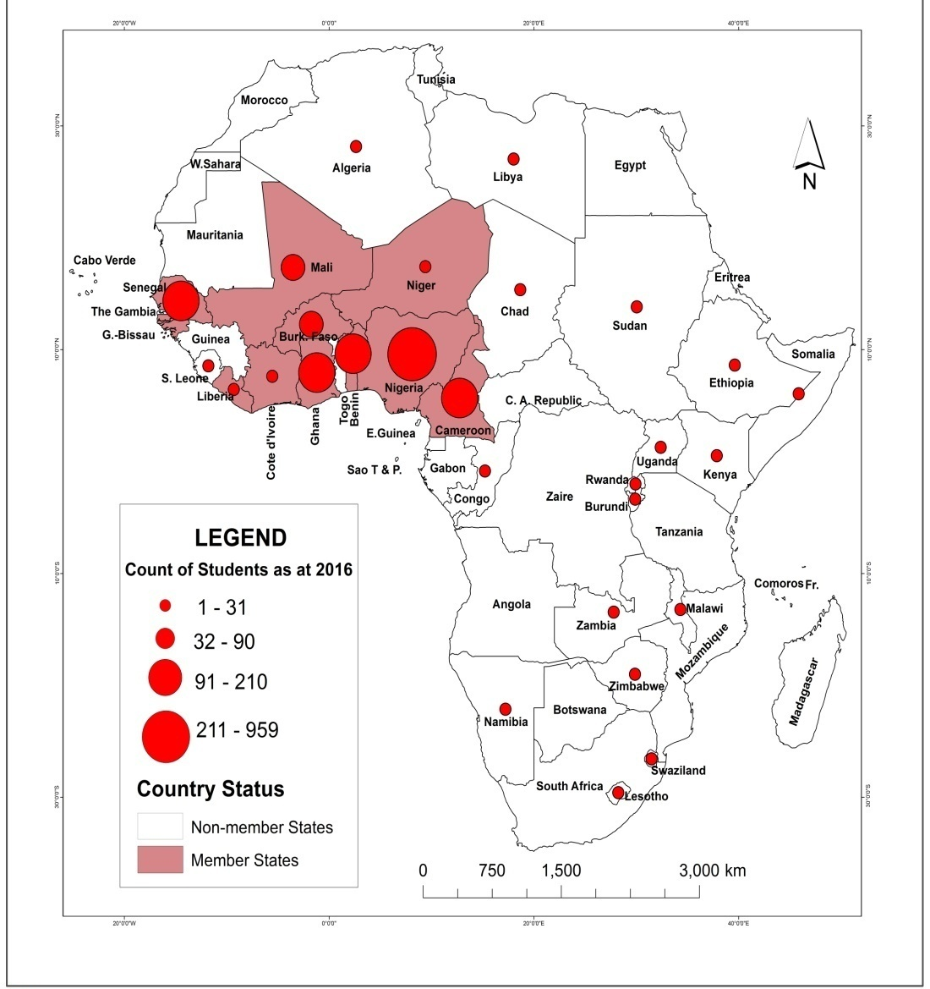
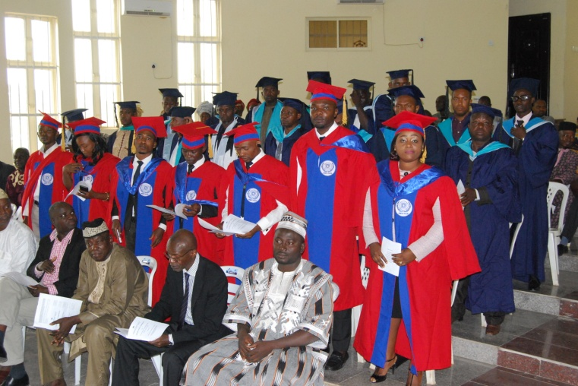
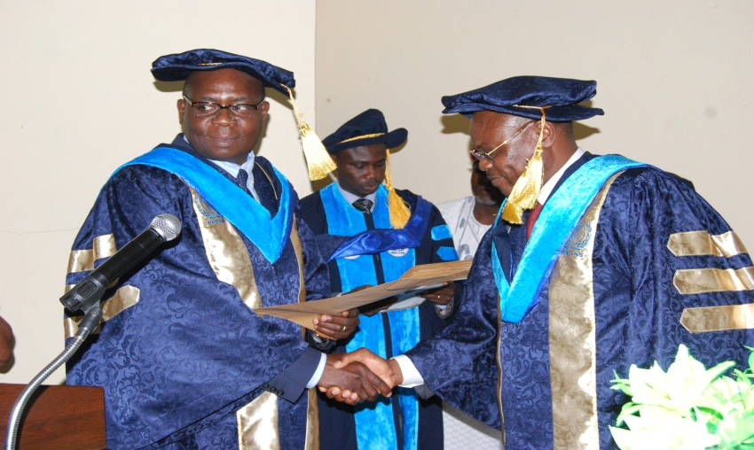
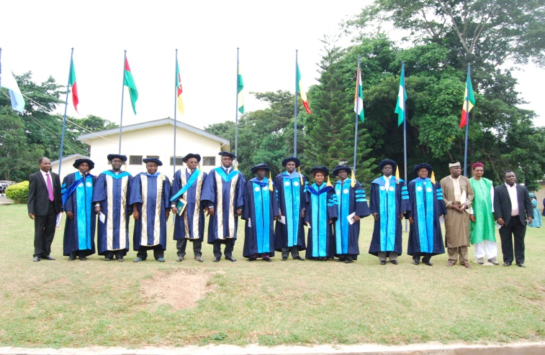
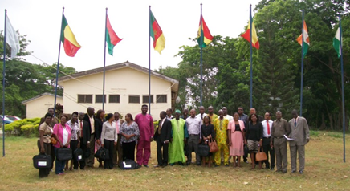
AFRIGIST in AFRICA Trainings
Handing over of AWARD by the Executive Director
Graduating Students
Management Staff with the Governing Council Members
AFRIGIST-ITC Refresher course participants

Slide 17
AFRIGIST in AFRICA Trainings
Programme | Duration
Technologist Diploma (TD) in Geo-information production and management. (Fr/En) | 18 months
Postgraduate Diploma (PGD) in Geo-information Production and Management (Specialisation: Remote Sensing, Photogrammetry, Geographic Information Systems) (Fr/En) | 12 months
Professional Master (PM) in Geo-information Production and Management.(Specialization: Remote Sensing, Photogrammetry, Geographic Information Systems) (Fr/En) | 12 months

Slide 18
AFRIGIST in AFRICA Trainings
Programme | Duration
Master in Geo-information Technology (MGIT) in collaboration with Federal University of Technology Akure (FUTA) (En) | 18 months
Master of Science in Geo-information Science (MGIS) in collaboration with University of Abomey Calavi. (Fr) | 18 months
Masters in Geo-spatial information and Land Administration Science (Fr/En) | 12 months
Masters in Geo-spatial information Science and Disaster Management (Fr/En) | 12 months
Master in Satellite Geodesy (Fr/En) | 18 months
Phd in Geospatial Information Science and Technology (Fr/En) | 3 years

Slide 19
AFRIGIST in AFRICA Trainings
RESEARCH ACTITIVIES undertaken at AFRIGIST
GSDI Research grant – GSDI Association, 2010
GARNET-E Research grant – GMES – EU grant, 2011
Indigenous Knowledge and Adaptation to Coastal Flooding in Nigeria – START, 2012 – 2013.
Comparative Analysis of Land Use Pattern in Sudano-Guinean Transition in the Central Region of Benin Republic and Central Western Nigeria – CODESRIA, 2013
Climate Change and Integration of Climate Resilient Agriculture in Coastal Nigeria – Ford Foundation for Conservation, 2014
Spatial Agricultural Intelligence - GEO and Amazon, 2019

Slide 20
AFRIGIST in AFRICA Trainings
CONSULTANCY ACTIVITIES
Short Term Courses | Execution of Geospatial related projects | Supply of satellite imageries | installation and maintenance of equipment | Guest house operations | renting of halls
Profile available in digital format

Slide 21
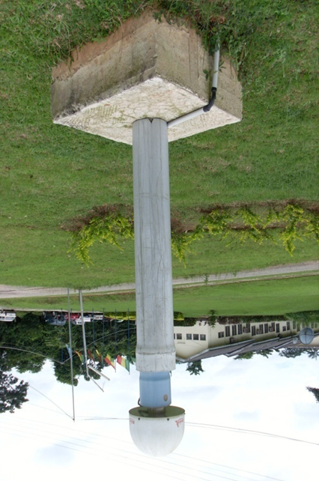
AFRIGIST in AFRICA Contribution to UN-GGIM: Africa
Contribution to all the meetings since CODI to UN-GGIM: Africa
Member of the Working groups
Great contribution to AFREF
Prof. Kufoniyi ED-RECTAS at the 1st technical workshop on AFREF
Cape Town, 2006
AFREF COR Station established at AFRIGIST since 2007 by Leica

Slide 22
AFRIGIST in AFRICA regional programmes
SERVIR WA
Digital Earth Africa
GMES & Africa

Slide 23
THANK YOU

