Slide 1
CAPACITY DEVELOPMENT AT THE REGIONAL CENTRE FOR MAPPING OF RESOURCES FOR DEVELOPMENT
(RCMRD)
PRESENTED BY RACHAEL UMAZI

Slide 2
ESTABLISHMENT OF RCMRD
The Regional Centre for Mapping of Resources for Development (RCMRD), previously known as Regional Centre for Services in Surveying, Mapping and Remote Sensing was established in Nairobi, Kenya in 1975 under the auspices of the United Nations Economic Commission for Africa (UNECA) and the then Organization of African Unity (OAU) now African Union (AU).
RCMRD is an intergovernmental organization with Head offices in Nairobi, Kenya.
RCMRD has twenty (20) Contracting member States and six (6) Non-Contracting member States

Slide 3
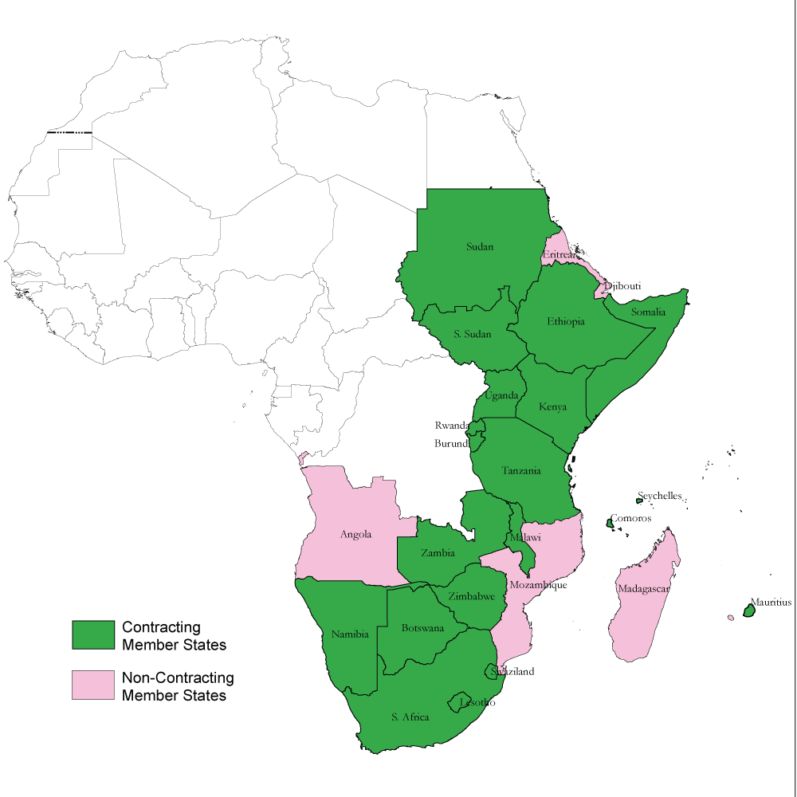
THE RCMRD MEMBER STATES

Slide 4
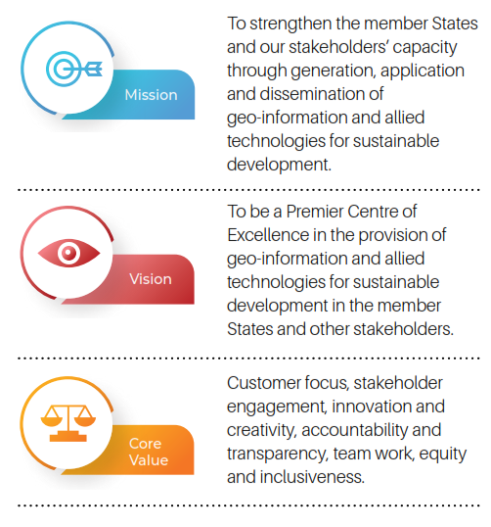
RCMRD MISSION AND VISION
ABOUT RCMRD

Slide 5
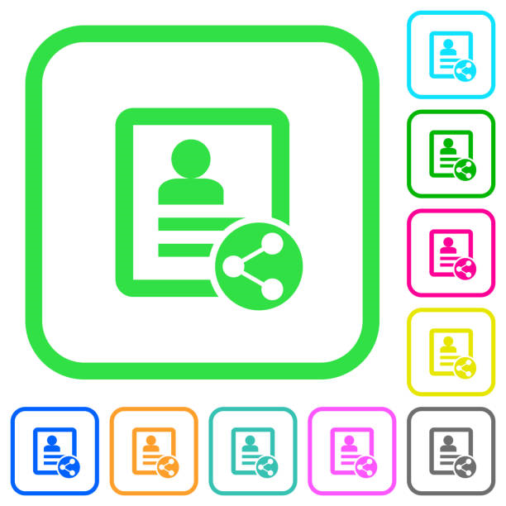
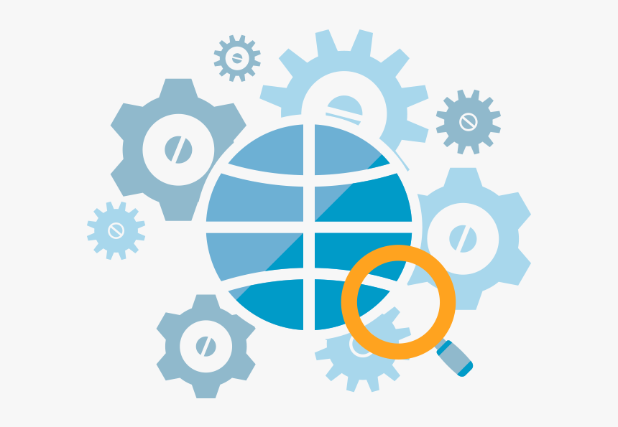
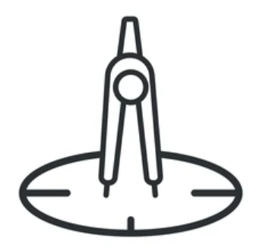
RCMRD CORE MANDATE
THE RCMRD CORE MANDATE
Advisory Services
Data and Information
Dissemination
Capacity Development
Knowledge Management
Project Implementation
Servicing and Calibration of Mapping Equipment
Research and Development

Slide 6
RCMRD THEMATIC AREAS In support of SDGs & AU 2063 Agenda
AGRICULTURE AND FOOD SECURITY
LAND ADMINISTRATION AND MANAGEMENT
WATER AND WATER RELATED DISASTERS
WEATHER AND CLIMATE
KNOWLEDGE MANAGEMENT

Slide 7
ACTIVITIES IN THE MEMBER STATES
PROJECTS BEING IMPLEMENTED IN THE MEMBER STATES
The Global Monitoring for Environment and Security and Africa (GMES & Africa).
The SERVIR Eastern and Southern Africa Project (SERVIR E&SA).
The Alliance for a Green Revolution in Africa (AGRA).
The Biodiversity and Protected Areas Management (BIOPAMA).
The Hazard Atlas Development Project.
The Eastern Africa Forest Observatory (OFESA).
The Network of Excellence on Land Governance in Africa (NELGA) Land Data Hub.
The Community-Based Flood Early Warning Systems (CBFEWS).
Digital Earth Africa (DEA).

Slide 8
GMES AND AFRICA
The Global Monitoring for Environment and Security and Africa ( GMES and Africa) is a flagship programme of the African Union Commission under the Africa Space Policy Strategy. The programme aims at improving African policy-makers’, planners’, scientists’, business and private sector and citizens’ capacities to design, implement, and monitor national, regional and continental policies and to promote sustainable management of natural resources through the use of Earth Observation data and derived information.
Areas of focus
Land Degradation Monitoring and Assessment
Wetlands Monitoring and Assessment
Open Geographical Regional Reference Vector Database for water and Agro-ecological Zoning
The project countries include Uganda, Kenya, Rwanda, Djibouti, Ethiopia, Mauritius, Eritrea, Somalia. Sudan and South Sudan.

Slide 9
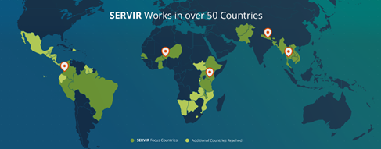
Connecting Space to Village
SERVIR Eastern & Southern Africa (SERVIR E&SA) is a joint development initiative of United States Agency for International Development (USAID) and National Aeronautics and Space Administration (NASA). SERVIR E&SA is helping countries in Eastern and Southern Africa Region use information provided by Earth observing satellites and geospatial technologies to improve environmental management and resilience to climate change. SERVIR empowers decision-makers with tools, products, and services to act locally on climate-sensitive issues.
SERVIR EASTERN AND SOUTHERN AFRICA
SERVIR Eastern & Southern Africa Services
Agriculture and Food Security - Rangeland Assessment and Monitoring Service, Regional Cropland Assessment and Monitoring Service, and Frost Monitoring and Forecasting Service.
Land Use Land Cover & Ecosystem- Ecological Modeling, and Land Use Land Cover and Change Mapping Service.
Water and Hydro-Climatic Disaster- Regional Stream Flow Monitoring and Forecasting Service, and Satellite- Based Water Quality Monitoring Service.
Weather and Climate - Climate Change Vulnerability, Impacts and Assessments Service, and Enhancing Drought Resilience in East Africa Service.

Slide 10
The project is funded by the United States Agency for International Development (USAID) and implemented through a grant by AGRA to the RCMRD. The key project implementers are the RCMRD, AGRA and the government agriculture ministries in the project countries.
The goal of the project is to build the capacity of governments' ministries of agriculture to monitor agricultural value chain investments using Geographical Information Systems (GIS) and Earth observation information thereby strengthening their capacity for evidence-based policy, programming and M&E.
The project outputs:
Geo-information System/ Portal for tracking key CAADP indicators and agriculture investments in each of the project countries (Burkina Faso, Ghana, Malawi, Mozambique). The country portals will have modules to facilitate analytics to answer specific decision-making questions in the agriculture sector ministries.
Capacity strengthening on the use of remote sensing and GIS data for agricultural decision-making
Training of the technical officers in the government to effectively track key changes in the agriculture sector
National maps on crop suitability, climate risks, soil properties generated annually
AGRA PROJECT

Slide 11
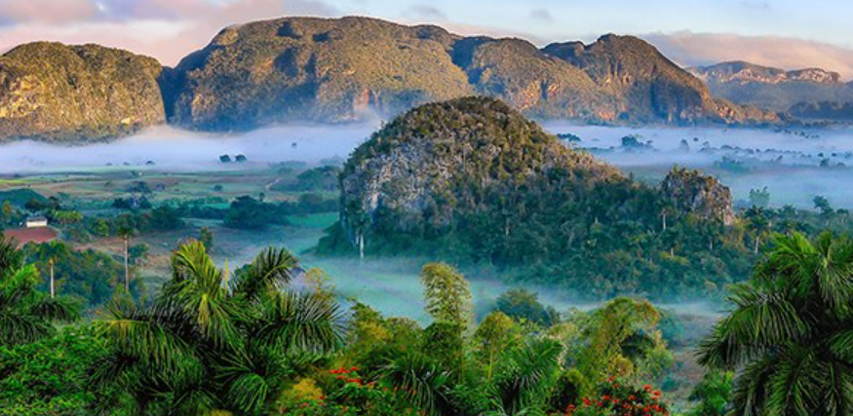
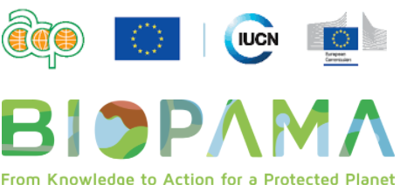
BIOPAMA PROJECT
The Biodiversity and Protected Areas Management (BIOPAMA) programme aims to assist the African, Caribbean and Pacific (ACP) countries in developing a framework for improving technical and institutional approaches to conserve biodiversity, in protected and conserved areas, through regional cooperation and capacity building activities. These actions are structured around the work of a series of Regional Observatories (RO) for protected areas across the ACP, managed by regional institutions, and housing Regional Reference Information Systems (RRIS) with tools and services that stakeholders can use to monitor and report on the status of biodiversity and PAs. In the Eastern and Southern Africa (ESA) region, the observatory will be known as the Regional Resource Hub.
BIOPAMA is jointly implemented by the International Union for Conservation of Nature (IUCN) and the Joint Research Centre of the European Commission (JRC) and RCMRD will be the host institution for this observatory.

Slide 12
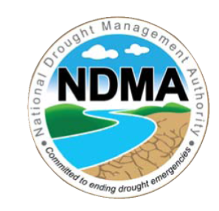
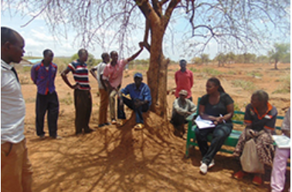
HAZARD ATLAS DEVELOPMENT
The project is for National Drought Management Authority(NDMA) with funding from United Nations Development Programme (UNDP).
The project is being implemented in six Counties in Kenya: Turkana, Tana River, Garissa, Kwale, Kilifi and Baringo.
The main objectives of Hazard Atlas Development Project are as follows:
Identifying hazards occurring in the counties and the hotspots
Mapping hazards
Developing hazard atlases for the counties
Improving capacity of the stakeholders through training
Target users of the products include:
County and National Governments
NDMA
Various stakeholders in the field of Disaster Risk Reduction in the Counties such as UN agencies, International Organizations, NGOs, CBOs
Academia

Slide 13
Eastern Africa Forest Observatory
The East and Southern Africa Forest Observatory aims at providing streamlined information on the trends and threats to forests in Ethiopia, Kenya, Tanzania, Mozambique and Uganda in order to support better decision-making to improve the management of forests. The observatory seeks to foster data-sharing across the region to support collaboration in forest management and address common issues.
OFESA is jointly led by the Center for International Forestry Research (CIFOR) and the Regional Centre for Mapping of Resources for Development (RCMRD). This initiative is funded by the European Union. The target beneficiaries of this project are Forest, Environment, Biodiversity and Wildlife Institutions.
Ongoing activities include collaboration with various ministries and other regional and country-level actors to understand their needs, strengthen their capacity to collect data, and address gaps and data quality issues.

Slide 14
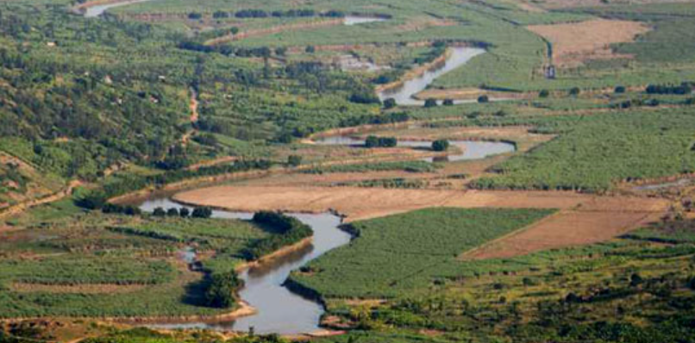
NELGA LAND DATA HUB
To strengthen human and institutional capacities for the implementation of the AU agenda on land, the African Land Policy Centre (ALPC) has established a Network of Excellence on Land Governance in Africa (NELGA) in collaboration with the GIZ.
RCMRD and GCI – GeoConsult International, are jointly implementing a Land Data Platform (LDP) in four countries (Senegal, Rwanda, Tanzania and Botswana) to support NELGA in its mandate.
The objectives of the NELGA LDP are to:
Accumulate country- and region-specific sources of land-related information and guide the user in obtaining this information.
Provide necessary data to monitor government policy and program implementation.
Enable researchers across the continent to carry out applied research to inform policy dialogue, reforms etc.

Slide 15
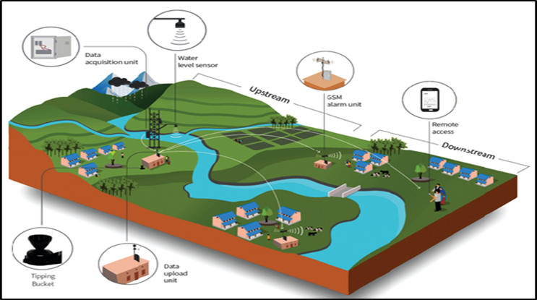
ESTABLISHMENT OF COMMUNITY-BASED FLOOD EARLY WARNING SYSTEMS (CBFEWS)
RCMRD was contracted by UNDP to support the Government of Malawi in Establishing Community-Based Flood Early Warning System (CBFEWS) in the flood prone districts in Malawi. The project aimed at supporting the government efforts of Scaling up the Use of Modernized Climate Information and Early Warning systems (M-CLIMES) with support of Green Climate Fund (GCF) through UNDP.
Through partnership with International Centre for Integrated Mountain Development (ICIMOD) and Sustainable Eco Engineering Pvt. Ltd (SEE) of Nepal and local support from UNDP, DoDMA, Department of Water Resources (DWR) and Department of Climate Change and Meteorological Services (DCCMS) and Malawi Red Cross Society (MRCS) of Malawi, RCMRD established and operationalized 21 telemetric CBFEWS systems in the 8 districts providing timely and reliable flood early warning information to most vulnerable communities.
CBFEWS system has been integrated with Earth Observation (EOs) and Satellite technologies (GEOGloWS) hence increasing the warning lead time from hours to 15 days to enhance community preparedness. It automatically generates the flood early warning information that enable the community take action towards that reduces their risk and vulnerability flood disaster hence saving lives and livelihood and enhancing community preparedness. Training and capacity building for stakeholders are on-going.

Slide 16
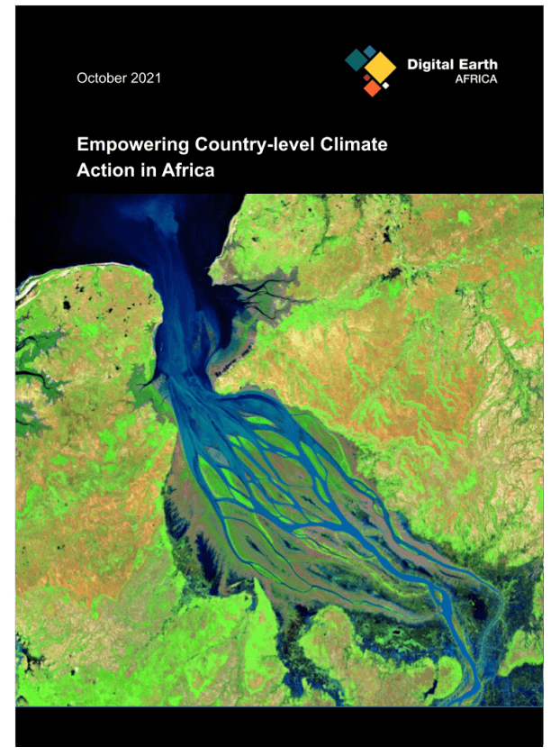
DIGITAL EARTH AFRICA
DE Africa is a not-for-profit initiative funded by US-based Leona M. and Harry B. Helmsley Charitable Trust and the Australian Government. In collaboration with Implementing Partners (IP) based in Africa, DE Africa is providing reliable, operational analysis ready EO data to deliver decision ready products and services to address social, environmental and economic changes in Africa.
DE Africa is a Group on Earth Observations (GEO) community activity. Geoscience Australia (GA), on behalf of DE Africa, and the RCMRD signed a Memorandum of Understanding, which stipulates that the Parties anticipate collaboration in the following areas:
Supporting the leadership of DE Africa through nomination of people at leadership levels for the DE Africa Technical Advisory Committee,
(Access to DE Africa infrastructure. RCMRD may have (non-exclusive) access to DE Africa for use by RCMRD, including its member countries and beyond, benefitting the mission of both RCMRD and DE Africa,
Capacity building both within RCMRD and more widely, such as training programs to build expertise in Open Data Cube and the production and use of DE Africa products, and
Country-level engagement including the leveraging of relationships that RCMRD holds with its member countries and involvement of DE Africa in country level engagement and events.

Slide 17
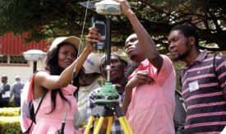
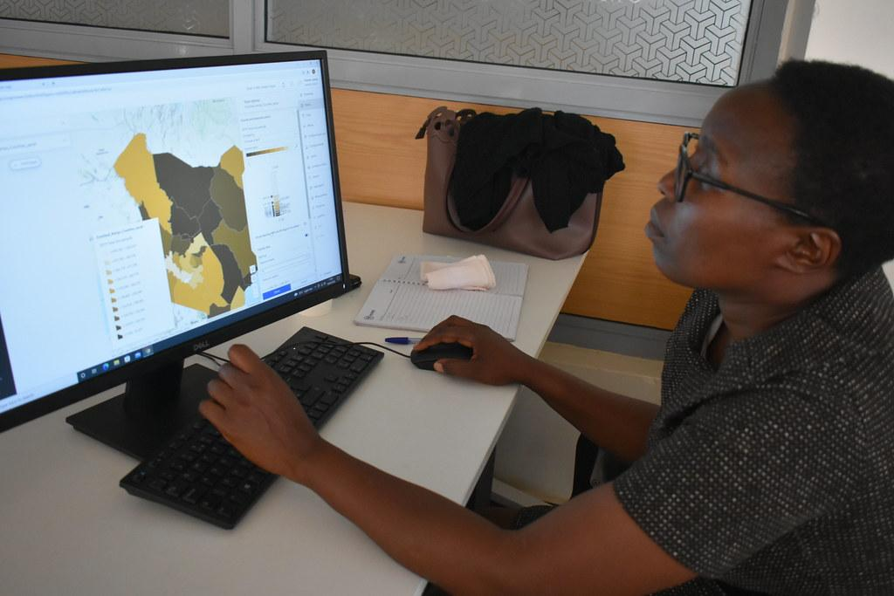
CAPACITY BUILDING ACTIVITIES
Professional & Short Courses
Introduction to Earth Observation (Remote Sensing- RS)/ Digital Image Processing
Open Source Tools Data and Applications
Introduction to Geographic Information System (GIS)
Introduction to Digital Cartography & GIS Mapping
Radar & Lidar Remote Sensing
Applied Remote Sensing & GIS
Mobile GIS
CAD Drawings (AutoCAD Civil 3D)
Digital Photogrammetric Mapping and Terrain Modeling
Global Navigation Satellite Systems (GNSS) Technologies for Precise Applications
Global Positioning System and Mobile Mapping for General Applications
Level Use and Applications
Service, Repair & Adjustment of Opti-Mechanical Surveying Instruments
Total Station, Use and Applications
Technical Diploma Courses
Diploma in Land Surveying
Diploma in Cartography and GIS
Diploma in Photogrammetry and Remote Sensing
Diploma/ Certificate in Information Technology
AFREF Training
AFREF Concepts, Applications, and Progress of Continuously Operating GNSS Reference Stations (CORS), and Real-Time GNSS Geodetic Networks (RGTN) concepts and needs to implement

Slide 18
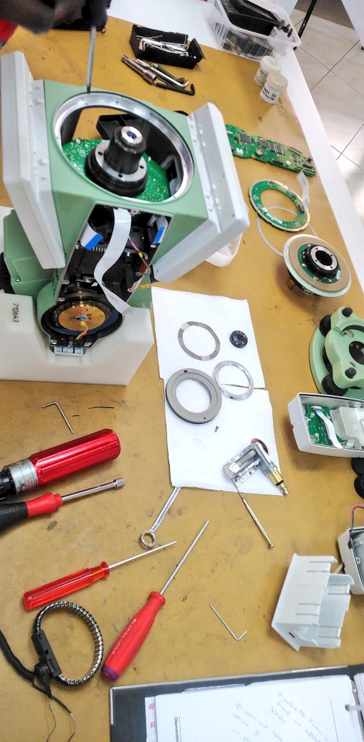
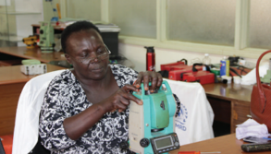
CALIBRATION OF SURVEY INSTRUMENTS

Slide 19
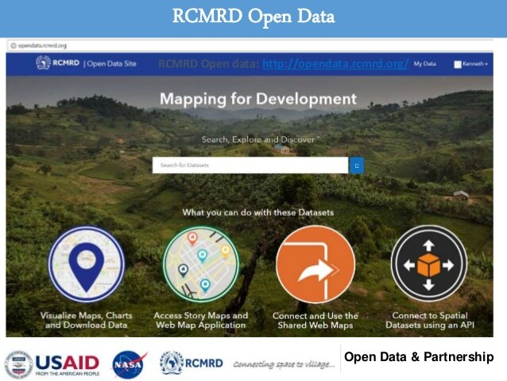
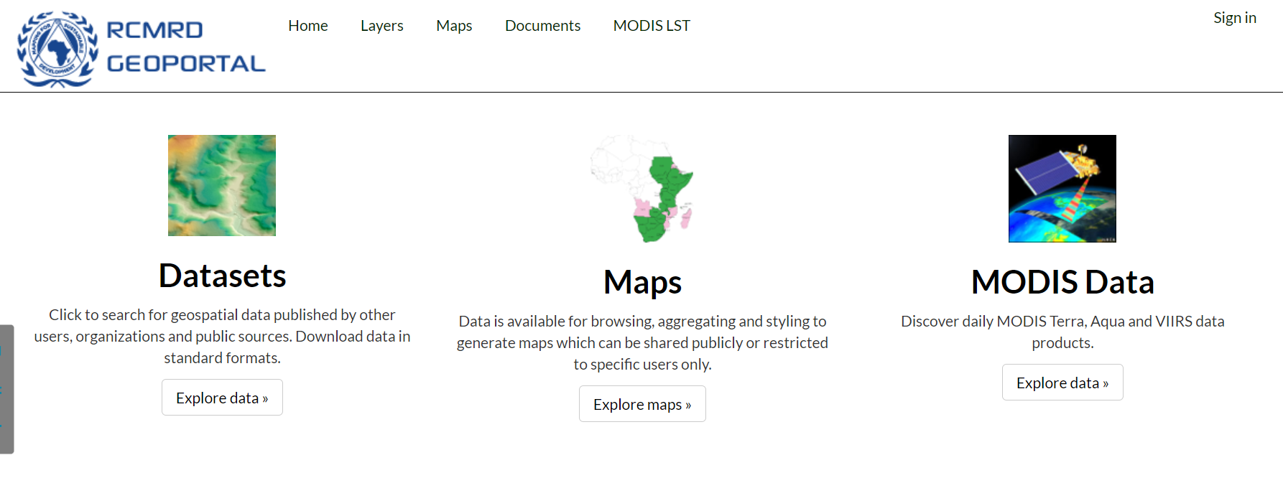
KNOWLEDGE MANAGEMENT

Slide 20
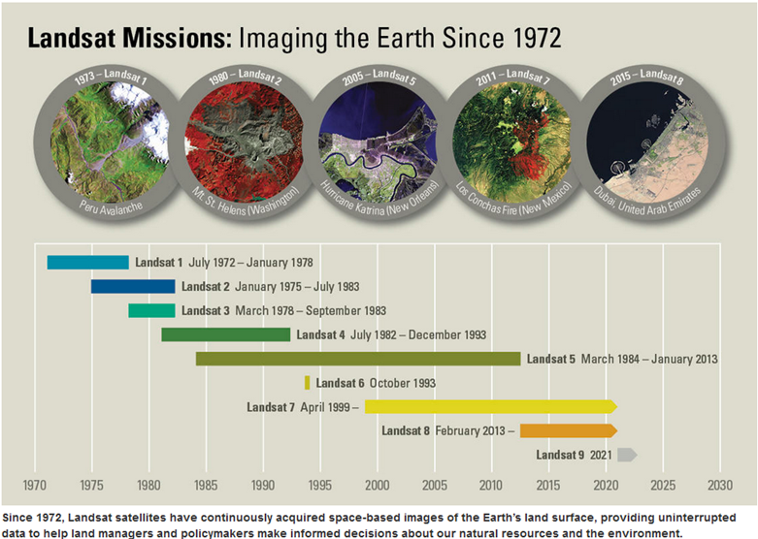
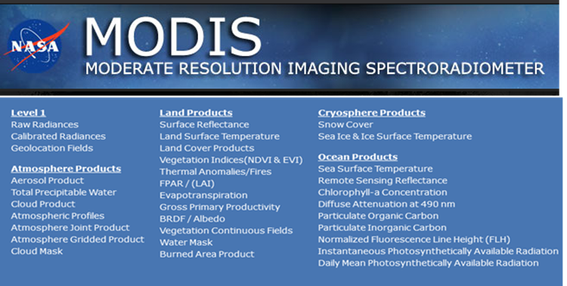
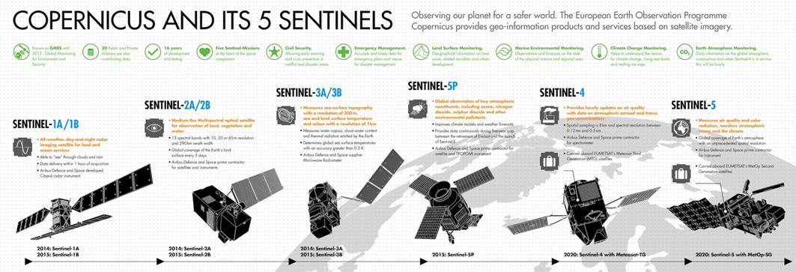
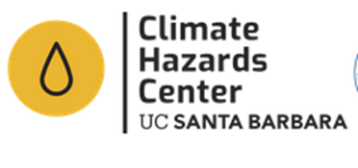
DATA AND INFORMATION DISSEMINATION

Slide 21
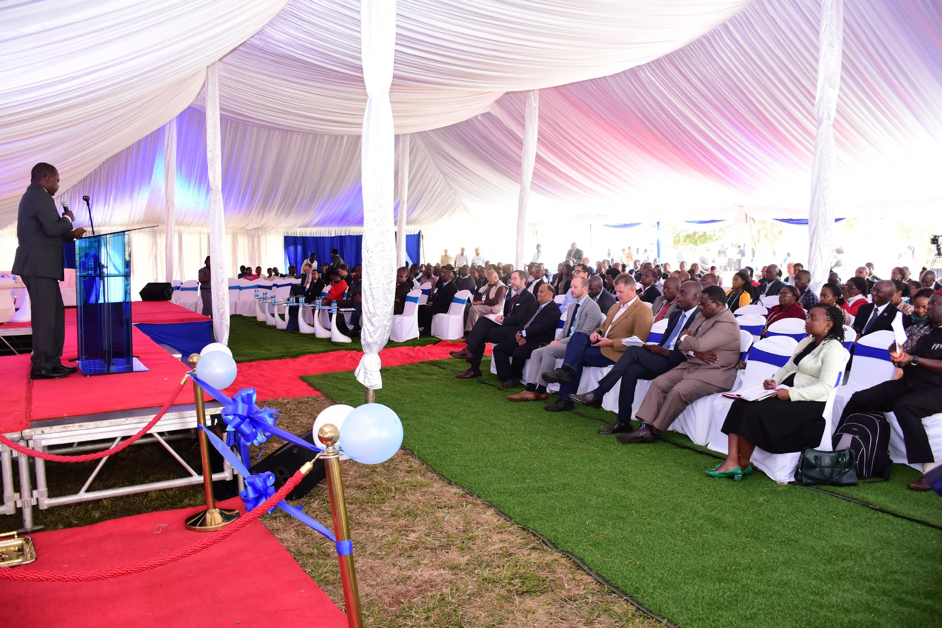
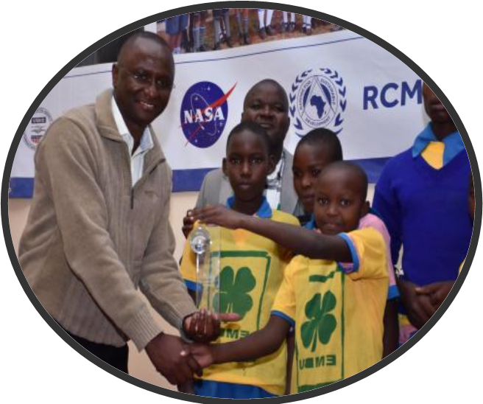
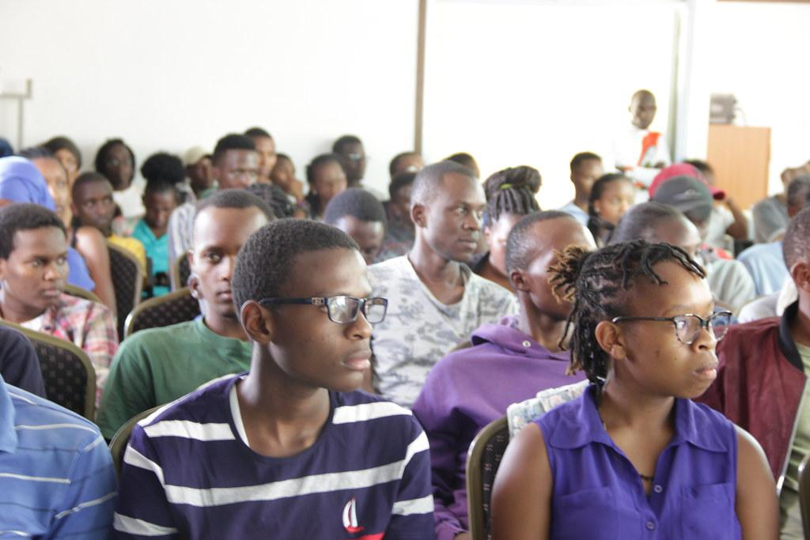
RAISING RCMRD PROFILE & YOUTH MENTORSHIP PROGRAMS
The Annual RCMRD International Conference (RIC)
The RCMRD Space
Challenge Program
The RCMRD Mentorship Programmes – Kuza and GIS Day

Slide 22
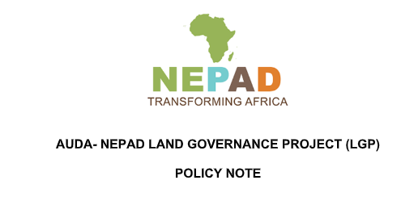
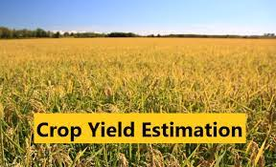
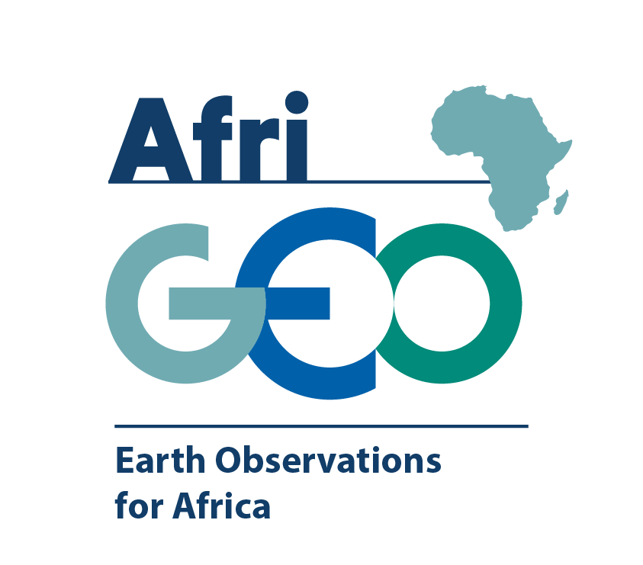
Aspects of Land Governance (Regional and Country Level Through Ministries of Lands)
ADVISORY SERVICES &
Aspects of Food Security (Country Level through Ministries of Agriculture)
RCMRD is the AfriGEO Secretariat

Slide 23
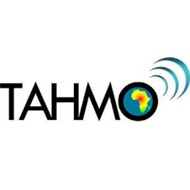
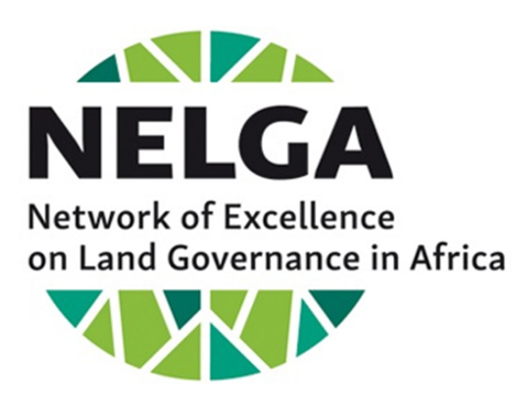
PARTNERS

Slide 24
RCMRD Links
https://www.rcmrd.org/
https://apps.rcmrd.org/
http://geoportal.rcmrd.org/
https://opendata.rcmrd.org/
https://www.rcmrd.org/projects/servir-esa
https://rcmrd.maps.arcgis.com/home/index.html
Thank you!

