Slide 1
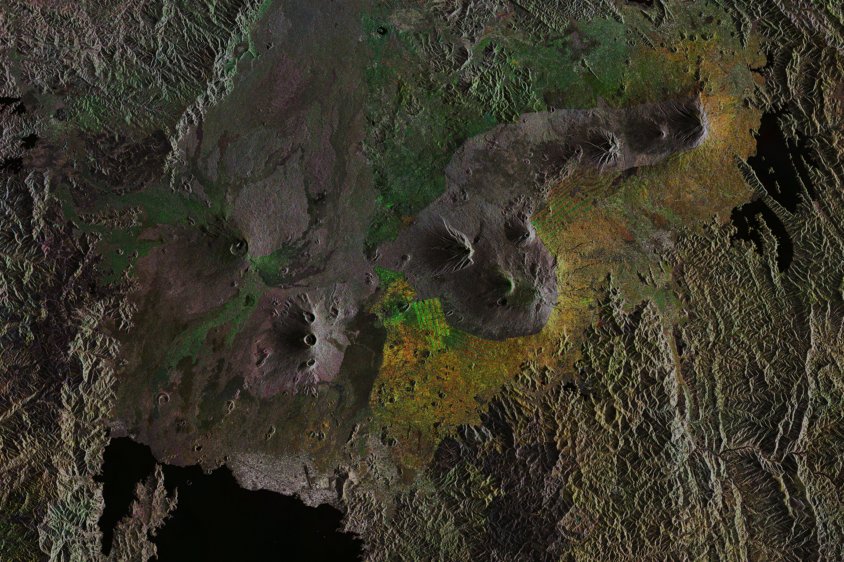
Common geographies for
Sustainable Development Goals
United Nations |
Geospatial
Programme SALB

Slide 2
Global Agendas
On geospatial information, common geographies and administrative units :
UN-GGIM
Africa
Plan of Action
UN-GGIM
Core data (see FGDT), including for geospatial and statistical integration (see GSGF)
UNGEGN
Promotion of geographic names
Rio+20
For policy making, programming and project operations
SDGs
National ownership in supporting and tracking progress of the SDGs
United Nations |
Geospatial
Notes:
The principle of the programme is to leverage the use of common geographies to integrate with statistics, to measure the Sustainable Development Goals, to promote geographic names, and monitor risk and evaluate disasters. The common geographies are based on the principles that they should be accessible, interoperable and global.

Slide 3
Deliverables
Identify and maintain of authoritative contact information of the National Geospatial Authorities responsible for administrative boundaries validation
Compile complete and consistent GIS dataset worldwide for administrative boundaries and names at first and second level below national, at 1 million scale;
Maintain a table overview of historical changes (data through time) of national administrative units and names
United Nations |
Geospatial

Slide 4
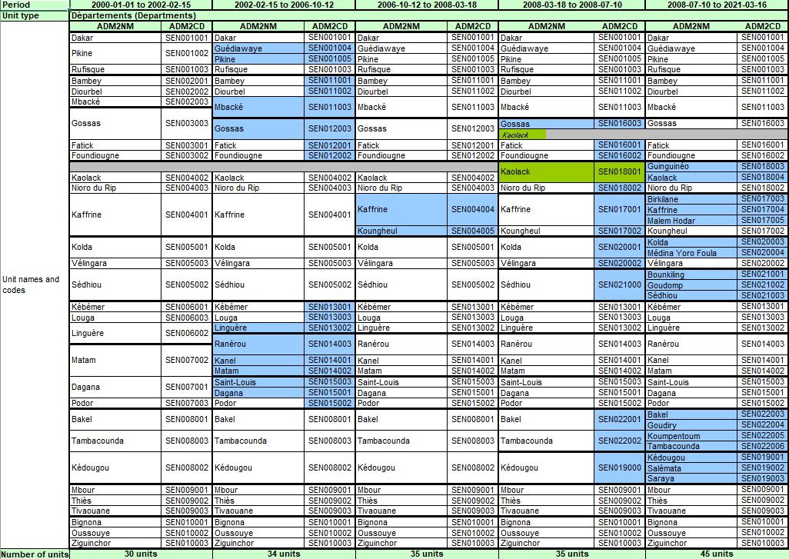
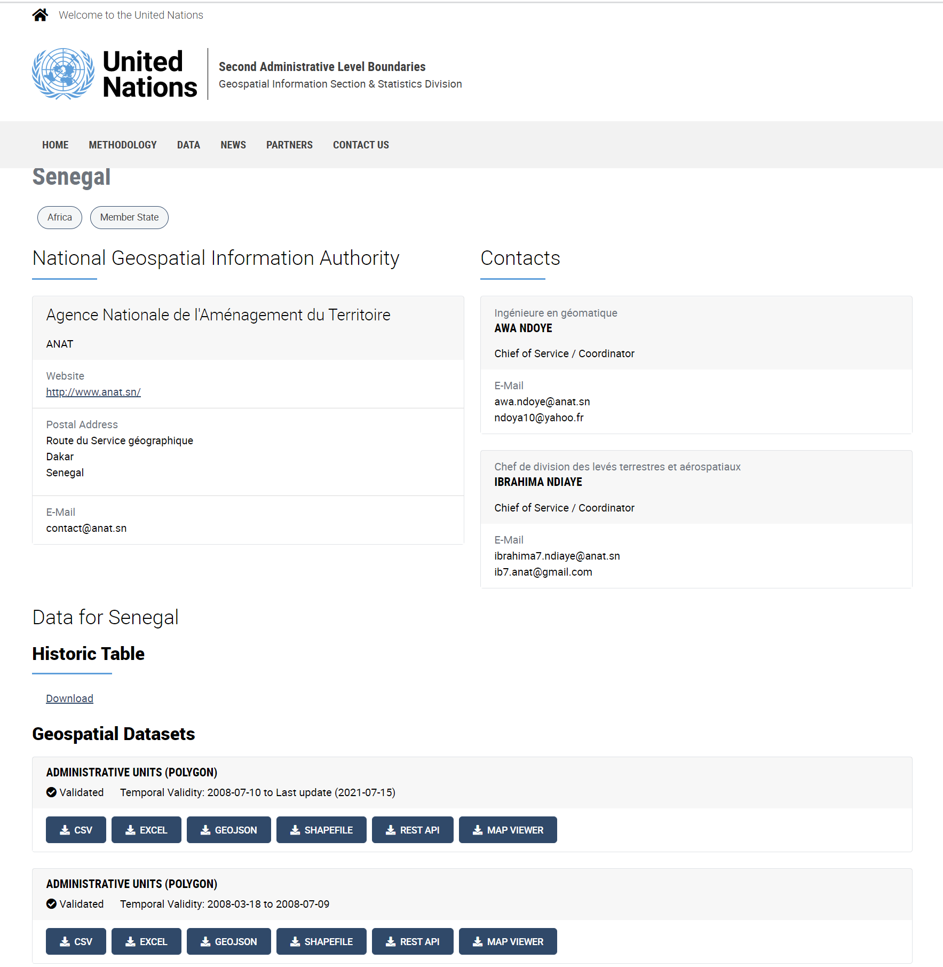
National
contact
Historical table (change overview)
Geospatial dataset (5 periods)
United Nations |
Geospatial
The better is the enemy of the good data
Notes:
The SALB objective is to promote accessible, interoperable and global common geographies on subnational units and boundaries to measure and monitor the Sustainable Development Goals for effective decision-making at global, regional, national and sub-national levels.
L'objectif du SALB est de promouvoir des géographies communes accessibles, interopérables et mondiales sur les unités et les frontières infranationales afin de mesurer et de surveiller les objectifs de développement durable pour une prise de décision efficace aux niveaux mondial, régional, national et sous-national.

Slide 5
Historical changes since 2000
Split
Merge
Renaming of administrative units
Adding a new administrative level in the administrative structure
Changing the administrative unit type for a given administrative level
Removing a level in the administrative structure
Re-introducing a level in the administrative structure
Split
Include treatment of territories with special status (territory without administration or under national administration)
Merge
United Nations |
Geospatial

Slide 6
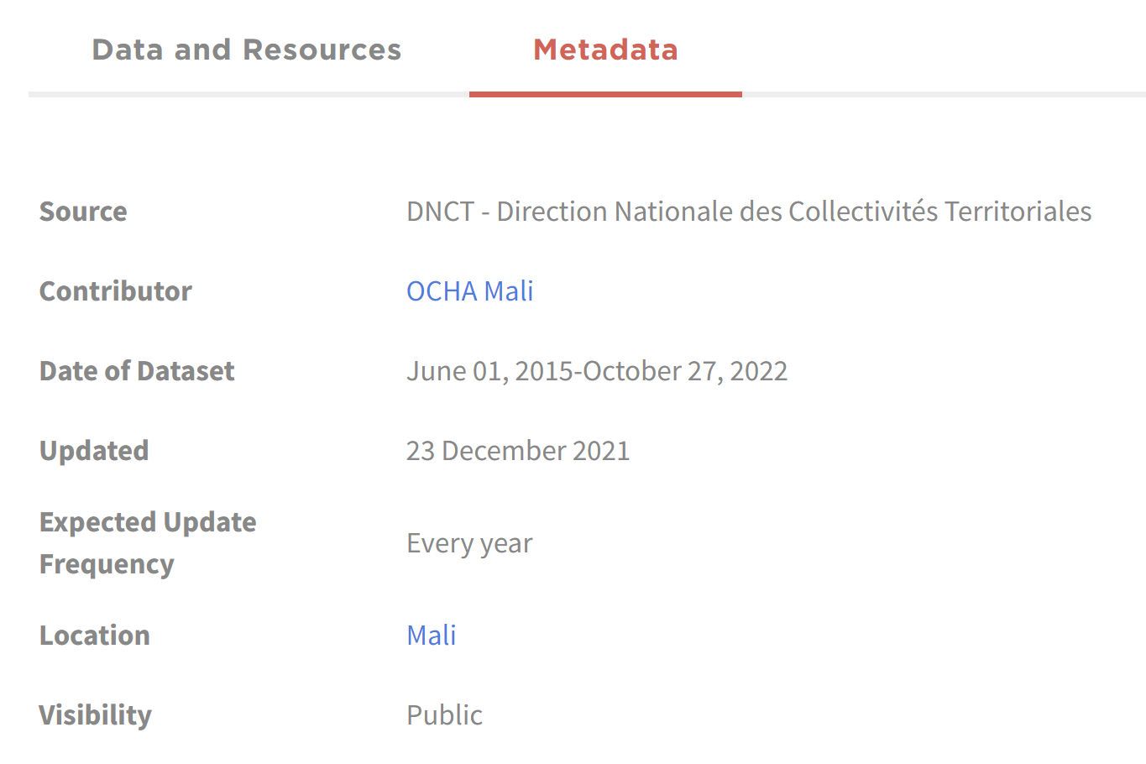
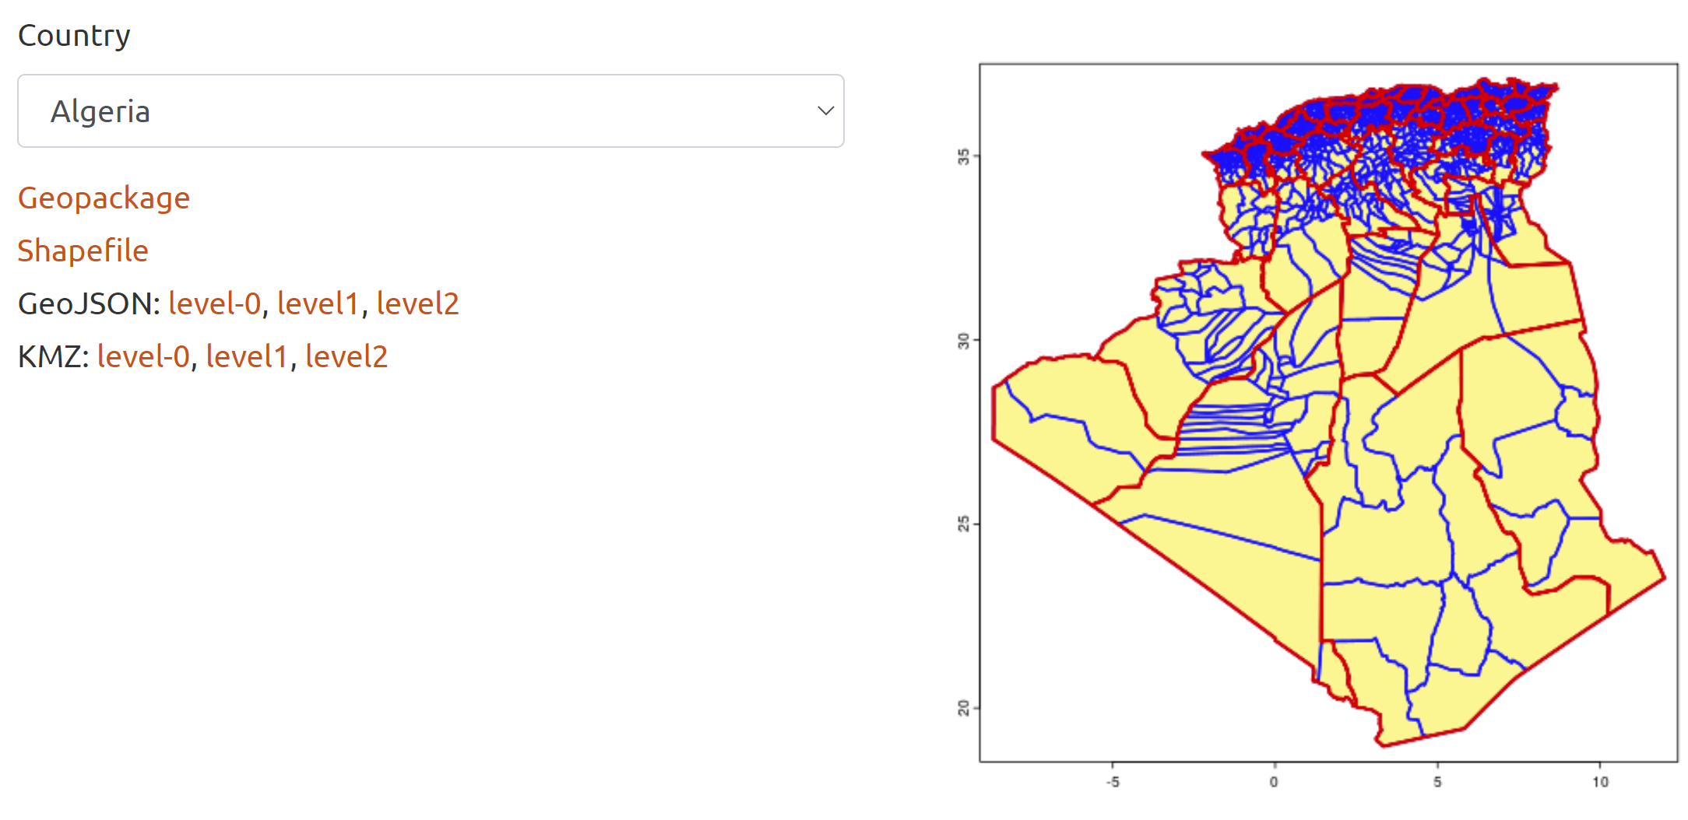
National ownership
United Nations |
Geospatial

Slide 7
SALB components
Accessible and Complete data (spatial+temporal)
Demonstration of value
(UN and governments)
National ownership, governance & promotion
Capacity and
Sponsor
Interoperable and standardized see Data specifications
Policy/Terms of use
United Nations |
Geospatial
Notes:
The principle of the programme is to leverage the use of common geographies to integrate with statistics, to measure the Sustainable Development Goals, to promote geographic names, and monitor risk and evaluate disasters. The common geographies are based on the principles that they should be accessible, interoperable and global.

Slide 8
What for?
Make available accessible and interoperable common geographies to compare
areas, sub-national and regional levels and time for decision-makers
within and between countries and across sectors, ministries or SDGs
Data is only useful as it is used
Agriculture
Health
Gender
Water
Inequalities
Disasters
United Nations |
Geospatial
Notes:
The principle of the programme is to leverage the use of common geographies to integrate with statistics, to measure the Sustainable Development Goals, to promote geographic names, and monitor risk and evaluate disasters. The common geographies are based on the principles that they should be accessible, interoperable and global.

Slide 9
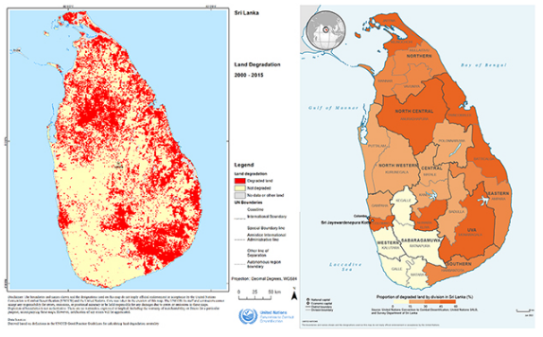
Demonstration case
Land degradation by district
Subnational data: Sri Lanka
Data on land degradation (raster)
UNCCD
SDG10: priority districts
link
United Nations |
Geospatial

Slide 10
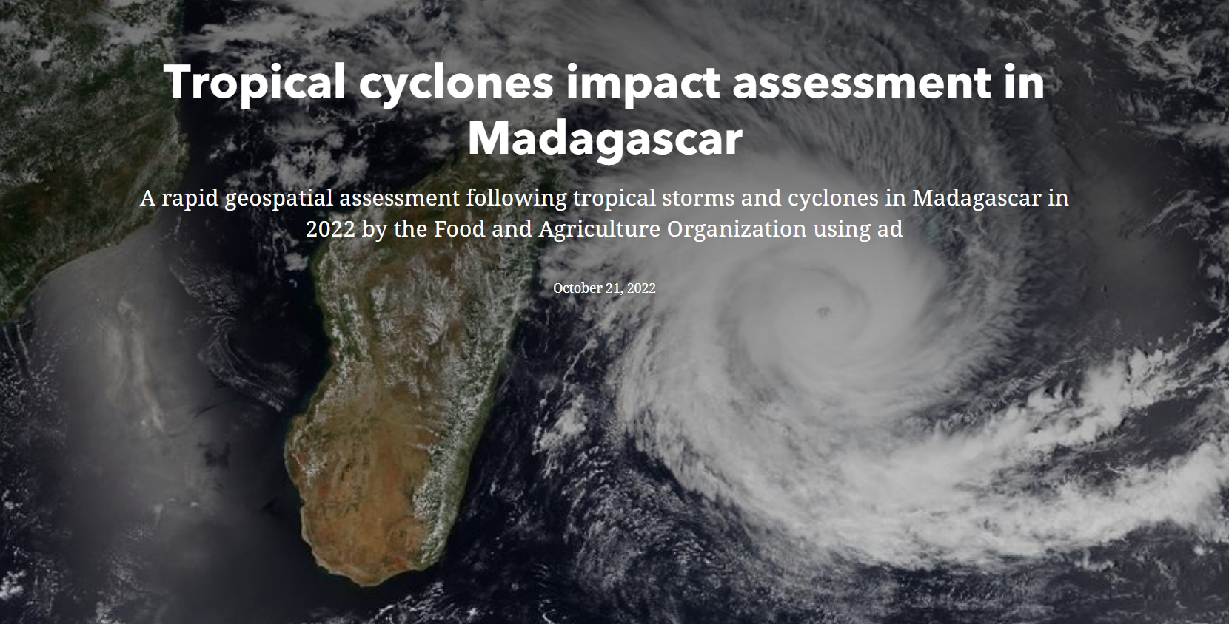
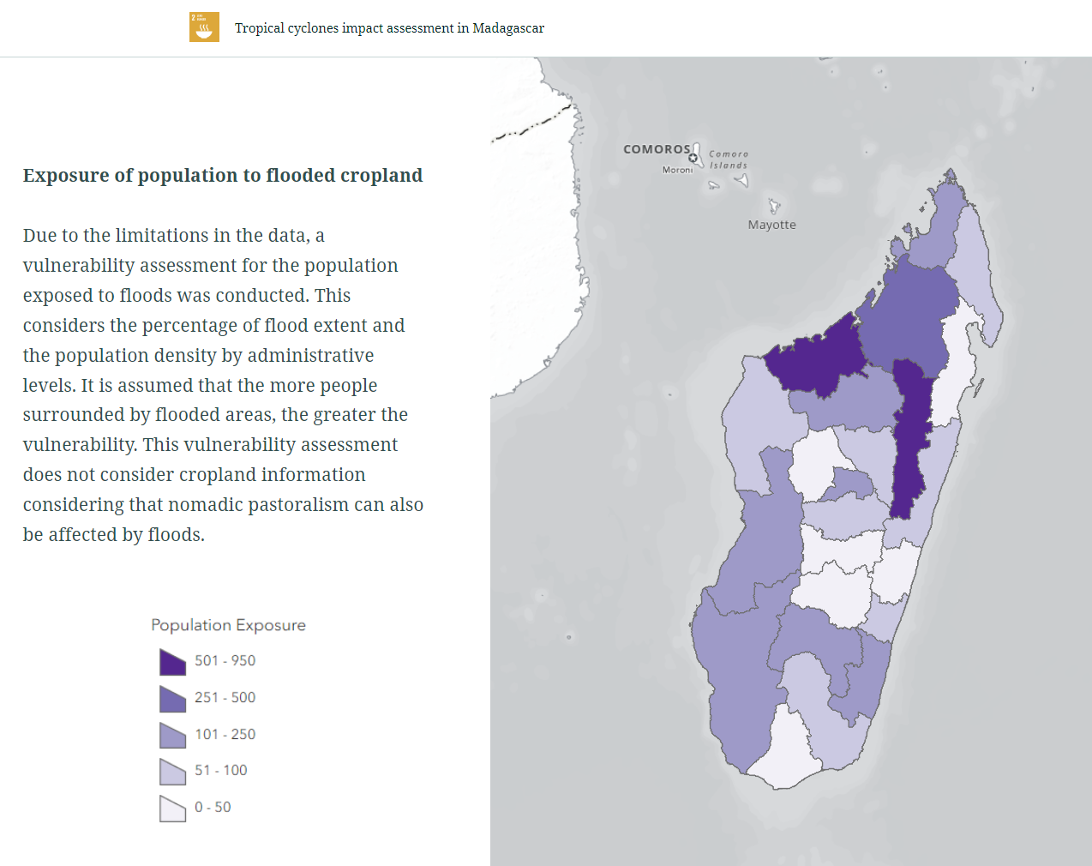
Demonstration case
Population exposure to cyclones
Subnational data: Madagascar
Agency impact assessment on
Tropical cyclones with Ministry of
Agriculture
Zero Hunger &
Climate Action
United Nations |
Geospatial

Slide 11
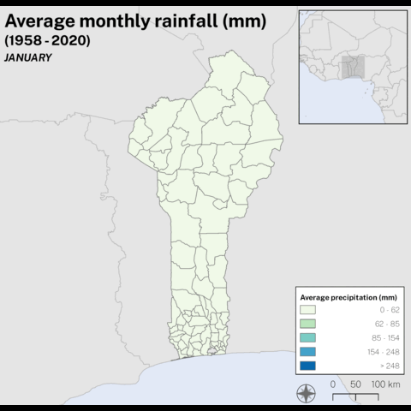
Demonstration case
Precipitation by month (1958-2020)
Subnational data: Benin and Togo
Analysis of school calendar and
Climate
Agency modeling on school calendar
United Nations |
Geospatial

Slide 12
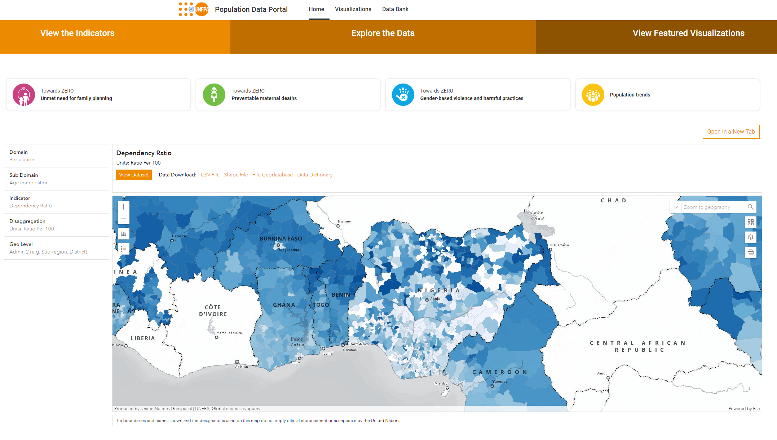
Demonstration case
Population data estimates across countries
Subnational data: Malawi
SDG topic: Gender Equality
Agency analysis on gender-based
violence
United Nations |
Geospatial
OCHA

Slide 13
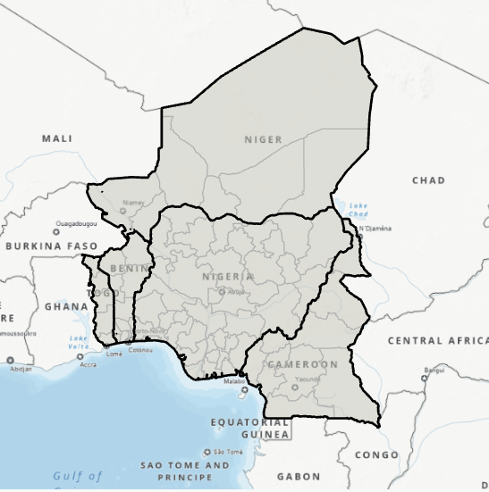
Demonstration case
Regional analysis (upcoming)
Subnational data: Western Africa
SDG topic: Good Health and
Well-being
Agency survey on demand
for family planning
United Nations |
Geospatial

Slide 14
SALB components
Accessible and Complete data (spatial+temporal)
Demonstration of value
(UN and governments)
National ownership, governance & promotion
Capacity and
Sponsor
Interoperable and standardized see Data specifications
Policy/Terms of use
United Nations |
Geospatial
Notes:
The principle of the programme is to leverage the use of common geographies to integrate with statistics, to measure the Sustainable Development Goals, to promote geographic names, and monitor risk and evaluate disasters. The common geographies are based on the principles that they should be accessible, interoperable and global.

Slide 15
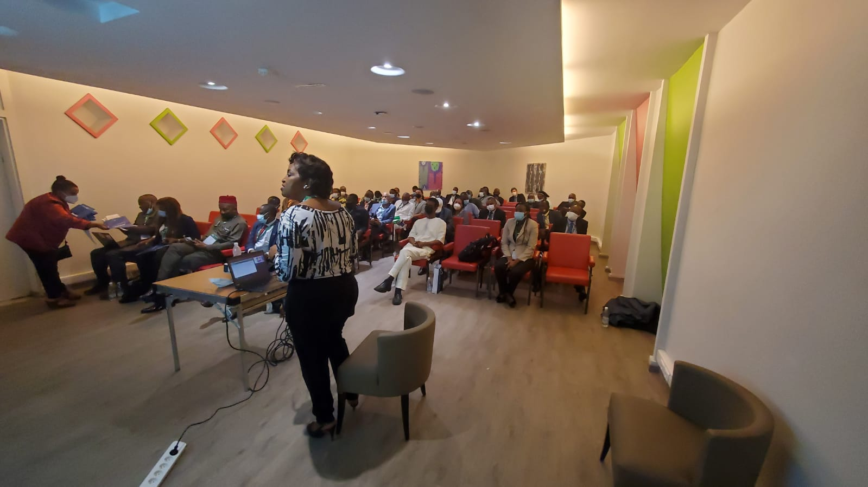
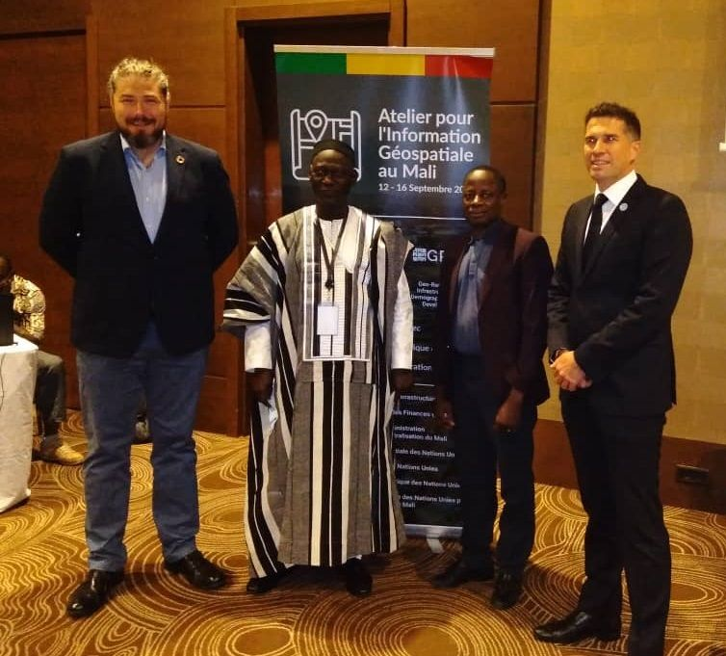
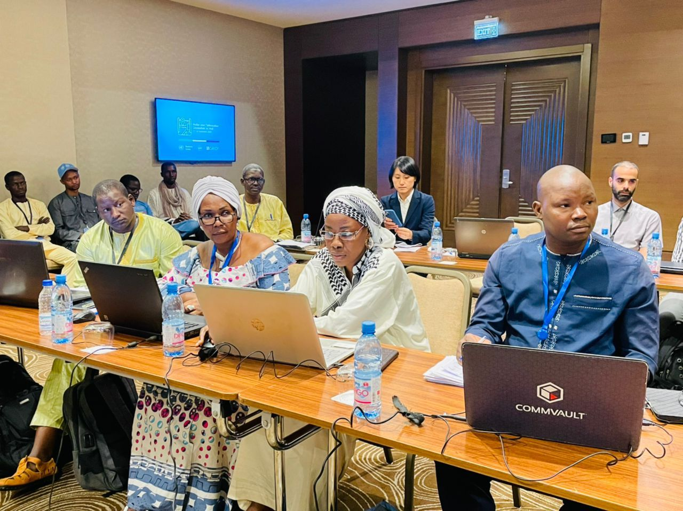
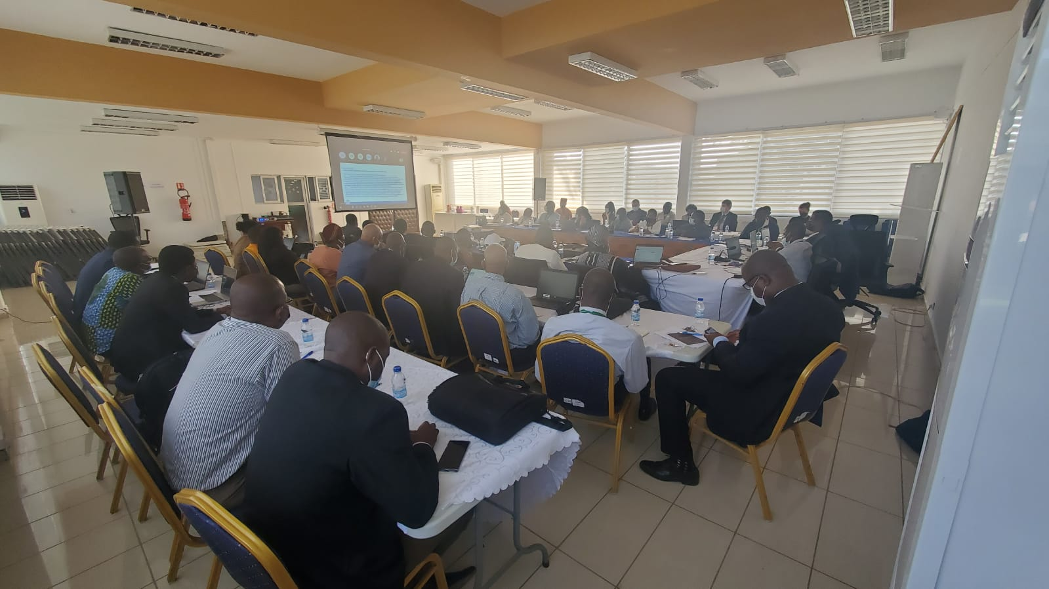
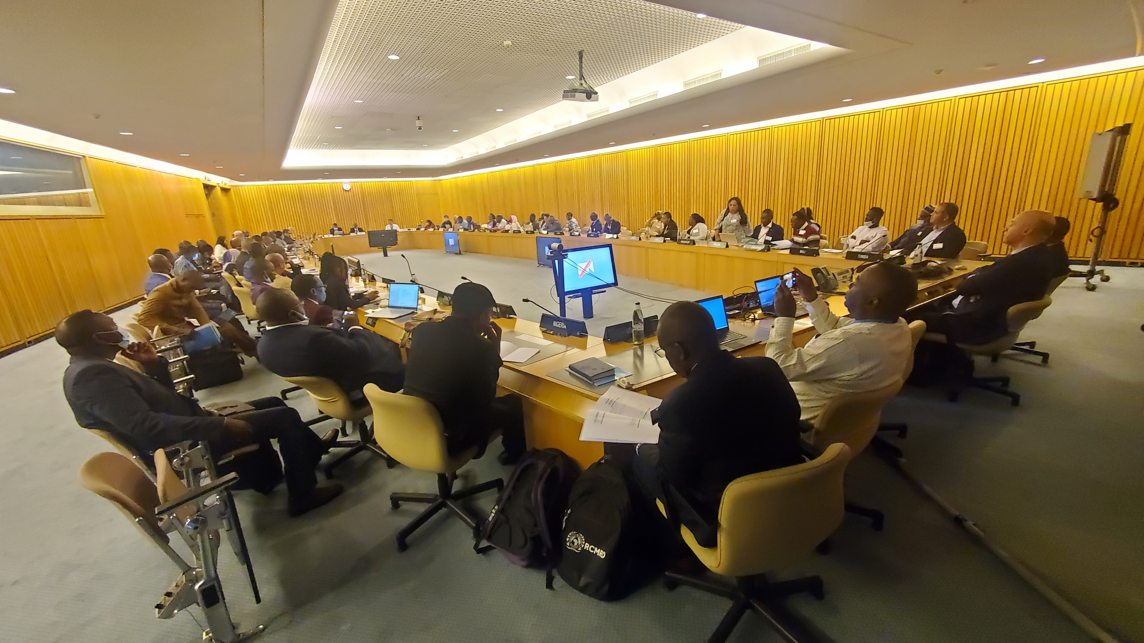
Capacity and sponsor
Bamako 2022
Abidjan 2021
Addis Abeba 2022
United Nations |
Geospatial

Slide 16
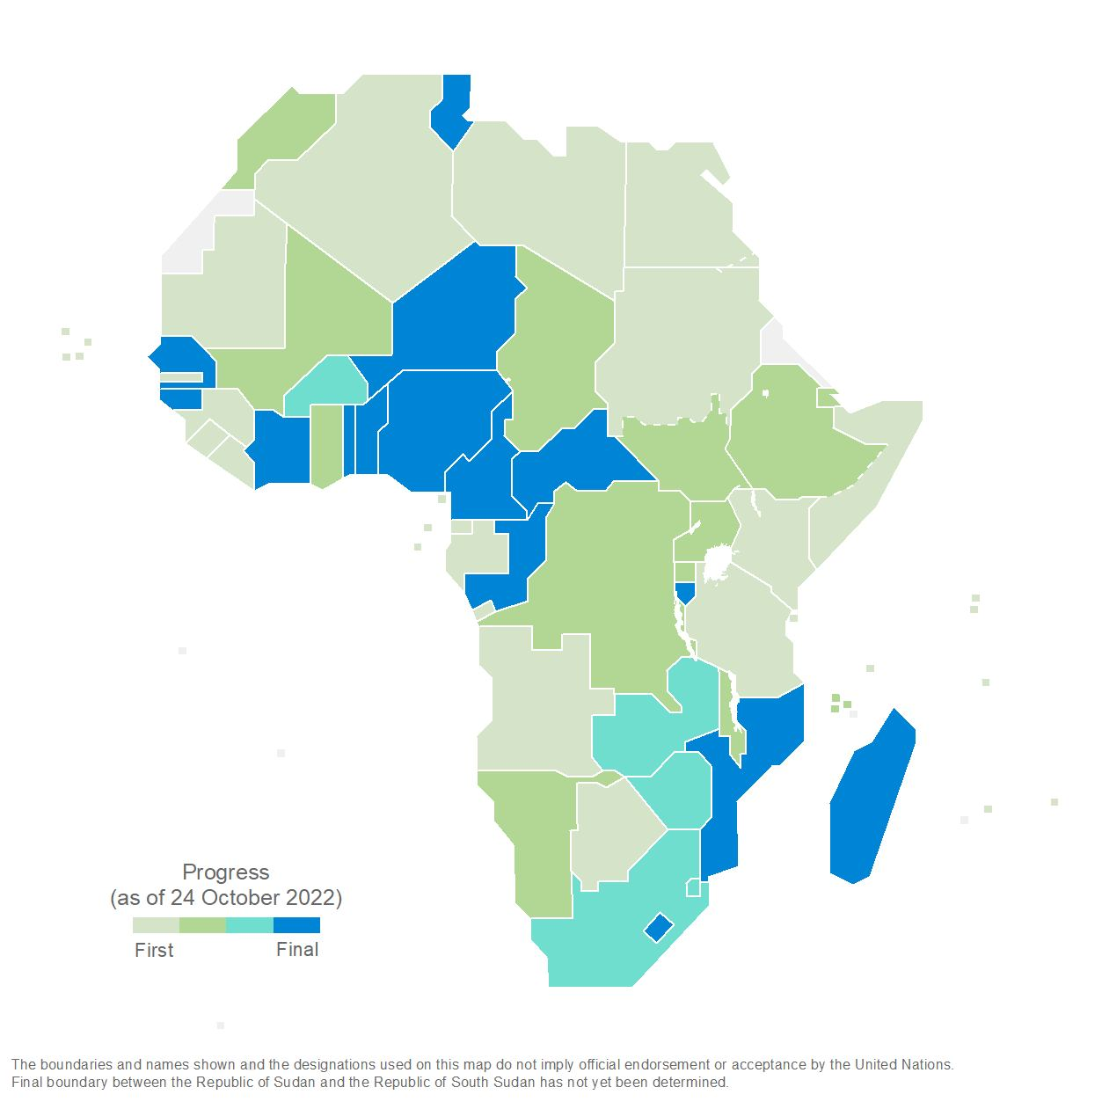
Current status of completion
United Nations |
Geospatial
Notes:
The principle of the programme is to leverage the use of common geographies to integrate with statistics, to measure the Sustainable Development Goals, to promote geographic names, and monitor risk and evaluate disasters. The common geographies are based on the principles that they should be accessible, interoperable and global.

