Slide 1
Workshop on Availability of Geospatial Datasets for Sustainable Development Goals Side Event at Eighth meeting of UN-GGIM: Africa and StatCOM: Africa VIII 22-28 October, 2022 Addis Ababa, Ethiopia
Availability of Geospatial Datasets for Sustainable Development Goals in Africa
Aster Denekew Yilma
Geospatial Information Officer
Geospatial Information Management Section
African Center for Statistics

Slide 2
Background
ECA geospatial information activities include:
Harnessing and building geospatial data and information resources to improve availability and use of spatially enabled data for informed decision making for addressing national, regional and global development agenda
Assisting Member States in the development and implementation of spatial data infrastructures (NSDI), and integrating NSDI with the Integrated Geospatial Information Framework (IGIF)
Supporting Member States in the integration of statistics and geospatial information through mainstreaming geospatial technology into National Statistics Offices’ activities
Advancing holistic geospatial information policies that enable and encourage linkages with international programmes and initiatives, through the UN-GGIM: Africa

Slide 3
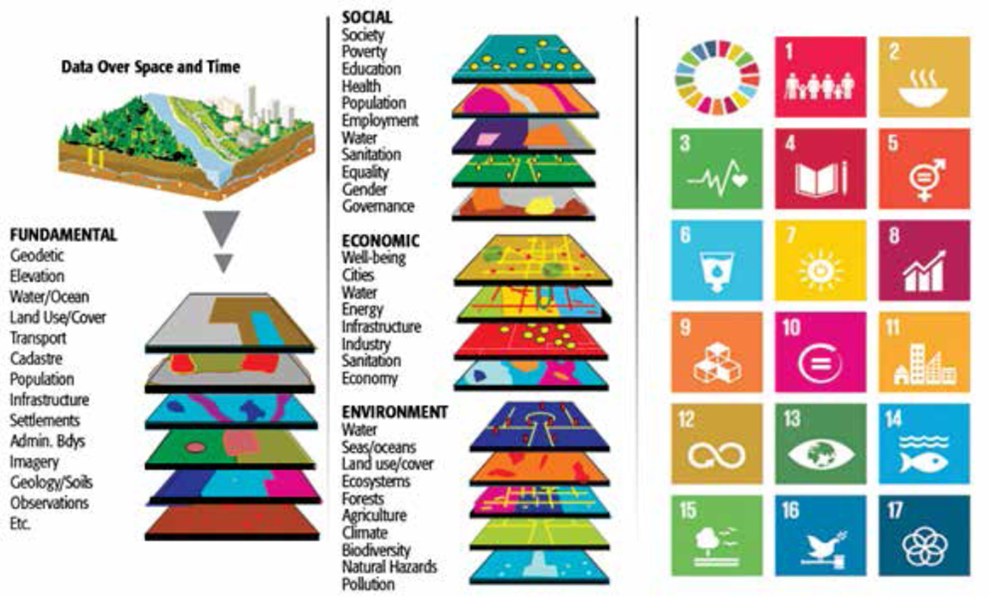
Background…
The relevance of Data, Location /geospatial data, is evident to fulfil the responsibilities and mandates of the United Nations, to accelerate the attainment of SDGs and AU Agenda 2063
Sustainable development goals (SDGs) indicators require the use of modern, innovative technologies, including geospatial technologies
Fundamental geospatial datasets are crucial for addressing sustainable development in all its dimensions: social, economic, and environmental
Source: UN-GGIM

Slide 4
Background…
ECA promotes and supports Member States in building fundamental datasets in order to make geospatial information readily available and easily accessible
Identification and Inventory of geospatial datasets is part of the work programme of ECA
In the past, ECA conducted a study and published document: ‘Determination of the Fundamental Geospatial Datasets for Africa’ - published in 2007
Notes:
https://archive.uneca.org/sites/default/files/PublicationFiles/geoinformation_socio_economic_dev-en.pdf

Slide 5
Background…
Recently, ECA conducted a study in the identification of fundamental datasets that are relevant for the SDGs.
Published, in November 2020, a technical document on ‘Geospatial Data Taxonomy for the Sustainable Development Goals in Africa’ which was prepared with the financial support of the 2030 Agenda for Sustainable Development Sub-Fund of the United Nations Peace and Development Trust Fund (UN-PDF).
The document is a result of study which conducts an assessment to identify the need for geospatial information at the level of the indicators of the Sustainable Development Goals.

Slide 6
Background…
ECA through the Geospatial Information Management Section, ACS, implemented UN-PDF project: ‘Strengthening the capacities of ECA Member States to develop geospatial information resources and services in support of the implementation and monitoring of the sustainable development goals’
Funded by 2030 Agenda for Sustainable Development Sub-Fund of the United Nations Peace and Development Trust Fund (UN-PDF); UN-DESA

Slide 7
Background…
Objective of the project:
Strengthening the capacities of selected African countries to produce, utilize, and manage geospatial information resources and services in support of Sustainable Development Goals (SDGs)
To assist beneficiary countries to develop National Spatial Data Infrastructure (NSDI), and to improve the availability of geospatial information for effective monitoring and implementation of the SDGs
Notes:
Selected/Target countries:
Comoros (Eastern Africa)
Cameroon (Central Africa)
Eswatini (Southern Africa)
Kenya (Eastern Africa)
Niger (Western Africa)

Slide 8
UNPDF Project Activities
Project main activities include:
Development of policy guideline document for the implementation of NSDI in Africa;
Organization of regional workshops to discuss the policy guideline document
Organization of regional capacity building workshops to raise awareness and improve countries capacity in the production of geospatial information, giving particular emphasis on the empowerment of young female geospatial professionals;
Development of a technical document on Geospatial Data Taxonomy for Sustainable Development Goals in Africa
Development of an online application with customized interface for information sharing and access

Slide 9
Geospatial Data Taxonomy for SDGs in Africa

Slide 10
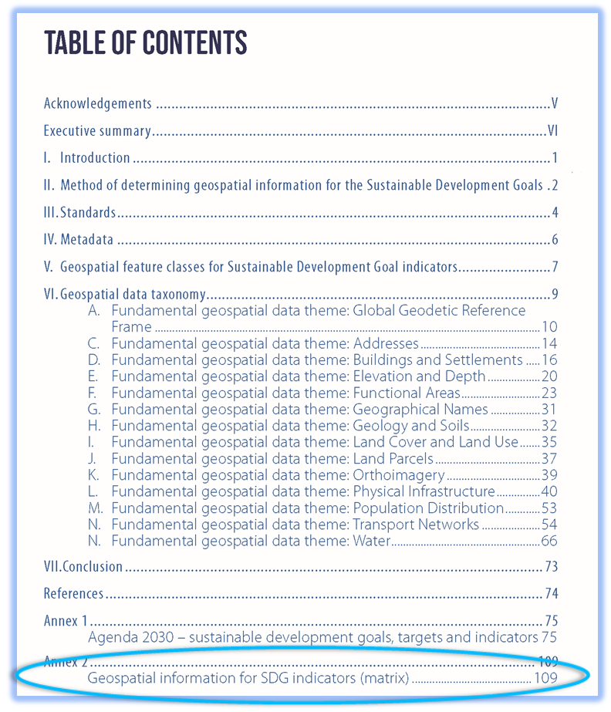
Geospatial Data Taxonomy for SDGs in Africa…
Geospatial Data Taxonomy for SDGs in Africa identified:
The document identified all the SDG indicators which requires geospatial data and the corresponding geospatial data themes required
Provides a geospatial data taxonomy for those geospatial information organized at a feature class level for each of the global fundamental geospatial data themes of UN-GGIM
Geospatial feature classes for each Fundamental geospatial data themes (14 Data Themes of UN-GGIM)
Identified relevant geospatial information required for SDG indicators (Matrix)

Slide 11
Geospatial Data Taxonomy for SDGs in Africa…
Geospatial feature classes required for the indicators of Sustainable Development Goals
Data theme* | Feature Class – Level I | Feature Class – Level II | Key Attributes
A. Global Geodetic Reference Framework | Geodetic Control Network | Geodetic Control Station | Ref. No., Type, Description
B. Addresses | Address | - | Type, Value
C. Buildings and Settlements | Building | - | Type
 | Settlement | - | Name, Class
D. Elevation and Depth | Elevation | Digital Elevation Model | Post spacing
 | Depth | Digital Bathymetric Model | Post spacing
E. Functional Areas | Administrative Area | Country | Name, Status
 |  | Second-level Administrative Area | Name
 |  | Third-level Administrative Area | Name
 |  | Government Functional Administration | Class, Name
 |  | Exclusive Economic Zone (marine) | Name
 | Conservation Area | - | Class, Name
 | Statistical Area | - | Class, Name
Data theme* | Feature Class – Level I | Feature Class – Level II | Key Attributes
F. Geographical Names | Geographical Name | - | Class, Name
G. Geology and Soils | Geology | Aquifer | Type, Volume
 | Soil Unit | - | Class
H. Land Cover and Land Use | Land Cover Unit | - | Class
 | Land Use Unit | - | Class
I. Land Parcels | Cadastral Land Parcel | - | Parcel ID, Land tenure type
J. Orthoimagery | Orthoimage | - | Sensor platform, Spatial resolution, Spectral bands, Radiometric resolution, Image date
K. Physical Infrastructure | Structure | Bridge | Type, Span, Bearing weight
 |  | Tunnel | Name
 |  | Aqueduct
 |  | Canal
 |  | Dam | Type
 | Public Utility | Telecommunications Tower | Type
 |  | Electrical Power Generation | Type
 |  | Waste Disposal Site
 |  | Sewerage Treatment
 |  | Water Reticulation Point
 | Public Service | School | Type, Name
 |  | Health Facility | Type, Name, Health services

Slide 12
Geospatial Data Taxonomy for SDGs in Africa…
Data theme* | Feature Class – Level I | Feature Class – Level II | Key Attributes
L. Population Distribution | Population | -
 | Population Density | -
M. Transport Networks | Road Network | Road | Class, route number/name, Surface type
 |  | Street | Surface type, Name
 | Rail Network | Railway | Class, Gauge
 |  | Station | Name
 | Water | Harbour | Class, Name, Capacity
 |  | Ferry Crossing | Transport type
 | Air | Airport or Aerodrome | Class, Name, Facilities
 | Public Transport Route | -
N. Water | Inland Water | River | Class, Name
 |  | River Basin | Name
 |  | Lake | Class, Name
 |  | Wetland | Type
 |  | Reservoir | Class
 | Marine | Ocean or Sea | Name
 |  | Coastline

Slide 13
Geospatial Data Taxonomy for SDGs in Africa…
Indicators | Geodetic Control Station | Address (dwelling) | Building (dwelling) | Settlement | Population Distribution (statistical unit) | Cadastral Land Parcel | Country | Second-level Administrative Area | Third-level Administrative Area | Exclusive Economic Zone | Government Functional Administration | Conservation Area | Statistical Area | Geographical Name | Aquifer | Soil Unit | Land Cover Unit | Land Use Unit | Orthoimage | Bridge | Tunnel | Aqueduct | Canal | Dam | Reservoir | Electrical Power Generation | Waste Disposal Site | Sewerage Treatment | Water Reticulation Point | Road (centreline) | Street | Station | Railway | Harbour | Ferry Crossing | Airport/Aerodrome | River (centreline) | River Basin | Lake | Wetland | Ocean/Sea | Coastline | Digital Elevation Model | Digital Bathymetric Model | Building (storage facility) | School | Building (commercial bank) | Building (automated teller machine) | Health Facility | Telecommunications Tower (mobile signal coverage)
1.1.1 Proportion of population below the international poverty line, by sex, age, employment status and geographical location (urban/rural) | √ | √ | √ | √ | √ |  |  |  |  |  |  |  |  | √ |  |  |  |  | √
1.2.1 Proportion of population living below the national poverty line, by sex and age | √ | √ | √ |  | √ |  |  |  |  |  |  |  |  |  |  |  |  |  | √
1.2.2 Proportion of men, women and children of all ages living in poverty in all its dimensions according to national definitions | √ | √ | √ |  | √ |  |  |  |  |  |  |  |  |  |  |  |  |  | √
1.3.1 Proportion of population covered by social protection floors/systems, by sex, distinguishing children, unemployed persons, older persons, persons with disabilities, pregnant women, newborns, work-injury victims and the poor and the vulnerable | √ | √ | √ |  | √ |  | √ | √ | √ |  | √ |  |  |  |  |  |  |  | √
1.4.1 Proportion of population living in households with access to basic services | √ | √ | √ |  | √ |  |  |  |  |  |  |  |  |  |  |  |  |  | √
1.4.2 Proportion of total adult population with secure tenure rights to land, (a) with legally recognized documentation, and (b) who perceive their rights to land as secure, by sex and type of tenure | √ | √ | √ |  |  | √ |  |  |  |  |  |  |  |  |  |  |  |  | √
Notes:
Geospatial Information for SDG indicators (Matrix): Geospatial Information that are required for each SDGs indicators are identified

Slide 14
Geospatial Data Taxonomy for SDGs in Africa…
Indicators | Geodetic Control Station | Address (dwelling) | Building (dwelling) | Settlement | Population Distribution (statistical unit) | Cadastral Land Parcel | Country | Second-level Administrative Area | Third-level Administrative Area | Exclusive Economic Zone | Government Functional Administration | Conservation Area | Statistical Area | Geographical Name | Aquifer | Soil Unit | Land Cover Unit | Land Use Unit | Orthoimage | Bridge | Tunnel | Aqueduct | Canal | Dam | Reservoir | Electrical Power Generation | Waste Disposal Site | Sewerage Treatment | Water Reticulation Point | Road (centreline) | Street | Station | Railway | Harbour | Ferry Crossing | Airport/Aerodrome | River (centreline) | River Basin | Lake | Wetland | Ocean/Sea | Coastline | Digital Elevation Model | Digital Bathymetric Model | Building (storage facility) | School | Building (commercial bank) | Building (automated teller machine) | Health Facility | Telecommunications Tower (mobile signal coverage)
SDG 1: No Poverty | √ | √ | √ | √ | √ | √ | √ | √ | √ |  | √ |  |  | √ |  |  |  | √ | √
SDG 2: Zero Hunger | √ | √ | √ |  | √ |  | √ | √ | √ |  | √ |  |  |  |  |  |  | √ | √
SDG 3: Good Health and Well-Being | √ | √ | √ | √ | √ |  | √ | √ | √ |  | √ |  |  | √ |  |  |  |  | √
SDG 4: Quality Education | √ | √ | √ | √ | √ |  | √ | √ | √ |  | √ |  |  | √ |  |  |  |  | √
SDG 5: Gender Equality | √ | √ | √ |  | √ | √ | √ | √ | √ |  | √ |  |  |  |  |  |  | √ | √
SDG 6: Clean Water and Sanitation | √ | √ | √ | √ | √ |  |  |  |  |  |  |  |  | √ | √ |  |  |  | √ |  |  | √ | √ | √ | √ |  |  | √ | √ |  |  |  |  |  |  |  | √ | √ | √ | √ | √ |  | √
SDG 7: Affordable and Clean Energy | √ |  |  | √ | √ |  | √ | √ | √ |  |  |  |  | √ |  |  |  |  | √
SDG 8: Decent Work and Economic Growth | √ | √ | √ | √ | √ |  | √ | √ |  |  |  |  | √ | √ |  |  |  |  | √ |  |  |  |  |  |  |  |  |  |  |  |  |  |  |  |  |  |  |  |  |  |  |  |  |  |  |  | √ | √
SDG 9: Industry, Innovation and Infrastructure | √ | √ | √ | √ | √ |  |  |  |  |  |  |  |  | √ |  |  |  |  | √ |  |  |  |  |  |  |  |  |  |  | √ |  |  |  |  |  |  |  |  |  |  |  |  | √ |  |  |  |  |  |  | √
SDG 10: Reduced Inequalities | √ | √ | √ |  | √ | √ |  | √ | √ |  |  |  |  | √ |  |  |  |  | √
SDG 11: Sustainable Cities and Communities | √ | √ | √ | √ | √ | √ |  | √ | √ |  |  |  | √ | √ |  |  |  | √ | √ | √ | √ |  |  | √ | √ | √ | √ | √ | √ | √ | √ | √ | √ | √ | √ | √ | √ |  |  |  |  |  | √ |  |  | √ |  |  | √
SDG 12: Responsible Consumption and Production | √ | √ | √ | √ | √ |  | √ | √ | √ |  |  |  | √ | √ |  |  |  |  | √ |  |  |  |  |  |  |  | √
SDG 13: Climate Action | √ | √ | √ |  | √ |  | √ | √ | √ |  | √ |  |  |  |  |  |  |  | √
SDG 14: Life Below Water | √ |  |  |  |  |  |  |  |  | √ |  | √ |  |  |  |  |  |  | √ |  |  |  |  |  |  |  |  |  |  |  |  |  |  | √ |  |  |  |  |  |  | √ | √ |  | √
SDG 15: Life on Land | √ |  |  |  |  |  | √ | √ | √ |  |  | √ |  |  |  | √ | √ |  | √ |  |  |  |  |  |  |  |  |  |  |  |  |  |  |  |  |  |  |  |  |  |  |  | √
SDG 16: Peace, Justice and Strong Institutions | √ |  |  | √ | √ |  | √ | √ | √ |  |  |  | √ | √ |  |  |  |  | √
SDG 17: Partnerships for the Goals | √ | √ | √ | √ |  |  | √ | √ | √ |  |  |  | √ |  |  |  |  |  | √
Notes:
Following the work of UNPDF, we summarized the geospatial datasets relevant for each goal.

Slide 15
Availability of Geospatial Datasets for SDGs in Africa
Currently, ECA engaged consultant to conduct an assessment on availability of geospatial datasets in African countries for tracking the SDGs
Based on the work accomplished , Taxonomy document,
Questionnaire is designed and distributed to Member States
Responses are low, 19 countries
Preliminary result is analyzed
The result of the assessment will inform the status of countries in availability and utilization of geospatial datasets in monitoring the SDGs
To be presented by the resource person
Notes:
ECA continued the work, and currently conducting an assessment on availability of geospatial datasets in African countries for tracking the SDGs
More than 15 countries responded to the questionnaire

Slide 16
Objective of Workshop
Workshop on Availability of geospatial datasets for Sustainable Development in Africa
Discuss on the availability of geospatial datasets in African countries,
Share best practice and experiences of countries who made progress in production, use and management of fundamental geospatial datasets for monitoring the SDGs
Discuss challenges in sourcing and utilizing geospatial datasets
Put forward recommendations on the way forward on making available geospatial datasets for monitoring SDGs

Slide 17
Thank you!

