Slide 1
Integration of Geospatial Data for Effective Development Planning
Olena Borkovska, October 2022
Notes:
-Add faded gridlines for slides with text no images and remove full page gridlines

Slide 2
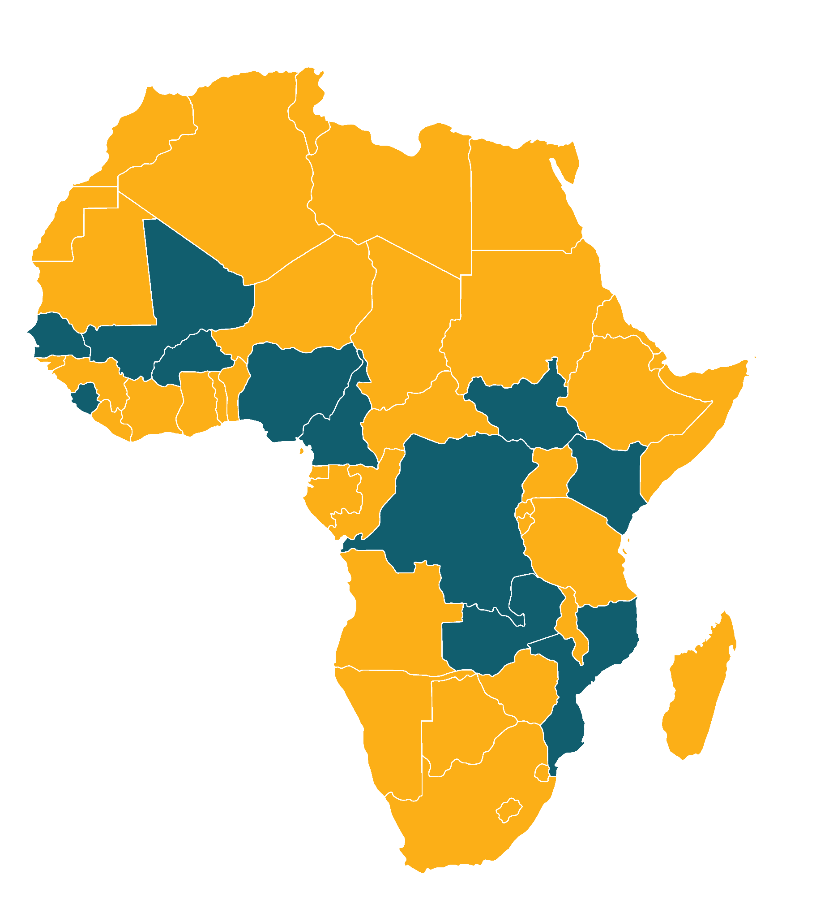
GRID3 is actively supporting
the following African countries:
Burkina Faso
Cameroon
Guinea
Kenya
Mali
Mozambique
Nigeria
Senegal
Sierra Leone
South Sudan
The Democratic Republic of the Congo
Zambia
Notes:
Data source: Global Administrative Areas ( 2012). GADM database of Global Administrative Areas, version 2.0. [online] URL: www.gadm.org.

Slide 3
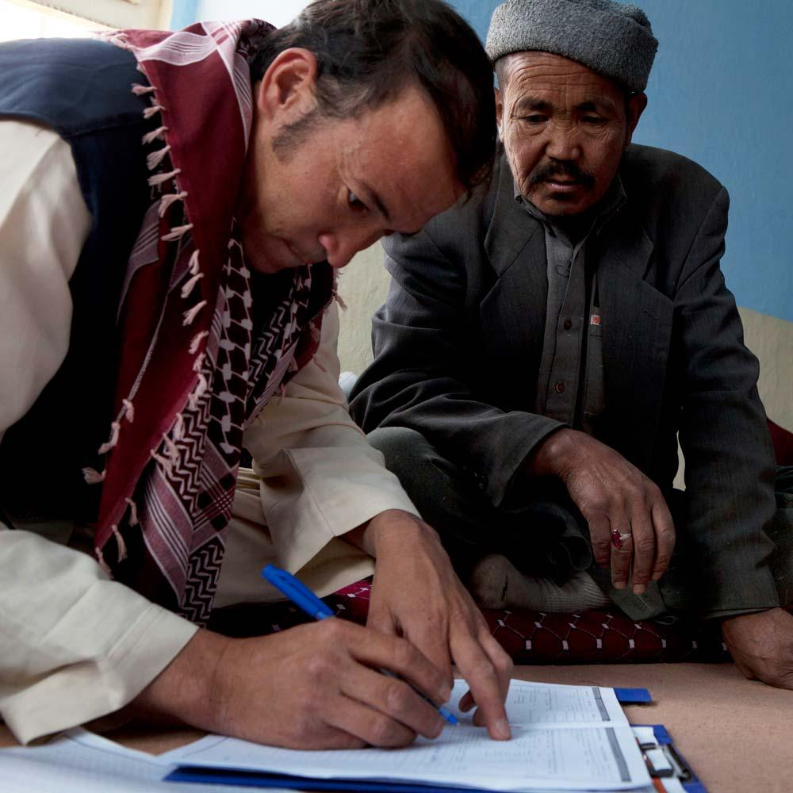
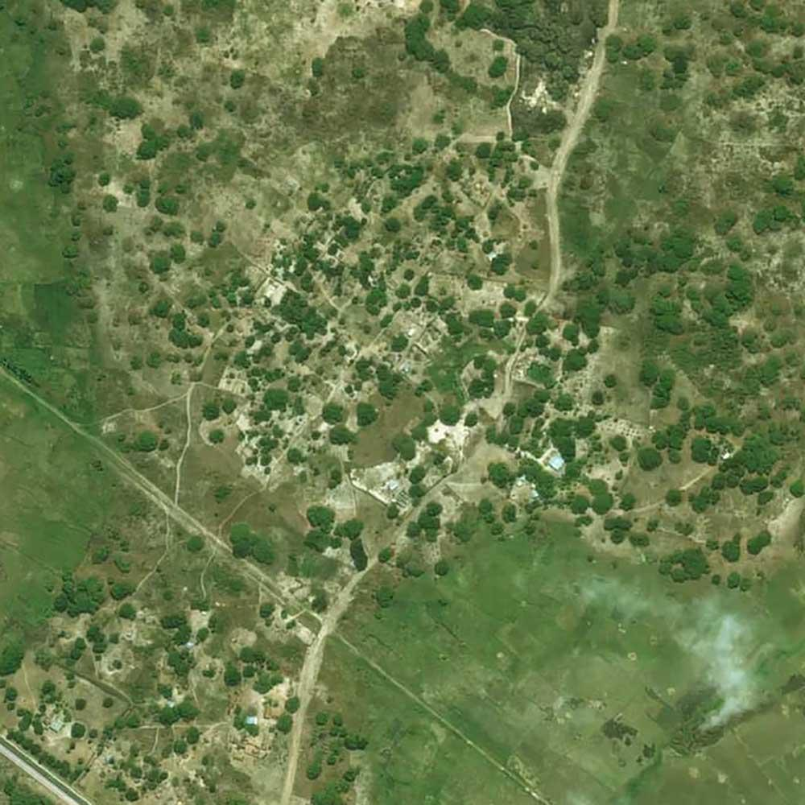
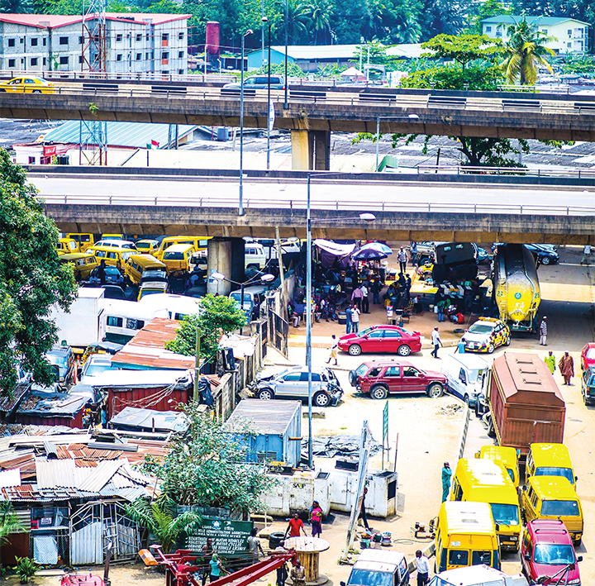
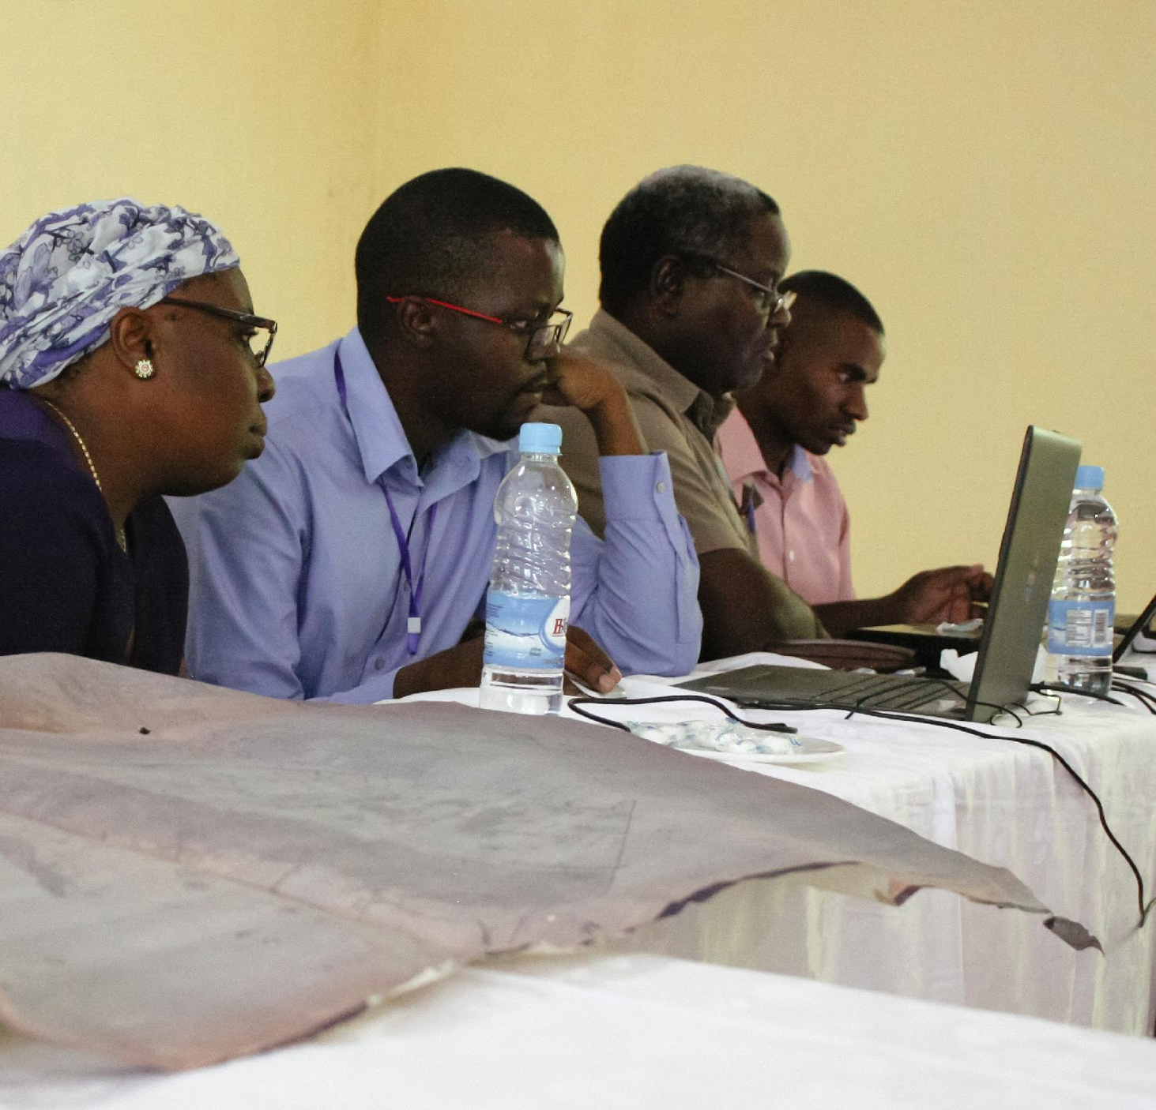
Our Vision:
Mapping a path to sustainable development for everyone.
Our Mission:
To build spatial data solutions that make development goals achievable.
Housing census & hybrid method support
High-resolution population estimates
Subnational boundaries
Comprehensive settlement locations
Locating critical infrastructure
Capacity
Strengthening
Notes:
GRID3 (Geo-Referenced Infrastructure and Demographic Data for Development) works with countries to generate, validate and use geospatial data on population, settlements, infrastructure, and subnational boundaries. GRID3 combines the expertise of partners in government, United Nations, academia, and the private sector to design adaptable and relevant geospatial solutions based on capacity and development needs of each country.
Our vision: Launched in March 2018, GRID3 aims to facilitate the production, collection, use, and dissemination of high-resolution population, infrastructure and other reference data in support of national sectoral development priorities, humanitarian efforts, and the United Nations’ Sustainable Development Goals (SDGs).

Slide 4
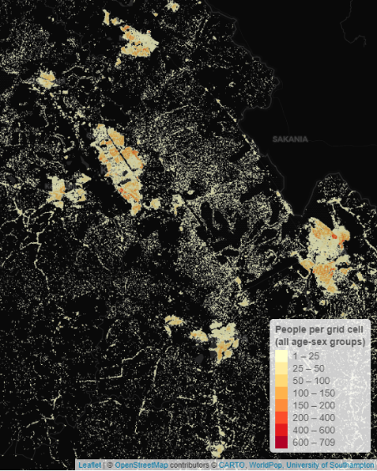
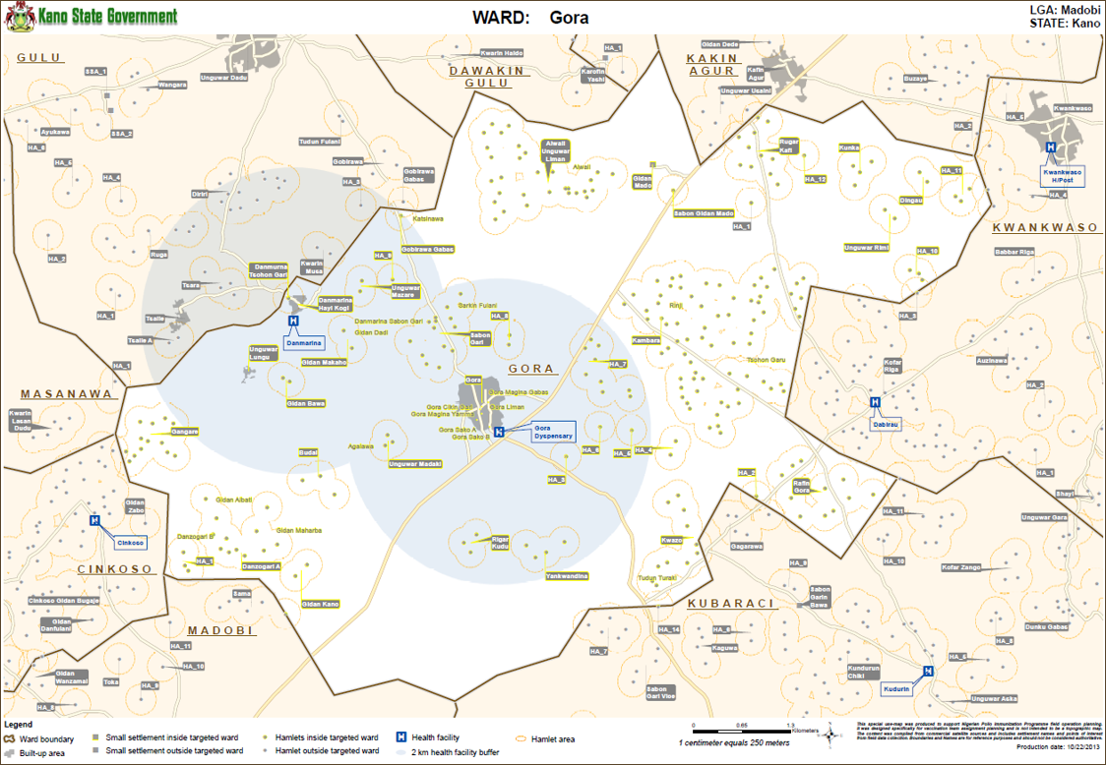
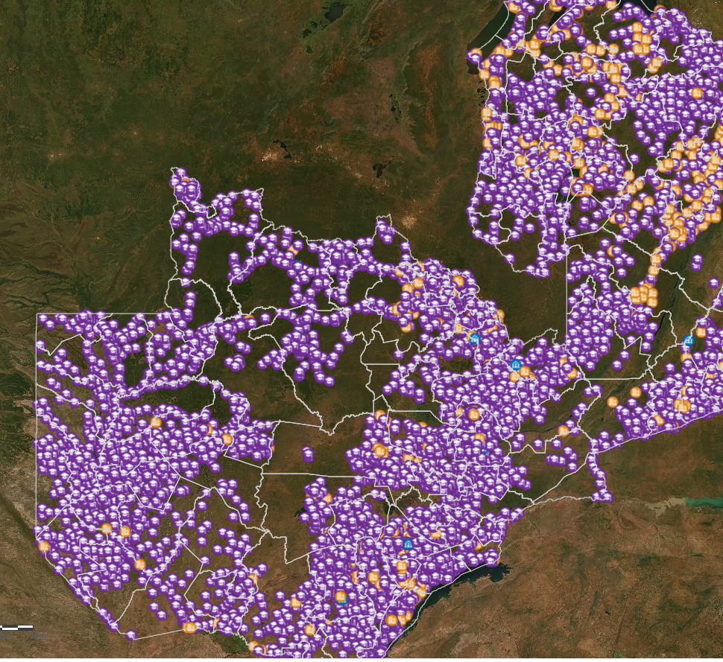
Core geospatial datasets
Population
Administrative maps
Infrastructure
High Resolution Population estimates (100m x 100m)
Settlement place names
Settlement extents
Harmonized Administrative Boundaries
Operational Boundaries
Catchment Areas
Points of Interest
Health Facilities
Schools
Notes:
GRID3 was created to help developing country governments obtain and use 3 core spatial data layers as necessary conditions for effective development interventions. They are: distribution of population, where people are in space, with high resolution and accuracy.
Administrative basemaps, where the location of settled places are identified and also qualified in relation to administrative or operational subdivisions. We focus on named locations, settlement contours or extents, and boundaries.
Finally the products and services of development that need to be in place within a geographic framework as well -- for example, the geolocation of health infrastructure, schools and other points of interest; or inferences of population mobility based on Call Detail Records.
It is through the combination of these 3 geospatial layers that we’ve seen effective outcomes. It is then possible to plan and deliver interventions, be accountable, responsible, and effective at the same time.

Slide 5
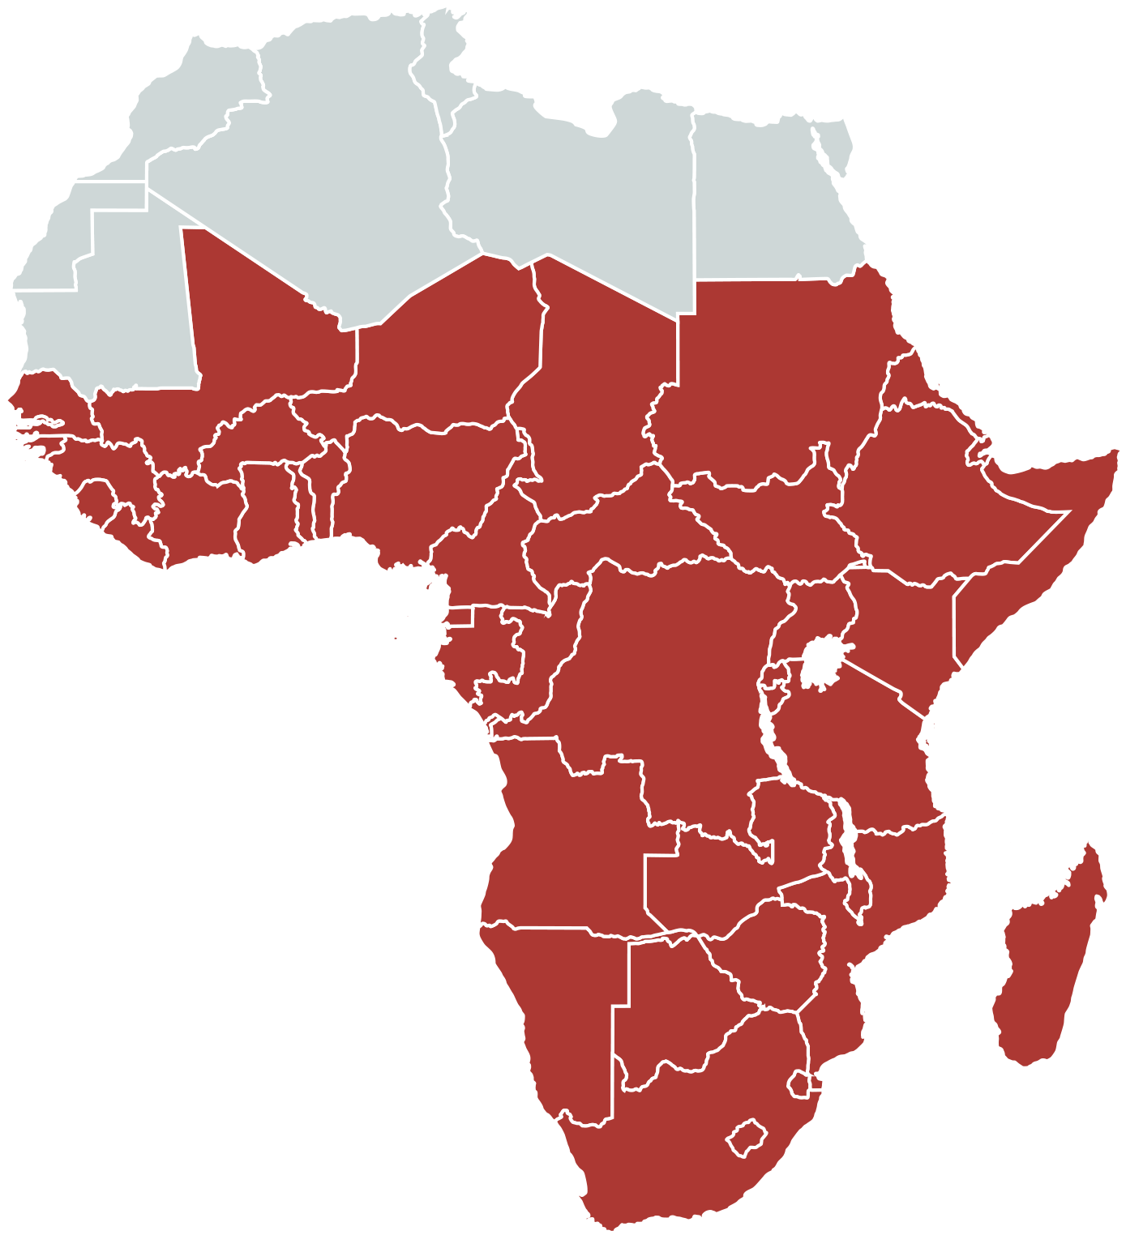
Putting people on the map
through reliable methods that estimate the distribution of populations in countries that have not had a census in a long time
GRID3 team at WorldPop estimated and mapped the entire population of Nigeria and South Sudan - and about half of DRC - on a 100 x 100m grid cell
We collaborated with the NSO in each country - and resulting datasets are co-owned by the governments
Numbers are aggregated by age/sex and to subnational administrative units and health catchments so that they can be easily incorporated into plans, delivery, and surveillance
107 million Nigerians (44% of total population) were not alive when the last census was carried out in 2006
2 in 5 people in South Sudan were born after Sudan’s last census in 2008 - independent South Sudan has not yet fielded a census
77% of DRC’s population are younger than the last census in 1986 - and many of those that were alive then have moved

Slide 6
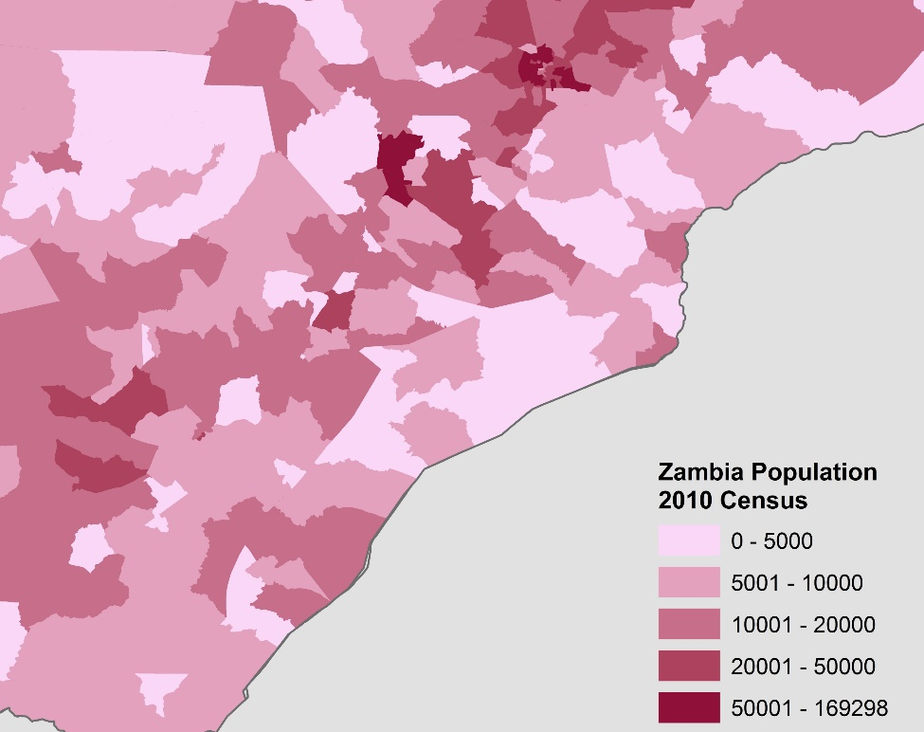
High-resolution population maps
Depending on needs and feasibility, GRID3 can support the generation of high-resolution geo-referenced census data or produce model-based population maps
High-resolution census data
Model-based population map
Two complementary approaches

Slide 7
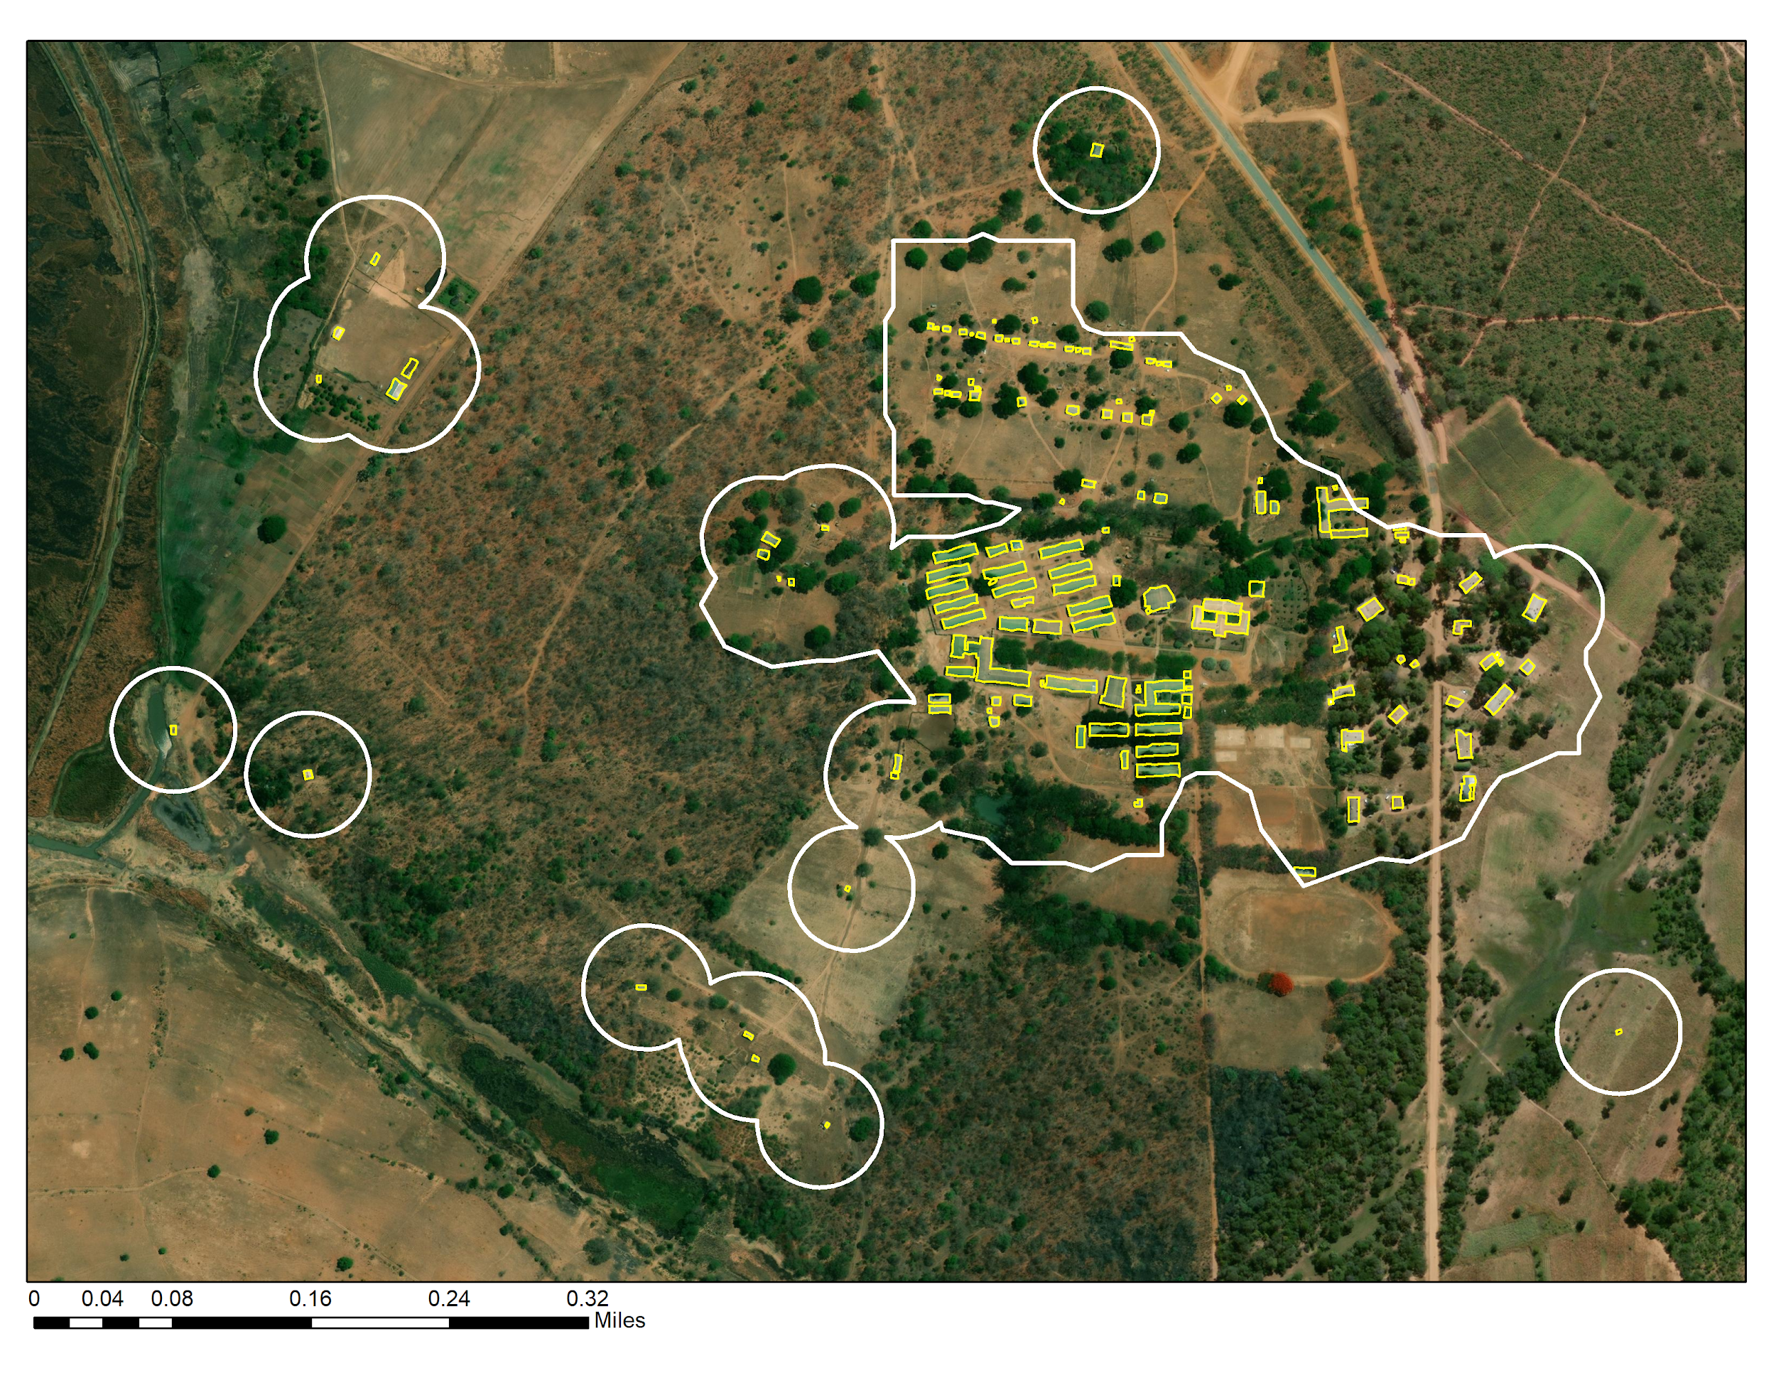
GRID3 settlement extents are derived from Maxar-Ecopia Building Footprints
Settlement extents are available for the following countries:
Namibia
Niger
Lesotho
Rwanda
Sierra Leone
South Sudan
Swaziland
The Gambia
Uganda
Western Sahara
Zambia
Somalia
Priority Nigeria
Remaining Nigeria
South Africa
Réunion
Sao Tome and Principe
Seychelles
Mauritius
Togo
Zimbabwe
Sudan
Tanzania
Ethiopia
Senegal
Angola
Benin
Botswana
Burkina Faso
Burundi
Cabo Verde
Cameroon
CAR
Chad
Comoros
Congo (Brazzaville)
DRC
Côte d'Ivoire
Djibouti
Equatorial Guinea
Eritrea
Ghana
Guinea
Guinea-Bissau
Liberia
Madagascar
Malawi
Mali
Mozambique
Settlement extents are classified into built up area, small settlement area and hamlet. Where available population estimates are aggregated to the polygon areas

Slide 8
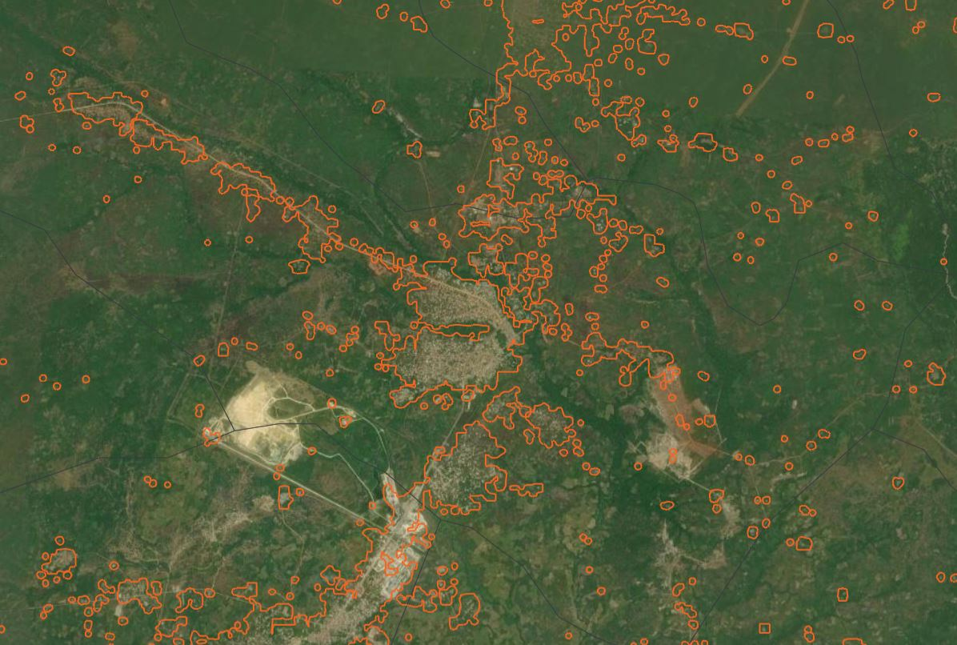

Slide 9
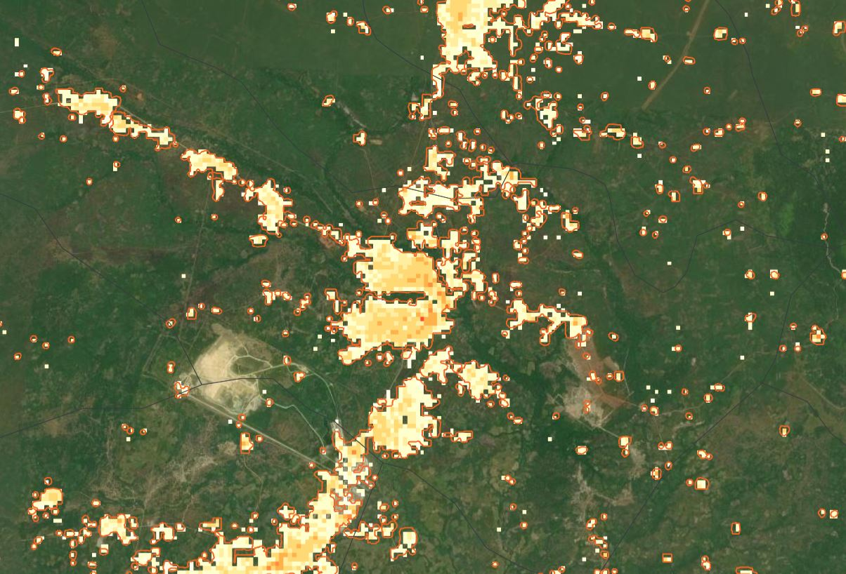

Slide 10
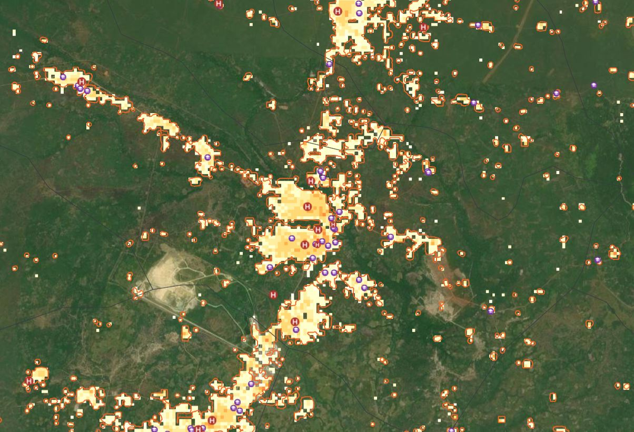

Slide 11
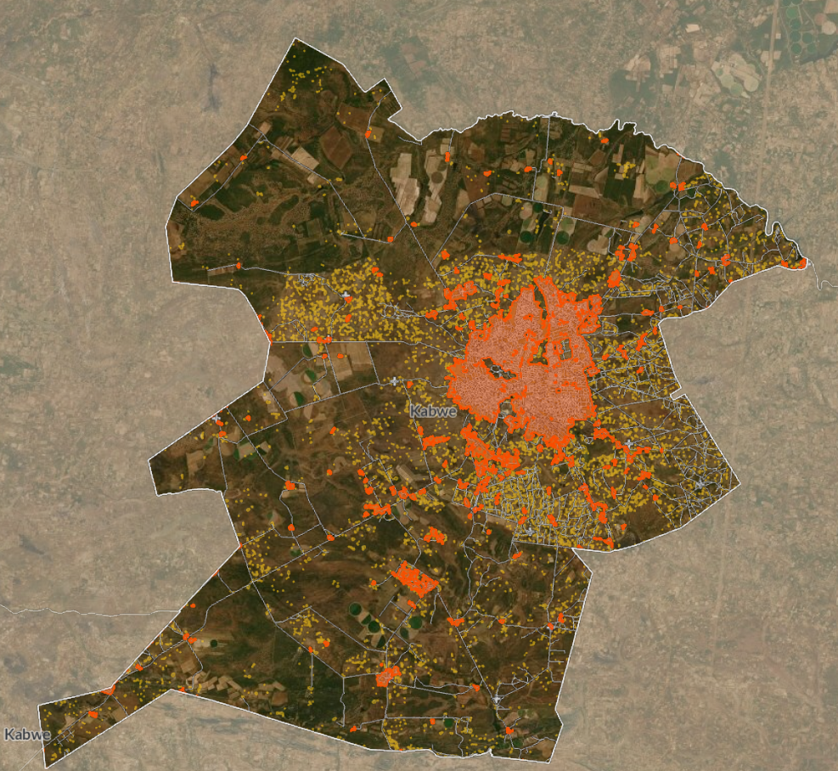
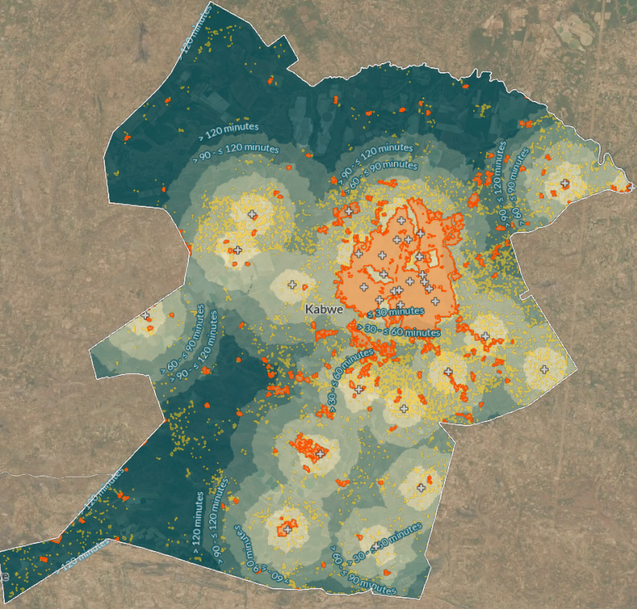
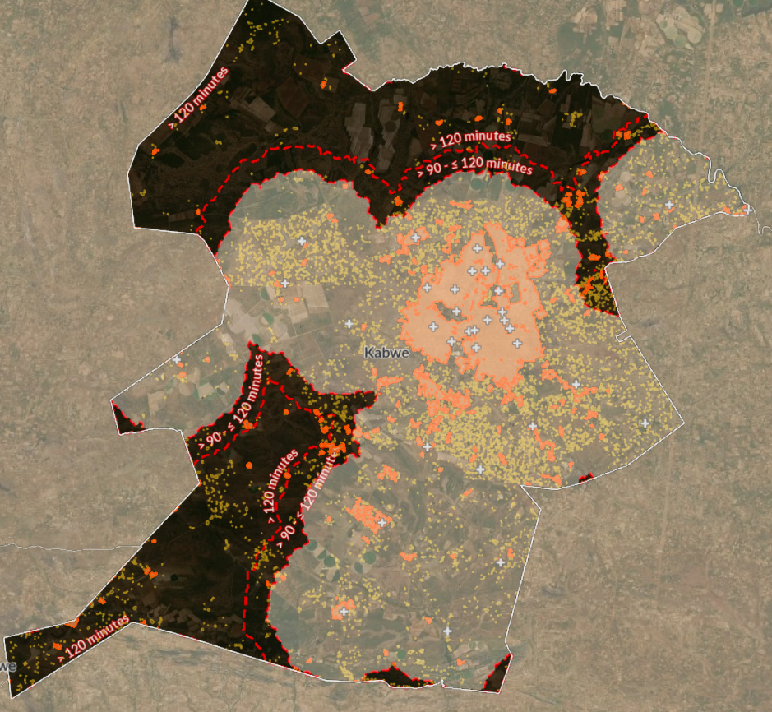
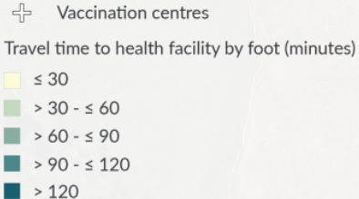
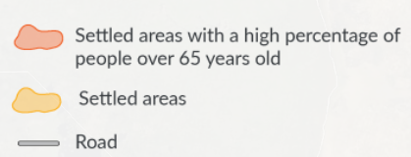
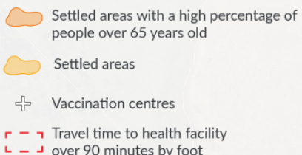
Identify vulnerable populations and where they live in relation to vaccination centres
Add travel times to settlement, health facility and population datasets
Use data to determine where to locate additional vaccination sites in order to increase coverage
Data analysis to determine accessibility
Notes:
Data sources: Settlement: CIESIN and Novel-T, 2020, updated 2021 ; district boundaries: Zambia OSG, MLNR, 2020 ; roads: OSM, 2021

Slide 12
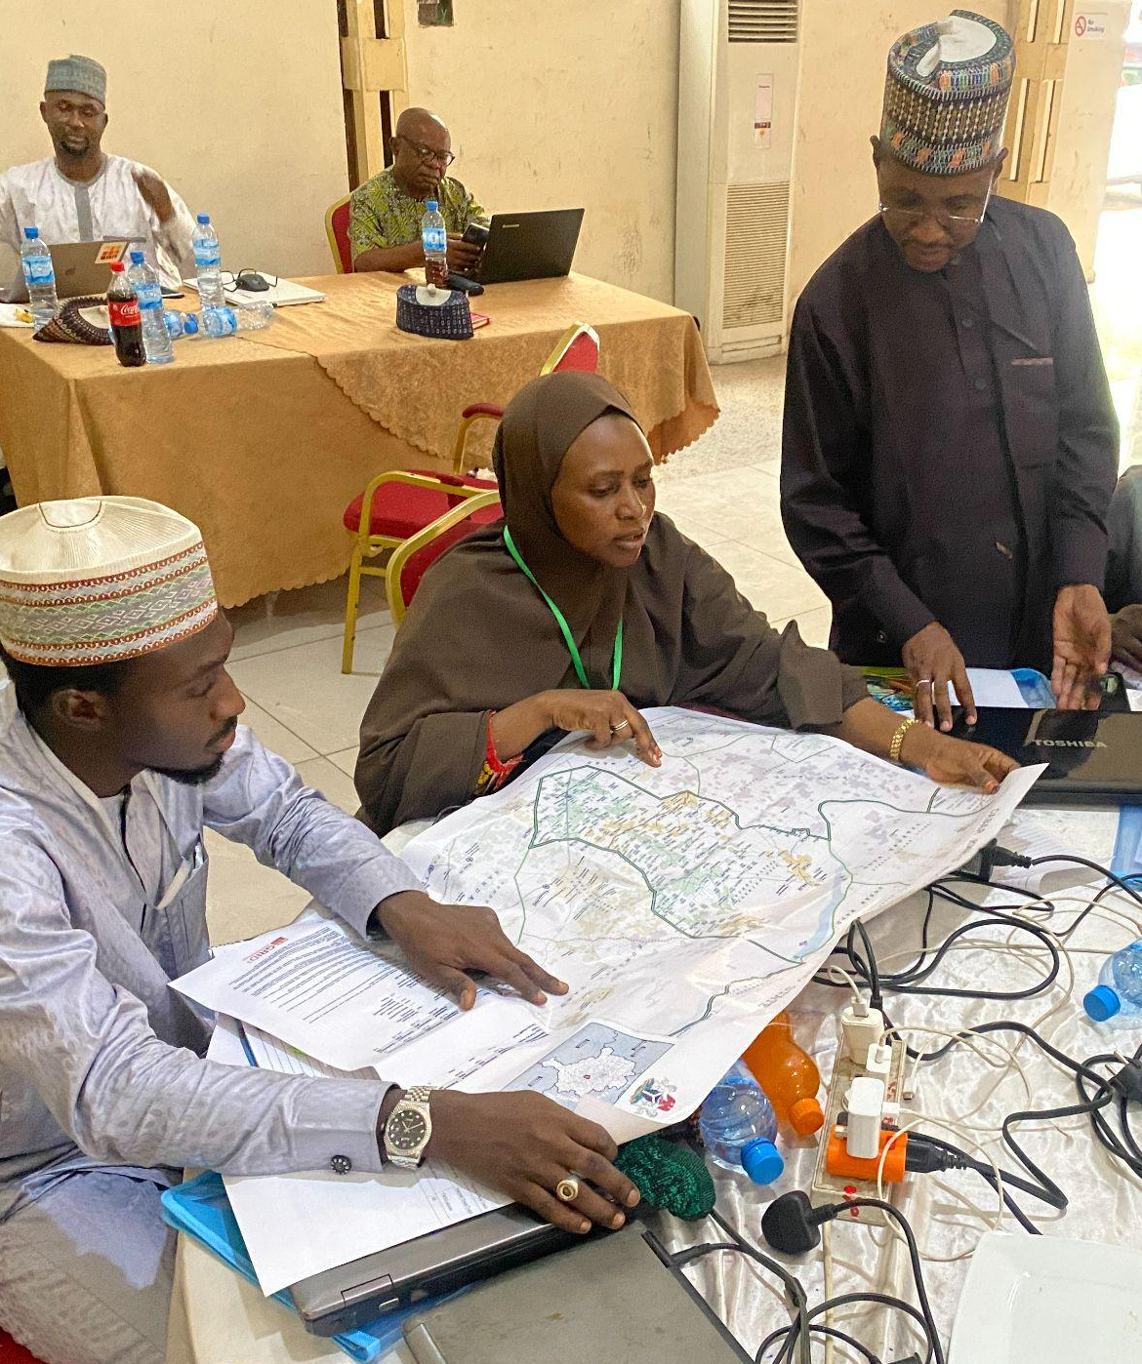
Integrating spatial data to health campaigns
GRID3/IFRC team training health officials on map use for malaria microplanning in Kano, Nigeria
GRID3 works with governments to support data use for campaign planning, delivery and surveillance:
Ongoing support for polio control
Routine immunization in DRC, Nigeria
Non-polio SIA in Nigeria
Malaria control in Zambia, Nigeria
CHW planning in Sierra Leone, Zambia
COVID-19 response in Nigeria, Zambia, Sierra Leone, Burkina Faso and Mozambique
We help assess needs, prepare data relevant to campaign targets, create maps showing target settlements, populations and catchment areas, and train campaign staff, with the goal of achieving higher coverage, better access to services, and more efficient resource allocation
29,000 maps
delivered to government partners to support digital microplanning for COVID-19, malaria, routine immunization, and measles campaigns
1,500 health facilities in Zambia received training in microplanning for COVID-19 using maps and SOPs created by GRID3 (which integrate into RED/REC microplanning templates)

Slide 13
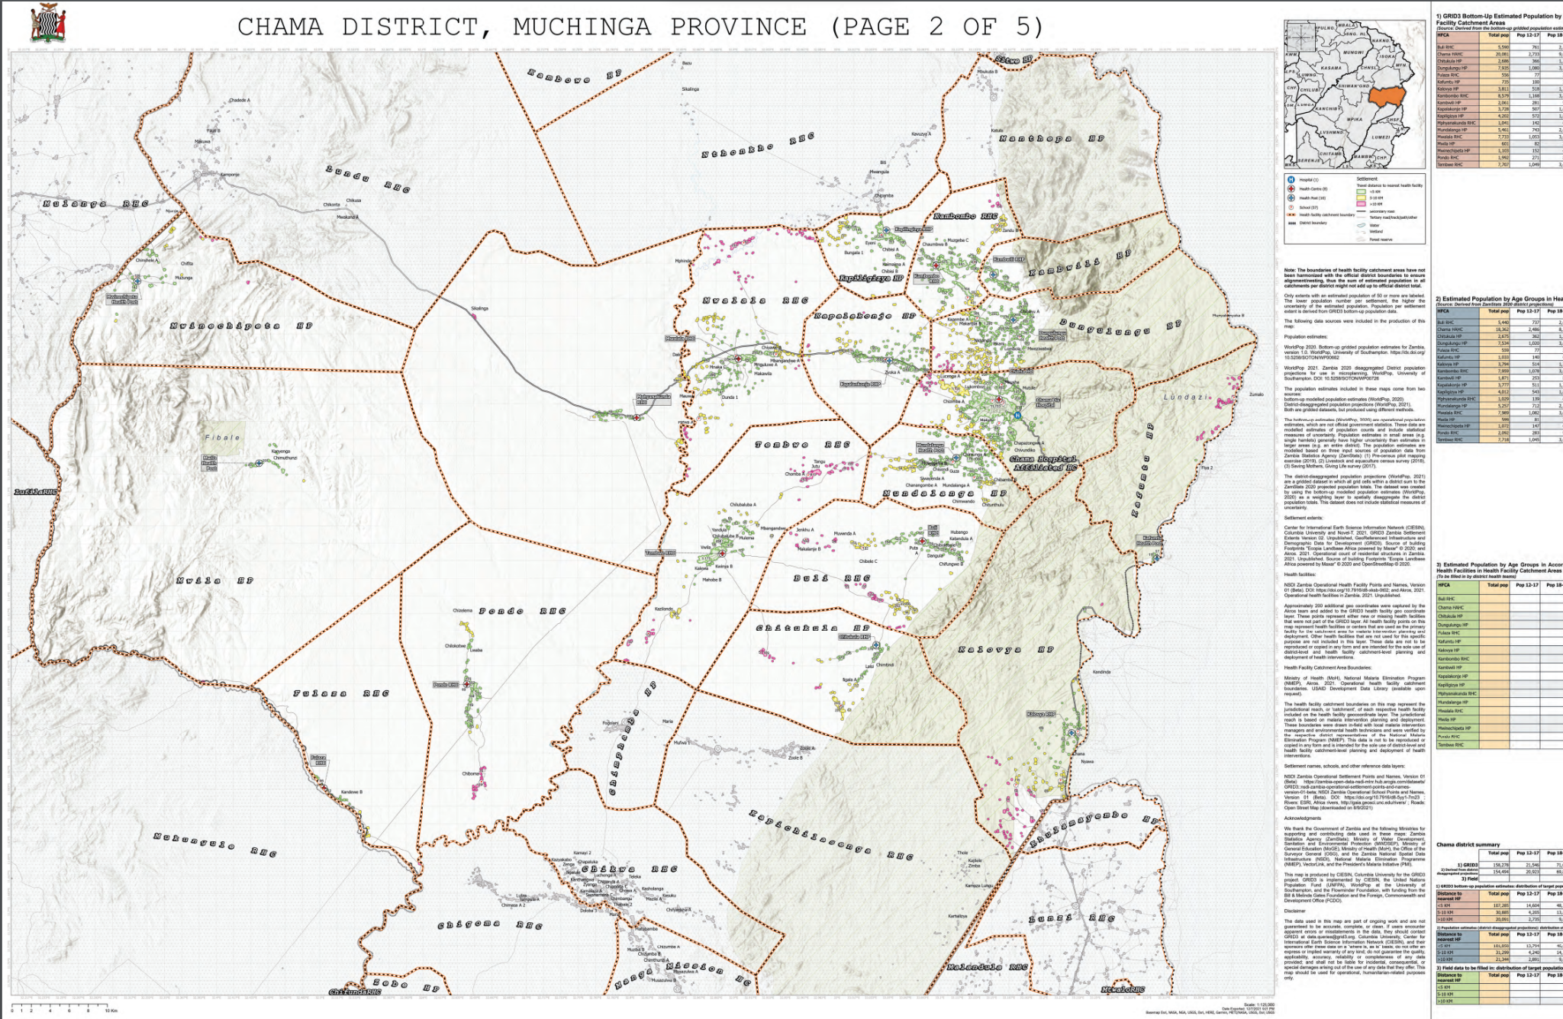
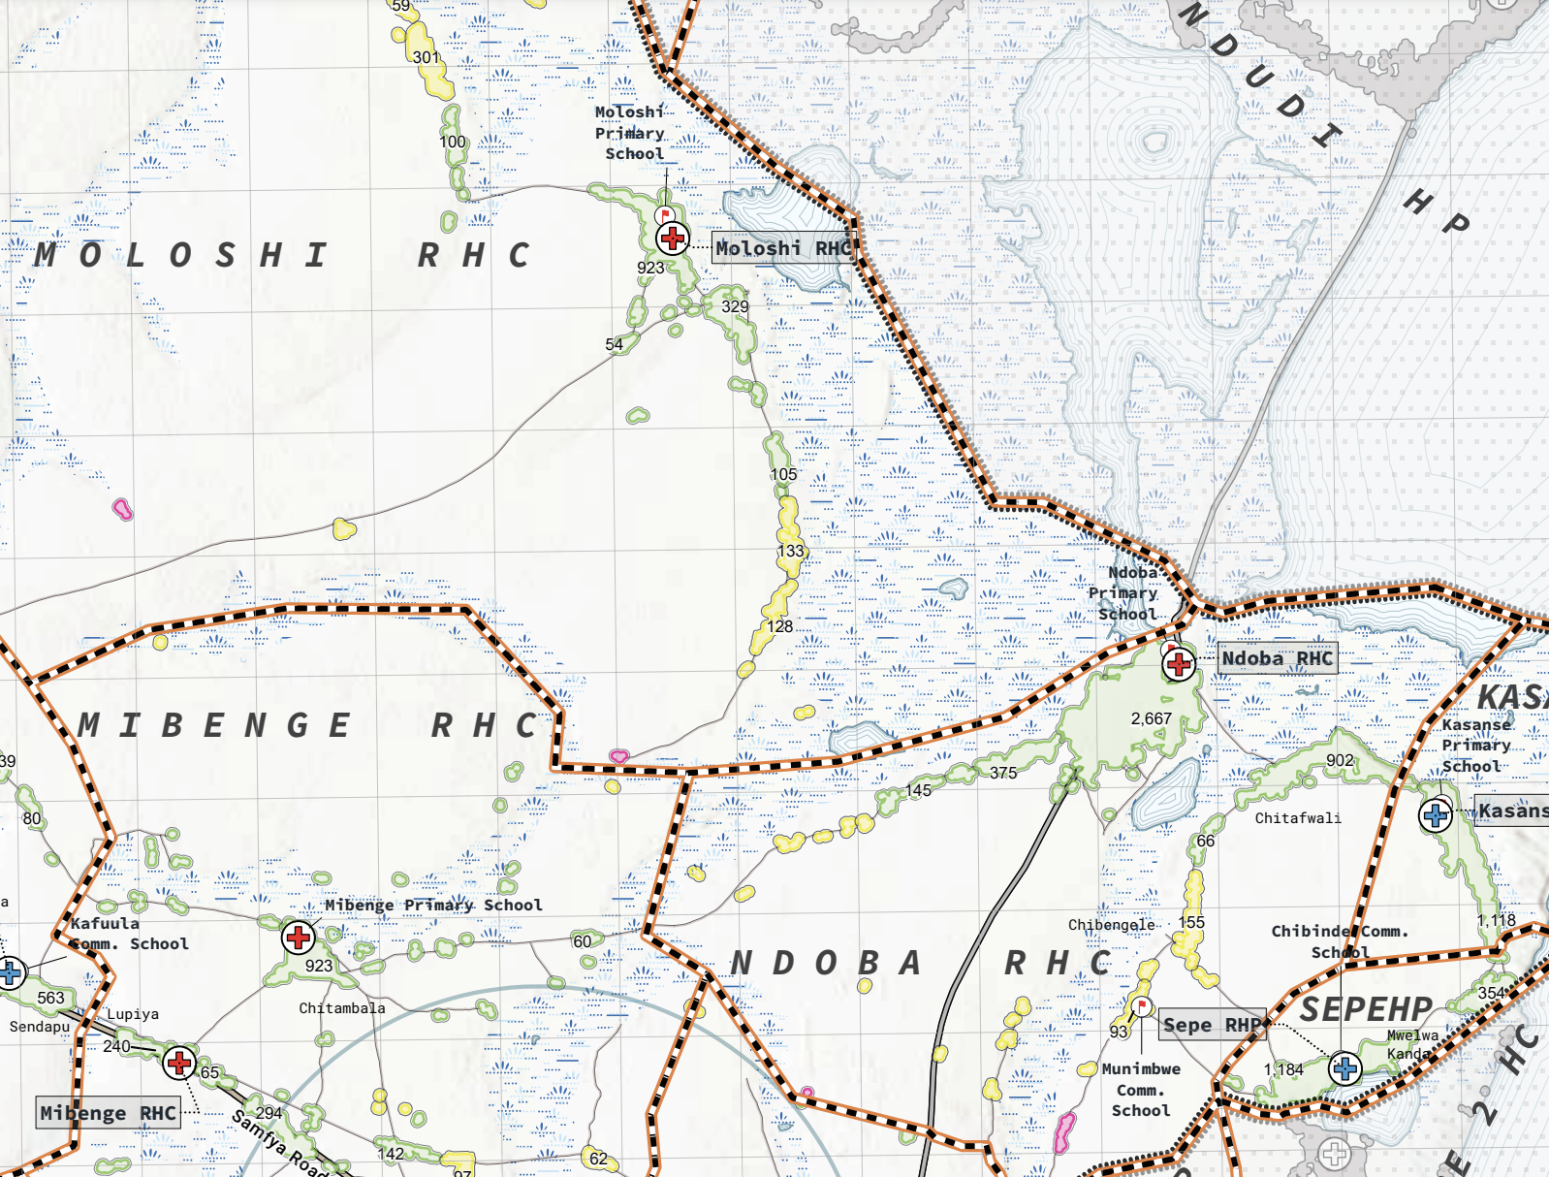
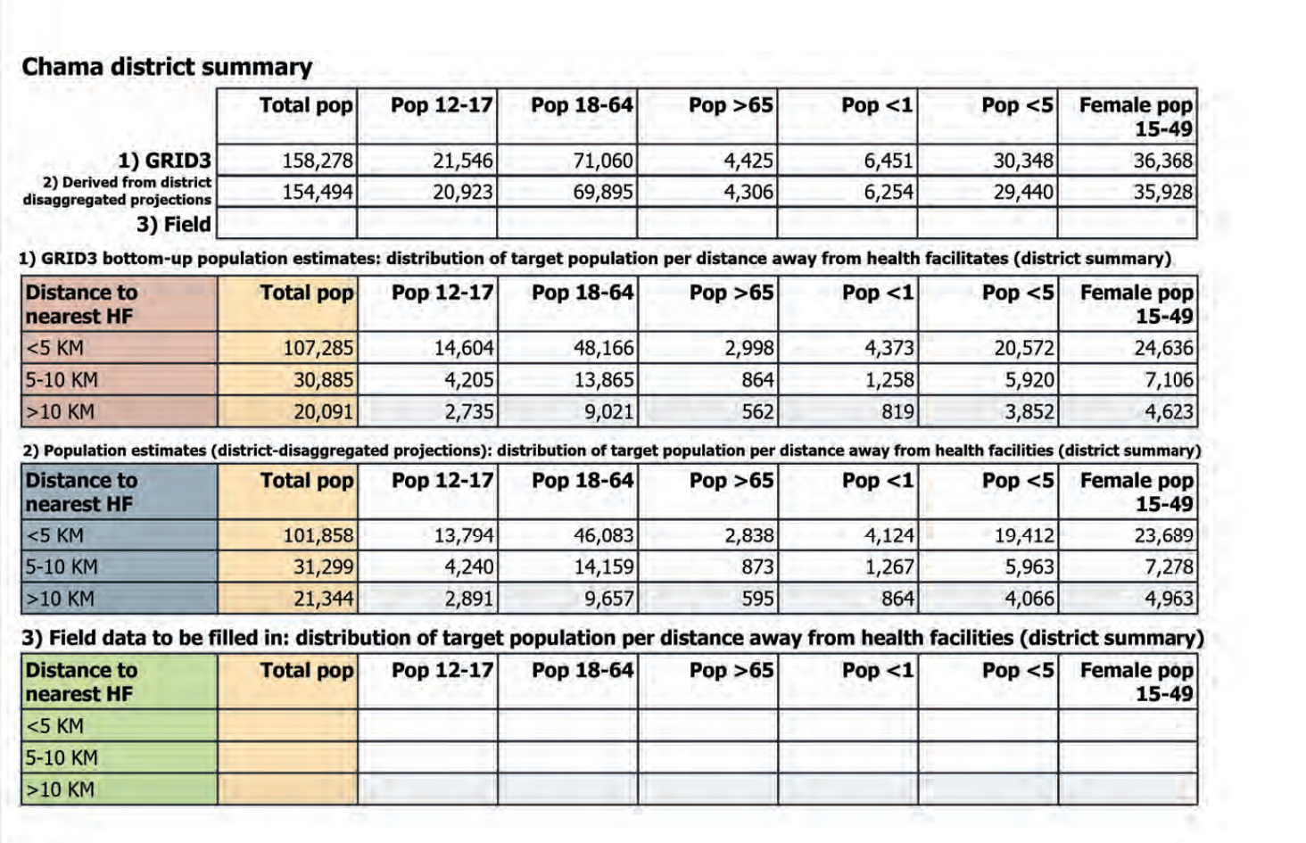
Map, Zambia, Muchinga Province
1. Population distribution and summary per district and catchment
2. Distance to nearest health facility (<5km, 5-10km, >10km).
Notes:
a sample of district maps produced by GRID3 to support COVAX planning in Zambia

Slide 14
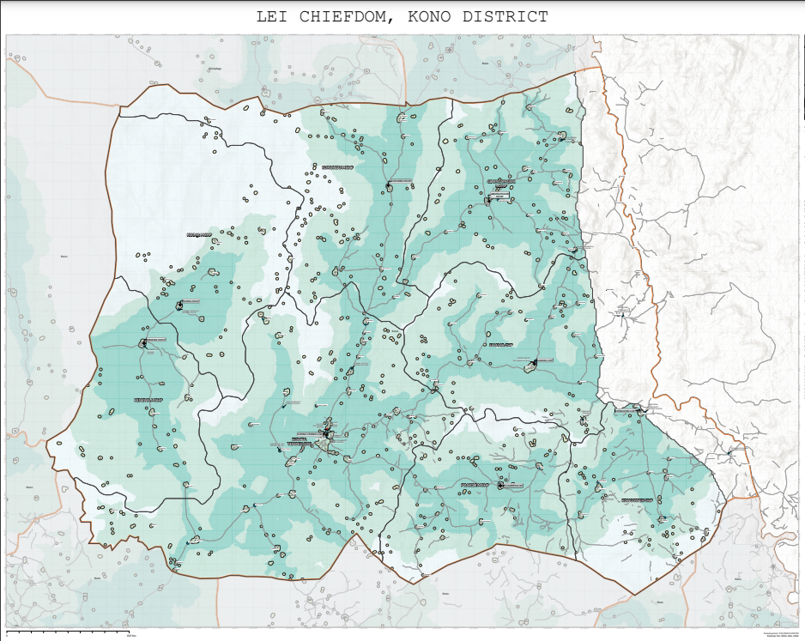
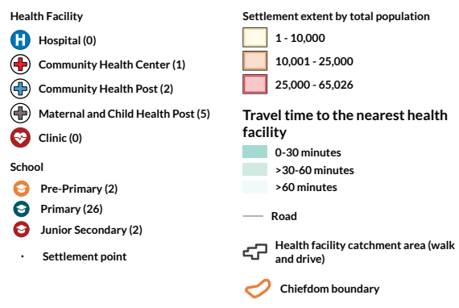
Map production in Sierra Leone
Notes:
Source: Ministry of Basic and Senior Secondary Education (MBSSE), 2021) Higher resolution image can be found here
*Health facility catchment areas are modelled using a travel time based approach

Slide 15
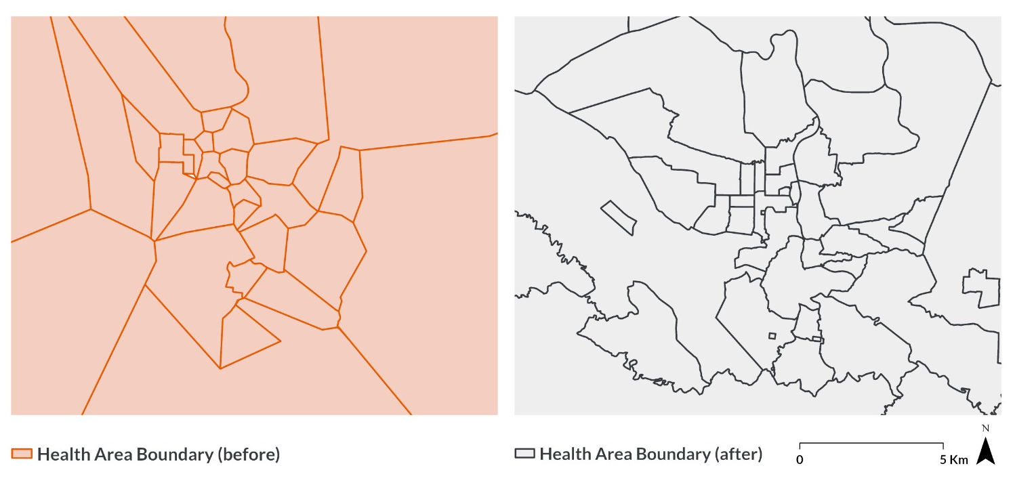
Mapping settlements, boundaries and facilities
15 million settlements mapped across 48 countries in Africa
62,000 health facilities mapped in DRC, Nigeria and Zambia
116,000 schools mapped in Zambia and Nigeria
240,000 other POIs cleaned, harmonized and mapped in DRC, Nigeria and Zambia
Improved health area boundary data from Likasi, Haut-Katanga province, DRC, mapped by the GRID3 team at CIESIN

Slide 16
Questions?
Reach out to us at: info@grid3.org
For project updates and announcements, visit us online at:
@GRID3Global
www.grid3.org
GRID3
Or follow our partners on Twitter at @Flowminder, @WorldPopProject, @UNFPA, @PopDevUNFPA, and @CIESIN

