Slide 1
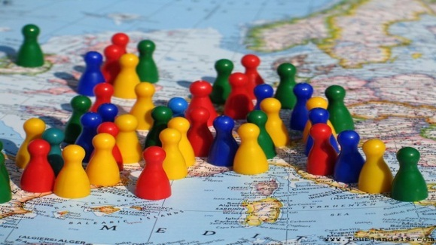
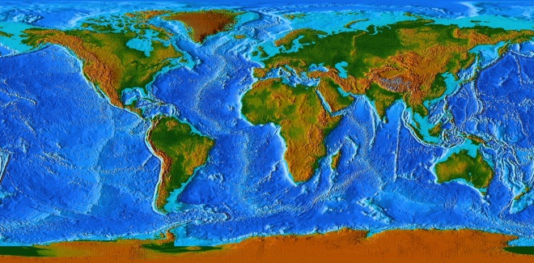
Integrated Geospatial Information Framework (IGIF)
SDG Data Alliance
Positioning geospatial information to address global challenges

Slide 2
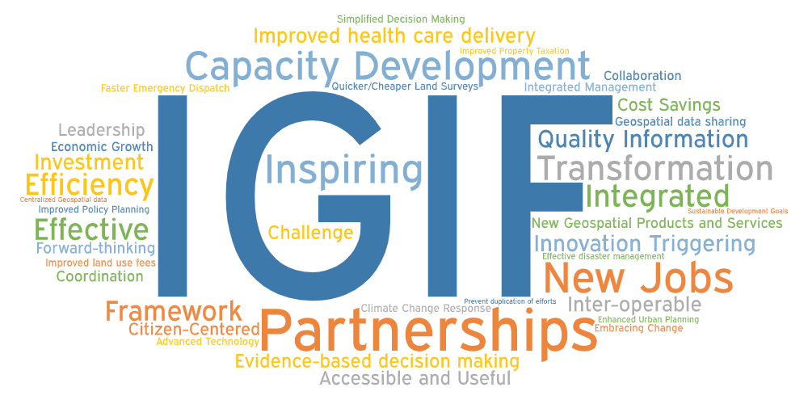
Positioning geospatial information to address global challenges

Slide 3
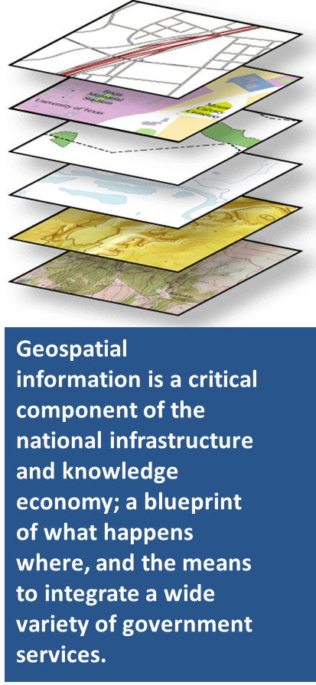
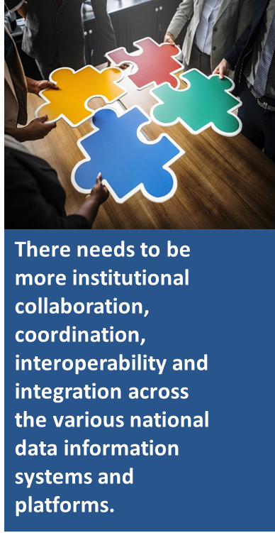
What is the IGIF
The IGIF is a multi-dimensional Framework aimed at strengthening national geospatial information management, particularly in developing countries.
With a focus on the ability for geospatial information to be integrated with any other meaningful data to solve societal and environmental problems, the IGIF acts as a catalyst for economic growth and opportunity and stimulates improved understanding and decision-making for national development priorities and the SDGs.
http://ggim.un.org/IGIF/
Positioning geospatial information to address global challenges

Slide 4
Knowledge ▪ Decisions ▪ Development
Governance and Institutions
Policy and Legal
Governance
Financial
9 Strategic Pathways solve the IGIF puzzle
Technology
Data
Technology ▪ Applications ▪ Value
Users ▪ Citizens ▪ Access
Innovation
Standards
Capacity and Education
Communication
and
Engagement
People
Partnerships
Society ▪ Economy ▪ Environment
Positioning geospatial information to address global challenges

Slide 5
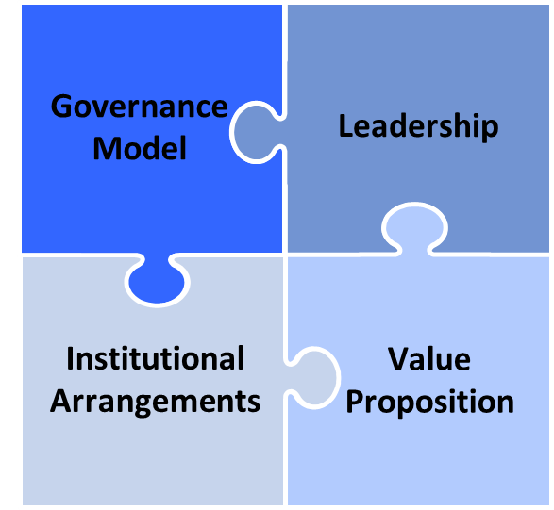
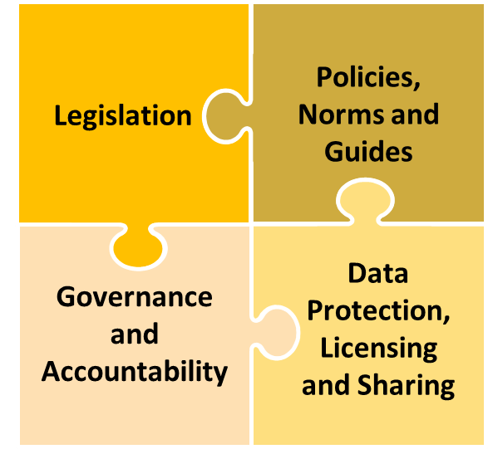
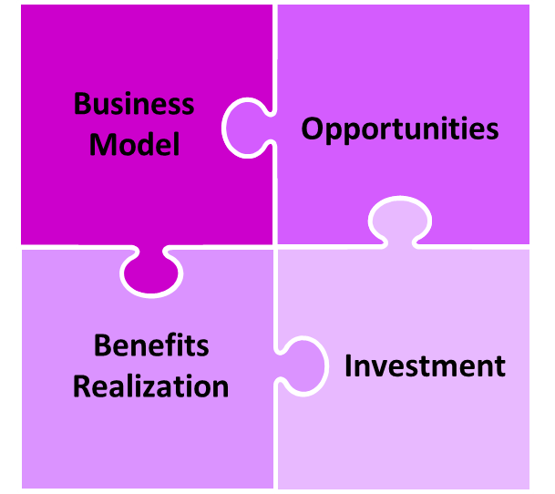
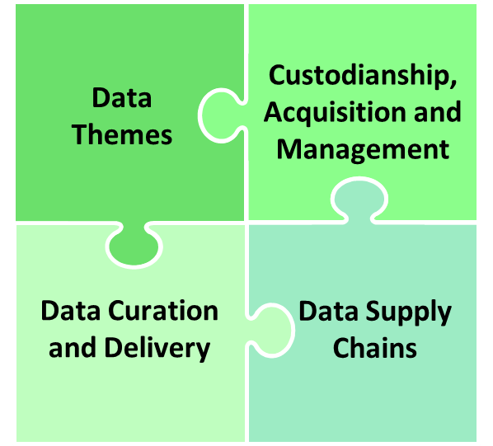
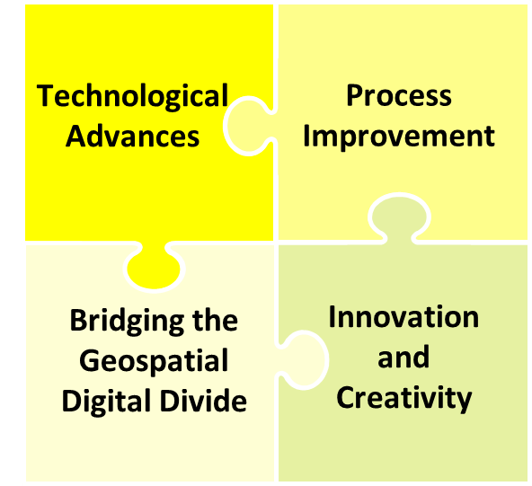
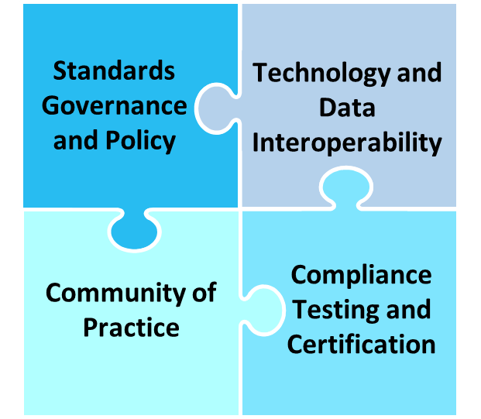
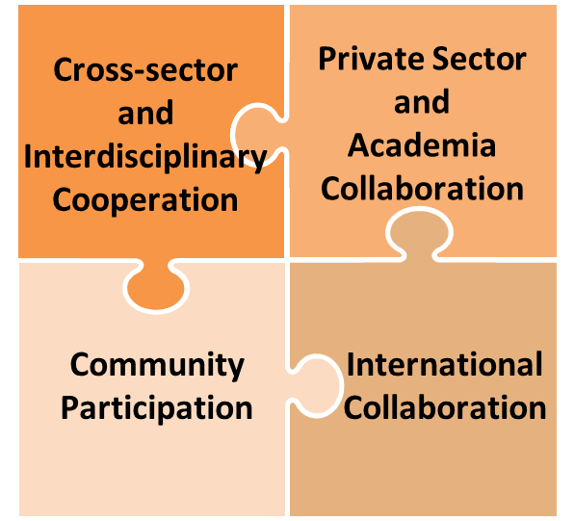
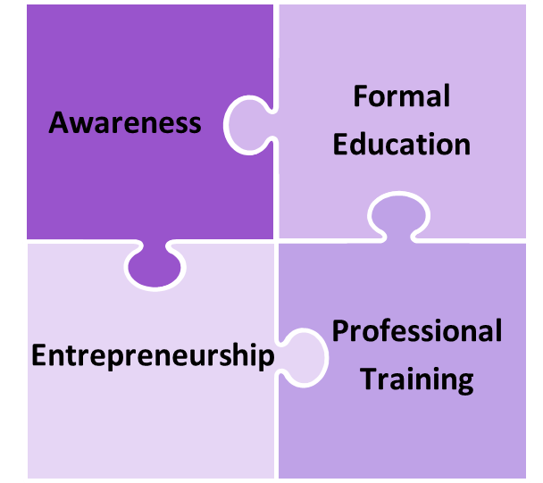
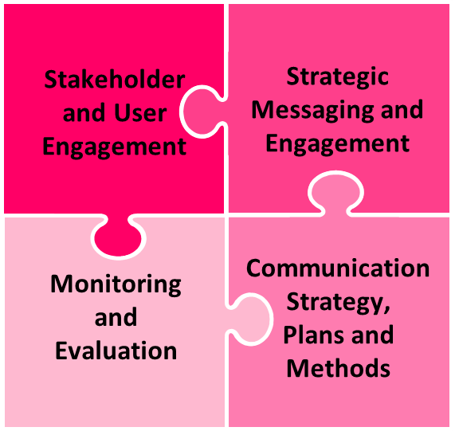
Knowledge ▪ Decisions ▪ Development
Governance
9 Strategic Pathways solve the IGIF puzzle
…with 36 Key Elements
Technology
Technology ▪ Applications ▪ Value
Users ▪ Citizens ▪ Access
People
Society ▪ Economy ▪ Environment
Positioning geospatial information to address global challenges

Slide 6
IGIF: Benefits
The ultimate benefits, including the considerable economic benefits, of integrating and strengthening national geospatial information management is that it is a strategic enabler for all levels of government and the broader community.
It improves planning for economic growth and delivery of better services.
It supports the delivery of the SDGs, such as poverty alleviation, socially inclusive development, protection of the environment, disaster response times, regional cooperation and transparency in governance.
Positioning geospatial information to address global challenges

Slide 7
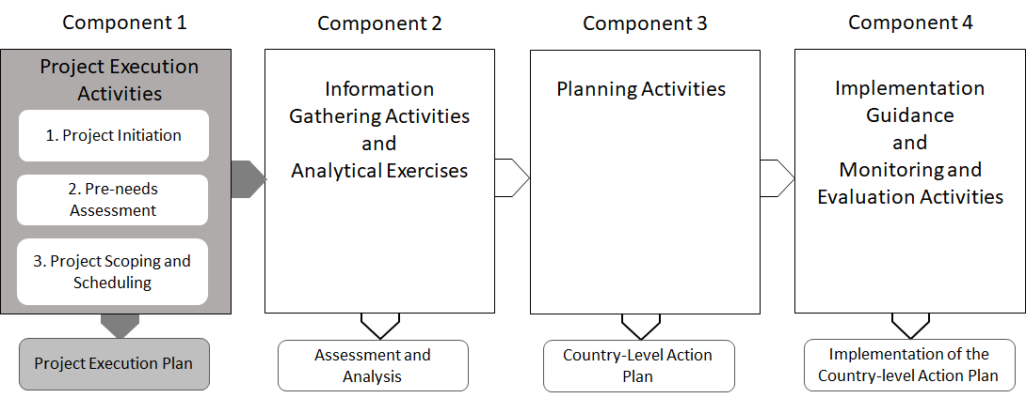
IGIF: Country-level Action Plan (CAP)
Component 1: Project Execution
Positioning geospatial information to address global challenges

Slide 8
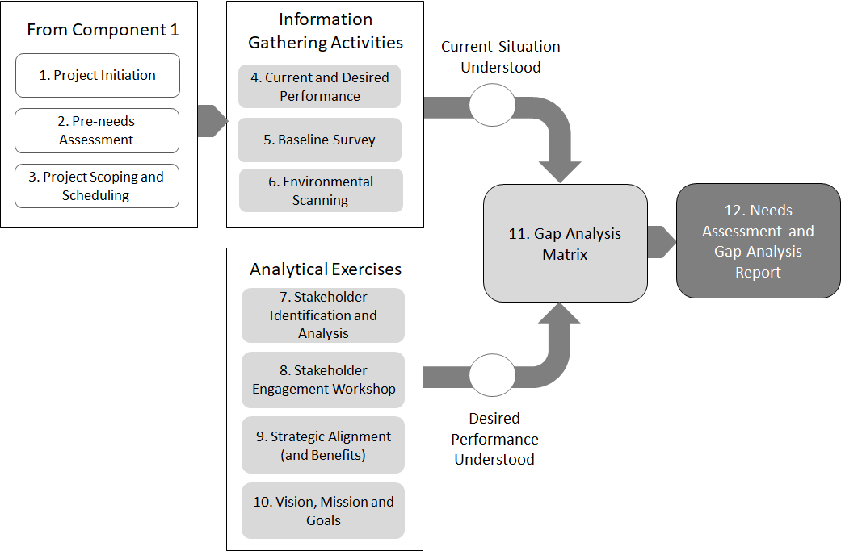
IGIF: Country-level Action Plan (CAP)
Component 2: Assessment and Analysis
Positioning geospatial information to address global challenges

Slide 9
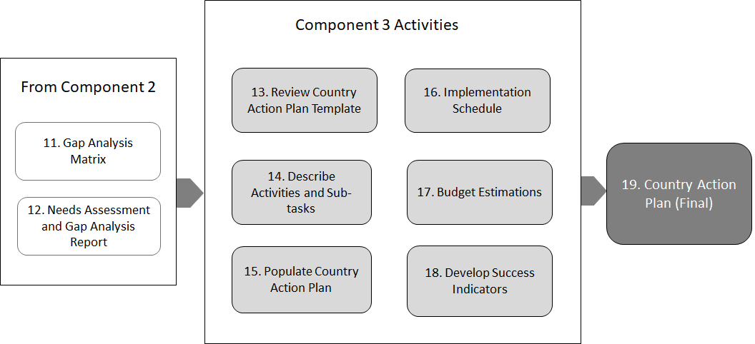
IGIF: Country-level Action Plan (CAP)
Component 3: Country Action Plan
Positioning geospatial information to address global challenges

Slide 10
IGIF: Country-level Action Plan (CAP)
Project Execution Plan
Positioning geospatial information to address global challenges

Slide 11
Positioning geospatial information to address global challenges

Slide 12
Positioning geospatial information to address global challenges

Slide 13
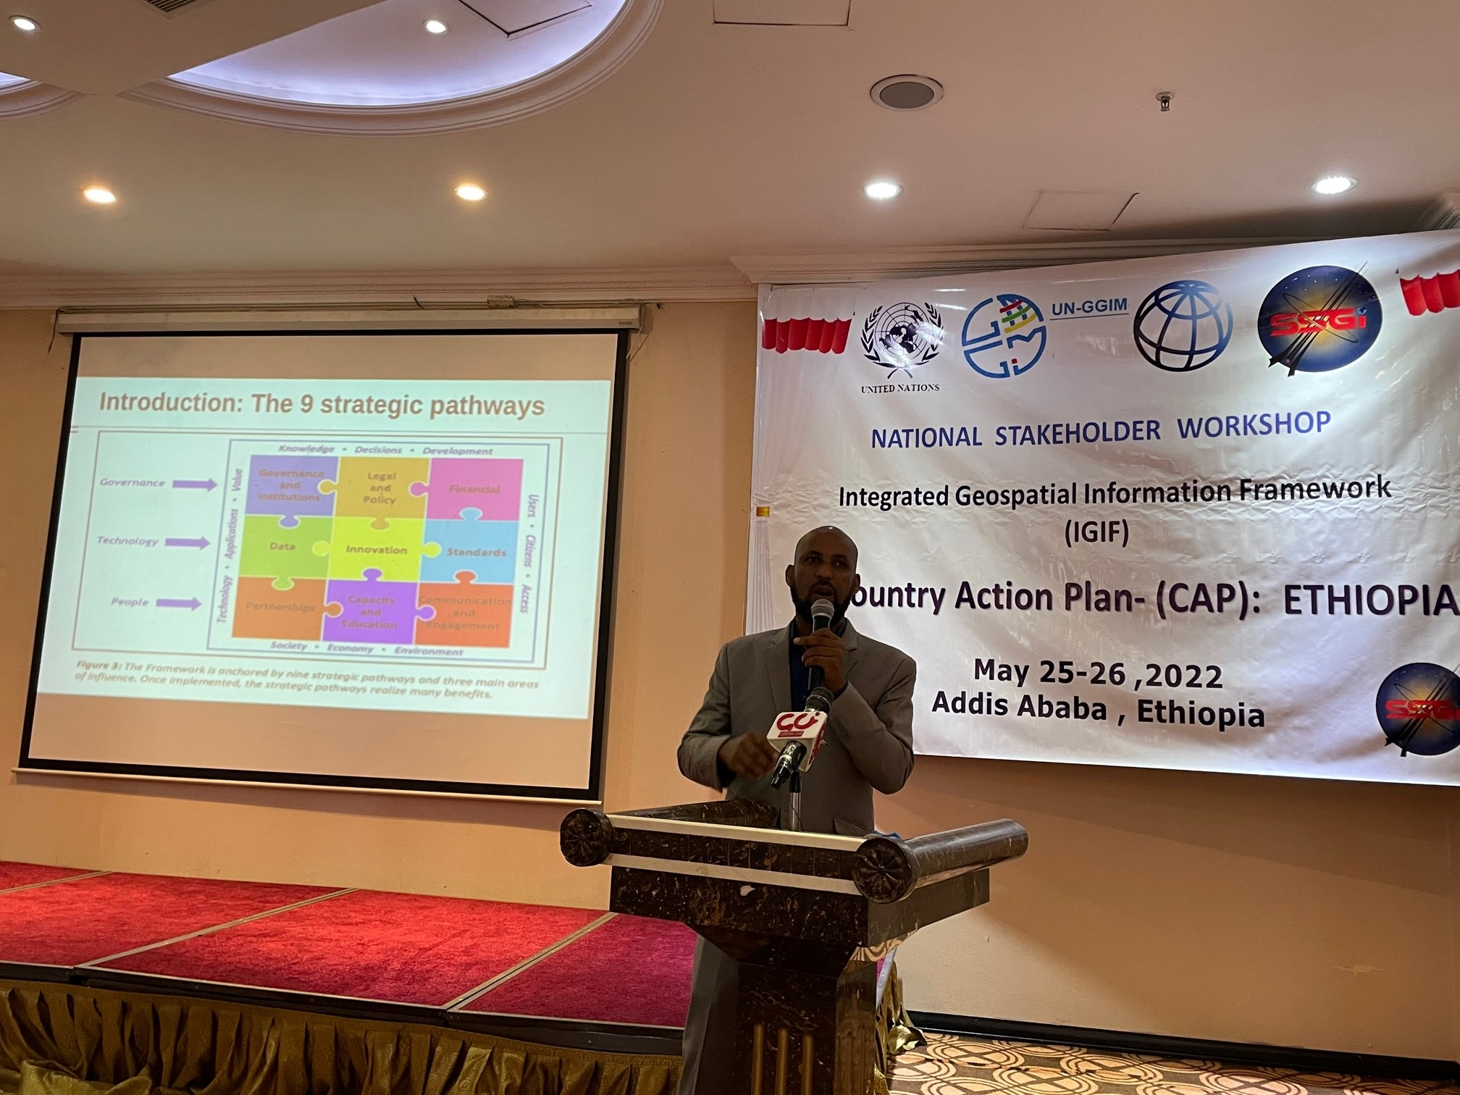
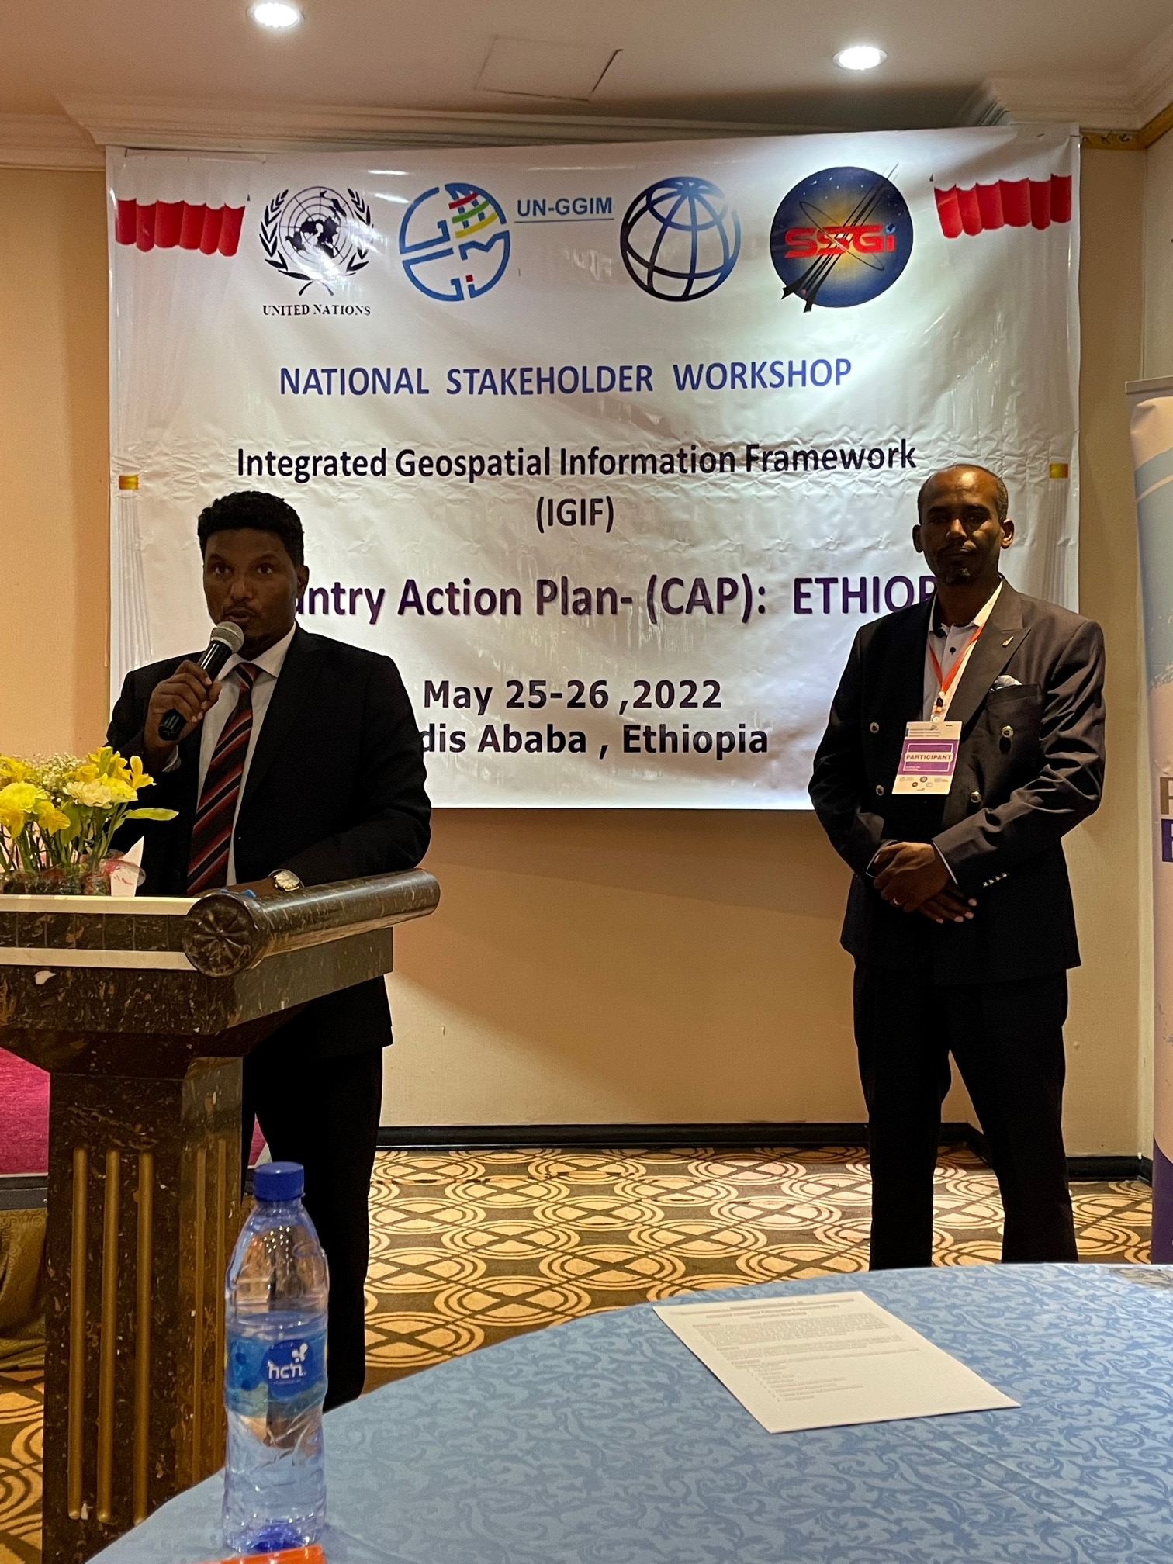
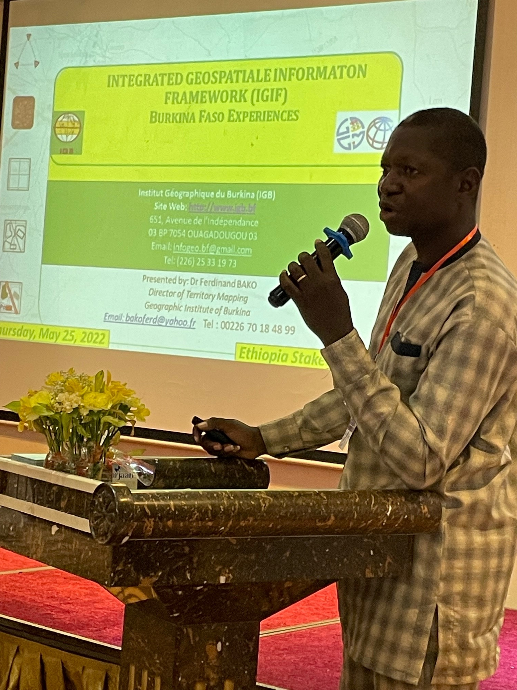
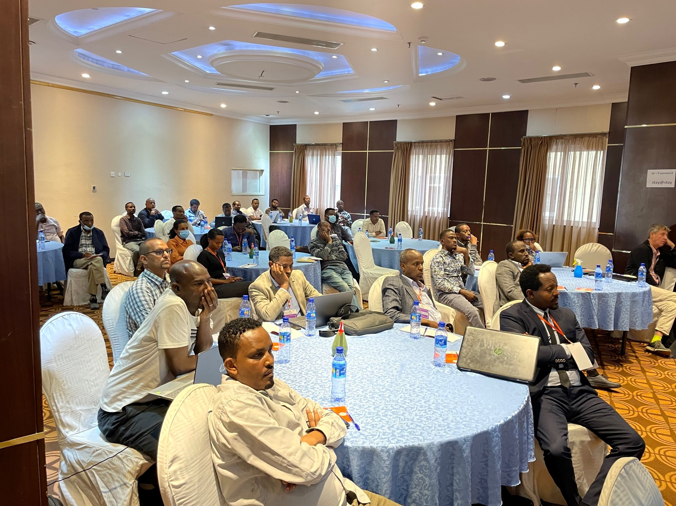
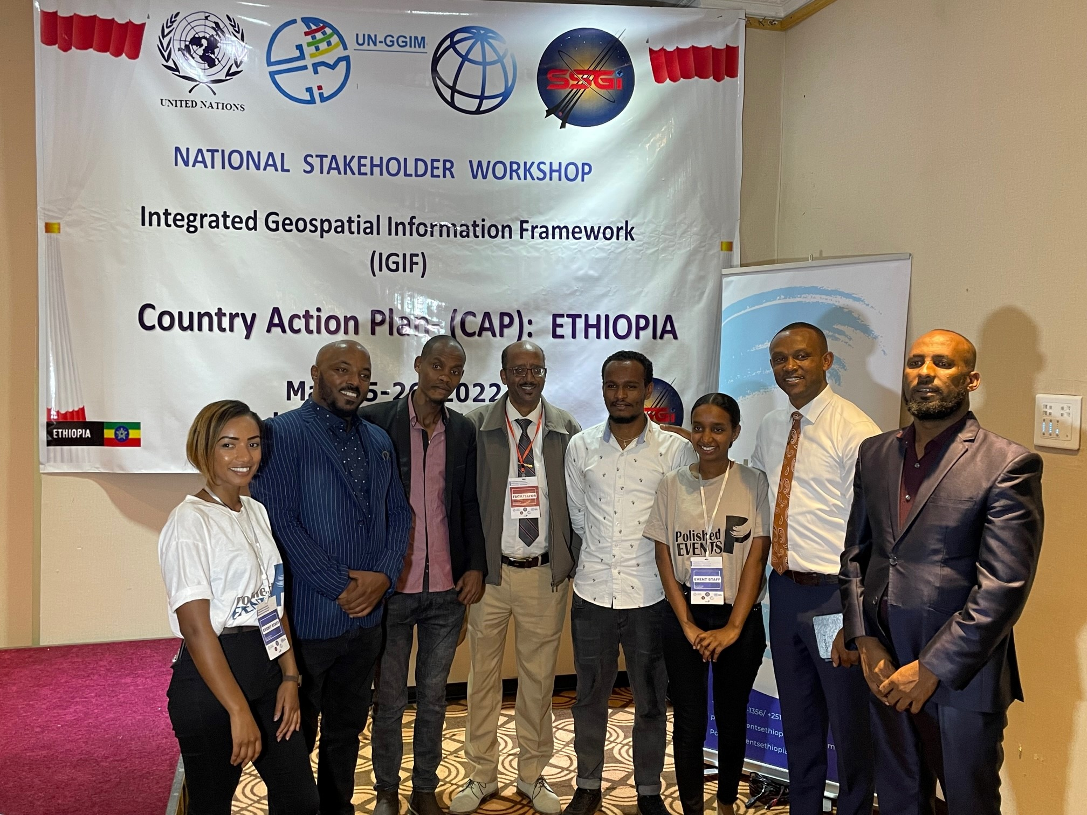
Positioning geospatial information to address global challenges

Slide 14
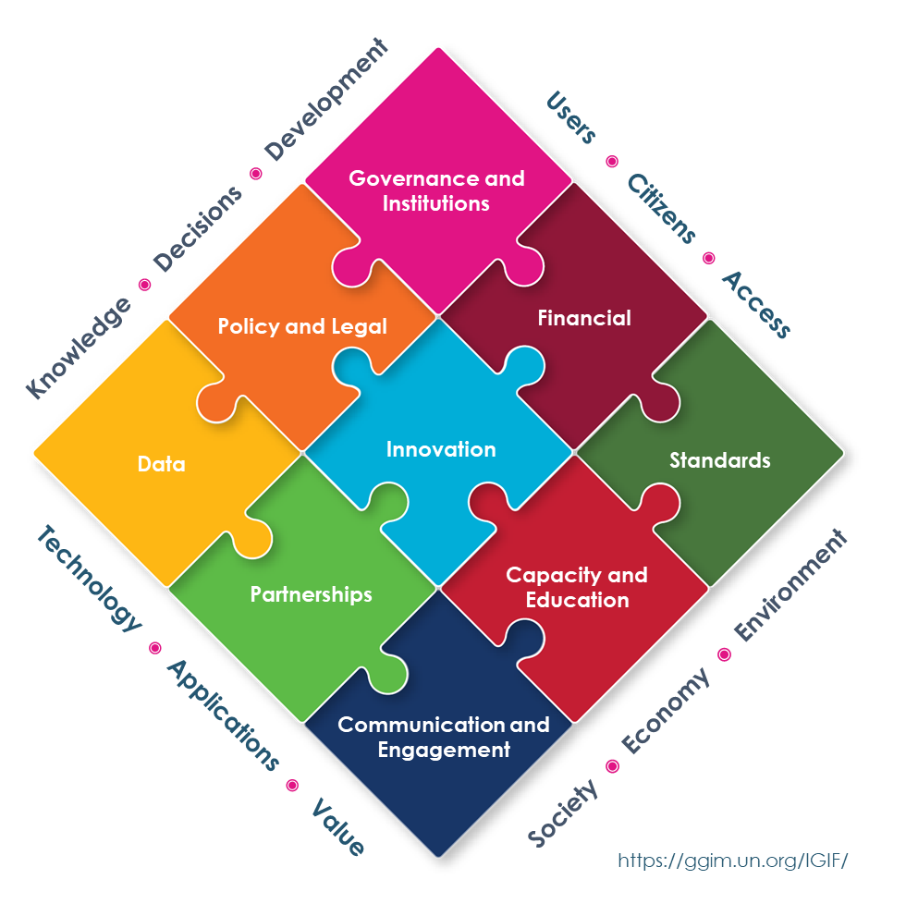
SDG Data Alliance
Positioning geospatial information to address global challenges

Slide 15
A Multi-Stakeholder Partnership

Slide 16
SDG Data Alliance
Based on the foundational principle of reducing inequalities of all kinds, the W.K. Kellogg Foundation, Esri, PVBLIC Foundation, the United Nations Global Geospatial Information Management Section in the Statistics Division, Department of Economic and Social Affairs (DESA), joined forces in 2021 to form the SDG Data Alliance.
Using the power of purpose-driven collaboration and leading GIS technology, this influential group of partners will accelerate achievement of the SDGs by creating 20 SDG Data Hubs across developing countries in Africa, Asia and the Pacific and Latin America and the Caribbean.

Slide 17
The SDG DATA ALLIANCE is influenced by
Governance, Technology & People
Asia
SDG Data Alliance provides the detailed guidance towards ‘integrating’ geospatial information with any other meaningful data to solve our societal problems
Latin America
Africa

Slide 18
Reducing inequality (SDG 10) is the most important step countries can take to improve standards of living
The SDG Data Alliance’s technology, expertise, and financial support enables countries to more precisely allocate resources to address all forms of inequity - reducing inequalities of all kinds.
Including
Equity for women, reducing hunger
Reducing poverty
Improving access to clean water
Taking action to reduce the impact of climate change

Slide 19
Objectives and Outcomes
Governance and Institutions
Knowledge ◉ Decisions ◉ Development
Users ◉ Citizens ◉ Access
Leverage and strengthen the in-country expertise from geospatial experts within
and across governmental agencies and organizations leveraging the data hubs
Address national and global reporting requirements to report on the SDGs with specific focus on SDG 10
Accelerate achievement of the SDGs by accurately identifying areas for focus and investment
Policy and Legal
Financial
Data
Innovation
Standards
Partnerships
Capacity and Education
Society ◉ Economy ◉ Environment
Technology ◉ Applications ◉ Value
Communication and Engagement
https://ggim.un.org/IGIF/

Slide 20
IGIF: Country-level Action Plan (CAP)
Component 1: Project Execution
Positioning geospatial information to address global challenges

Slide 21
SDG Data Hubs
Positioning geospatial information to address global challenges

Slide 22
Candidate Countries
Africa | Asia and The Pacific | Latin America and The Caribbean
Burkina Faso* | Fiji* | Chile*
Cameroon* | Indonesia | Colombia
Comoros | Nepal | Dominican Republic*
Congo DRC | Philippines | Ecuador
Eswatini* | Tonga* | El Salvador
Ethiopia* |  | Guatemala*
Kenya |  | Haiti*
Madagascar |  | Honduras*
Morocco* |  | Panama*
Mozambique* |  | Saint Lucia
Niger
Rwanda*
Senegal*
South Africa*
Tunisia
The SDG DATA ALLIANCE began country-level
engagement with an initial group of countries.
There are a total of 30 candidate countries
*Currently working with Alliance
Notes:
For cohort 2 – Dominican Republic, Fiji, Guatemala, Honduras, Morocco, Panama and Saint Lucia

Slide 23
Lunch gathering – SDG Data Alliance Countries

Slide 24
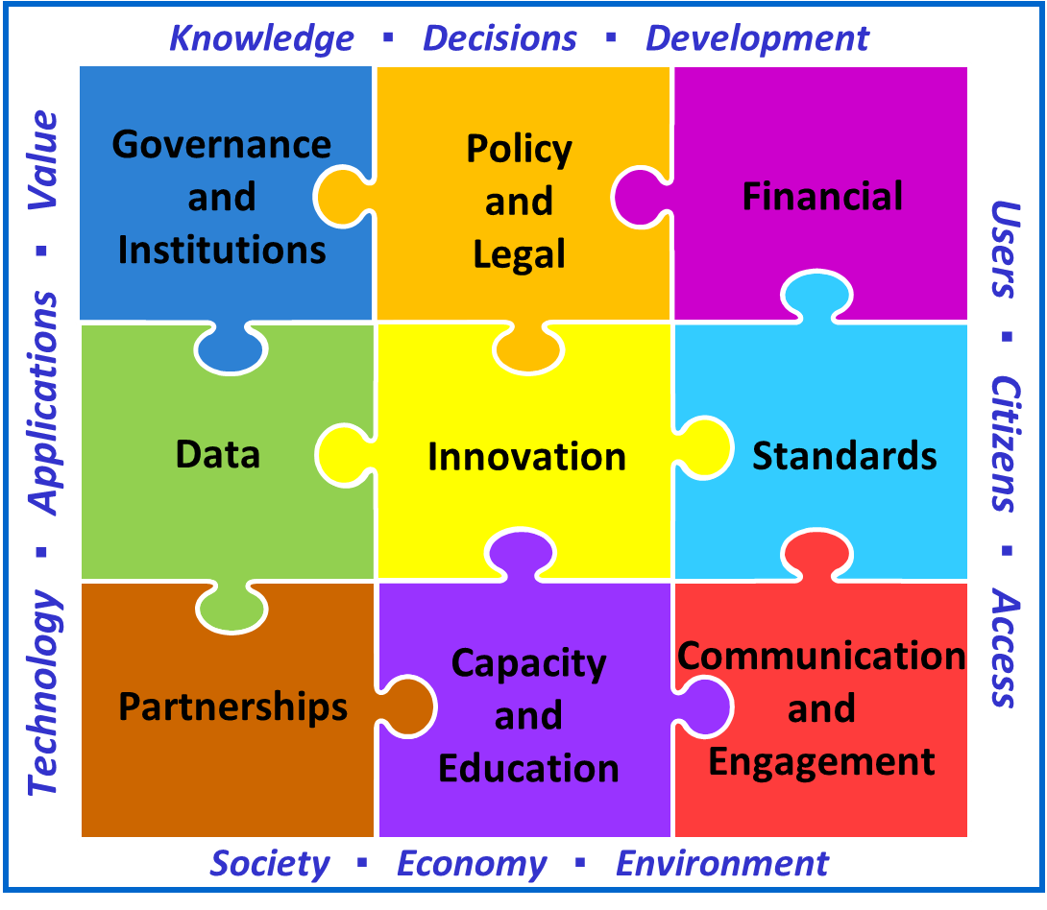
Governance and Institutions
Knowledge ◉ Decisions ◉ Development
Users ◉ Citizens ◉ Access
Policy and Legal
Financial
Data
Innovation
Standards
Partnerships
Capacity and Education
Society ◉ Economy ◉ Environment
Technology ◉ Applications ◉ Value
Communication and Engagement
Positioning geospatial information to address global challenges

Slide 25
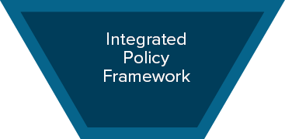
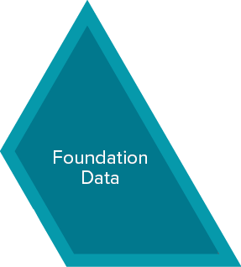
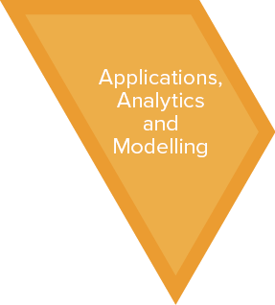
Geospatial Knowledge Infrastructure
Positioning geospatial information to address global challenges

Slide 26
Geospatial Knowledge Infrastructure
Positioning geospatial information to address global challenges

Slide 27
Integrated Geospatial Information Framework (IGIF)
SDG Data Alliance
Positioning geospatial information to address global challenges

