Slide 1
Sustainable methods for national land cover/use mapping in the context of scarcity of in-situ data and project resources
Eighth meeting of the Regional Committee of United Nations Global Geospatial Information Management for Africa
Lorenzo De Simone, PhD
Technical Adviser Geospatial Office of the Chief Statistician,
FAO
Notes:
The Integrated Geospatial Information Framework (IGIF) provides a basis and guide for developing, integrating, strengthening and maximizing geospatial information management and related resources in all countries. Geospatial data is at the core of implementing the IGIF together with data governance, and other elements well described under the 9 paths and the components of these.
Reading from the strategic path 4, Data..For a country ”Having access to the right data and at the right time is crucial to good decision making. It is data that provides new levels of insight into our past, present and future. For this reason, governments, businesses and the community need to know they are using the most accurate and authoritative data for planning, analysis, navigation and visualization – good data underpins good decisions”.
However making good land cover maps and good land use maps is not a trivial task. Keeping these up-t-date is also very difficult. As a result only few countries produce their LCLU maps on a regular basis and with high accuracy being reported.
In this context my presentation describes a novel approach developed by FAO to support countries to produce land cover maps and land use map (crop type maps) in the context of scarcity of in-situ data. The scarcity of in-situ data is in fact the biggest challenge that countries are facing globally and which impede their uptake of EO data for operational monitoring and reporting on land cover and agriculture.

Slide 2
Contents
Relevance of land cover and crop maps and alignment to the IGIF, GSGF, SDG Geospatial Road Map
Global vs National LCLU Maps
Challenges in the operational use of LCLU maps at the national level
Innovative solutions to use less in-situ data and to make better use of it
Success Stories
Next steps

Slide 3
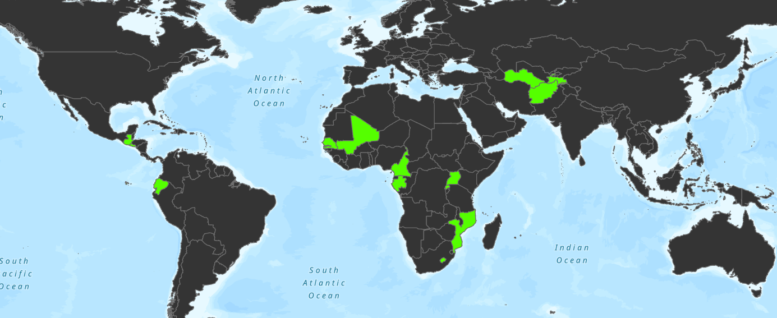
Countries where EOSTAT is being implemented
Country
Afghanistan
Turkmenistan
Senegal
Mali
Cameroon
Gabon
Uganda
Rwanda
Mozambique
Lesotho
Guatemala
Ecuador
El Salvador
Plus 4 to come in 2023

Slide 4
International partnerships
Notes:
La (FAO) et l'Agence spatiale européenne (ESA) ont renforcè leur partenariat afin de générer et de partager des données et des informations et ainsi mieux aider les pays à atteindre les Objectifs de développement durable (ODD). Un nouveau protocole d'accord entre les deux organisations a été signé 20 avril 2021. L'accord ouvre la voie à l'échange d'expertise pertinente et au développement d'applications dans lesquelles les images d'observation de la Terre peuvent être utilisées pour mieux surveiller les systèmes agroalimentaires.
Dans le cadre de ce protocole d'accord, la FAO et l'Université Catholique de Louvaine collaborent à la mise en œuvre du projet EOSTAT en lien direct avec l'initiative Sen4STAT de l'ESA.

Slide 5
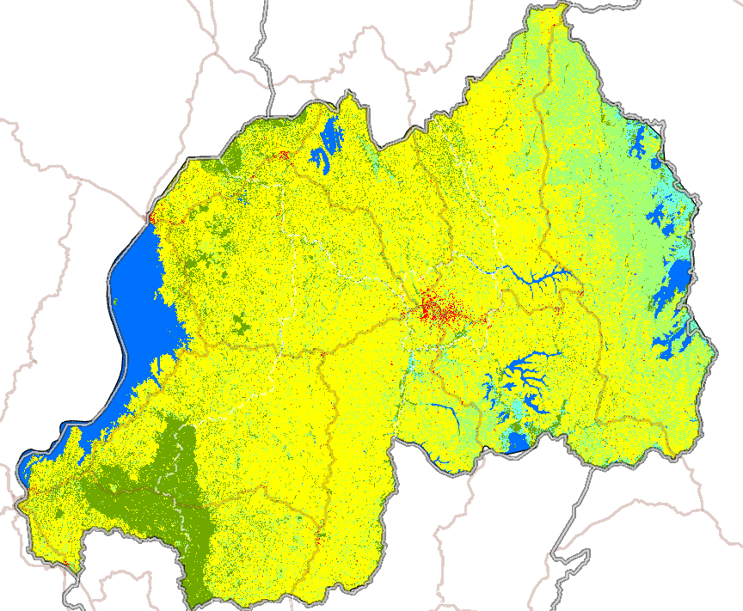
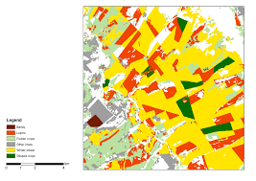
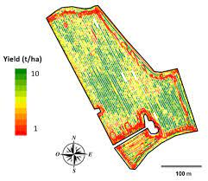
Scope of EOSTAT:
Actvities
Deployment of land cover and land use using GEE, DE Africa, Sent2Agri
Survey design and In-situ data support (example)
Testing and validation in the field
Production of validated maps and statistics
Training
Scope of work
Land cover mapping
Crop type mapping
Crop yield mapping
Agricultural Statistics (Acreage and Yield)
Environemntal Statistics
Main stakeholders
NSO’s
Ministry of Agriculture
Ministry of Environment
Land management and plannig

Slide 6
Relevance of land cover and crop maps

Slide 7
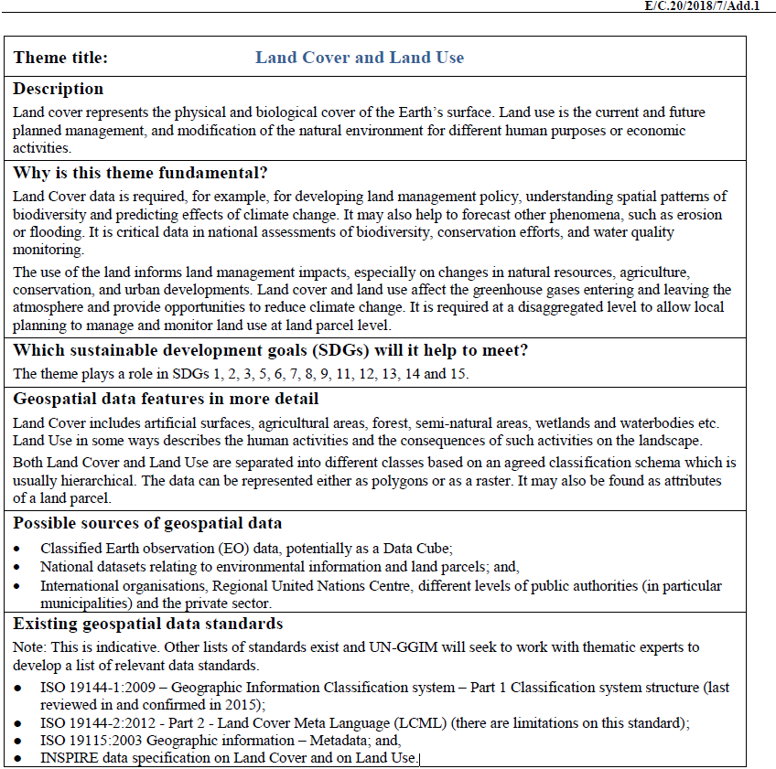
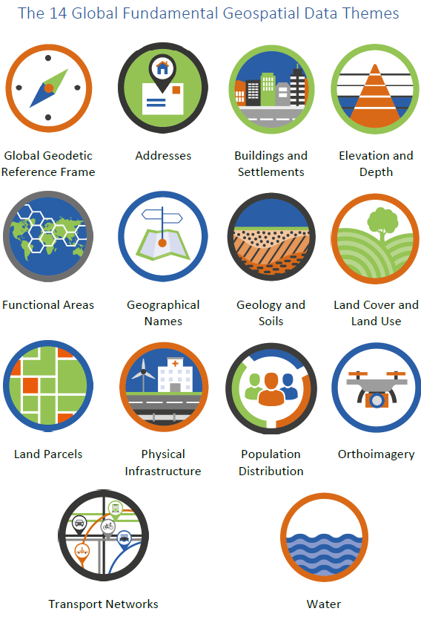
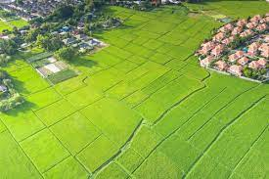
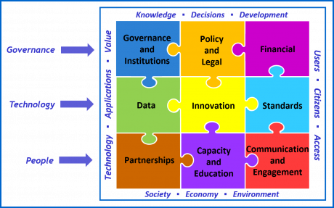
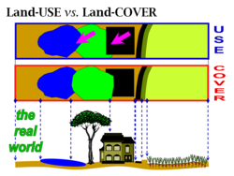
land cover & land use data are fundamental
Land cover and land use data have been included in the list of the global fundamental geospatial data themes by the Committee of Experts on Global Geospatial Information Management in 2018 (E/C.20/2018/7/Add.1).
The production of LCLU maps crosses several paths of the IGIF
Data
Innovation
Standards
Notes:
Relevant questions posed by the Committe of Experts are:
Title
Description
Why is this theme fundamental?
Which SDGs will it help to meet?
Geospatial data features in more detail
Possible sources of geospatial data
Existing geospatial data standards

Slide 8
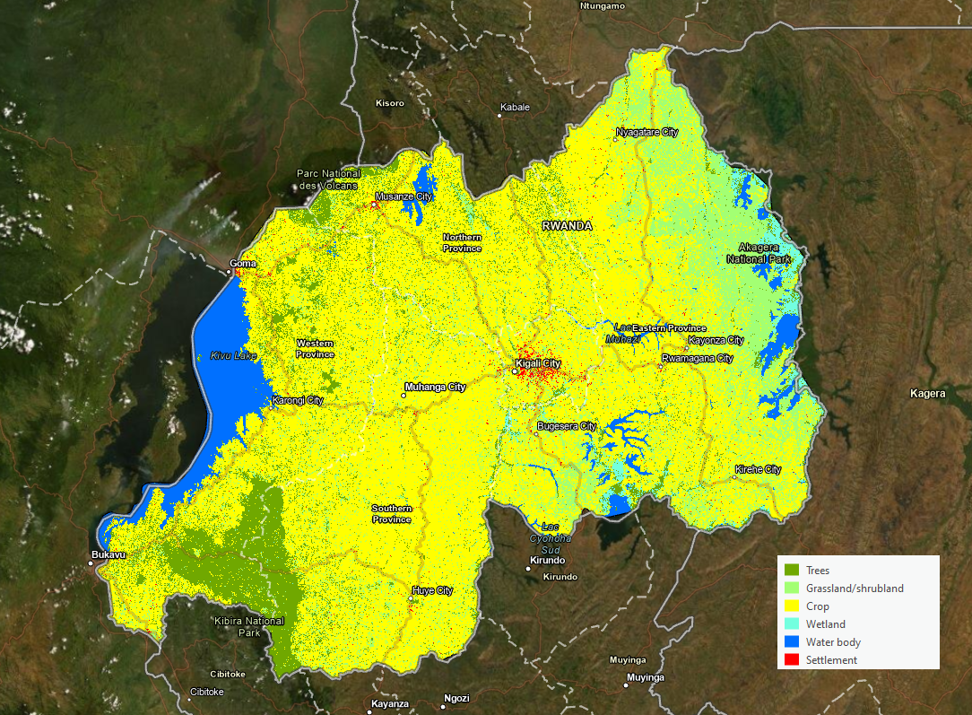
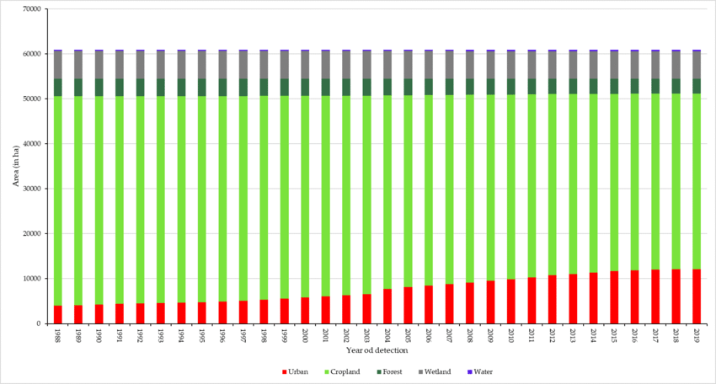
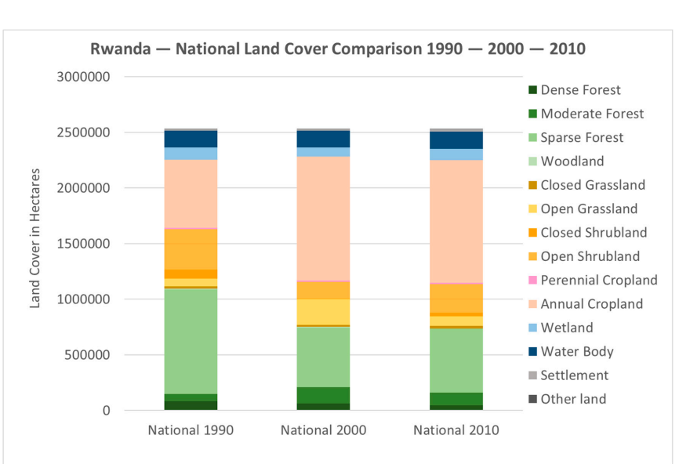
Relevance of earth observations data, land cover and land use data
Land Cover (LC) maps can be used to extract key information for a series of national applications, such as environmental monitoring, identification of land degradation trends, spatial planning, and for a wide range of scientific research fields.
The capacity of a country to consistently monitor land cover over time is essential for land cover change analysis and environmental monitoring.
Land cover statistics and land cover change statistics
Future scenarios
Agriculture
Forestry
Rangelnds
Wetlands
Settlmenet
Water
Official reporting and SDGs
National reporting
SEEA
SDG (land and water based indicators under 2, 6 and 15)

Slide 9
LCLU maps and the global statistical geospatial Framework
Notes:
Relevant questions posed by the Committe of Experts are:
Title
Description
Why is this theme fundamental?
Which SDGs will it help to meet?
Geospatial data features in more detail
Possible sources of geospatial data
Existing geospatial data standards

Slide 10
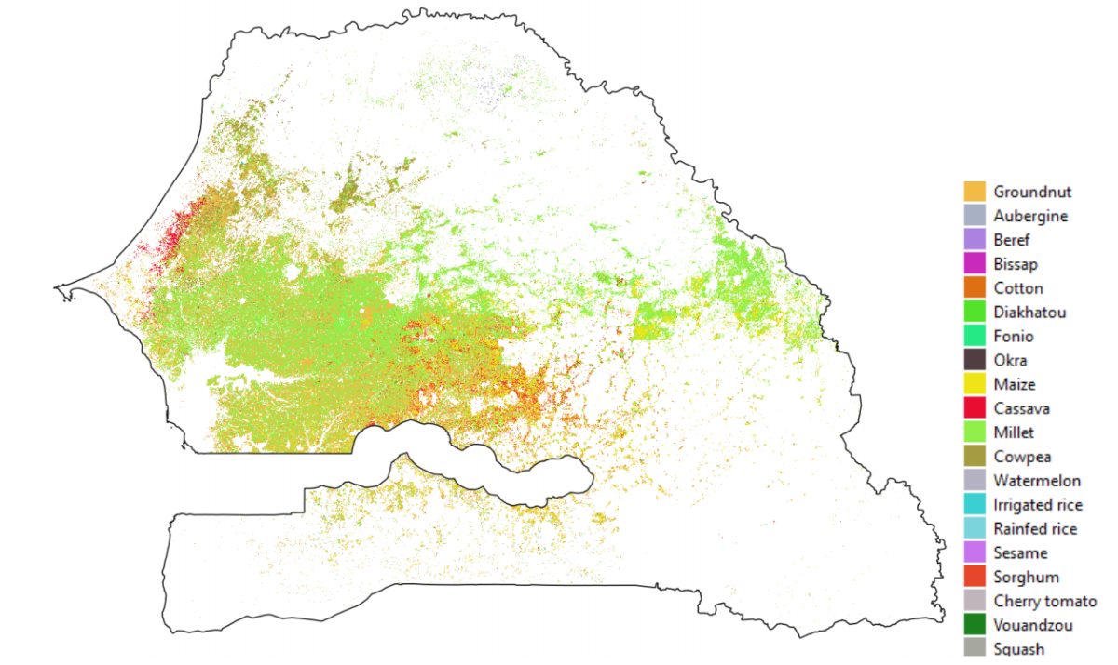
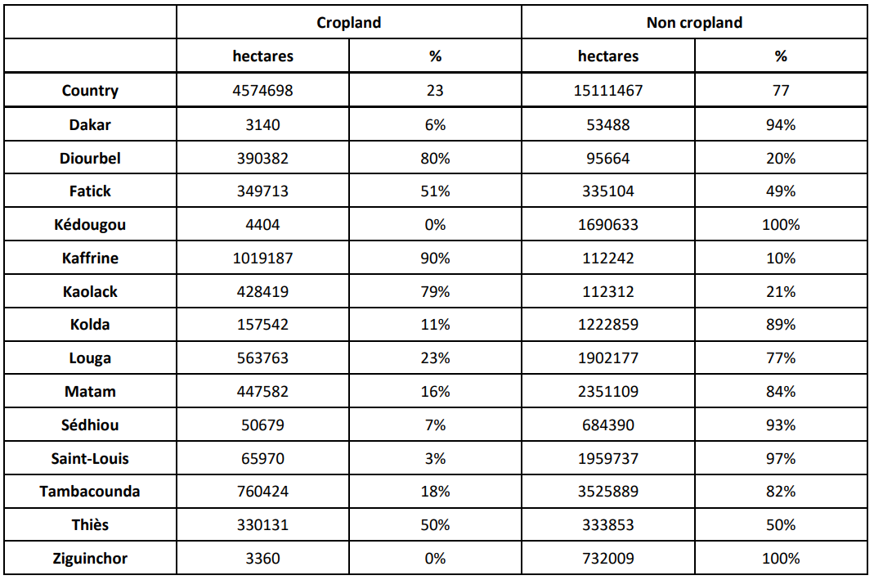
Relevance of earth observations data, land cover and land use data
Crop type map, Senegal 2018
Crop type maps are a “specialization” of the land cover class “agriculture”. They classify the cropland into crop types being cultivated during the agricultural season of reference.
Application of crop type maps:
Early estimates of crop statistics
Real time monitoring of crop health
Disaster impact assessments
Prediction of market price
Decision making for grains import/export

Slide 11
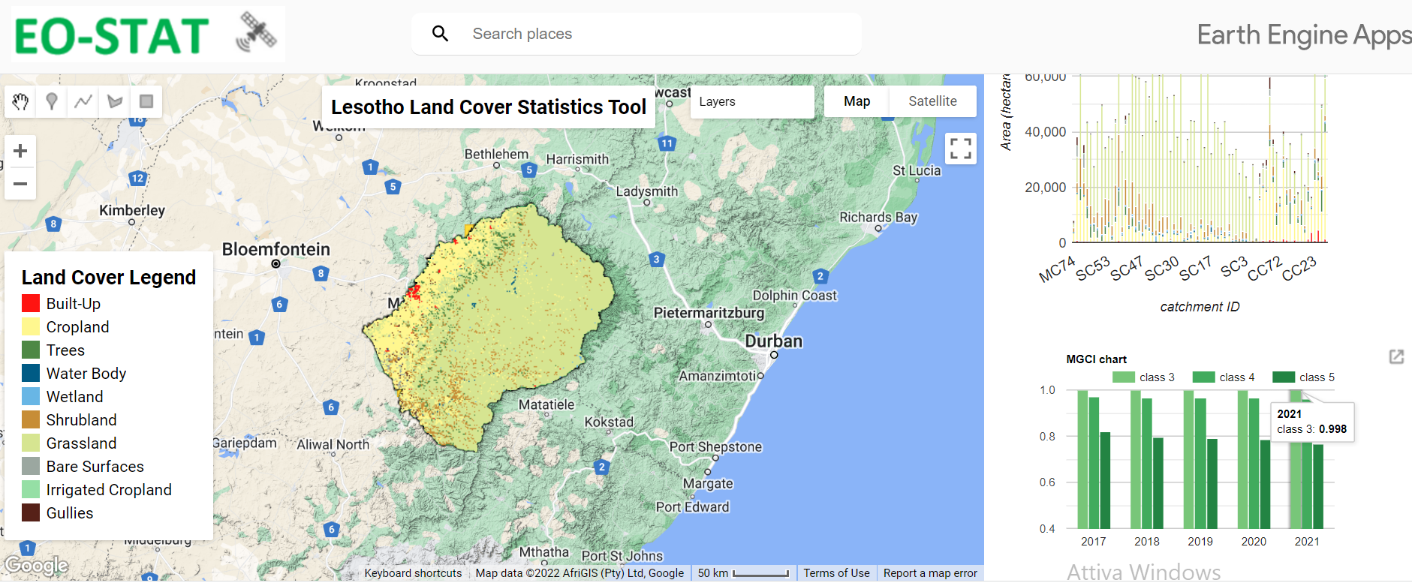
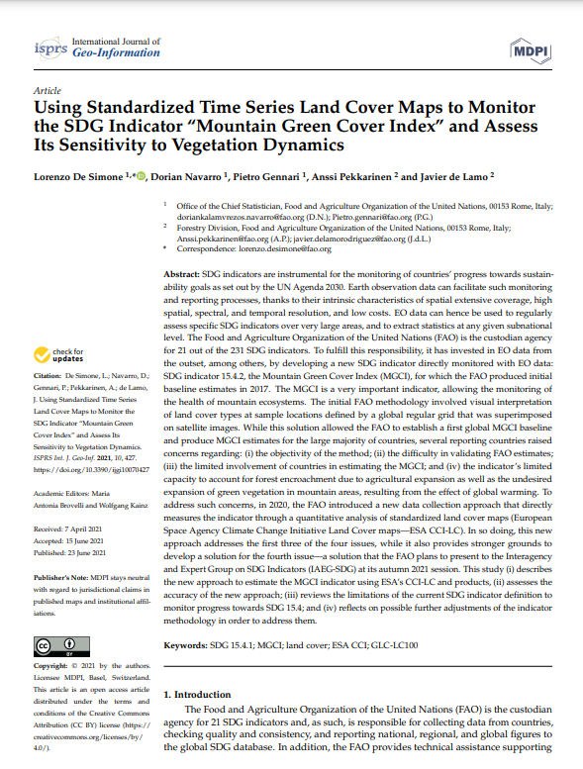
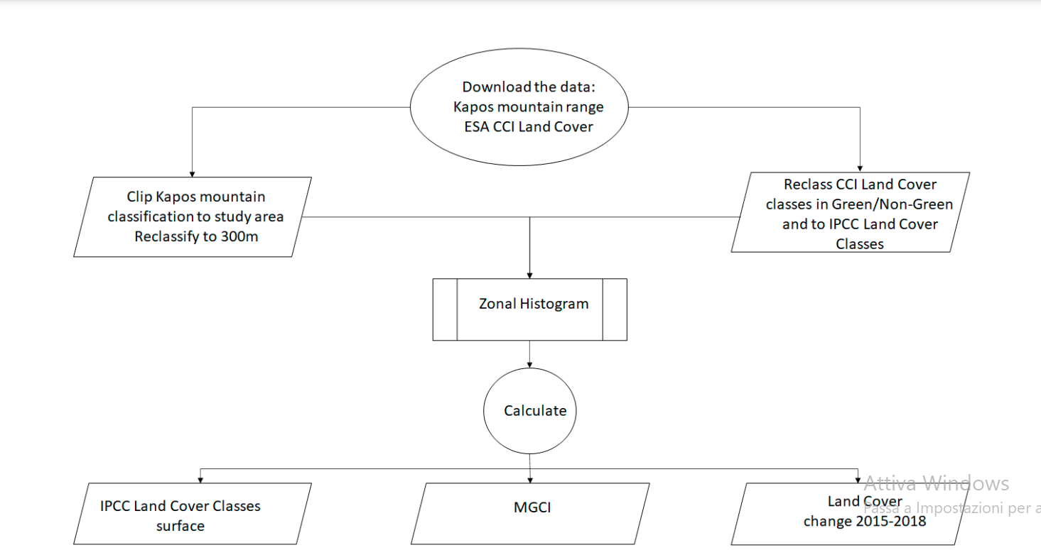
LCLU maps and SDG’s
SDG 15.4.2 reporting

Slide 12
Global and national land cover and land use maps

Slide 13
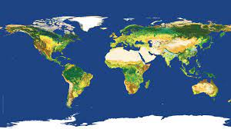
Global maps
Pros:
Wide availability: e.g. ESA WorldCover, ESA CCI, Copernicus, GlobeLand30, FROM-GLC30, etc.
Available from 1992 through 2021
Medium to high resolution (1km to 10m)
Strong consistency at a global scale, but large deviations at the regional scale.
Overall accuracy at the global level is from 72% to 76%.
Cons:
Low accuracy at the regional scale and very low at the national level
The legend may not satisfy national requirements
Minor LC/LU classes are underestimated
Notes:
Global Land cover maps are available from different sources, from moderate to high resolution
Global crop maps instead are lacking. At this time there is the WorldCereal by ESA, which is in validation step and includes two main grains. Maize and Wheat

Slide 14
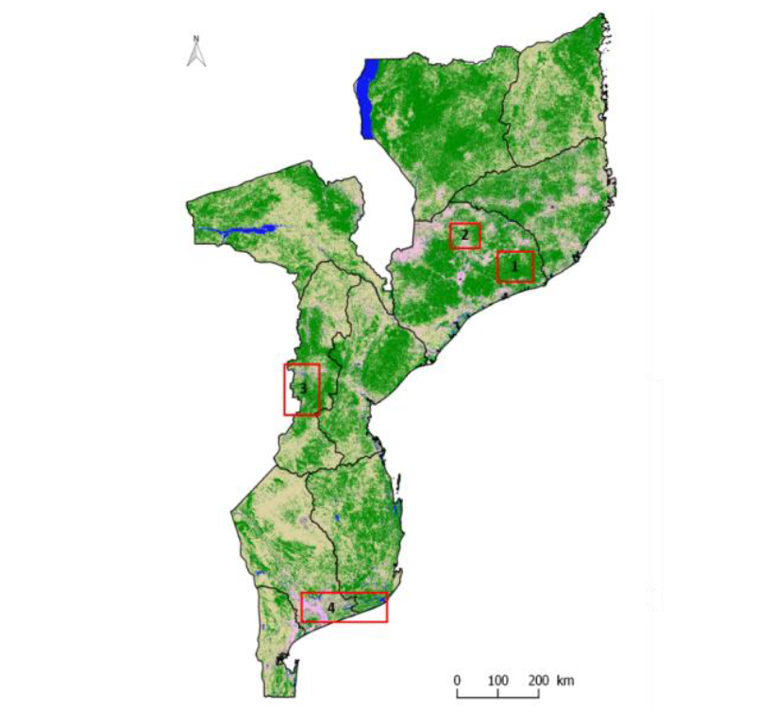
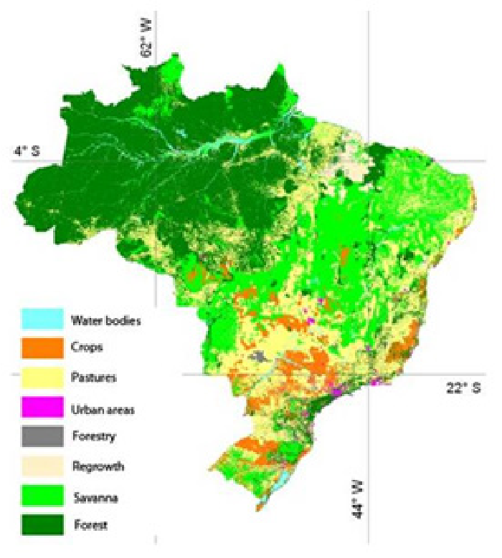
NAtional LC maps
National Maps
Pros
High spatial accuracy and thematic accuracy
Legend contains classes which satisfy national requirements
Cons
Maps are often old and are not not kept up-to-date regularly
Only few countries in the world produce their national land cover maps on a regular bases
Uncertainty in accuracy measures
Heterogeneity methods and data among different countries.
Many of the maps are produced under the auspices of specific projects by third parties that come to an end.
Brazil, 2000 2010, 2012, 2014, 2016, 2018, IBGE.
Landsat 30m.
Mozambique, 2000-2005-2010-2016, Nitidae and CIRAD in the LAUREL project. Landsat, 30m.
Notes:
Available

Slide 15
Main challenges to the operational uptake of eo in countries for LCLU mapping
Notes:
So why is it that EO data is still not being uptaken operatioanblly in coutnries to produces regulalry LC maps and Crop maps?

Slide 16
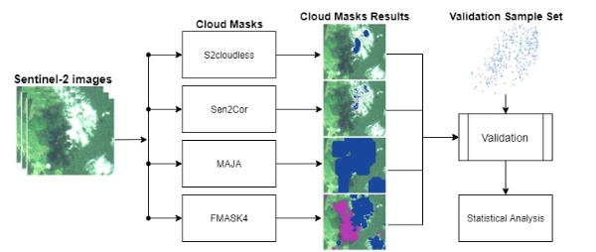
Complexity of Image Pre-processing
The complexity of image pre-processing (including image atmospheric correction and cloud masking), to more advanced temporal compositing and gap-filling which are required to derive analysis-ready data (ARD) also called data-cubes. Such operations are not trivial and require specialized expertise in Remote Sensing and big data handling.

Slide 17
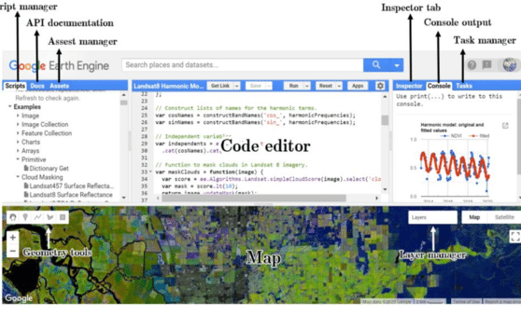
Programming skills required
EO data platforms which provide user with access to EO data archives and analytical libraries, function through code editors. GEE uses Javascript, SEPAL and DE Africa Jupyter Notebooks (Python).
Many technical experts in NSOs and concerned line ministries who are very familiar with traditional GIS packages (QGIS, ArcGIS) may not be very familiar with scripting, and may prefer the use of graphic user interfaces.

Slide 18
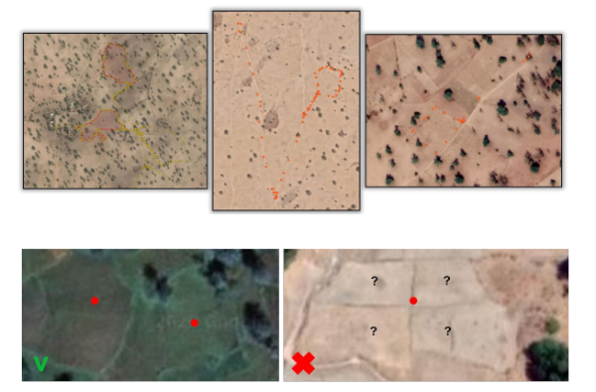
Lack of in-situ data of adequate quality
In-situ data are essential for the automatic classification of satellite images into land cover or land use classes, as opposed to visual interpretation.
In-situ data of sufficient quality is rare to find. Common reasons for this are:
I) high costs of field survey campaigns
Many data points to collect (e.g.12K for one country)
Transportation cost, plus human resources
Need to repeat survey for every reporting year
ii) suboptimal stratification of the samples
iii) suboptimal geo-referencing methods used in the field.
Top figure, example of GPS traces that contain more than parcels boundaries. Bottom figure, challenge to localize the surveyed parcels in the statistical database due to the fact that parcels are localized by geo-points (i.e. a single GPS coordinate)

Slide 19
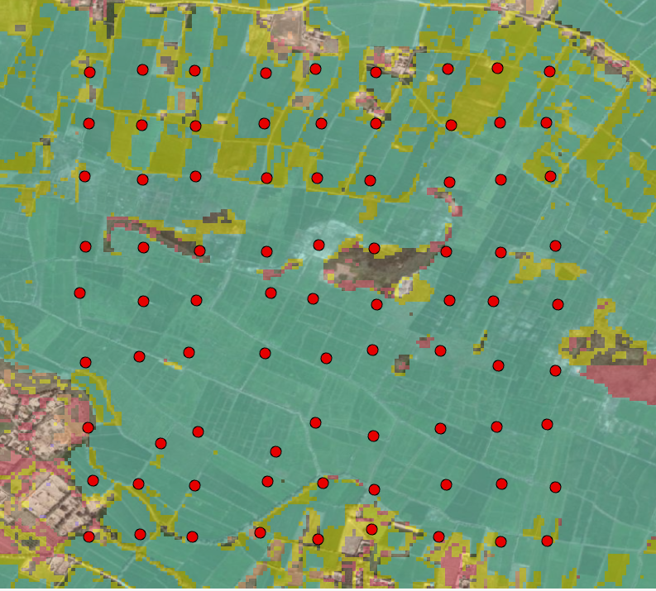
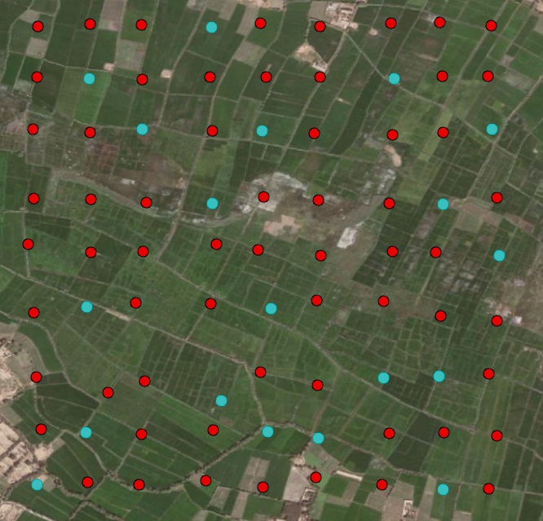
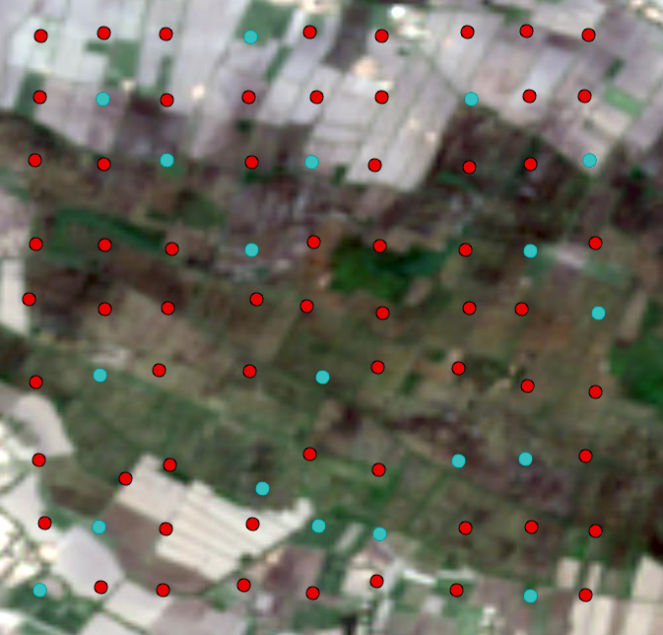
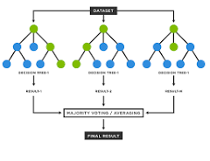
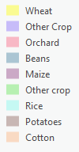
Why in-situ data is needed - calibration
In-situ data is used for the calibration of classification algorithms (e.g. Random Forest) and for the validation of results, allowing for calculating the accuracy of map (OA, UA and PA) and estimate the standard error in area estimation and the confidence intervals based on 95% confidence.
Classified ìmage: Crop Type Map
In-situ sampling locations
Sentinel-2 images acquired over the AOI
Validation
Training
Band 1
Band 2
Band 3
Band 4
NDVI
Point ID | Crop Type | Band 1 | Band 2 | NDVI | etc
1 | Rice | 100 | .... | .... | ....
2 | Wheat | 80 | ....... | ....... | .......
3 | Wheat | 110 | ......... | ......... | .........
4 | Cotton | 130 | .......... | .......... | ..........
Input features to the Random Forest

Slide 20
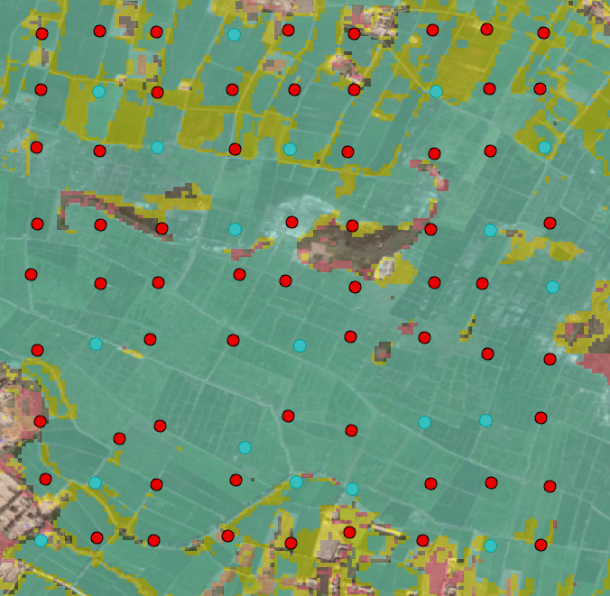
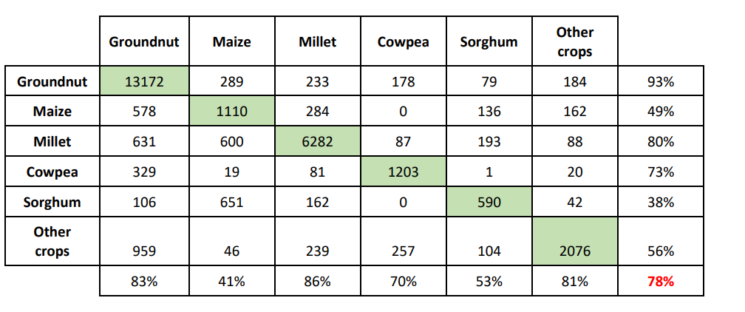
Why in-situ data is needed – validation
Accuracy Statistics
Overall Accuracy
Producer Accuracy
User Accuracy
Kappa Statistics
F1-Statistics

Slide 21
Innovation to overcome the challenge of lack of in-situ data of adequate quality for EO use

Slide 22
Overcoming the shortage of in-situ data by addressing 2 key questions?
Can we reuse in-situ data?
Can we use data frugal classification algorithms?

Slide 23
Can we reuse in situ data?
The question is if we have an in-situ dataset with high positional and attribute accuracy (we are lucky) for a given baseline year, can we re-use such a dataset to train and validate a classifier for a different year?
The issue in re-using the in-situ data for a different year is connected to the risk that the land cover or the land use at that specific location may have changed in the reference year, and therefore the in-situ data point would be outdated. Using outdated in-situ data to train the classifier would introduce bias. Similarly, using the outdated in-situ dataset for validation could hide commission errors.
However, it is possible to use EO data (e.g NDVI) to assess the consistency of the spectral characteristics of a pixel in time, and therefore to judge whether the LC/LU at this location has changed. In this context, we can use a modified version of the method developed by Paris and Bruzzone based on K-Means clustering to artificially update an in-situ dataset.

Slide 24
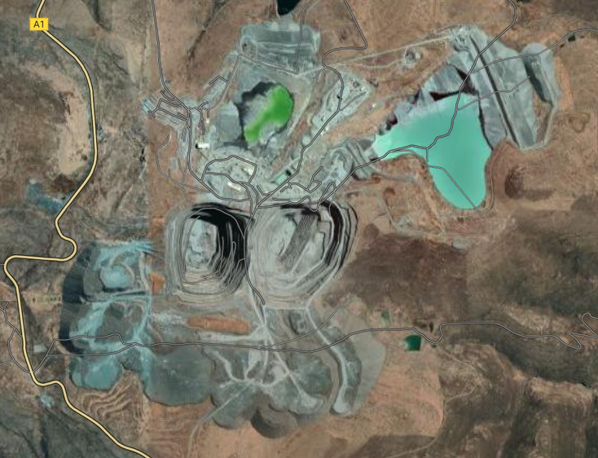
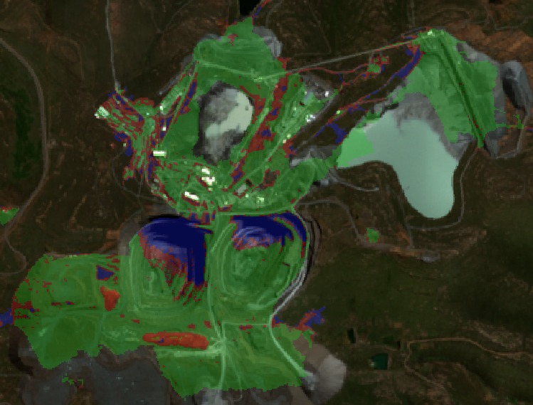
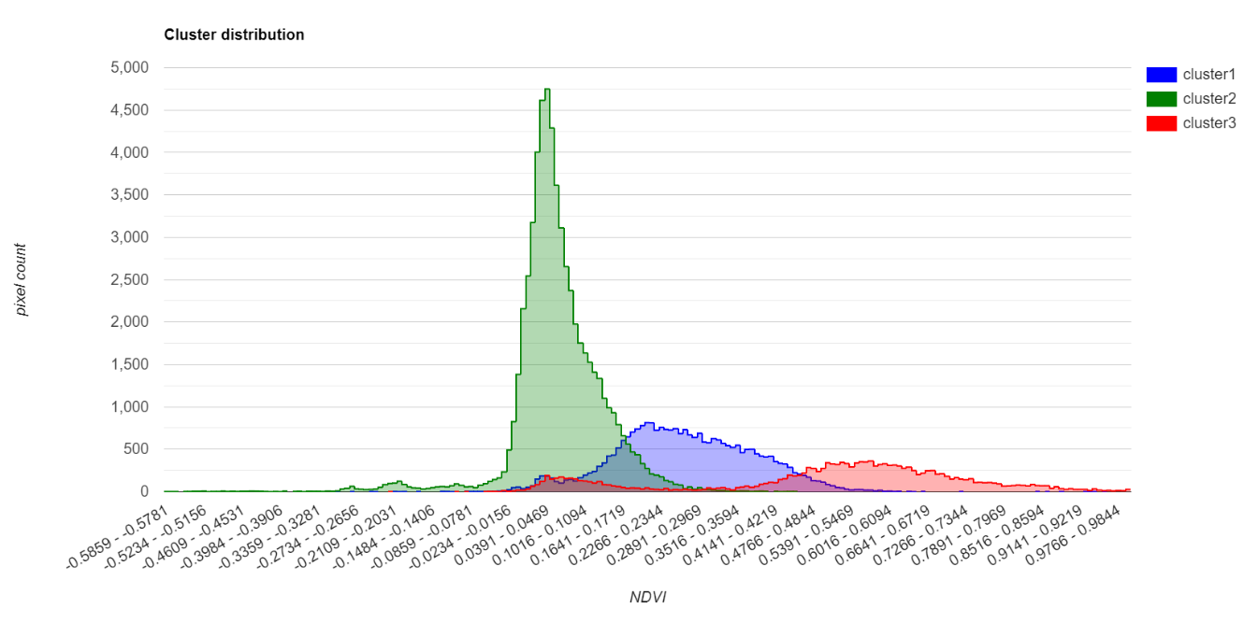
Step I: extraction of a land cover stratum from an existing LC baseline 2021. In this example, we extract only one feature for the ‘Mining’ class and overlay it on a true color image background.
Step II we apply the Kmeans on NDVI for our target year, 2019. Above we can clusters of pixels inside the target feature, and the distribution of pixels per cluster (below)
Step III: We select the pixels from the dominant cluster and we filter out minor clusters
Notes:
Step I: extract land cover stratas from an existing land cover map
Step II: apply a K-mean within each strata, using EO data for the reference year (e.g. NDVI) to EO data extracted for the reporting period. As a result within class clusters of pixels are formed.
Step III: select the dominant cluster, as this is contains the pixels which are representative of the given land cover class.
Step IV: select pixels randomly from the dominant cluster and create respectively a training and a validation datasets

Slide 25
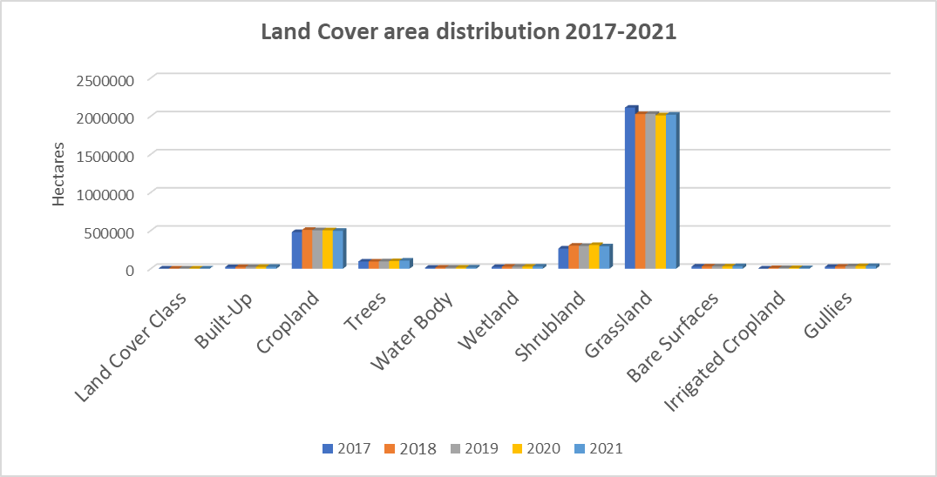
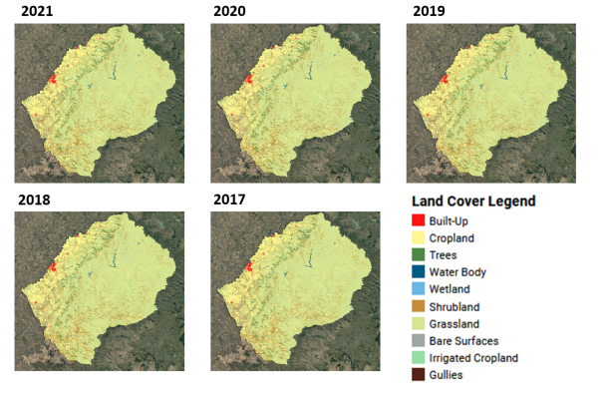
LESOTHO
5 Land Cover Maps 2017-2021
Overall Accuracy: 87% to 84%
Spatial Resolution: 10 meters
Geographic scope: National
Reference year(s): 2017 - 2021
Crop classes: 10
HiH sharing status: published
Project funded by a EU-GIZ trust fund
Notes:
Time series production that allows for land cover change analysis.
Ths solution ensures high accuracy of the land cover change estimates
The maps have been produced from a single field survey. A learnig method has been developed to update the field survey to the reporting year using EO data.

Slide 26
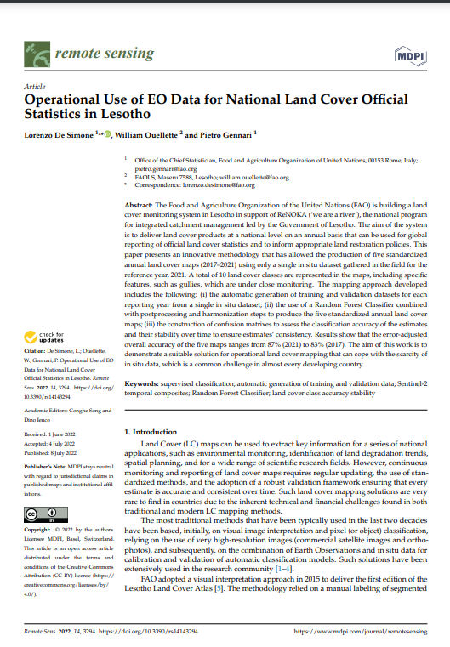
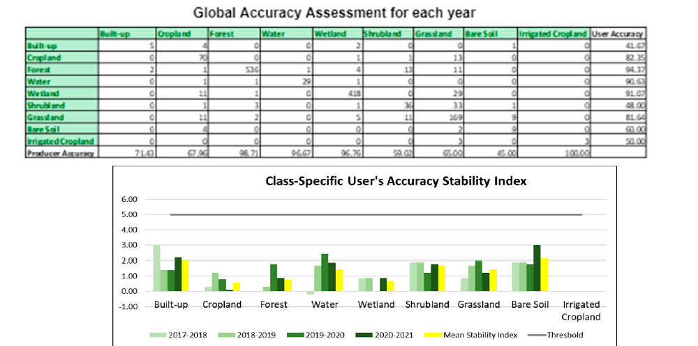

Slide 27
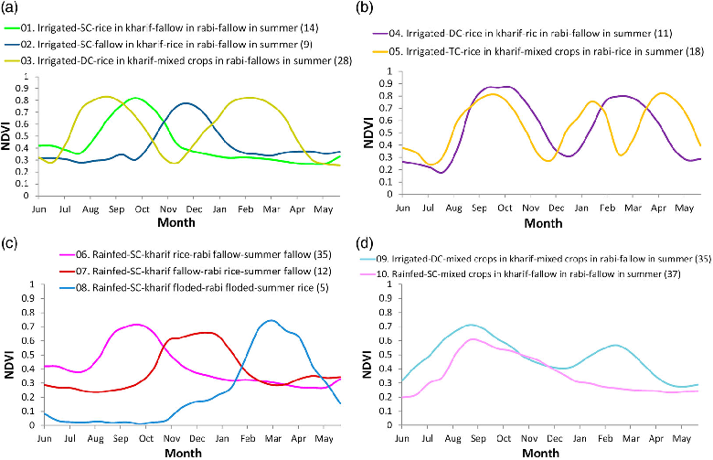
Can we use less in-situ data?
Random Forest (RF) is the de-facto mostly used supervised classifier. RF though necessitates of large amounts of training data to avoid overfitting, and this means thousands of data points.
FAO has explored the possibility to use a data frugal algorithm (Dynamic Time Warping), which instead works by assessing the similarities by pairs of time series data and allows also for coping with misalignment between these
Notes:
Compares pairs of EO time series.
We build a reference spectral signature for each crop using AEZ as strate
We compare every crop reference spectral signatures with the time series extracted at every pixel in the image
Calculates a dissimilarity matrix
The match that scores the lease dissimilarity is selected for classification
Only needs 5 to 10 points per crop to build the signature
Allows to account for seasona shifts
Allows to use time contraints and weights

Slide 28
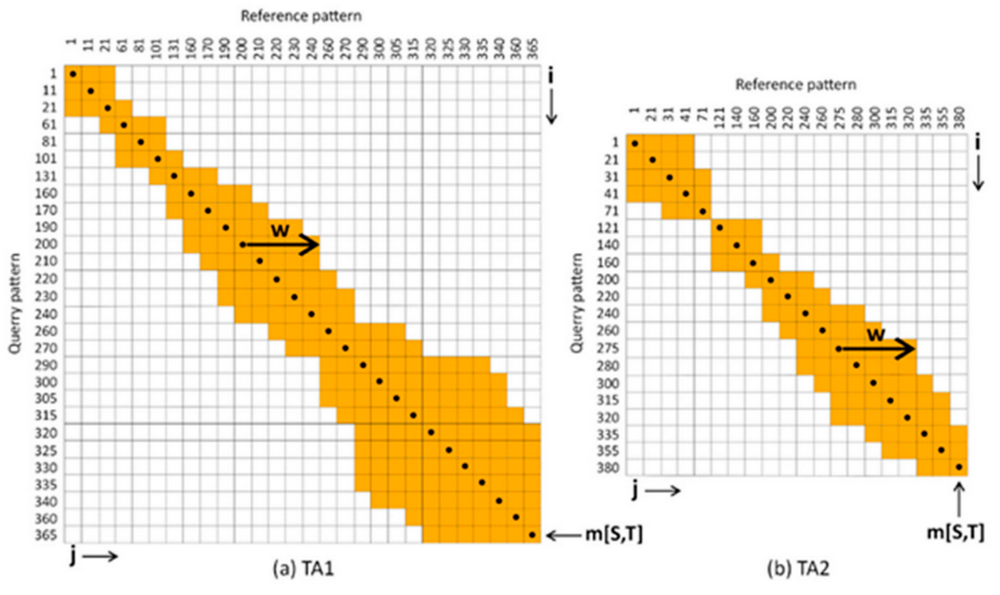
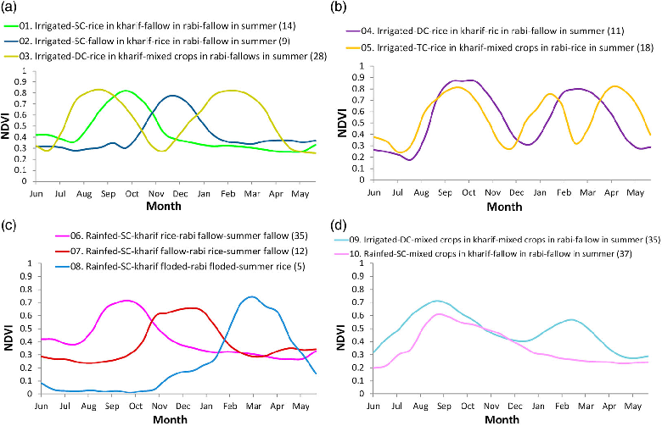
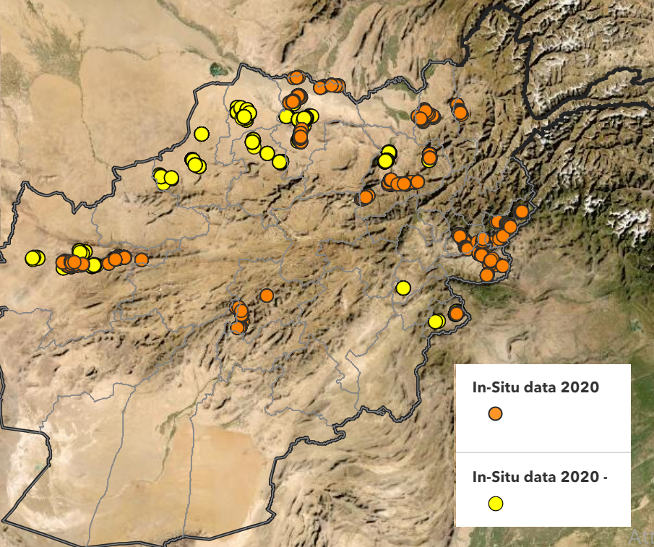
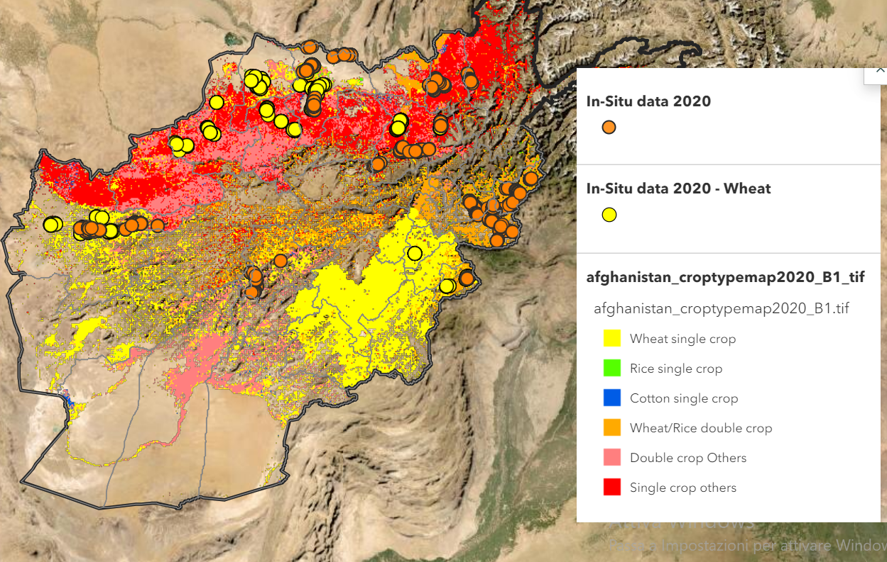
Three stePs steps of DTW
Step 2 Dissimilarity analysis of each pixels in the AOI against every RSS
Step 1 Define spectral signatures for different crops in the study area.
Step 3 Classification of pixels based on match with least min dissimilarity
Notes:
South India (Figure 1). It is located in the lower Krishna Basin

Slide 29
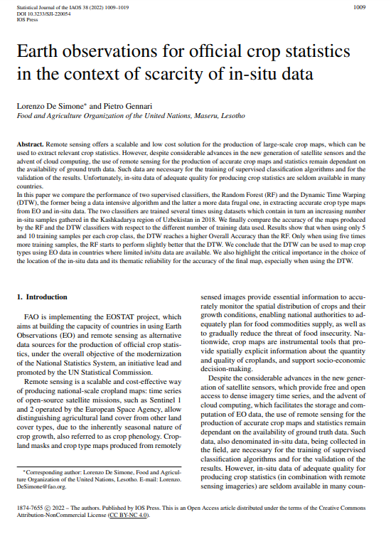
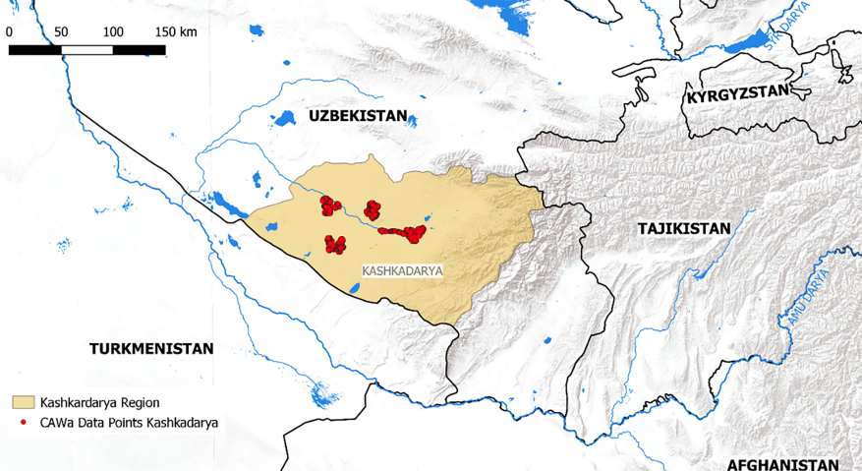
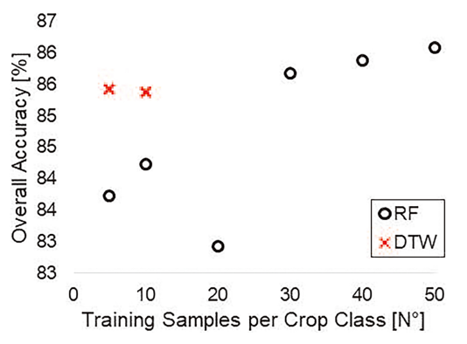
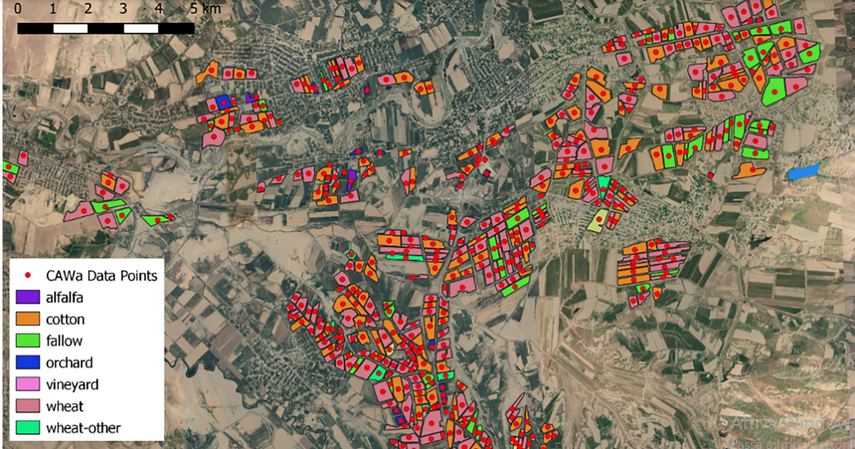
Overall accuracy of the DTW and RF classifiers as a function of the number of training samples used.
Notes:
DTW scores significantly higher OA than to RF, when 5 to 20 samples are used for training. Only when 30 or more training samples are used, the RF scores higher OA compared to DTW.
This example focuses on one class for one single crop in one agroecological zone. The total requirements is calculated by multiplying the number of samples required for a class, for the number of crop classes for the number of agroecological zones present in the country. E.g.

Slide 30
results

Slide 31
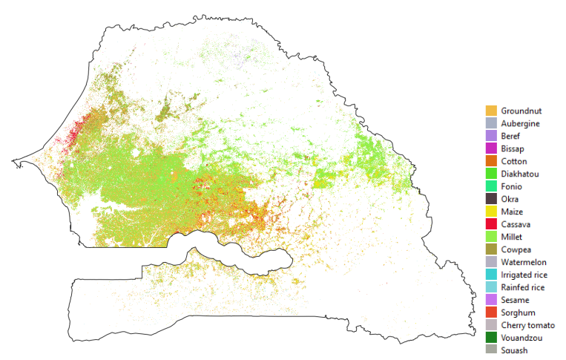
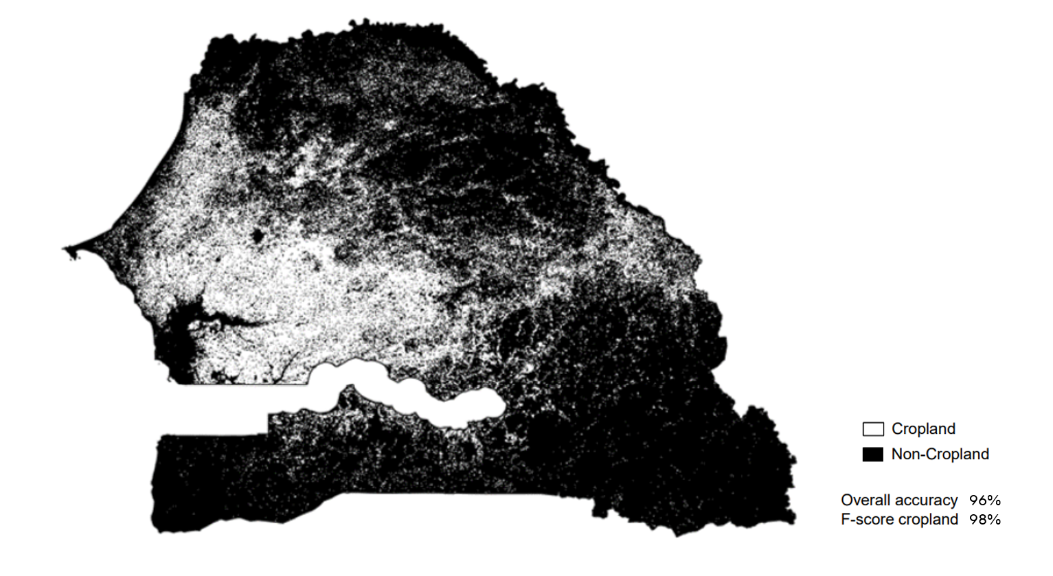
SENEGAL
Crop Mask 2018
Crop Type Map 2018
Overall Accuracy: 96%
Spatial Resolution: 10 meters
Geographic scope: National
Reference year: 2018
HiH sharing status: published
Overall Accuracy: 78%
Spatial Resolution: 10 meters
Geographic scope: National
Reference year: 2018
Crop classes: 20
HiH sharing status: published

Slide 32
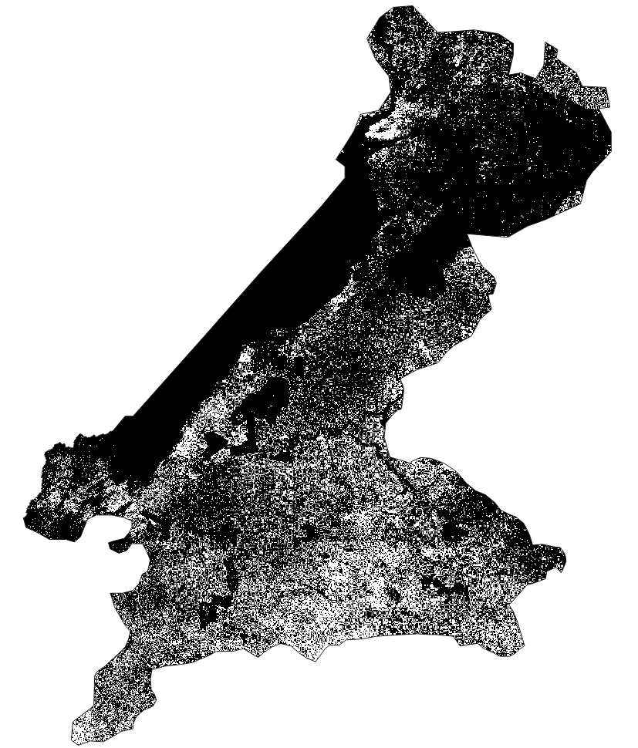
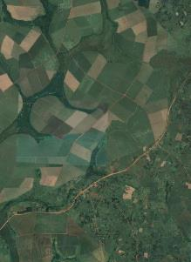
UGANDA
Sub-nantional Crop Mask 2021
QC in situ dataset
Cropland
Non-Cropland
Total number of samples: 3471
Non-Crop: 1917
Crop: 1554
Overall Accuracy: 73%
Spatial Resolution: 10 meters
Geographic scope: 1 district
Reference year: 2021
HiH sharing status: in progress
Notes:
Cropland generally of good quality
2 points of attention:
Northern area of the country = a lot of natural vegetation. Part of it is erroneously mapped as cropland; main reason is the absence of ground data in this region
Cropland mask maps the crops present during the « short » growing season (Oct – Jan); not all fields are covered with vegetation at this moment
Snapshots are done with Google Earth, not Sentinel-2. So, I don’t know the exact date of the VHR image available in Google Earth (seasonality might not be respected)

Slide 33
Focusing on the main pure crops
Overall accuracy : 79 %
UGANDA
Sub-national Crop Type Maps 2021: pure & mixed crops
Not enough validation samples
Ground data available to train the classification model
Adding the 2 main mixed crops
Overall accuracy : 72 %
Not enough validation samples
Not enough validation samples
Maize
Cassava
Sweet potato
Sugarcane
Overall Accuracy: 79 - 72%
Spatial Resolution: 10 meters
Geographic scope: 1 district
Reference year: 2021
HiH sharing status: in progress
Notes:
Cropland generally of good quality
2 points of attention:
Northern area of the country = a lot of natural vegetation. Part of it is erroneously mapped as cropland; main reason is the absence of ground data in this region
Cropland mask maps the crops present during the « short » growing season (Oct – Jan); not all fields are covered with vegetation at this moment
Snapshots are done with Google Earth, not Sentinel-2. So, I don’t know the exact date of the VHR image available in Google Earth (seasonality might not be respected)

Slide 34
RWANDA
National Land Cover map 2022
Overall Accuracy: In progress
Spatial Resolution: 10 meters
Geographic scope: National
Reference year: 2022

Slide 35
LESOTHO
5 Land Cover Maps 2017-2021
Overall Accuracy: 87% to 84%
Spatial Resolution: 10 meters
Geographic scope: National
Reference year(s): 2017 - 2021
Crop classes: 10
HiH sharing status: published
Project funded by a EU-GIZ trust fund
Notes:
Time series production that allows for land cover change analysis.
Ths solution ensures high accuracy of the land cover change estimates
The maps have been produced from a single field survey. A learnig method has been developed to update the field survey to the reporting year using EO data.

Slide 36
afghanistan
Crop Mask(s) 2020
Overall Accuracy: 94% and 98%
Spatial Resolution: 10 meters
Geographic scope: National
Reference year: 2020 and 2021
HiH sharing status: published
Notes:
Cropland generally of good quality
2 points of attention:
Northern area of the country = a lot of natural vegetation. Part of it is erroneously mapped as cropland; main reason is the absence of ground data in this region
Cropland mask maps the crops present during the « short » growing season (Oct – Jan); not all fields are covered with vegetation at this moment
Snapshots are done with Google Earth, not Sentinel-2. So, I don’t know the exact date of the VHR image available in Google Earth (seasonality might not be respected)

Slide 37
afghanistan
Crop Seasonality Map 2020
Overall Accuracy: 92 %
Spatial Resolution: 10 meters
Geographic scope: National
Reference year: 2020
HiH sharing status: published

Slide 38
afghanistan
Crop Type Map 2020
Overall Accuracy: 90 %
Spatial Resolution: 10 meters
Geographic scope: National
Reference year: 2020
Crop classes: 4 + others
HiH sharing status: published

Slide 39
afghanistan
Crop Type Map 2021
Overall Accuracy: 70-90% depending on tile
Spatial Resolution: 10 meters
Geographic scope: National
Reference year: 2021
Crop classes: 12
HiH sharing status: published

Slide 40
ECUADOR
Crop Type Map 2018 and 2021
Overall Accuracy: N/A
Spatial Resolution: 10 meters
Geographic scope: National
Reference year(s): 2018 and 2021
LU classes: 3
HiH sharing status: in progress

Slide 41
ECUADOR
Crop Type Yield Map 2022
Overall Accuracy of crop model: mode currently achieves a validation RMSE of 3.5 and 2.49
Spatial Resolution: 10 meters
Geographic scope: Guayas region
Reference year(s): 2022
Crop classes: 2
HiH sharing status: in progress
Maize yield prediction maps of winter (first season) in the Guayas
Rice yield prediction maps of winter (first season) in the Guayas.

Slide 42
EL SALVADOR
Land Use map 2020
Overall Accuracy: N/A
Spatial Resolution: 10 meters
Geographic scope: National
Reference year(s): 2020
LU classes: 58
HiH sharing status: in progress

Slide 43
Next steps

Slide 44
Integrating standards and methods into the IGIF
Introduce standard methods for LCLU within the National Implementation Plan under the IGIF
Develop guidelines and standards for geospatially integrated field surveys and national census

Slide 45
Thank you

