Slide 1
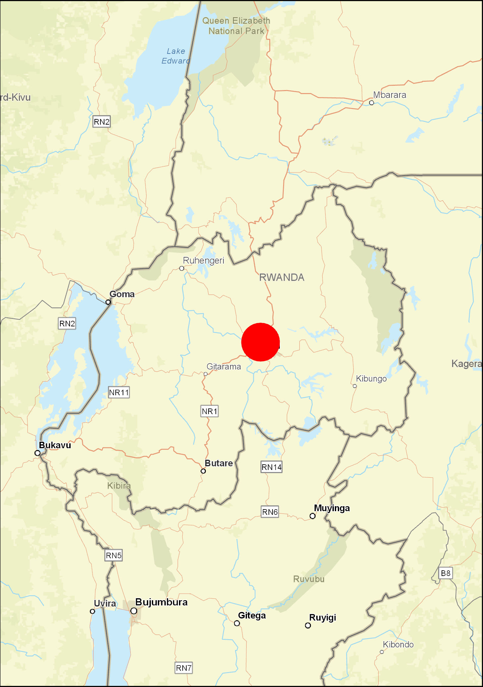
Rwanda NSDI Hub

Slide 2
Stakeholders’ Collaboration
NLA Meteo RBC NAEB
REG RHA RAB RWB
Mining RTDA CoK RFA REMA
MINAGRI WASAC
MININFRA CGIS RDB NISR RSA MINEMA
University of Rwanda
SPATIAL DATA
22 Main Custodians

Slide 3
NSDI Hub, officially launched in November 2021
Items of the portal have been used/viewed 523,621 times so far.

Slide 4
Land Use Master Plans
Fundamental Spatial Datasets
Topo maps 2020 (1:50,000)
Thematic maps
Dashboards
Story maps
Comment/contribution space
OneWeb
NSDI Hub
Components

Slide 5
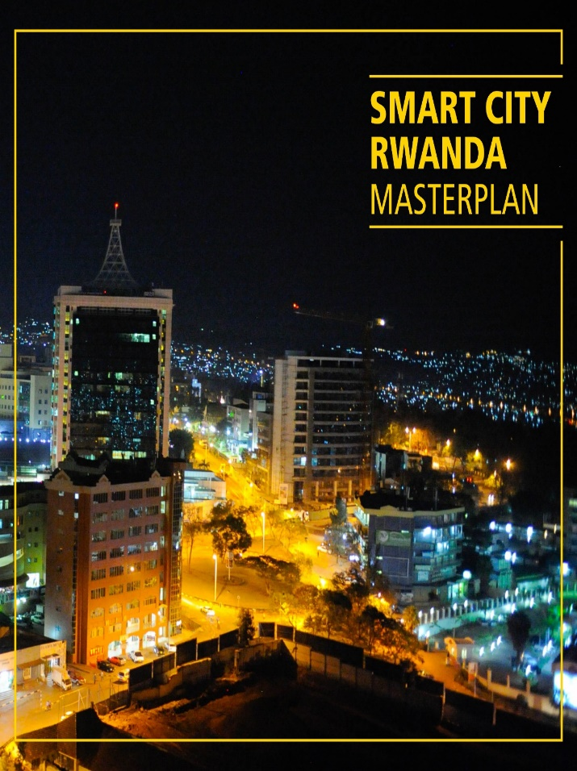
Fundamental Datasets

Slide 6
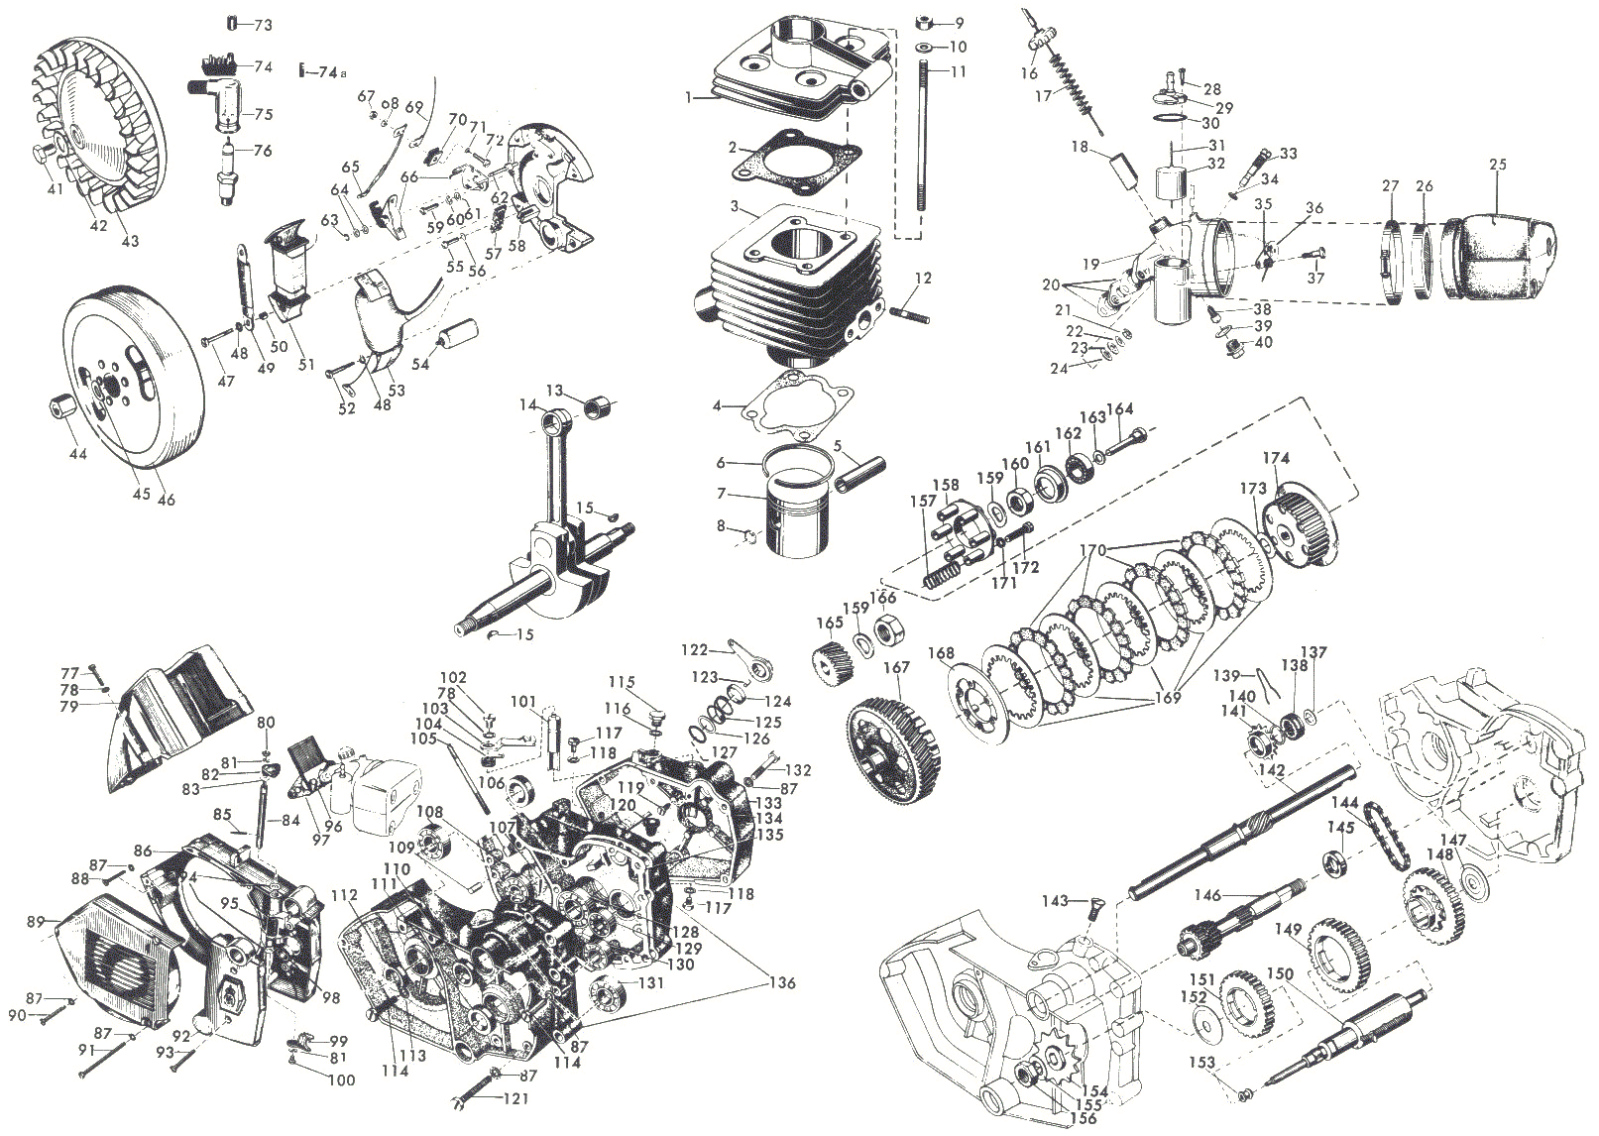
INTEGRATION
OUR CHOICE

Slide 7
NSDI Hub is integrated with Land Administration Information System (LAIS)
Building permitting system is also being integrated
The analysis is being done on how to integrated with other systems
Integration

Slide 8
TECHNOLOGY
ArcGIS Pro
ArcGIS Enterprise
ArcGIS Online
ArcGIS Server

Slide 9
DEMO
www.geodata.rw

