Slide 1
Towards greater integration: An introduction to the AfCFTA
Mahlet Girma
Trade Analyst
African Trade Policy Center
UNECA

Slide 2
Contents
AfCFTA :Justification
AfCFTA : Scope
Status of the AfCFTA : Ratification and negotiations
Expected effects of the AfCFTA: Empirical evidence from ECA
Conclusion

Slide 3
AfCFTA : Justification

Slide 4
AfCFTA : Why?
Removal of Tariffs
Removal of Non-Tariff Barriers
Food security
Coherent trade policy
Job creation
Access to wider markets
Makes investments worthwhile
Drives industrialisation
Expands sectors
Develops regional value chains

Slide 5
Scope of the AfCFTA

Slide 6
AfCFTA Framework : An overview
Agreement establishing the African Continental Free Trade Area (AfCFTA) | Protocol on Trade in Goods | Elimination of duties and quantitative restrictions on imports Imports shall be treated no less favourably than domestic products Elimination of non-tariff barriers Rules of Origin Cooperation of customs authorities Trade facilitation and transit Trade remedies, protections for infant industries and general exceptions Cooperation over product standards and regulations Technical assistance, capacity-building and cooperation
 | Protocol on Trade in Services | Transparency of service regulations Mutual recognition of standards, licensing and certification of services suppliers Progressive liberalization of services sectors Service suppliers shall be treated no less favourably than domestic suppliers in liberalized sectors Provision for general and security exceptions
 | Protocol on Dispute Settlement | Rules and Procedures for Settlement of Disputes within the African Continental Free Trade Area
 | Phase 2 negotiations : Intellectual property rights, Investment , Competition policy , digital trade, Women and Youth in Trade

Slide 7
Five Operational Instruments of the AfCFTA
RULES OF ORIGIN
Criteria which confer to a specific product “an economic nationality”. AfCFTA RoO determine the minimum level of processing of a product on the continent so that it benefits advantages provided by the Agreement
ONLINE TARRIF NEGOTIATION PORTAL
Tool with a view to facilitate and accelerate harmonization of data needed for negotiations and support preparation and submission of offers based on countries’ priorities, in accordance with the tariff liberalization schedule of the AfCFTA.
NON-TARIFF BARRIERS (NTB) MECHANISM
Online mechanism for notification, monitoring and elimination of NTBs under the AfCFTA. The tool is accessible via https://tradebarriers.africa/
PAN-AFRICAN PAYMENT AND SETTLEMENT PLATFORM
Digital payment system that will help companies to clear and settle intra-African trade transactions for goods and services in their local currencies
AFRICAN TRADE OBSERVATORY
Online platform that collect, process and analyse intra-Africa trade data and other related information.

Slide 8
Modalities to liberalize trade in goods
3 categories of products | 2 categories of countries | Periods of liberalization
Non-sensitive products : To be fully liberalized 90% | Non-LDCs | 5 years
 | Least developed countries(LDCs) | 10 years
Sensitive products : To be fully liberalized over a longer period 7% | Non-LDCs | 10 years
 | LDCs | 13 years
Excluded products : 3% | Non-LDCS, LDCs =>Double qualification (max 3% of tariff lines + max 10% of the average value of imports from African countries in the three years preceding the implementation of the AfCFTA) | Not liberalized, but the lists are reviewed every 5 years
Criteria for sensitive or excluded products: contribution to employment, revenue contribution, export earnings, food security, national security, fiscal revenue, livelihood and industrialisation

Slide 9
Understanding the modalities of liberalization
Tariffs on 90 per cent of goods of AfCFTA State Parties will be reduced in equal annual installments until they are eliminated: 5 years for non-LDCs and 10 years for LDCs.
i.e. A product exported from an AfCFTA State Party into a non-LDC ( if a 25% rate is applied the first year)
2021 : 25 per cent
2022 : 20 per cent
2023 : 15 per cent
Reductions each year until it is traded duty-free
On 7 per cent of ‘sensitive’ goods, tariffs will fall within 10 years for non- LDCs and 13 years for LDCs.
Tariffs will remain on 3 per cent of ‘excluded’ products.
.

Slide 10
Modes of supply : trade in services
Mode of supply | Description | Examples
Mode 1: Cross-border supply | Service flows that move from the territory of one Member into the territory of another member | A user in country A receives services from abroad through its telecommunications, information technology or postal delivery infrastructure
Mode 2:Consumption abroad | Service consumer moves into another Member’s territory to obtain a service | Nationals of country A travel to country B as tourists, students or patients to receive various services.
Mode 3:Commercial presence | Service supplier of one Member establishing territorial presence through ownership or lease of premises in another Member’s territory to provide a service | The service is provided in country A by a subsidiary, branch or representative office (hotel group, construction company)
Mode 4:Presence of natural persons | Consists of a person of one Member entering the territory of another Member to supply a service | A consultant , accountants or a doctor going to another country to offer their services

Slide 11
Status of the AfCFTA : Ratification and negotiations

Slide 12
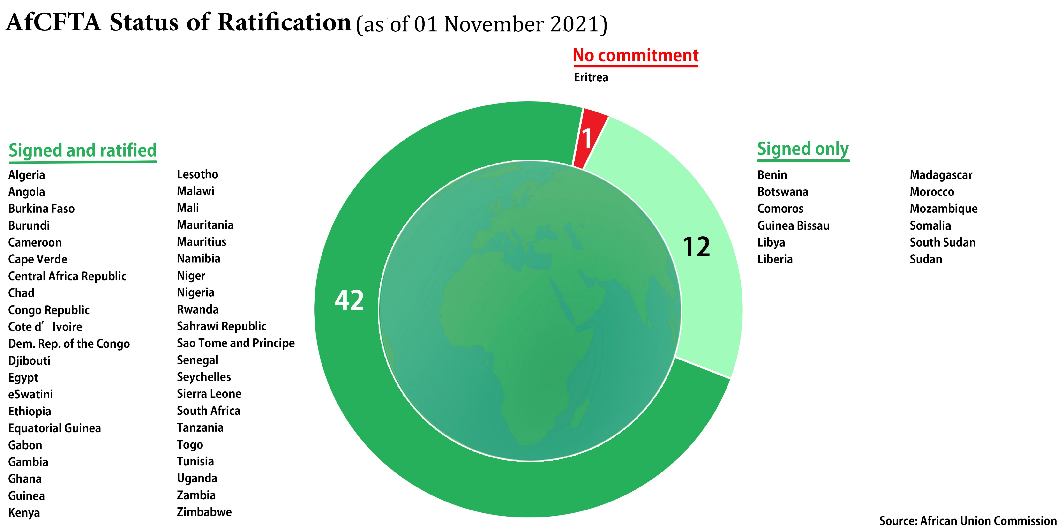
AfCFTA: Ratification status

Slide 13
AfCFTA : Status of the negotiations
Protocol on Trade in Goods
43 countries have submitted their tariff offers on goods representing 78 percent of AU Member States with consolidated submissions from 4 Customs Unions (CEMAC, ECOWAS + Mauritania, EAC and SACU)
28 of 43 Member States offers on goods for tariff liberalization have met the threshold - 90 percent of tariff lines to be fully liberalized.
87.7% of the tariff lines have agreed RoO. RECs RoO shall apply to the outstanding 12.3 percent tariff lines (on temporary bases).
Protocol on Trade in Services
5 priority sectors to be liberalized: financial services, transport, telecommunications/information technology, professional services tourism
46 African countries have submitted their Services Offers. CEMAC, EAC and ECOWAS have presented consolidated services offers.
Phase II issues: Investment, Intellectual Property Rights ,Competition Policy, digital trade, Women and Youth in Trade
Technical committees have been established by ministers and terms of reference approved for the competition policy, intellectual property rights and investment issues. The Protocol are being developed.
Digital Trade and Women and Youth Trade Protocols are at consultation level.

Slide 14
Expected effects of the AfCFTA: Empirical evidence from ECA

Slide 15
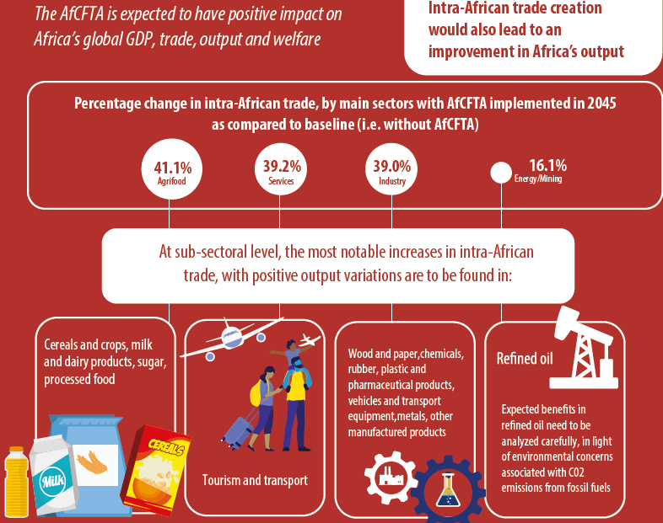
AfCFTA: Benefits centered on intra-African trade
Source: ECA (https://uneca.org/sites/default/files/keymessageanddocuments/en_afcfta-infographics-11.pdf)

Slide 16
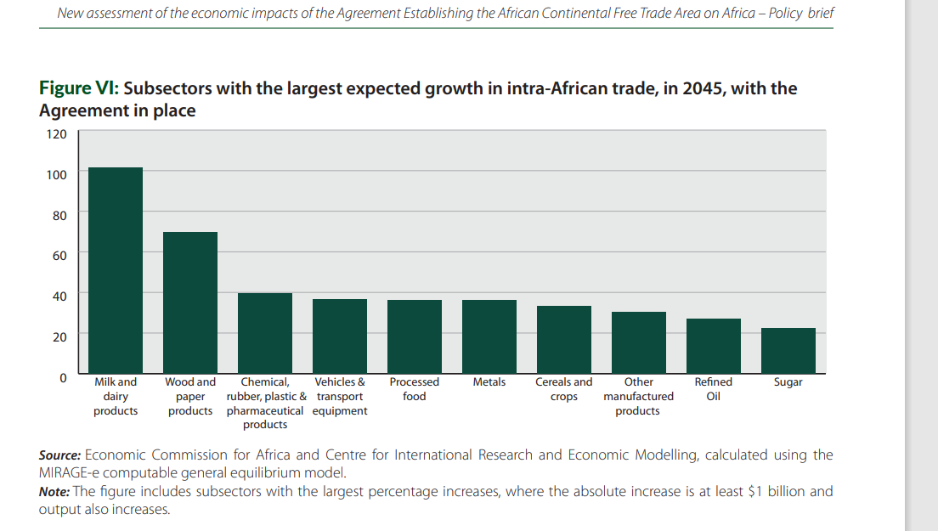
AfCFTA: expected impacts - intra-African exports
Top 10 gains in intra-African exports by sectors, as compared to the baseline without AfCFTA in place - 2045 - US$ bn (various scenarios)
Largest increases expected in exports of milk and dairy, wood and paper ,Chemical rubber , plastic and pharmaceutical products ,vehicles and transport, processed food , metals, Cereals and crops , other manufactured products, refined oils, sugar
Source: UNECA

Slide 17
AfCFTA and Inclusion (Women and Youth)
Agreement recognises the importance of gender equality and improving export capacity of informal suppliers, MSMEs, women/youth
Projected increases in exports of female-dominated sectors in manufacturing and agriculture and value addition along value chains
Projected increases intra-African exports in labour-intensive industries, low-skilled wages
Strengthening regional value chains, customs cooperation, trade facilitation
Mechanisms to address non-tariff barriers
Protocol on women and youth being developed

Slide 18
Deliberate actions to harness the benefits of the AfCFTA
Expected benefits from AfCFTA will not be automatic:
Pursue ratification of Agreement
Member States must
Implement Agreement effectively
Adopt AfCFTA Strategies & roll out Action Plans
Invest in skill development and education
Key role of Private Sector and development Partners
Infrastructure, Services (e.g. priority sectors, logistics, health & education), Goods (e.g. Agriculture, agro-processing, manufacture)
Invest in sectors of interest to them that are strategic for Africa & with potential for RVCs

Slide 19
Conclusion
AfCFTA implementation is crucial to build diversified and stronger African economies
Expected outcomes of the AfCFTA will not come overnight: integrated efforts needed at all levels for implementation
Need for deliberate actionsthrough effective and integrated strategies to maximize the benefits of the Agreement while minimizing potential risks;
Identification of opportunities for value chains development/integration;
Identification of constraints and definition of actions to address impediments;
Inclusive implementation of the AfCFTA
The private sector : pivotal in the AfCFTA implementation

Slide 20
THANK YOU!
www.uneca.org/atpc
Twitter: @atpc2
Facebook: @africantradepolicycentre
Email: eca-atpc@un.org
girma6@un.org Mahlet Girma Bekele

