Slide 1
Efforts in Supporting member States with technology in combating the impacts of the pandemic
15 May 2020

Slide 2
AFRICA COVID-19 COMMUNICATION & INFORMATION PLATFORM (ACCIP).

Slide 3
Background on ACCIP
The pandemic has already demonstrated impact beyond health, as there has already been notable socio- economic impacts necessitating urgent, effective and efficient intervention.
New initiative we are preparing to launch
Objective:
  to further support member states in their efforts towards combating the impact of the pandemic.
Focus
  enhancing the capability of governments across the African continent to communicate and interact with the citizenry in mitigating and managing the impacts of Covid-19.
  The ACCIP will complement the commendable work already in place or in planning by different governments and private sector.

Slide 4
Three Major components of the ACCIP-platform
A massive online digital data set covering public information on health, economy, livelihood and food security.
An Artificial Intelligence engine that explores, identifies and displays trends, information and insights and the answers to key questions which can determine where health interventions should be made, and how economic resources should be deployed; from thousands of sources including social media, covering Facebook, Twitter and WhatsApp.
Provides an inbound (USSD & IVR) communication tool (with customizable content for each country), which allows governments to conduct needs assessments (Health, Food, and Economic) as well as measuring the efficacy of current COVID 19 communication, and supplements and complement population screening (through a self-screener accessible to any citizen with a mobile device, including basic device users).
The true power of the platform is its ability to integrate both online broadband and mobile narrowband information, as well as facilitating collaboration across Mobile network operators to serve the people that live in the country.

Slide 5
Policy eXchange and peer Learning platform

Slide 6
Background on the Policy eXchange platform
Preparing to launch a peer exchange and e-learning platform for policy makers.
Policy and decision makers are inundated with addressing challenges and developing pragmatic solutions to national challenges as a result of the impact of the pandemic. This is all happening in real time.
Now more than ever, countries and policy makers need to learn from what has worked and what has not as they strive to address similar problems in their respective settings.
Objective :
The platform provides a safe haven for such policy and decision makers to come together and exchange solutions, good and promising practices as well as challenges with the aim of strengthening collaboration and learning.
Focus:
This space feeds also from the outcome of the AFRICA COVID-19 COMMUNICATION & INFORMATION PLATFORM (ACCIP) and is focused on converting the analytics towards possible lessons for policy and intervention design at member States level.

Slide 7
The Africa Pandemic Response Exchange Platform (APREX):

Slide 8
Background on the APREX
Afreximbank has received requests from African governments to provide them funds to buy Pharma products and PPEs but also expressed their need to be informed of potential suppliers as supplies from most traditional markets have blocked.
Objective:
to respond rapidly to gaps in the supply and policy for critical medical resources needed to combat the COVID-19 pandemic in Africa,
Focus:
ECA is supporting Afrixembank to develop an electronic platform for pooling supply/demand of the Covid-19 related pharmaceuticals and medical supplies such as face masks, personal protective equipment, test kits and ventilation machines.
This platform will enable suppliers (top Pharma and POE manufacturers in Africa identified by Afreximbank) and buyers (African governments) to trade covid19 products in a more transparency and more timely, reliable, and efficient manner as well as link them to both ends of the value chain i.e. to feed suppliers and feed traders or consumers (buyers).

Slide 9
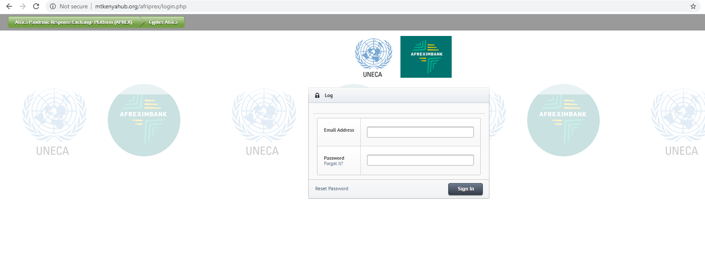
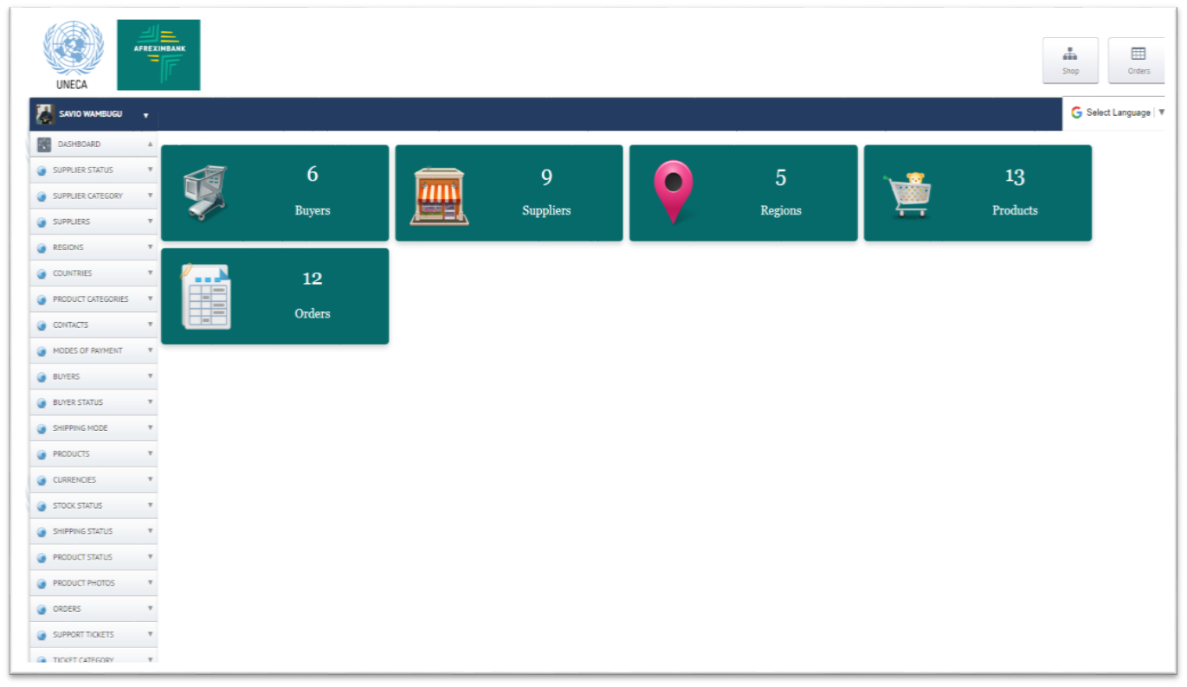
Accessing the system- beta version
Go to http://mtkenyahub.org/afriprex/

Slide 10
THANK YOU!

