Slide 1
Impacts of Covid19 on African Youth:
An Overview
Bakary DOSSO
Chief Demographic Dynamics for Development Center
ECA/SRO-WA
Niamey,Niger
June 4 , 2020
Niamey, Niger

Slide 2
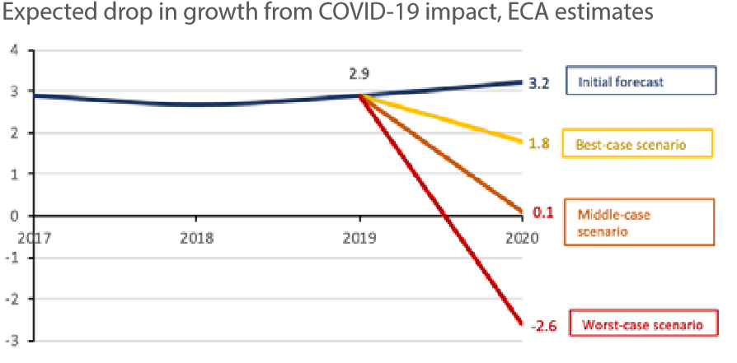
COVID-19: a health pandemic with major socio-economic impacts
The COVID-19 Pandemic is expected to reduce Africa’s 2020 GDP growth to 1.8% growth or in the worst case scenario, 2.6% contraction, further limiting governments’ abilities to effectively respond.
The disruption of the supply chains and the lockdown are producing huge unemployment and revenue losses and worsening poverty and inequality. This has the potential to push 27 million people into extreme poverty.
Young people (15-24), mostly depending on a rather widespread informal sector and SMEs, will be the most affected by the impacts of the pandemic.
Source: ECA, 2020
Notes:
According to the UN Secretary/UNESCO/ILO

Slide 3
Case study: Impact of COVID-19 on the private sector in Cameroon
Enterprises survey in Cameroon reveals that Informal production Units and SME are much more impacted by definitive and temporary closure of activities. Young people would therefore be more concerned
Source: ECA/SRO-CA

Slide 4
Case study: Impact on education in Southern Africa
Countries have implemented nation-wide school closures, with exception of Lesotho which has implemented localized closures
  48,365,522 learners from pre-primary to the tertiary levels have been affected: 48.9 per cent of females and 51.1 per cent of males
Countries have implemented measures such as digital distance learning via online platforms, TV and radio programs to help mitigate the adverse impacts
But persisting barriers: intermittent disruption of internet connectivity; limited access and high cost; intermittent cuts in power supply
  Internet penetration very low in countries like Malawi at 10% and highest in Mauritius, 56.5% and South Africa, 53.2%
Disrupted education may exacerbate teenage pregnancy and school dropout, undernutrition, deepen poverty and inequality gap especially for the under-privileged population of learners
  WFP school feeding disrupted in – DR Congo, Congo, Zambia, Malawi, Mozambique, Lesotho, Madagascar –2.2 million primary and pre-primary children reached in 2018

Slide 5
DEMOGRAPHY OF AFRICAN YOUTH IN 2020
 | 0-14 Years |  | 15-24 Years |  | 15-29 Years |  | 15-34 Years
 | M | F | M | F | M | F | M | F
Africa | 50.7% | 49.3% | 50.4% | 49.6% | 50.4% | 49.6% | 50.3% | 49.7%
Eastern Africa | 50.5% | 49.5% | 50.1% | 49.9% | 50.0% | 50.0% | 49.8% | 50.2%
Southern Africa | 50.5% | 49.5% | 50.3% | 49.7% | 50.3% | 49.7% | 50.3% | 49.7%
Western Africa | 50.9% | 49.1% | 50.7% | 49.3% | 50.6% | 49.4% | 50.6% | 49.4%
Northen Africa | 51.2% | 48.8% | 51.1% | 48.9% | 50.9% | 49.1% | 50.7% | 49.3%
Total Population Africa in 2020: 1,340 millions
Population 15-24 years: 254 millions
Source: ECA based on UNDESA
Notes:
Total Population Africa (2020) : 1,340,598 including 0-34 : 992,042.

Slide 6
DEMOGRAPHY OF AFRICAN YOUTH IN 2020
Source: ECA based on ILO (2020)
Source: ECA based on UNDESA

Slide 7

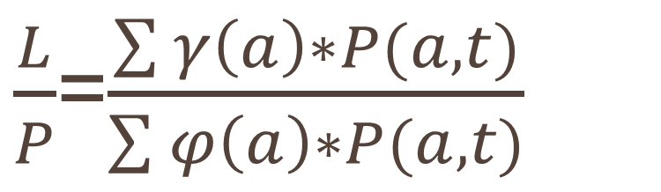
Economic Support Ratio
𝛾
represents purchasing power of each age group
THE RATIO BETWEEN THE NUMBER OF EFFECTIVE PRODUCERS AND THE NUMBER OF EFFECTIVE CONSUMERS
𝜑
represents the distribution of consumption needs by age
THE GROWTH RATE OF THE SUPPORT RATIO REPRESENTS THE FIRST DEMOGRAPHIC DIVIDEND

Slide 8
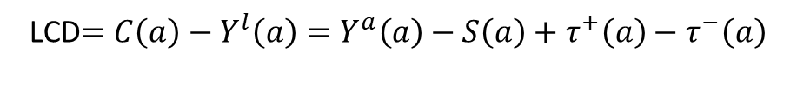

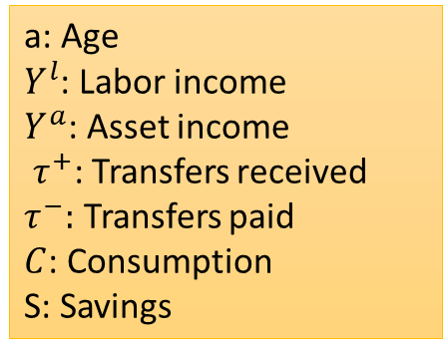
Life Cycle Deficit (LCD)
At each age, a:
Fundamental Equation of NTA
$Y^{l}\left(a\right)+Y^{a}\left(a\right)+τ^{+}\left(a\right)$=$C\left(a\right)+S\left(a\right)$+ $τ^{−}\left(a\right)$
a: Age
$Y^{l}$: Labor income
$Y^{a}$: Asset income
$τ^{+}$: Transfers received
$τ^{−}:$ Transfers paid
$C$: Consumption
S: Savings
Life Cycle Deficit (LCD): consumption needs to satisfy at each age
LCD$=C\left(a\right)−Y^{l}\left(a\right)=Y^{a}\left(a\right)−S\left(a\right)+τ^{+}\left(a\right)−τ^{−}\left(a\right)$
Life Cycle Deficit
Asset redeployment
Net transfers
Year based Redeployment
A positive LCD(a) indicates a consumption surplus (or income deficit) requiring reallocations from other age groups with income surplus.
A negative LCD(a) means a surplus of income, which can be used to finance the consumption of deficit age groups

Slide 9
START and END YEAR OF GENERATION OF SURPLUS
 | Start year of surplus | End year of Surplus | Duration of Surplus
Central Africa | 28 | 64 | 36
Northern Africa | 23 | 56 | 33
Southern Africa | 26 | 57 | 31
Western Africa (ECOWAS) | 31 | 62 | 31
Eastern Africa | 26 | 56 | 30
Source: CREG estimates, 2020
The earliest surplus starts at 23 years in Northern Africa and the latest at 31 years in Western Africa
The highest duration of surplus is 36 years and is observed in Central Africa and the smallest duration is 30 years in Eastern Africa

Slide 10
LIFE CYCLE DEFICIT FOR YOUTH
 | LCD Global 15-24 (Billions USD) | LCD Global 15-29 (Billions USD) | LCD Global 15-34 (Billions USD) | LCD Global 15-24 as % GDP | LCD Global 15-29 as % GDP | LCD Global Youth 15-34 as % GDP
Eastern Africa | 47.54 | 43.57 | 26.16 | 6.7% | 6.1% | 3.7%
Central Africa | 17.85 | 13.24 | 3.32 | 3.8% | 2.8% | 0.7%
Northern Africa | 143.53 | 12.91 | -133.52 | 6.8% | 0.6% | -6.3%
Southern Africa | 80.29 | 74.50 | 59.81 | 10.6% | 9.8% | 7.9%
Western Africa | 206.46 | 249.57 | 243.69 | 14.3% | 17.3% | 16.9%
Source: CREG estimates, 2020
Life Cycle deficit for youth ranges between 0.7% (Central Africa) to 16.9% (Western Africa) of GDP for all the regions except Northern Africa
In Northern Africa, Youth generates a surplus of 6.3% of GDP and this ressource is reallocated to other age groups

Slide 11
POTENTIAL GAINS as percentage of GDP TO PROVIDE JOBS TO YOUTH
The potential GDP gain is $78 billion/year, if Youth from 15 to the start year of surplus, who are NEET were provided jobs that allow them to just cover their deficit:
Source: CREG estimates, 2020
Notes:
Assumptions to compute the potential gains: (Neet ratio*LCD youth 15-24 + full LCD for Youth 25-start year of surplus)/GDP_PPP_current 2014

Slide 12
ECONOMIC SUPPORT RATIO & 1st DD
Support Ratio of West Africa and East Africa are increasing while that of other regions have a downward trend
SR: West : 43% to 59% from 2020 to 2095; Central :50% to 44% on the same period
Window of Opportunity closed for Northern Africa at the beginning of the last decade
Window of Opportunity will be closed for the Southern Africa in 2040, between 2055-2060 for the Central Africa and for Eastern Africa in 2080
Window will not be closed for Western Africa before 2100
Source: CREG estimates, 2020

Slide 13
COST OF INACTION
The health crisis could become a structural crisis with a loss of productivity and could harm youth economic potentials
The COVID19 could cause a loss of 1% to 2% of SR. In normal situations, 5 years are required to get at 1% of Support ratio (SR).
Need to provide employment opportunities to youth not only to benefit from their potentials but also to avoid a crisis similar to the Arab spring in other regions: probably around 2040 for Southern Africa, 2060 for Middle Africa, 2080 for Eastern Africa.
Notes:
(evidence of Côte d’Ivoire during the crisis 1999-2012; Burkina Faso 2003-2008)

Slide 14
Observations, Mitigations
Observations
Some Mitigations
Tracking socioeconomic effects of covid-19 is not disaggregated by sex, neither does it take youth into consideration;
Handling of the pandemic is gender blind;
Draw lessons from Ebola when women suffered setbacks
Support firms (tax measures, financing partial unemployed workers, guaranteed loans and special lines of credit etc.)
Support workers and vulnerable populations through targeted policies and wide social protection measures (cash transfers, food aid, unemployment benefits and paid sick leave protection, food access etc.).
Minimize disruptions to supply chains;
Encourage the use of technology for financial transactions
Support the vulnerable through social protection measures including food aid

Slide 15
Opportunities and Conclusions
Africa’s young people are pivotal to its growth and sustainable development.
  The potential GDP gain is $78 billion/year, if Youth from 15 to the start year of surplus, who are NEET are provided jobs that allow them to just cover their deficit:
To fully exploit the potential demographic dividend, Governments need not only to maintain their current level of services, but also to increase per capita investments in health, education, infrastructure and in the future of work
Unfortunately, COVID-19 threatens to undermine gains in efforts made to integrate youth into Africa’s productive labour force with implications for the SDGs Agenda 2030 and Agenda 2063
  The burden of mortality falls on the older population but the socioeconomic impacts are felt by the younger population
  Women and other vulnerable groups (people living with disability, HIV, etc.) need to be prioritized for interventions
The voices, and contribution of African Youth are critical in shaping the narrative for building back better Africa’s economic and social fabrics
Fostering of innovation, entrepreneurship and technology to transform challenges of COVID-19 into opportunities is therefore key for dialogue

Slide 16
THANK YOU!

