Slide 1
INFF Building Block 4
Governance and
Coordination
DESA/FSDO
26 August 2021

Slide 2
Where does it fit?
Inception phase: stakeholder mapping; scoping of existing institutions and processes related to financing; identification of institutional home for INFF (and selection of INFF Oversight Committee)
Building Block 1 Assessment and diagnostics: engagement of all relevant stakeholders within and beyond government to accurately reflect financing needs, challenges, opportunities, exposure and vulnerabilities to different risks
Building Block 2 Financing strategy: involvement of all relevant stakeholders for design of coherent financing policy solutions
Building Block 3 Monitoring and review: governance arrangements underpin adequate transparency and accountability

Slide 3
Why is it important?
Driver of overall effectiveness
  Guides entire INFF process
  Ensures country ownership and leadership
  Strengthens intra-governmental collaboration and multi-stakeholder participation
  Enhances coordination with development partners
  Overcomes siloes and increases coherence and integration of existing approaches and processes

Slide 4
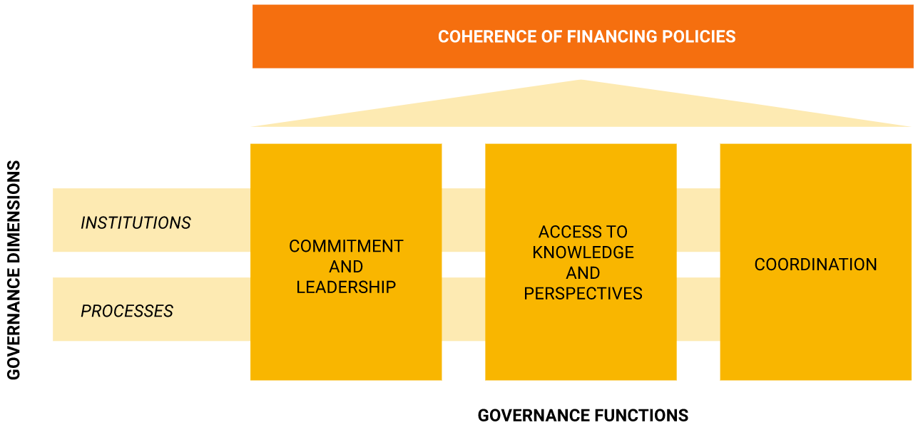
Key functions of INFF governance
Form of governance arrangements will vary across contexts.
Functions will be common, to support increased coherence of financing policies.

Slide 5


Suggested approach
STEP 1
STEP 2
IDENTIFY AND ASSESS EXISTING GOVERNANCE ARRANGEMENTS
ENHANCE COHERENCE, CLOSE GAPS IF NEEDED
Identify and assess the institutions and processes that exist to guide, enable and support (coherent) financing policy making:
Commitment and leadership
Access to knowledge and perspectives
Coordination
[Self-assessment questions are included in the guidance].
Establish how to strengthen existing arrangements, based on:
Appropriate level of ambition
Available capacity and resources
Objectives identified in the financing strategy.
[Typical challenges and steps to overcome them are included in the guidance].

Slide 6
Step 1: Identify and assess exisiting governance arrangements
Checklist of self-assessment questions + findings from the scoping of relevant institutional mechanisms, bodies and processes and the stakeholder mapping undertaken as part of the inception phase can inform this step
Commitment and leadership
  Clear commitment and mandate from highest political level
  Sustainability features
  Institutional catalyst with required authority and convening power
  Capacity building measures for state and non-state actors

Slide 7
Step 1 (cont‘d)
Access to knowledge and perspectives
  Commitment and rationale for INFF
  Mechanisms for information exchanges within government and with other partners
  Transparent reporting on financing
  Mechanisms to assess and review financing policies
Coordination
  Clearly defined roles and responsibilities
  Intra-governmental mechanisms
  Mechanisms for coordination with development partners
  Mechanisms for aligning private finance with national priorities
  Use of national processes to encourage an integrated approach to financing

Slide 8
Step 2: Enhance coherence of existing governance arrangements, close gaps if needed
Baseline from Step 1 will drive determination of appropriate level of ambition for Step 2
Priority may be given to strengthen institutions and processes related to a specific financing policy area with the view of encouraging a more comprehensive approach over time.
How to increase commitment and leadership:
  Sustain interest and buy-in
  Address capacity gaps

Slide 9
Step 2 (cont‘d)
How to increase access to knowledge and perspectives:
  Strengthen dialogue and participation
  Improve transparency and accountability
How to increase coordination:
  Define clear roles and responsibilities
  Encourage effective collaboration among stakeholders
  Incentivise alignment of all types of finance with national priorities

Slide 10
Guiding principles and key lessons
Enhancing coherence is a moving target (appropriate level of ambition will depend on context, resources, capacity and financing strategy objectives)
Build on what is already in place, only add if there are gaps (opportunity to identify, assess and streamline existing governance and coordination structures and mechanisms)
Consider both top-down institutional structures and other complementary mechanisms (such as specific tools, incentives, financing instruments)
Overcome silos (process must be country-led, mandated from the highest political level and supported by senior technical officials across relevant ministries)

Slide 11
Thank you!
You can access the IATF global guidance on Building Block 4 Governance and Coordination at:
https://inff.org/report/governance-and-coordination-report

Slide 12
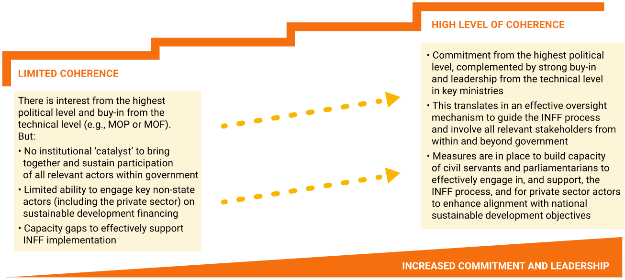
Levels of commitment and leadership: stylized examples

Slide 13
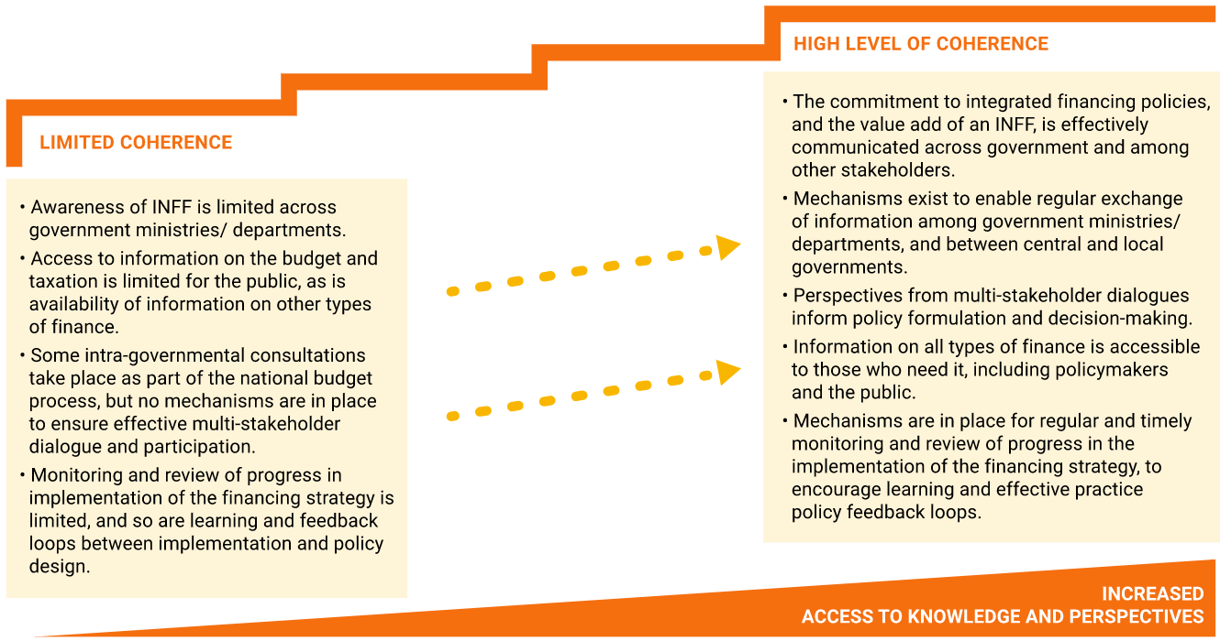
Levels of access to knowledge and perspectives: stylized examples

Slide 14
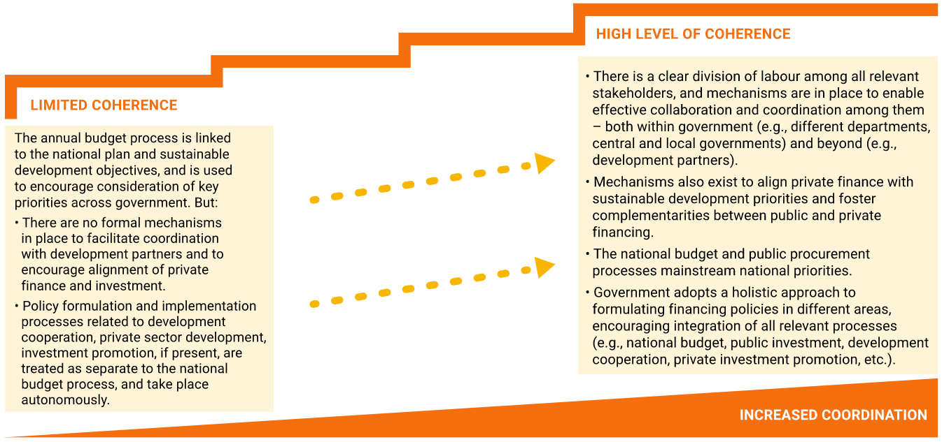
Levels of coordination: stylized examples

