Slide 1
Regional Cooperation: Impact of COVID-19 on Transport and Trade in Africa
Economic Commission for Africa
10 September 2020
Addis Ababa, Ethiopia
Notes:
ROBERT LISINGE/SOTERI: Transition statement from previous presentation
This project builds on the findings of the CBT report just presented by including the transport angle and focusing on solutions for regional cooperation. This presentation highlights the preliminary findings in Phase 1 of this project, which will be validated as part of the next steps.

Slide 2
Background & Objective
Joint UN project launched May 2020
  ECA’s focus: regional cooperation for mitigating border disruptions
Phase 1: Identify critical areas for immediate actions
  Collect data on the impact of COVID-19 on transport and trade
  Document responses by RECs and members at ports and crossings
  Briefly assess the impact of these measures on trade and transport
  Suggest possible policy recommendations that support regional cooperation and areas for further work to inform Phases 2 and 3
Notes:
ROBERT LISINGE/SOTERI (1min)
UN project: implement UN solutions, standards, guidelines, metrics, tools and methodologies to help build transport, trade and logistics resilience in the wake of COVID-19, with UNCTAD and other UN RCs
Collect data on the impact of COVID-19 on transport and trade
Document responses by RECs and their members at ports and strategic checkpoints along trade and transport routes/corridors
Briefly assess the impact of these measures on trade and transport
Suggest possible policy recommendations that support regional collaboration and areas for further work to inform Phases 2 and 3
draft report for Phase I aims to collect data on the impact of COVID-19 on transport and trade, document in detail responses by RECs and their members at ports and strategic checkpoints along trade and transport routes/corridors, briefly assess the impact of these measures on trade and transport, and design policy recommendations that support regional collaboration. It includes information made available by AUC, RECs, national authorities, and partners, results of surveys done of member states, and data on trade and transport flows. Using the Northern Corridor as a pilot, the report documents trends in volumes and transit times for goods traded across borders and through ports. It touches on topics such as the status of border entry points, status and considerations for landlocked developing countries (LLDCs), changes in the use of rail, the use of digital technology, and public-private partnerships, among others. The Phase I report can be shared with colleagues following internal review.

Slide 3
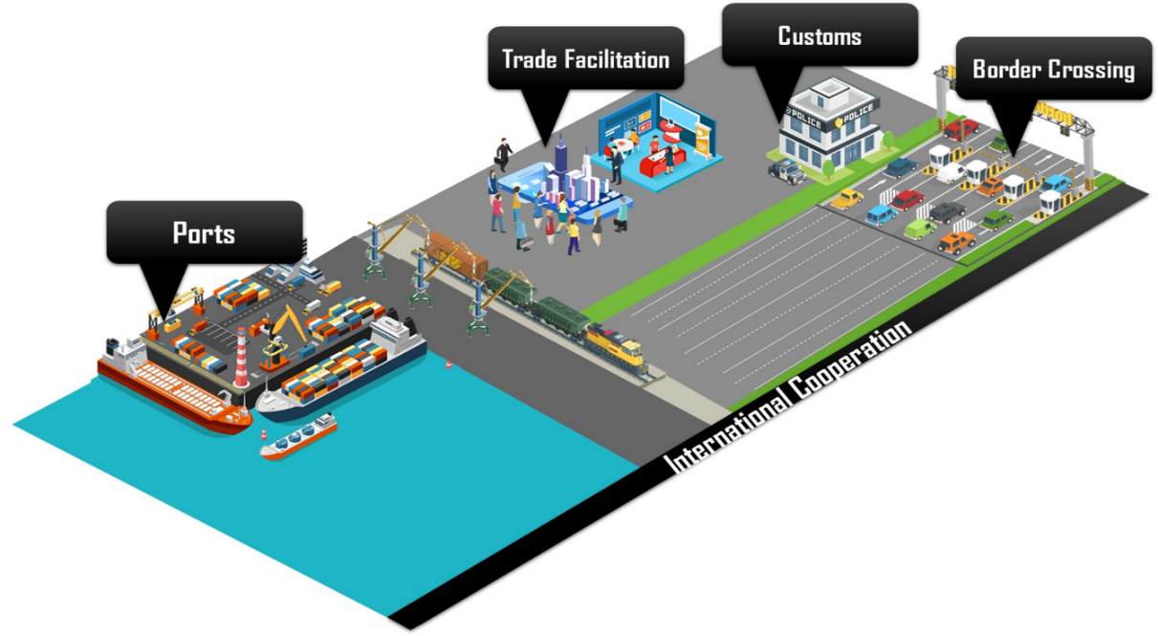
Approach & Methodology
Cross-border trade & transport along corridors
Mechanisms for regional integration
  RECs: Coordination framework
  for policy guidelines
  CMIs: Data and monitoring
Case Studies: COMESA and Northern Corridor
Methods: secondary data and data analysis of transit and trade flows
Preparation for survey of key stakeholders & expansion of methodology
Notes:
DR OKELLO (1 min)
FOCUS ON SHORT-TERM IMPACTS AND AREAS OF IMMEDIATE RESPONSE IN RECS AND CMIS. SCOPE LIMITED TO EAST AFRICAN REGION. NO DIRECT SURVEYS CARRIED OUT. USED SECONDARY DATA. RESULTS TO BE VALIDATED IN OTHER REGIONS AS PART OF PHASE II PROJECT.
UNCTAD partners focusing on maritime aspects – (one discussant is from UNCTAD)
Methods – secondary data
Desk research/literature review
Results of COMESA member states survey and Afreximbank Trade Finance Survey 2020
Data analysis of transit changes and trade flows
It includes information made available by AUC, RECs, national authorities, and partners, results of surveys done of member states, and data on trade and transport flows. Using the Northern Corridor as a pilot, the report documents trends in volumes and transit times for goods traded across borders and through ports. It touches on topics such as the status of border entry points, status and considerations for landlocked developing countries (LLDCs), changes in the use of rail, the use of digital technology, and public-private partnerships, among others. The Phase I report can be shared with colleagues following internal review.

Slide 4

Preliminary Findings: Regional Response
Documentation of measures of RECs
Building on CBT project
Including ECCAS and transport/transit focus
Coordination at REC Level:
Coordination Committees (Hospital/Ministerial/Technical/Operational)
Agreed Policy Guidelines for Coordinated Action at National & Regional Levels
Follow-up Actions at National Level
Notes:
DR OKELLO (0.5min)
REFER TO TABLE COMPARING REC GUIDELINES FROM CBT PRESENTATION, our report builds on the transport angle.
(no need to go into detail on the national level or the guidelines since they will already have been presented)
COUNTRIES RECOGNIZED NEED FOR COORDINATION. RECS PROVIDED NATURAL FRAMEWORKS FOR THIS.
COORDINATION AT DIFFERENT LEVELS. SIMILARITIES IN GUIDELINES OF THE VARIOUS RECS – REVIEW EACH REC: (EAC, COMESA, SADC, ECOWAS, ECCAS.} ALL ESTABLISHED DASHBOARDS ON COVID STATUS IN MEMBER STATES (EXC. ECCAS). COORDINATION INCLUDED CROSS_BORDER TRANSPORT AND TRADE. EACH REC AGREED POST-COVID RESPONSE.

Slide 5
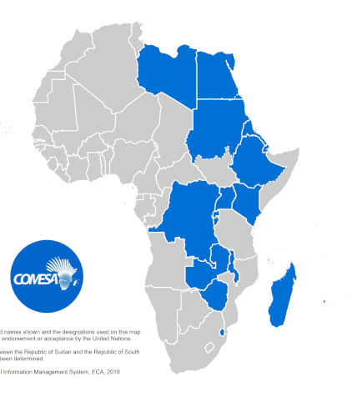
Impact on Trade for LLDCs & SIDS – Case Study: COMESA
Trade Flows in 5 Countries
  Malawi, Zambia (SADC LLDC); Rwanda, Uganda (EAC LLDCs); Madagascar (SIDS)
All countries report immediate significant drops in all aspects of trade (imports, exports, customs duty receipts), March-April 2020
Reported challenges include increased time taken due to COVID-19 measures, low customs receipts, low use of e-payments
Notes:
DR OKELLO (1min)
WHY COMESA? IT HAS BEEN CLOSELY MONITORING ECONOMIC IMPACT ON REPORTING COUNTRIES. COMESASTAT GRANTED ACCESS TO CONSULTANTS.
Trade Flows in 5 Countries (LLDCs/SIDs):
Malawi, Zambia – SADC Region LLDC
Rwanda, Uganda – EAC Region LLDC
Madagascar – SIDS

Slide 6
Finance for Trade Facilitation
Trade finance gap estimated at USD 82 billion (AfDB, 2020)
Measures introducing flexibility most widespread across COMESA
Rapid emergency facilities for banks and SMEs in critical sectors required
Financing should support trade facilitation
AfCFTA implementation supports resiliency
Source: Authors’ calculation based on Afreximbank Trade Finance Survey, 2020
Notes:
DR OKELLO (0.5min) – can remove if not relevant
Trade finance gap estimated at USD 82 billion (AfDB, 2020) and increasing
Measures aimed at introducing more flexibility to terms and conditions of official support most widespread across COMESA
Many focused on existing transactions
Some directed towards potential transactions
Measures to increase availability of working capital financing in response to supply shock popular among insurance/credit agencies
Rapid emergency facilities for banks and SMEs in critical sectors are required
Financing should support trade facilitation to ensure new measures do not become barriers;
Implementing AfCFTA fully would help usher in the kinds of deep reforms necessary to enhance economic growth/recovery in the face of future crisis/shocks such as this (Covid-19 and beyond to shorten the time to recoup) through measures…, in particular on TF, transit & customs cooperation protocols (esp. in annex 3 & 4).

Slide 7
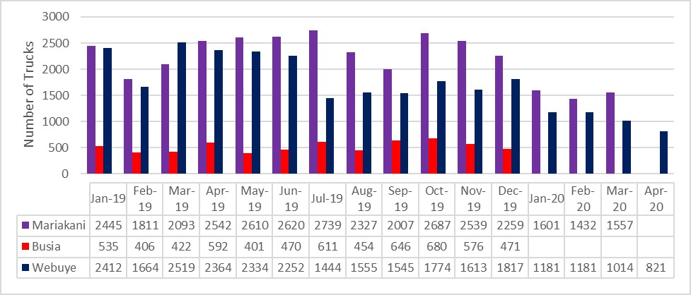
Impact on Transport – Transit Case Study: Northern Corridor
Port of Mombasa: Reduced traffic but no major impact on operations
Interventions implemented before COVID-19 at borders have maintained transit times
Weighbridge
Traffic,
Jan 2019 - April 2020
Notes:
DR OKELLO (2min)
NCTTCA Case Study (Kenya, Uganda, Rwanda, Burundi, DRC, South Sudan)
IMPACT OF COVID-19 GREATEST IN LLDCS – TRANSIT TRANSPORT. NORTHERN CORRIDOR AS EXAMPLE. RECENT GAINS IN TRADE AND TRANSPORT FACILITATION REVERSED BY COVID-19. TRANSPORT OBSERVATORY PROVIDES TIMELY INFORMATION ON CORRIDOR OPERATIONS IN ITS DASHBOARD. ANALYSIS AT CRITICAL NODES: PORT OF MOMBASA; TRANSIT IN KENYA; BORDER OPERATIONS; TRANSIT IN UGANDA, RWANDA AND BURUNDI.
Number of ships comparable to same time last year
Reduction in traffic from the port as indicated by traffic weighed at Mariakani
Transit traffic at Webuye drastically reduced from 1,817 (Dec 2019) to ~821 (April 2020)

Slide 8
Impact on Transport – Transit Case Study: Northern Corridor
Corridor Transit Times: No major disruptions (except in Rwanda)
From Mombasa port: Significant increase Jan to March, decline in June
Rwanda: trends follow COVID-19 measures after reduced times in 2019
  Road improvements, one-stop border points, and single customs territory
Source: Authors’ calculation based on Northern Corridor Observatory Dashboard
Notes:
DR OKELLO (2min)
IMPACT OF COVID-19 GREATEST IN LLDCS – TRANSIT TRANSPORT. NORTHERN CORRIDOR AS EXAMPLE. RECENT GAINS IN TRADE AND TRANSPORT FACILITATION REVERSED BY COVID-19. TRANSPORT OBSERVATORY PROVIDES TIMELY INFORMATION ON CORRIDOR OPERATIONS IN ITS DASHBOARD. ANALYSIS AT CRITICAL NODES: PORT OF MOMBASA; TRANSIT IN KENYA; BORDER OPERATIONS; TRANSIT IN UGANDA, RWANDA AND BURUNDI.
From Mombasa port: Significant increase from 77 hrs (Jan) to peak of 191 (March), slight decline to 115 (June), mainly due to delays at Malaba, with new measures sustaining trends
Uganda to DRC and South Sudan: no significant changes, drivers encouraged to not stop
Burundi: transit times spiked in Feb only
Rwanda: overall increase from Jan to June, peaking in April, in line with movement restrictions
Prior to COVID-19 certain routes saw reduced times due to road improvements, one-stop border points, and single customs territory implementation

Slide 9
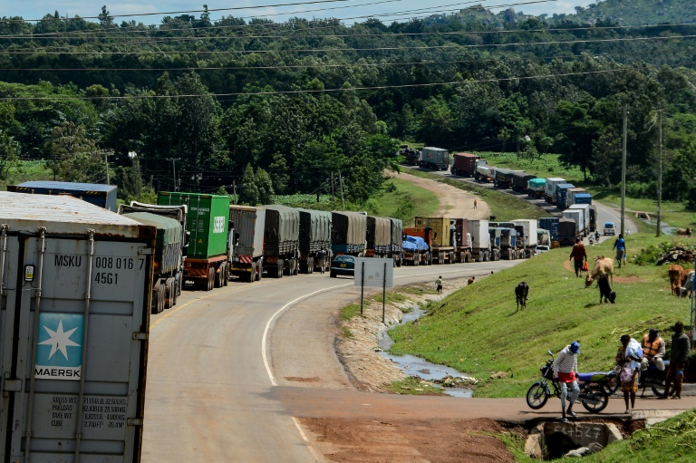
Impact on Transport – Transit Case Study: Northern Corridor
Border Crossing Points: Major delays due to health checks, customs operations
National measures at entry points at designated weighbridges
Digital surveillance tracker for drivers adopted by EAC
Public-private partnership – National Logistics Platform
Truck drivers stuck along Bungoma-Malaba highway
Source: AFP
Notes:
DR OKELLO (1min)
IMPACT OF COVID-19 GREATEST IN LLDCS – TRANSIT TRANSPORT. NORTHERN CORRIDOR AS EXAMPLE. RECENT GAINS IN TRADE AND TRANSPORT FACILITATION REVERSED BY COVID-19. TRANSPORT OBSERVATORY PROVIDES TIMELY INFORMATION ON CORRIDOR OPERATIONS IN ITS DASHBOARD. ANALYSIS AT CRITICAL NODES: PORT OF MOMBASA; TRANSIT IN KENYA; BORDER OPERATIONS; TRANSIT IN UGANDA, RWANDA AND BURUNDI.
Digital surveillance tracker for drivers adopted by EAC as part of Regional Electronic Cargo and Drivers Tracking System

Slide 10
Critical Areas Identified: Impact on Key Stakeholders
Key Stakeholders
Transport Operators
Transport Users
Service Providers
Customs Agents
Border Agencies
Transport Regulators
Areas for investigation:
Trade and trade-related measures
Port Operations
Transport Logistics
Border Controls
Customs Control
Highway Operations
Notes:
DR OKELLO (0.5min)

Slide 11
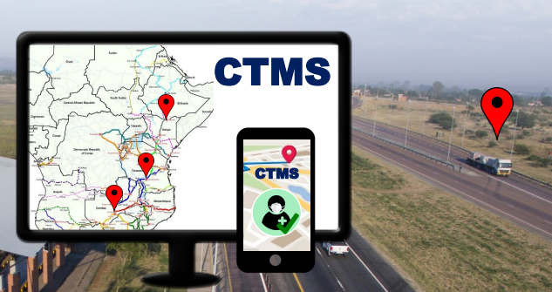
Policy Recommendations
Increased use of ICT Capabilities and Digital Solutions
  Develop/implement Corridor Trip Monitoring System, vehicle monitoring/tracking systems
  Implement COMESA Digital Free Trade Area
  Use mobile tech to improve contact tracing
  Promote use of single windows, trade info portals, e-commerce, mobile payments, required infrastructure, and related policies
  Investigate successes and apply across RECs
Corridor Trip Monitoring System
Source: SADC, Aug 2020
Notes:
ROBERT LISINGE/SOTERI (2min)
This recommendations informs the focus of Phase 2
RECOMMENDED COMMON ACTION BY EACH REC INDIVIDUALLY. AIMED AT ENHANCING BUSINESS CONTINUITY BY IMPROVING TRADE FACILITATION. ALSO REDUCES HUMAN CONTACTS.
Develop and implement Corridor Trip Monitoring System in regional corridors
Develop vehicle monitoring and tracking systems along corridors
Implement COMESA Digital Free Trade Area
Use mobile tech to strengthen contact tracing
Promote use of single windows, trade info portals
Promote e-commerce to limit physical interaction (adequate ICT infrastructure, relevant data privacy and cybersecurity policies)
Promote use of mobile payments systems for cross-border transfers (cashless policy)
Investigate successes and apply across RECs
examples
(Northern Corridor Regional Electronic Cargo Tracking Systems (RECTS); ASYCUDA; ECOWAS Inter-connected Goods and Transit Management System (SIGMAT)

Slide 12

Policy Recommendations
Development of Multi-modal and Inter-modal Transportation Systems
  Develop ICD to decongest seaports & border posts for customs clearance and as advanced logistics hub
  Rehabilitate and extend rail services
  Rehabilitate, upgrade marine transportation
Development of Roadside Truck Stops along Transit Corridors
  Develop roadside stations, wellness centres, as multi-purpose facility
  Minimise possible interaction between truck drivers and local communities
  Serve as checkpoints for tracing drivers
Notes:
ROBERT LISINGE/SOTERI (1min)
Development of Multi-modal and Inter-modal Transportation Systems
Develop ICD to decongest seaports and border posts for customs clearance and as advanced logistics hub for interoperability between different modes of transport
Rehabilitate and extend rail services in the region for inter-modal connectivity
Rehabilitate and upgrade marine transportation
NEED TO REDUCE DEPENDENCE ON TRUCKS FOR ALL TRANSPORTATION IN AFRICA: REDUCE LEVEL OF VIRUS TRANSMISSION BY TRANSBORDER TRUCK DRIVERS; INCREASED EFFICIENCY OF TRANSPORTATION SYSTEM AS A WHOLE; ENVIRONMENTAL IMPACT; REDUCED COST.
Development of Roadside Truck Stops along Transit Corridors
Develop special roadside stations and wellness centres at selected locations
Develop multi-purpose facility providing food, rest and accommodation, vehicle service and refueling, medical emergency, etc. equipped with health facilities
Minimise possible interaction between truck drivers and local communities
Serve as checkpoints for tracing drivers
PROMOTES SAFE AND EFFICIENT TRANSPORT SYSTEM.
examples
Rehabilitation and upgrading of marine transportation (ferries, piloting, navigation and safety systems, and marine security)

Slide 13
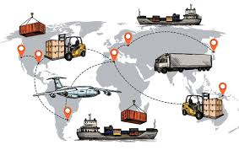
Additional Recommendations
Development of transport corridor observatories
Enhanced role of private sector in regional cooperation on transport/trade
AfCFTA implementation to enhance regional cooperation
Trade finance for recommended trade facilitation measures
Regional cooperation for countering the illicit trade of pharmaceuticals
Diversification of sources of sustainable energy
  Particular attention to LLDCs and SIDS
Notes:
ROBERT LISINGE/SOTERI (1min)

Slide 14
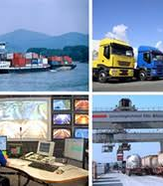
Way Forward: Phases 2 and 3
Peer review to validate findings, recommendations
Consider implications for future work and collaboration
Phase 2
Replicate methodology for other corridors
Conduct survey of key stakeholders
Investigate link between regional measures and trends in transport and trade flows, volumes, and transit times
Focus on inclusive scale-up of digital solutions for resilience
Understand how to sustain increased regional cooperation for trade facilitation
Phase 3
Recommend measures for regional cooperation to support transport and trade facilitation during border disruptions, with UNCTAD and RCs
Host capacity building webinars for RECs and CMIs with experts and partners
Where possible, support implementation of recommendations and assessments of effectiveness
Notes:
ROBERT LISINGE/SOTERI (2min)
Phase 2:
Replicate methodology for other corridors and conduct survey of key stakeholders
Investigate link between regional measures put in place before and during the pandemic, and changes in transport and trade flows, volumes, and transit times
Focus on scale-up of digital solutions for resilience while accounting for marginalized groups
Understand how to sustain increased regional cooperation for trade facilitation
Phase 3:
Make recommendations on measures for regional cooperation to support transport and trade facilitation during border disruptions, in collaboration with UNCTAD and RCs
Host capacity building webinars for RECs and CMIs with experts and partners
Where possible, support implement of recommendations and assessments of effectiveness
The emphasis is on the primacy of regional cooperation to implement these solutions. This is clear in its importance in keeping transport and trade possible during COVID-19. Therefore, RECs and CMIs need to be key points in implementing solutions going forward, particularly in the context of the AfCFTA. Phase II and III also include plans to conduct capacity building workshops for these institutions, in addition to port management and cross-border authorities.
Analysis to follow will assess the effectiveness of these mitigating measures in terms of sustaining transport and trade flows, volumes, and times. ECA is also planning a survey of key stakeholders in partnership with UNCTAD, including of mid-level staff at ports and border crossings, and transport companies, to gain their perspectives on the effectiveness of measures at an implementation level.
Phase II over the next six months, followed by Phase III, will build on this analysis, make recommendations on regional cooperation for transport and trade facilitation, including digital solutions, and support capacity building. Analysis during this phase may include a look at:
the effectiveness of previously implemented digital solutions to help mitigate the impacts of COVID-19 related downturns and closures, i.e. ports such as Mombasa who had digital scanning prior to COVID, compared to those ports who did not have it;
measures and interventions, especially digital but also otherwise, that have been implemented during the COVID period to mitigate the effects of COVID, and the perceptions of their success;
leveraging the increased cooperation made possible during this time, especially on areas such as customs cooperation, that might have taken longer in non-emergency times, and apply this process and willingness/ability to cooperate to difficult issues that require cooperation such as cashless transfer options (eg cashless transfers and cross-border mobile money); and
using lessons learned to propose longer-term digital and process-related interventions that would create resilience in the face of future disruptions, but also to accelerate progress on transport and trade in normal times and reduce possibilities for human distortions or errors.
ECA emphasises the need to ensure the implementation of digital solutions considers vulnerable groups such as women as they tend to have lower levels of digital literacy, lower access to digital solutions, higher levels of being unbanked, etc. Solutions should take into account additional training, interventions to improve access, digital infrastructure improvements, among other options.
In the longer term, ECA aims to inform the implementation of the successful measures on a larger scale and also to encourage measurements of their impacts over a longer period intentionally, including a baseline and trends over time.

Slide 15


