Slide 1
BEV initiative in the DRC : harnessing
the potential of AfCFT A
Jean-Marc Kilolo, PhD, MBA
UNECA SRO-CA
ICE Meeting, Seychelles
November 2022

Slide 2
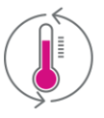
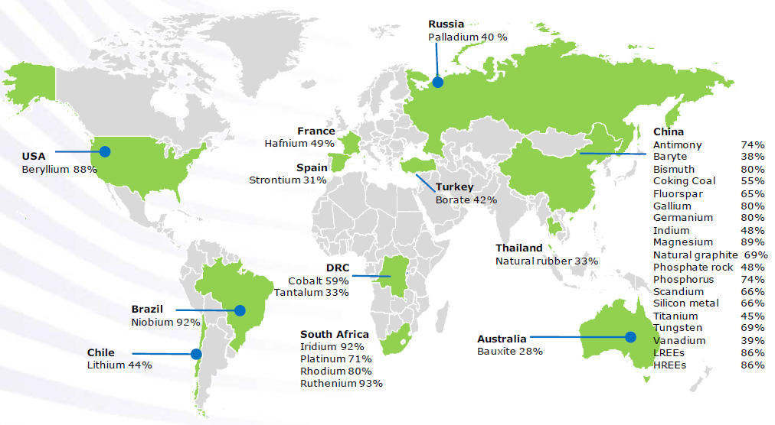
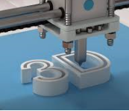
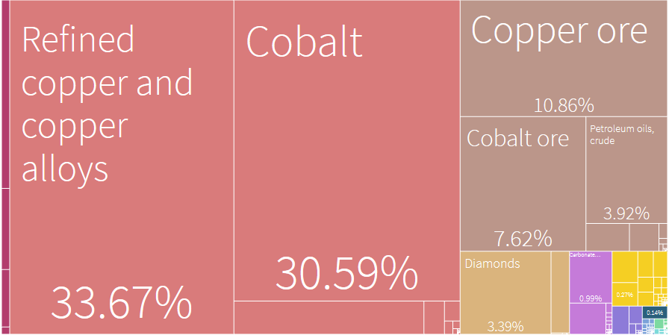
Megatrends
Source: EU on CRMs, 2020
Scandale géologique
Potentiel agricole énorme (2e après Brésil) …
Mais aussi
Very Poor population: ±¾ of people live with < 1.90$/day
Doing Business : 184/190.
GDP per capita: $501
Massive Unemployment
Energy transition metals: copper, nickel, cobalt and lithium
Top 3 export destinations
51.01%
China
12.51%
Zambia
7.63%
UAE
Notes:
The energy transition requires substantial amounts of metals such as copper, nickel, cobalt and lithium.

Slide 3
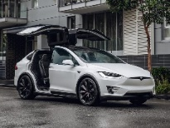
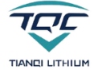
BEV initiative in the DRC : moving up the ladder
Capture opportunity post Covid-19
Understanding the supply chain
Africa’s focus
Mining
Metals
Precursor
Production
Cell
Production
Cell Assembling
Electric Vehicles
Nickel
Lithium
Cobalt
Smelt and refine
Precursor
Cells
Battery
$11b
$44b
$271b
$387b
$1.18t
$7t+
Market Value by 2025
Source: BloombergNEF, Australia Government’s Future Batteries Industry CRC

Slide 4
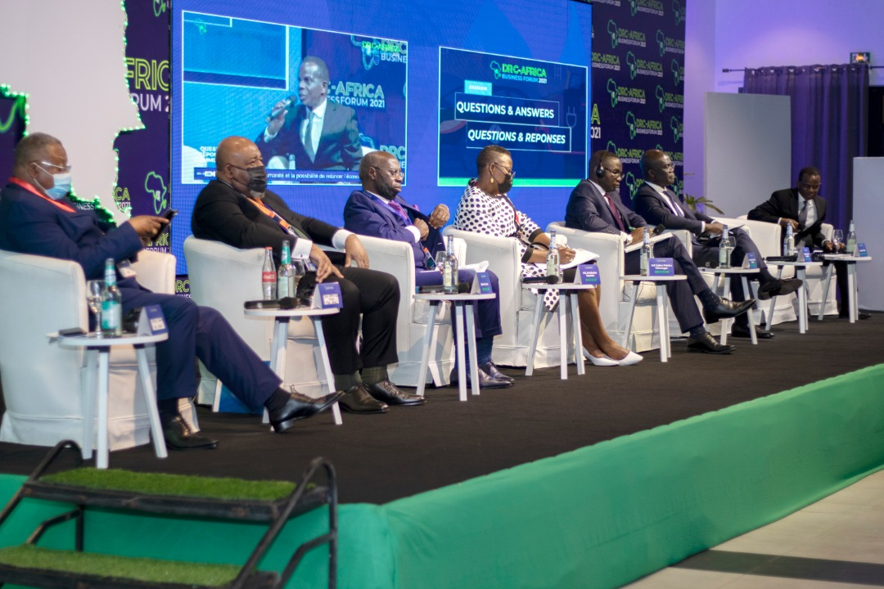
ECA supported the organisation of the DRC-Africa Business Forum on the battery value chain
In November 2021, the government of the Democratic Republic of Congo (DRC) organized in Kinshasa, with the support of the Economic Commission for Africa (ECA) and other partners (Afreximbank, AFC, the AfDB, BADEA and the United Nations Global Compact) the DRC-Africa Business Forum on the theme “Fostering the development of a battery, electric vehicle and renewable energy industry value chain and market in Africa”.
During the opening ceremony, BloombergNEF presented the results of a study demonstrating the potential competitive advantage of the DRC in the manufacture of battery precursors whose market is estimated at 271 billion US dollars, while that electric vehicle is around US$7 trillion (by 2025).
During this political dialogue, under the high patronage of HE Mr. Felix-Antoine Tshisekedi, President of the DRC, the President of Zambia, HE Mr. Haikinde Hichilema, expressed his willingness to contribute to the development of this industrial project, considering the strategic mineral endowments of the DRC and Zambia

Slide 5
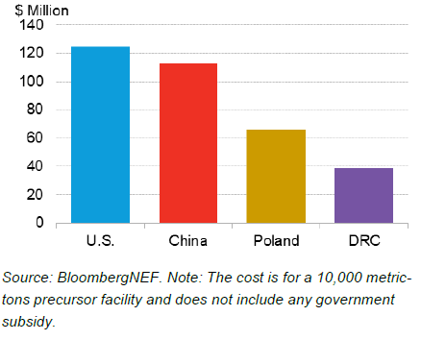
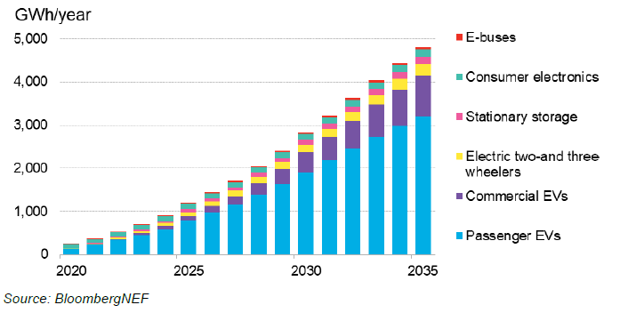
BloombergNEF studiy reveals DRC comparative advantage for battery precurssors
CA 1 – production costs
Lithium-ion battery demand outlook
NMC 622 cathode chemistry
CA 2 – labour costs
CA 3 – ecological footprint

Slide 6
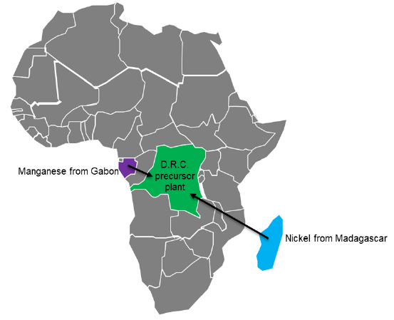
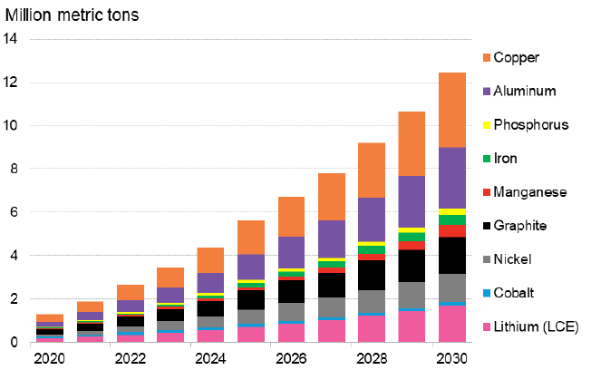
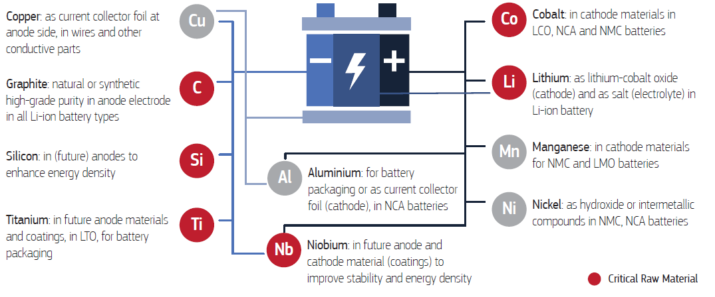
BEV and AfCFTA
Raw materials supply chain
Metals demand from lithium-ion batteries
Cote d’Ivoire, Zambia, Ghana
Source: BloombergNEF, 2021
Source: EU on CRMs, 2020
Notes:
Target margets: Nigeria, Morocco

Slide 7
Resolutions from the DRC-Africa Business Forum

Slide 8
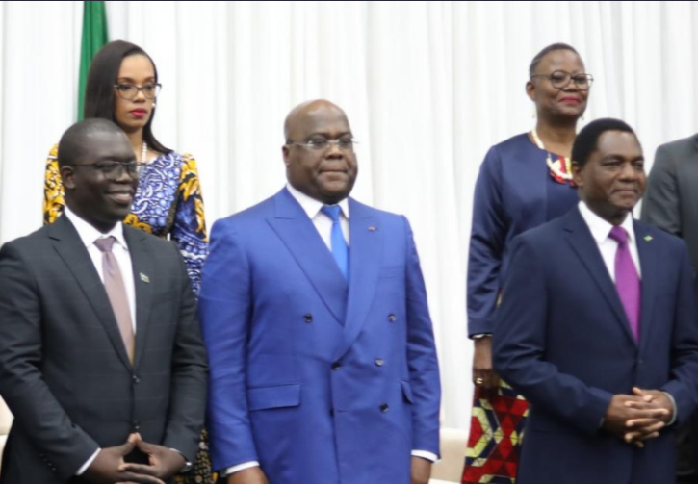
ECA supported the creation of the Centre of Excellence for batteries and the signing of the cooperation agreement between DRC and Zambia
In April 2022, the two countries signed a cooperation agreement in Lusaka, with a view to developing a cross-border Special Economic Zone (SEZ) to house the value chain of batteries and electric vehicles (BEV) and clean energies.
To ensure the success of this initiative, the DRC committed to building the necessary skills for the electric battery industry. With ECA’ support, the African Center of Excellence for Research and Innovation on Batteries (CAEB) was officially launched on April 22, 2022, in Lubumbashi by the Minister of Industry of the DRC, HE Julien Paluku Kahongya. The Minister of Scientific Research, HE José Mpanda Kabangu signed on April 19, 2022, a ministerial decree establishing the CAEB, which is housed within the polytechnic faculty of the University of Lubumbashi, under the direction of Professor Jean-Marie Kanda.
In October 2022, a joint mission of ECA SRO-CA and the European Union (EU) delegation in the DRC visited Haut-Katanga and Lualaba to assess vocational and technical training. At the end of this mission, the two institutions agreed on the principle of supporting the development of professional and technical training programs relevant to the BVE sector, in partnership with the CAEB.

Slide 9
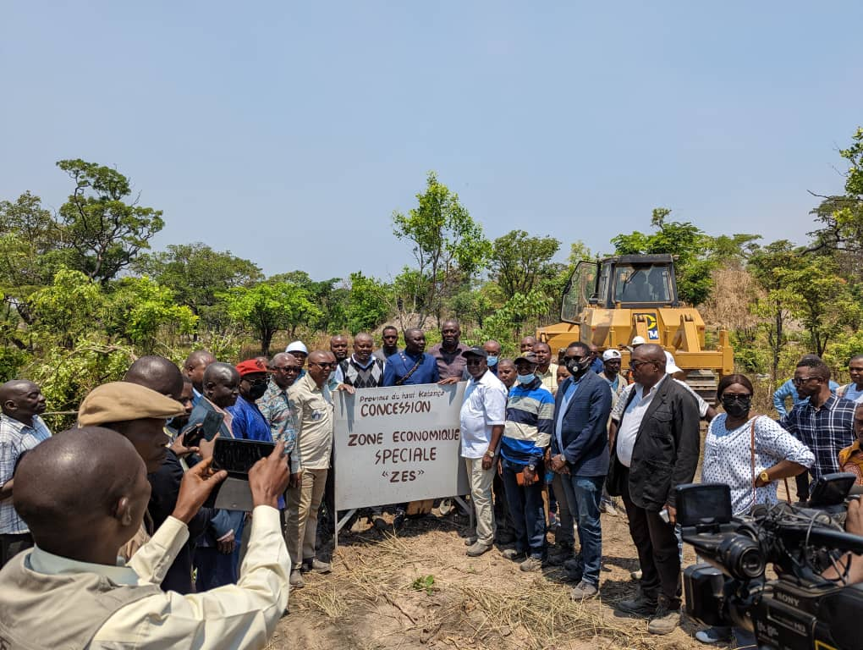
Identification of the space to host the SEZ on the DRC side
In its efforts to turn ideas into action, ECA has, through its sub-regional office for Central Africa (SRO-CA), intensified its support to the DRC in the establishment of the SEZ of the value of electric batteries.
In addition, ECA organized a dialogue with the Congolese banking sector, with a view to mobilizing national savings to finance the BEV initiative, in particular through special purpose vehicles.
The governor of Haut-Katanga, HE Jacques Kyabula, reserving 2000 ha for the BEV SEZ

Slide 10
Conclusion
AfCFTA could support Africa’s auto sector by improving cross-border manufacturing and sales.
Original equipment manufacturers (OEMs) sold 44% of the vehicles assembled on the continent in South Africa, 26% in Egypt and 16% in Morocco.
Electric vehicles are already assembled in Africa: South Africa, Egypt, Morocco, Ghana.
Notes:
Toyota, Nissan, Ford, Volkswagen, Isuzu, Mazda, BMW, Mercedes Benz, BYD, Chery, Geely, Hyundai, Mitsubishi, Chevrolet, Nissan, Lada, Jeep, KIA, Renault, Dacia and BYD

Slide 11
THANK YOU!

