Slide 1
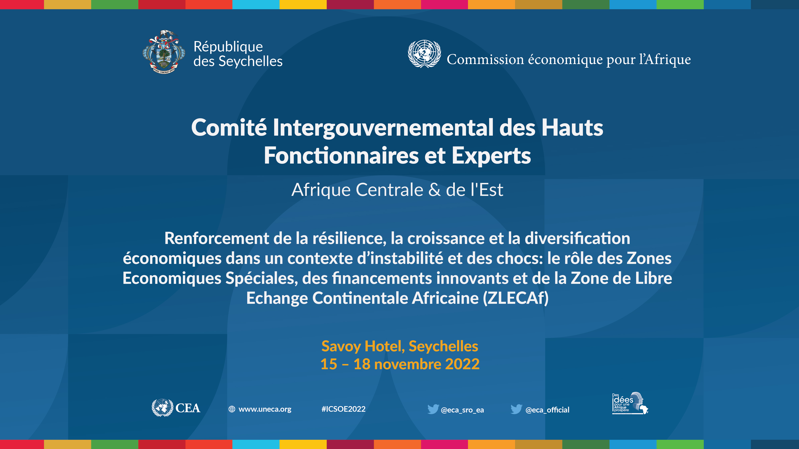
Event | Date
Presenter
Title
UNECA Sub-Regional Office for Eastern Africa

Slide 2
Challenges and opportunities of a consortium on the evaluation and valuation of natural capital in central Afrique -
The high road of substainable value chains
Session 7 - 17 November 2022
Dr. Nebiyeleul Gessesse
Expert, Natural Capital Assets Strategist
UNECA Sub-Regional Office for Eastern Africa

Slide 3


OUTLINE
01
WHAT IS NATURAL CAPITAL
02
NATION’S WEALTH
03
EDUCATION AND INFRASTRUCTURE FOR CAPACITY AND NATIONAL CAPABILITY BUILDING

Slide 4
OUTLINE
04
NATURAL CAPITAL AND HUMAN CAPITAL MATRIX
05
VALUE CHAIN ANALYSIS
06
GREENING THE VALUE CHAIN

Slide 5
What is Natural Capital
Natural capital is the stock of renewable and non-renewable resources that combine to yield a flow of benefits to people. As such, it can be helpful in drawing connections between the natural world, sustainable development, and human well-being and/or livelihoods.

Slide 6
Nation’s Wealth
A nation's wealth comprises five core stocks of capital:
Manufactured capital (e.g. machines and buildings),
Human capital (e.g. people, their skills and knowledge),
Social capital (e.g. trust, norms, and institutions),
Natural capital (e.g. minerals and ecosystem services),
Financial capital, which is the medium of exchange between the four underlying capital stocks.

Slide 7
Education and Infrastructure for Capacity and Capability Building
Natural capital should not be abused but used pragmatically. Renewable resources, such as agricultural land, forests, freshwater ...etc. can provide ecosystem services sustainably if managed appropriately. In contrast, non-renewable natural capital, such as fossil fuels and minerals, offers a one-time chance to finance development for growth.
Therefore, there is a need for strong institutions and good governance in order to ensure that resources are invested in education and infrastructure for capacity and national capacity building and not used entirely for consumption. We have to invest in ….
  Human capital (e.g. people, their skills and knowledge),
  Social capital (e.g. trust, norms, and institutions),

Slide 8
Natural Capital and Human Capital Matrix

Slide 9
Combination of Natural Capital and Human Capital … Cont’
CA countries are categorized in a low level of human capital and a high abundance of natural capital.
Therefore, CA countries have to invest in human and social capital to bring about the development of their technological capability to fall in quadrant IV (abundant natural resources and high level of human capital), in order to ensure their sustainability.

Slide 10
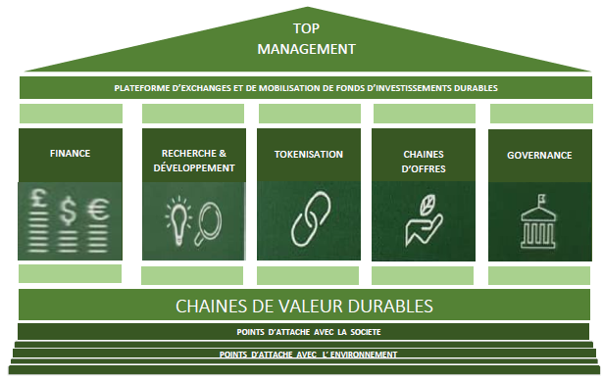
Towards the Establishment of a Sustainable and Inclusive Membership Organization

Slide 11
Value Chain Analysis: Concept of Value Chain
The Value Chain describes the full range of activities required to bring a product or service from conception, through the different phases of production to delivery to the final consumer. The phases of production involve a combination of physical transformation and the input of various producer services.

Slide 12
An example, the Value chain of maize farming in Côte d’Ivoire

Slide 13
Value Chain Analysis: Greening the Value Chain
Optimize the productivity of the chain with …
Minimal impacts on ecosystem services and biodiversity,
Minimize the use of natural resources,
Sustainable use of resources,
Reduce or mitigate negative environmental impacts along the value chain stages

Slide 14
GHG emissions along the Maize Production Value Chain
Emission Sources | CO₂ (tCO₂e/ha) | CH₄(tCO₂e/ha) | N₂O(tCO₂e/ha) | Total (tCO2e/ha) | Total (%)
Fertilizer (all stages) | 0.06 |  | 0.05 | 0.56 | 87.5
Residue burning |  | 0.02 | 0.01 | 0.03 | 4.7
Fuel Consumption | 0.05 |  |  | 0.05 | 7.8
Total | 0.11 | 0.02 | 0.51 | 0.64 | 100
Total (%) | 17.5 | 3.2 | 79.4

Slide 15
Value Chain Analysis: How to Green the Value Chain (VC)?
Approaches for greening the VC include:
Applying the Circular Economy (triple “R”: Recycling, Reusing & Reducing) mechanism,
Use Low-carbon energy (Energy that is generated using lower amounts of carbon emissions such as wind, solar, hydro, or “nuclear power”,
Application of Resource Efficiency and Cleaner Production Practices (pollution prevention),
Sustainable agricultural practices (water conservation, soil conservation (biological and physical methods), soil health maintenance, …etc.

Slide 16
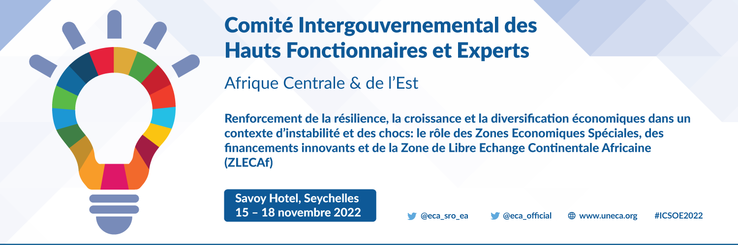
Pour plus d'informations:
www.uneca.org/ea-icsoe26

